Slide 1



Chapter 4
Trigonometric
Functions
© 2010 Pearson Education, Inc.
All rights reserved

Slide 2
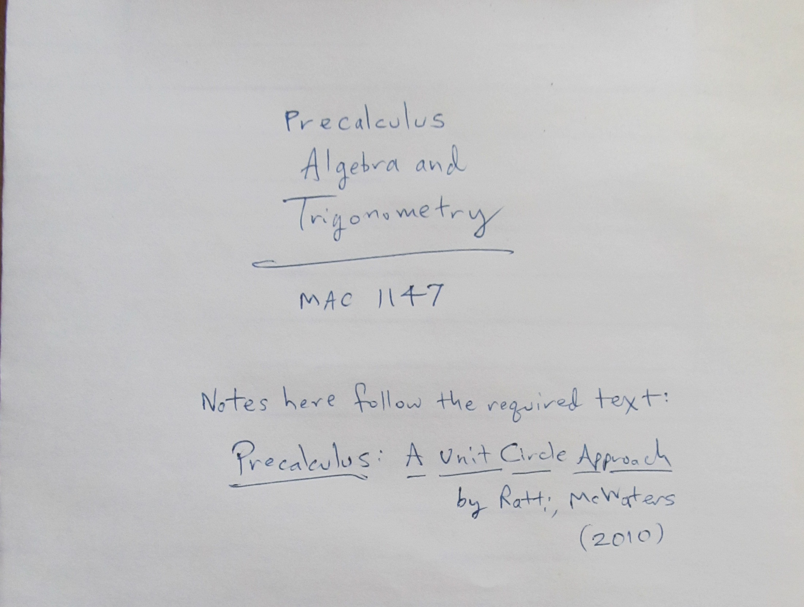

Slide 3
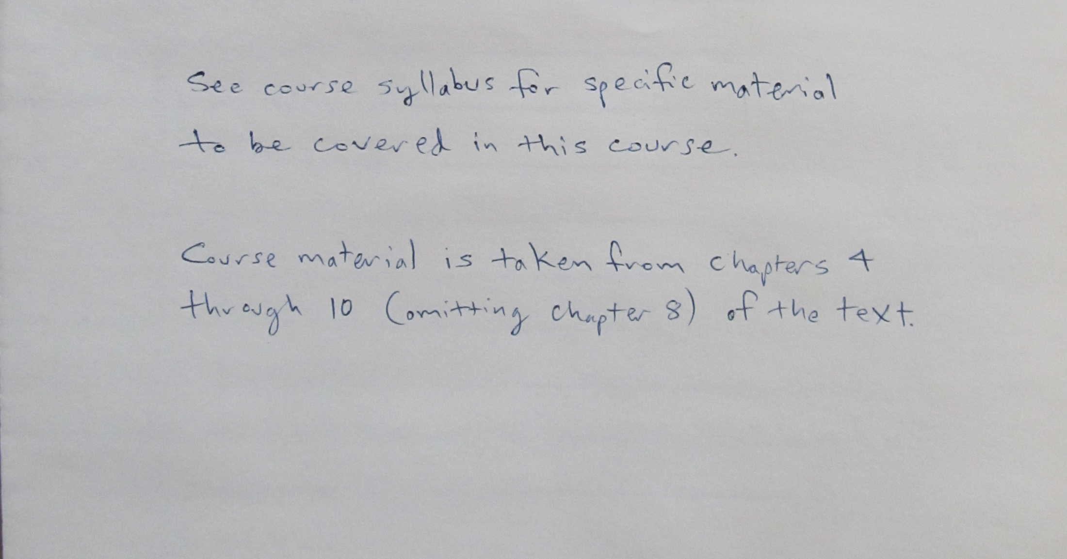


Slide 4
Angles and Their Measure
SECTION 4.1
1
Learn the vocabulary associated with angles.
Use degree and radian measure.
Convert between degree and radian measure.
Find complements and supplements.
Find the length of an arc of a circle.
Compute linear and angular speed.
Find the area of a sector.
2
3
4
5
6
7

Slide 5
ANGLES
A ray is a portion of a line made up of a point, called the endpoint, and all points on the line on one side of the endpoint.
An angle is formed by rotating a ray about its endpoint.
The ray in its original position is called the initial side, while the ray in its new position after the rotation is called the terminal side.
The endpoint is called the vertex of the angle.

Slide 6
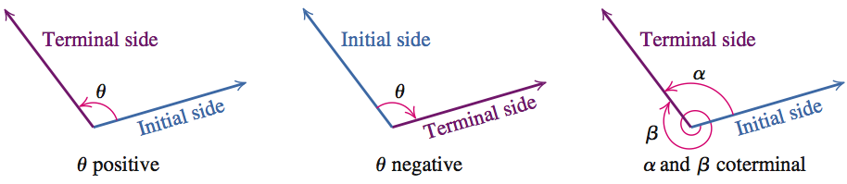
ANGLES
If the rotation of the initial side to the terminal side is counterclockwise, the result is a positive angle, if the rotation is clockwise, the result is a negative angle.
Angles that have the same initial and terminal sides are called coterminal angles.

Slide 7
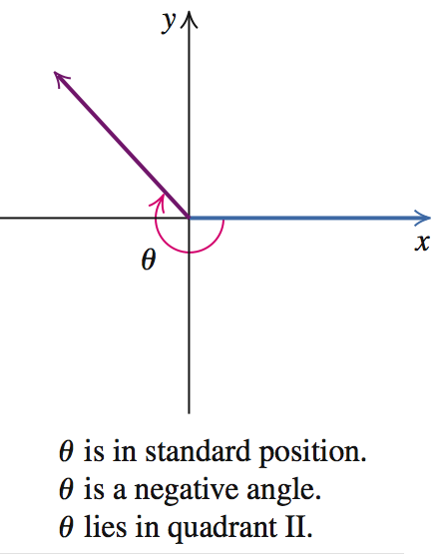
ANGLES
An angle in a rectangular coordinate system is said to be in standard position if its vertex is at the origin and its initial side coincides with the positive x-axis.

Slide 8
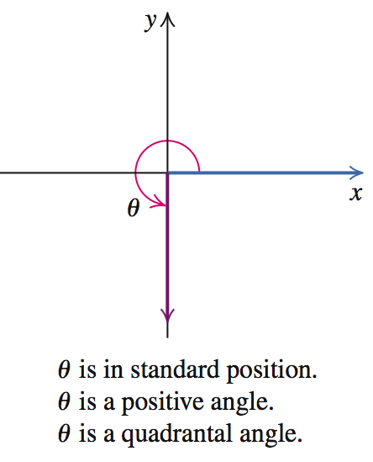
ANGLES
If the terminal side of an angle in standard position lies on the x-axis or the y-axis, the angle is said to be a quadrantal angle.

Slide 9
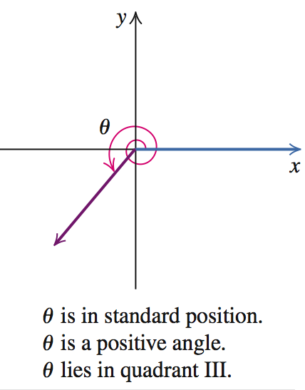
ANGLES
If the terminal side of an angle θ lies in a quadrant rather than on a coordinate axis, we say that θ lies in that quadrant.

Slide 10

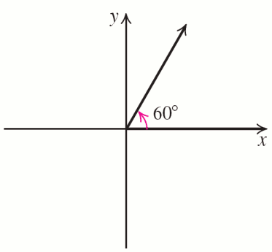


EXAMPLE 1
Drawing an Angle in Standard Position
Draw each angle in standard position.
a. 60° b. 135° c. −240° d. 405°
Solution
a.

Slide 11
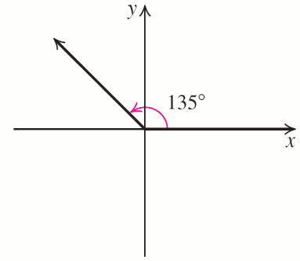
EXAMPLE 1
Drawing an Angle in Standard Position
Solution continued
b. Since 135 = 90 + 45, a 135º angle is a counterclockwise rotation of 90º, followed by half a 90º counterclockwise rotation.

Slide 12
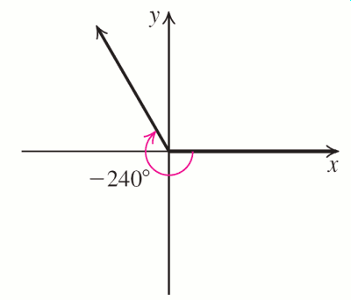
EXAMPLE 1
Drawing an Angle in Standard Position
Solution continued
c. Since −240 = −180 − 60, a −240º angle is a clockwise rotation of 180º, followed by a clockwise rotation of 60º.

Slide 13
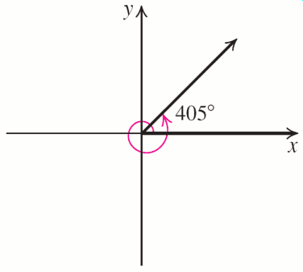
EXAMPLE 1
Drawing an Angle in Standard Position
Solution continued
d. Since 405 = 360 + 45, a 405º angle is one complete counterclockwise rotation, followed by half a 90º counterclockwise rotation.

Slide 14
RELATIONSHIP BETWEEN DEGREES, MINUTES, AND SECONDS

Slide 15
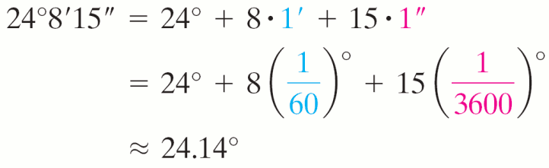
Converting Between DMS and Decimal Notation
EXAMPLE 2
a. Convert 24º8′15′′ to decimal degree notation, rounded to two decimal places.
b. Convert 67.526º to DMS (Degree Minute Second) notation, rounded to the nearest second.
Solution
a.

Slide 16
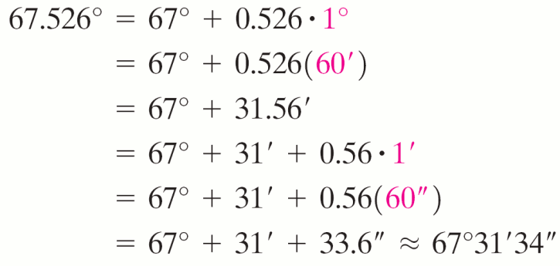
Converting Between DMS and Decimal Notation
EXAMPLE 2
Solution continued
b.

Slide 17
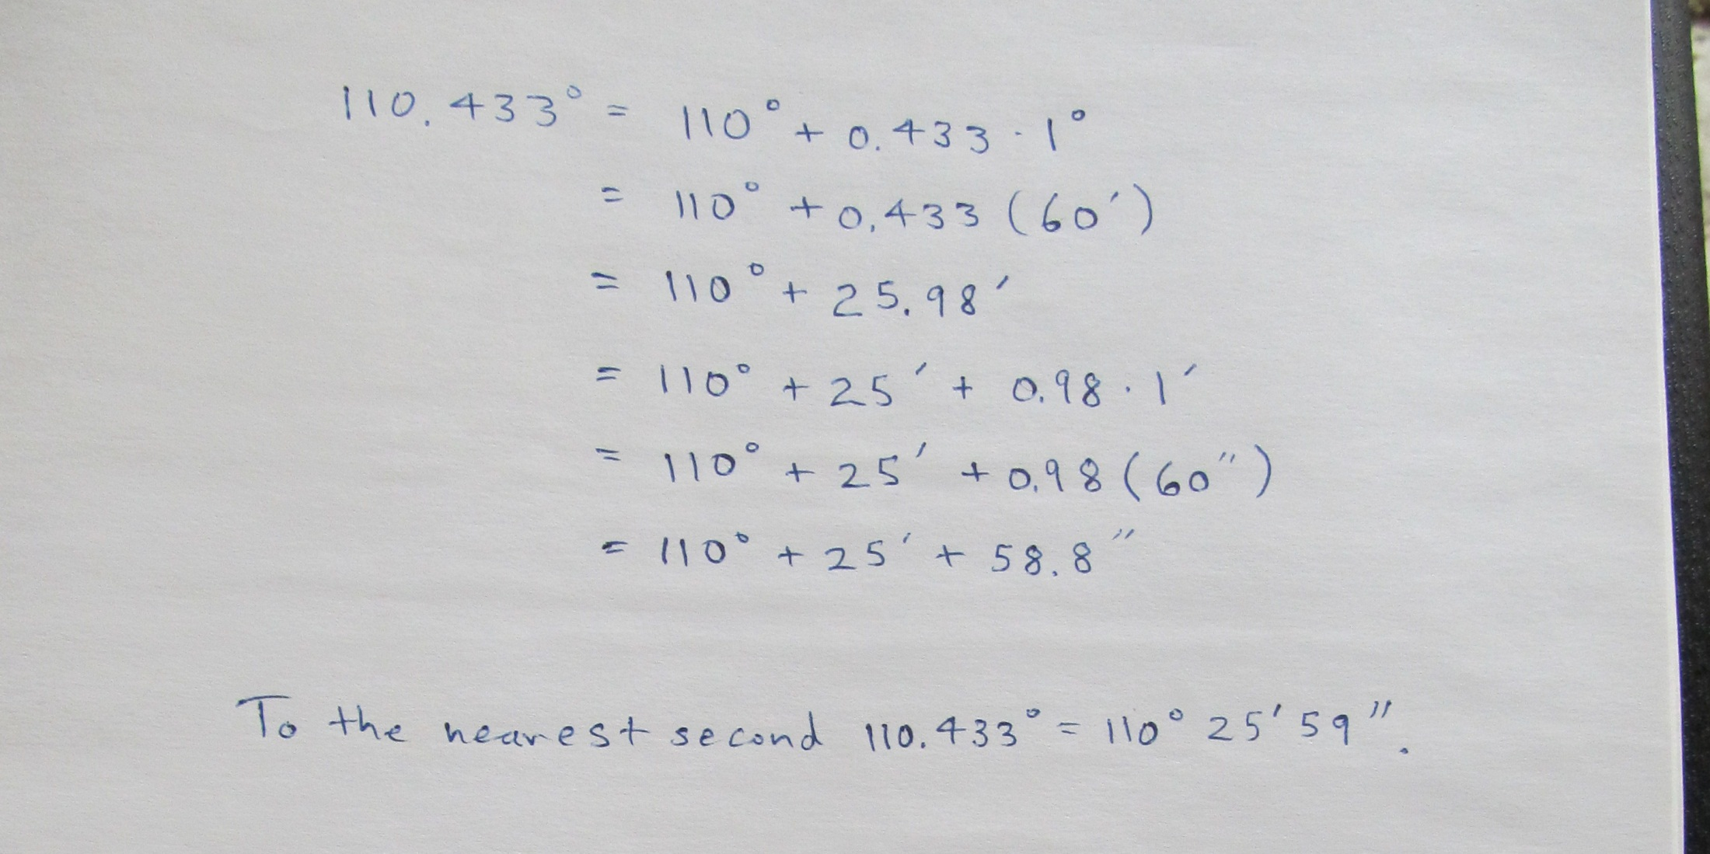

Slide 18
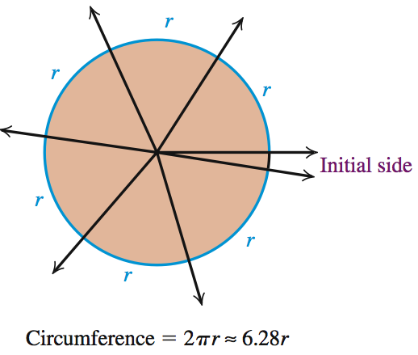
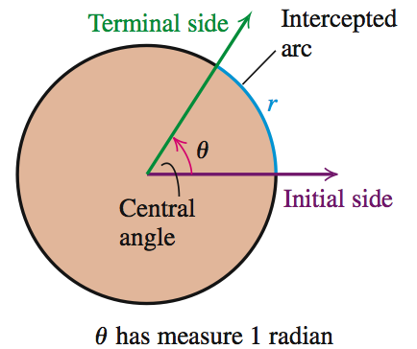
RADIAN MEASURE
An angle whose vertex is at the center of a circle is called a central angle. A positive
central angle that intercepts an arc of the circle of length equal to the radius of the circle is said to have measure 1 radian.

Slide 19
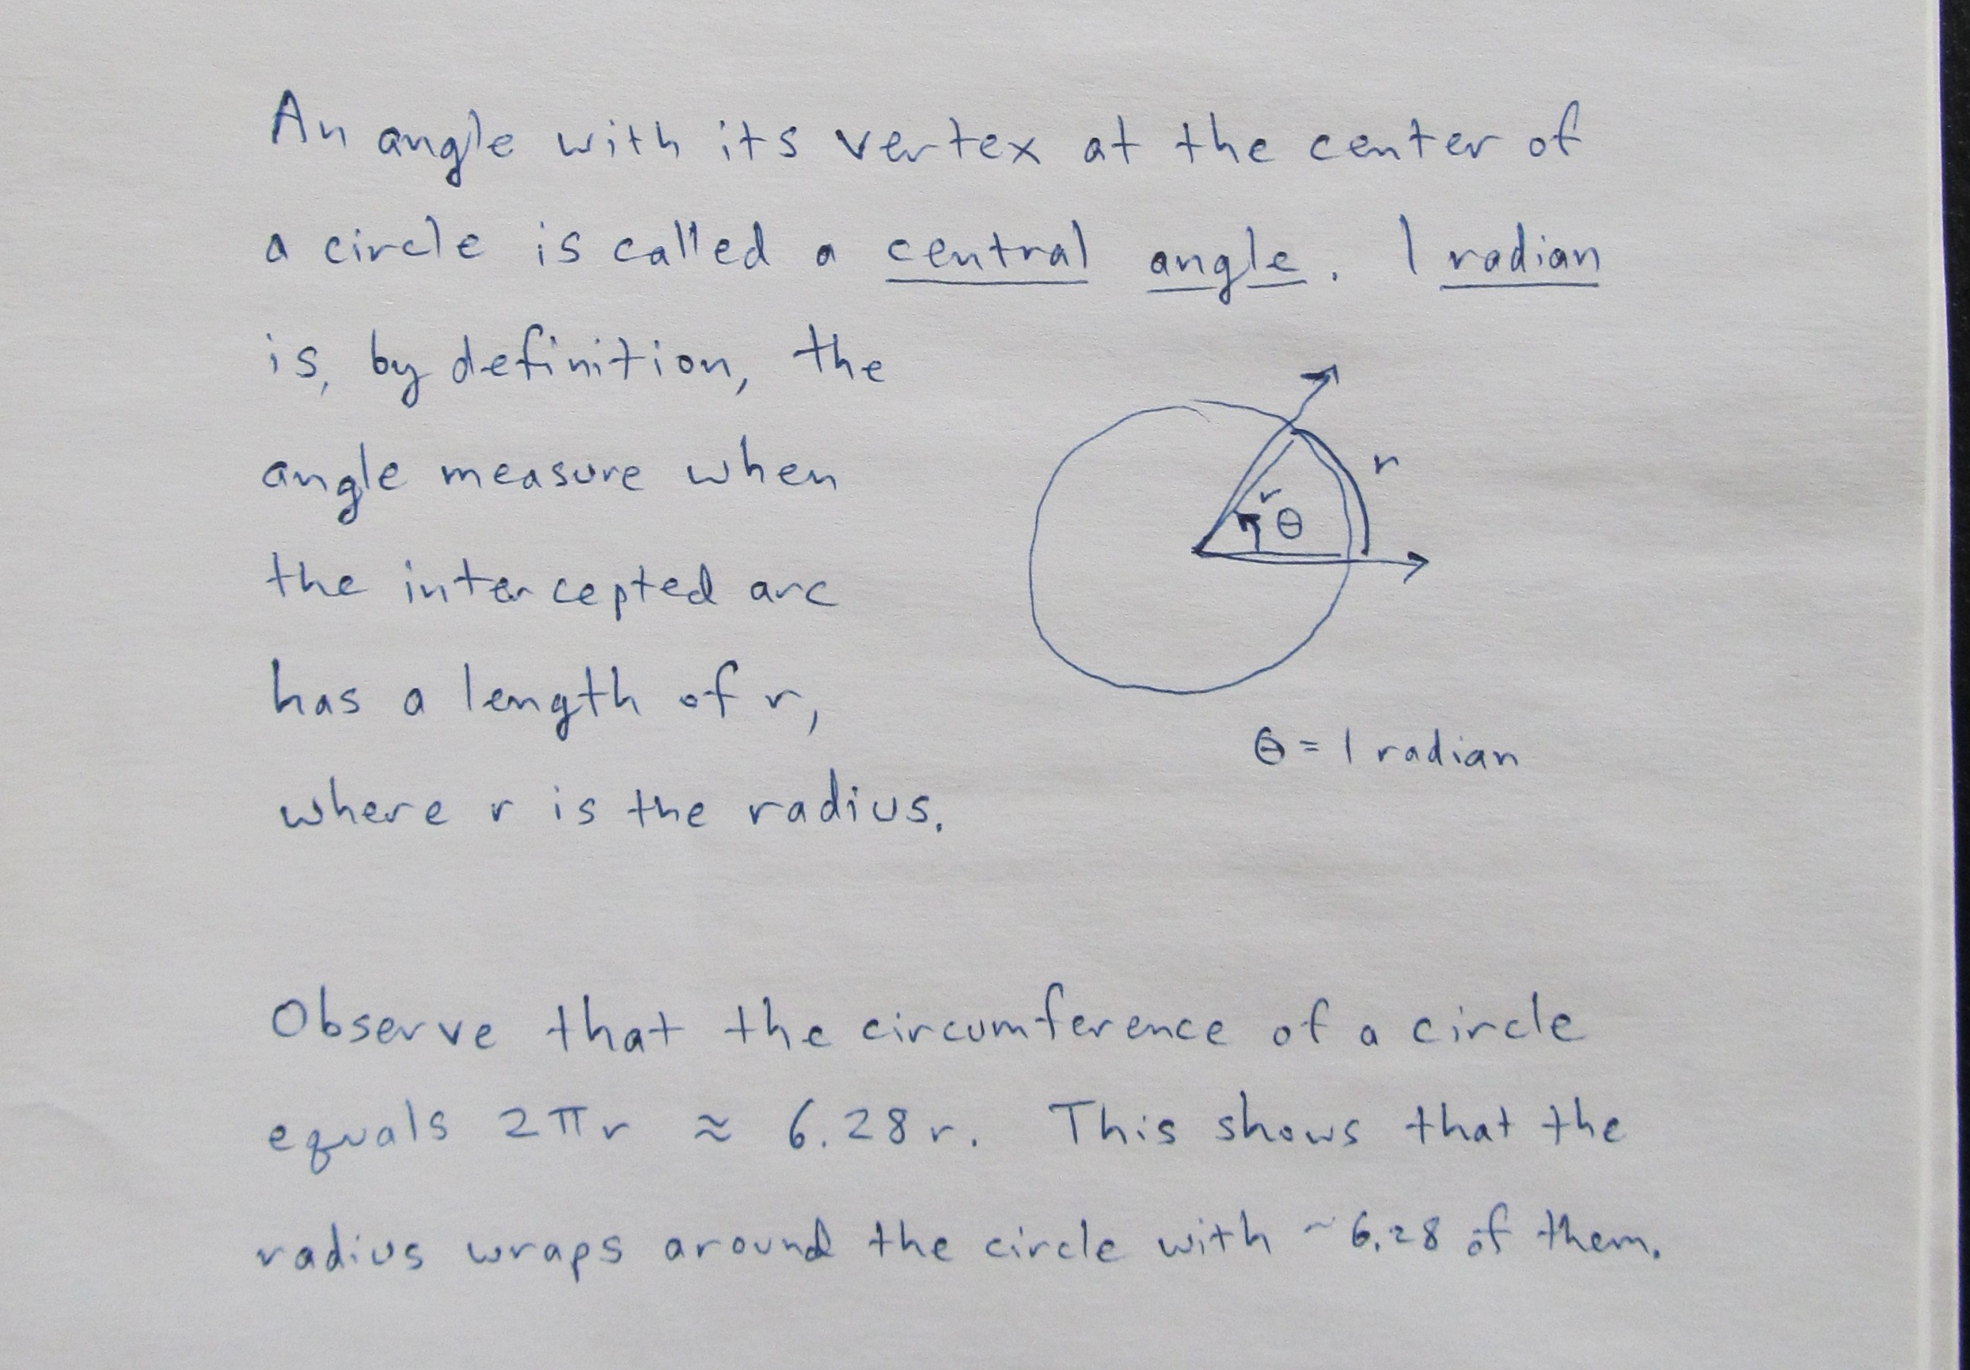

Slide 20
RADIAN MEASURE OF A CENTRAL ANGLE
The radian measure θ of a central angle that intercepts an arc of length s on a circle of radius r is defined by

Slide 21
CONVERTING BETWEEN
DEGREES AND RADIANS

Slide 22

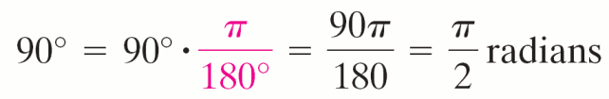
EXAMPLE 3
Converting from Degrees to Radians
Convert each angle in degrees to radians.
a. 30° b. 90° c. −225° d. 55°
Solution
a.
b.

Slide 23
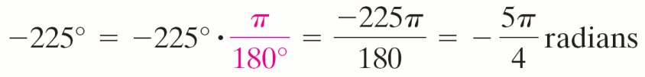
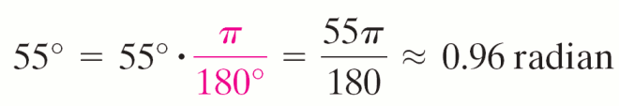
EXAMPLE 3
Converting from Degrees to Radians
Solution continued
c.
d.

Slide 24
EXAMPLE 4
Converting from Radians to Degrees
Convert each angle in radians to degrees.
Solution

Slide 25
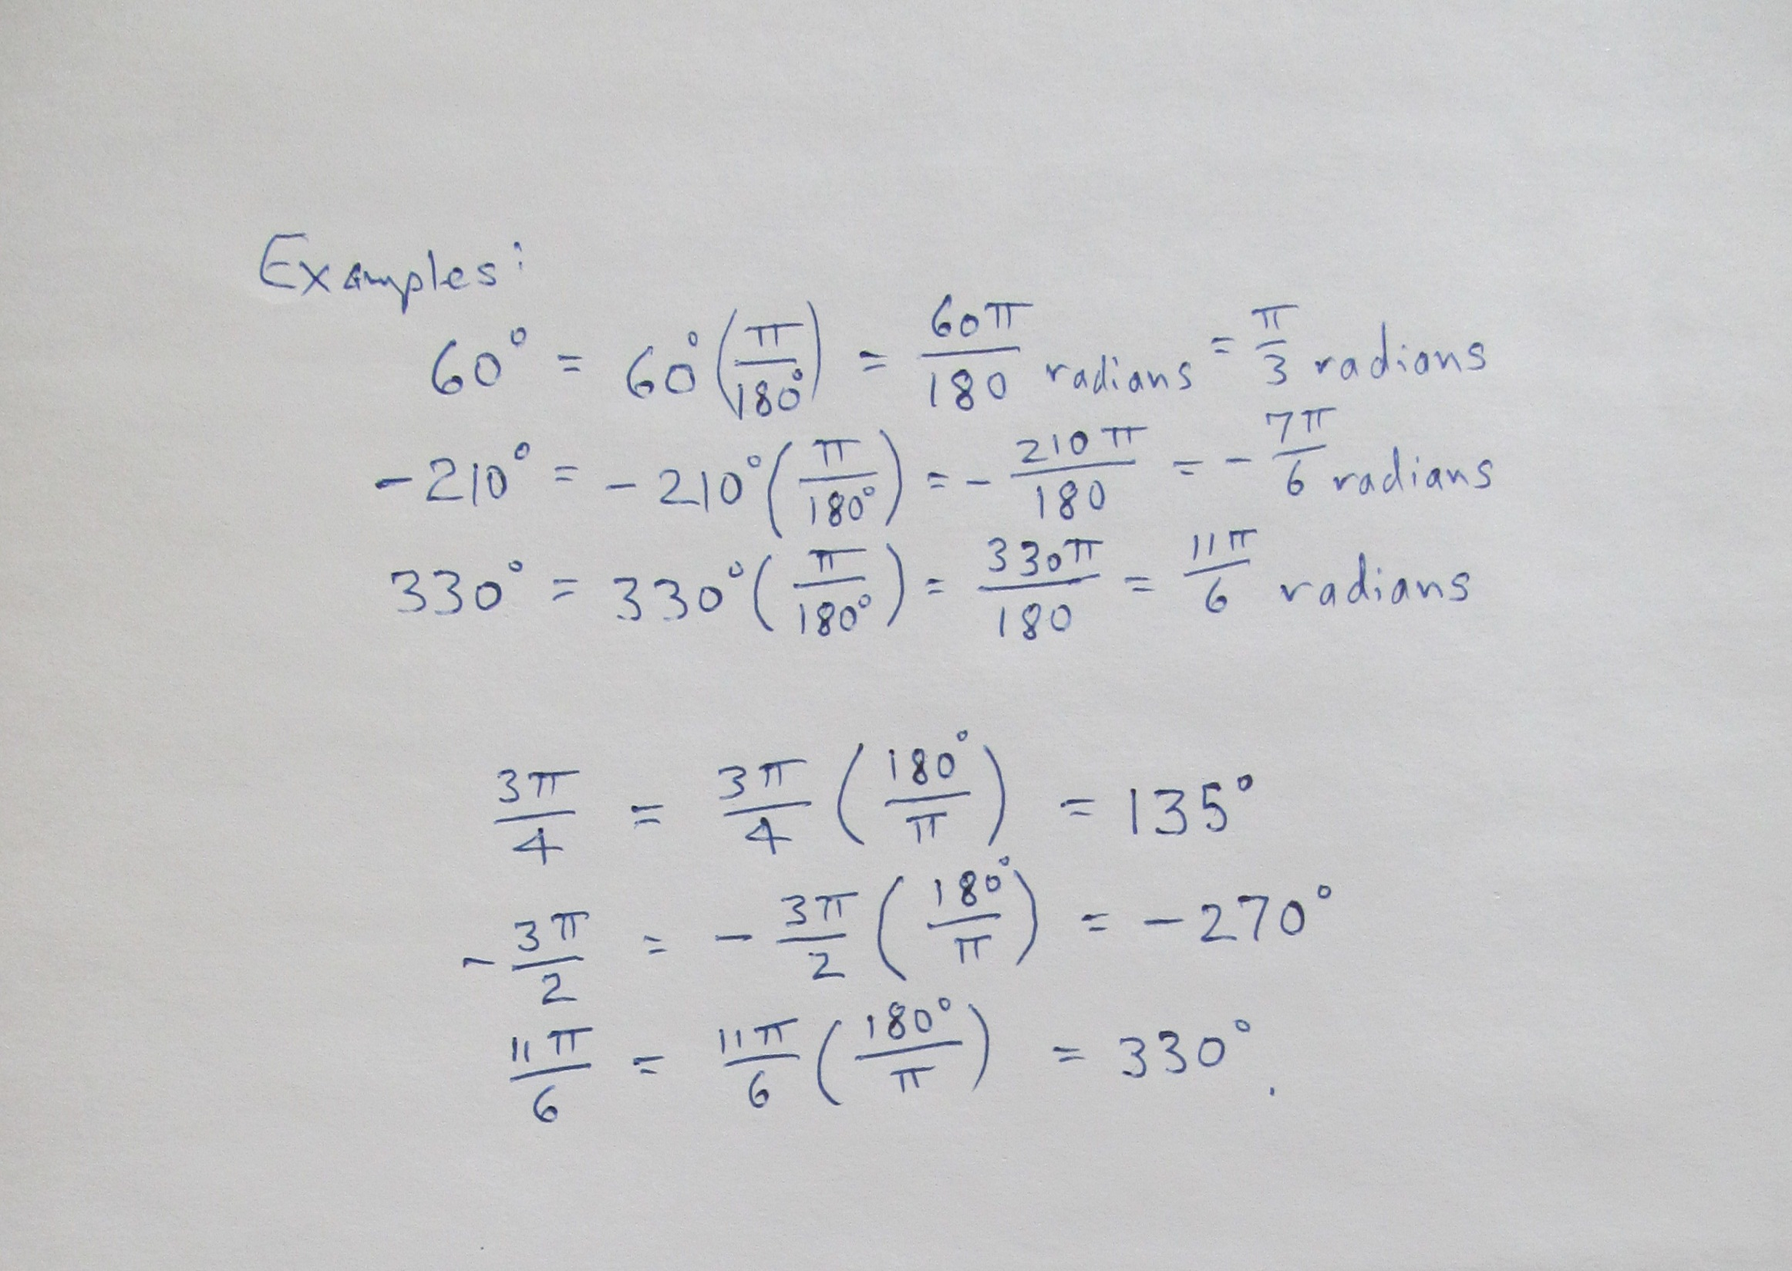

Slide 26
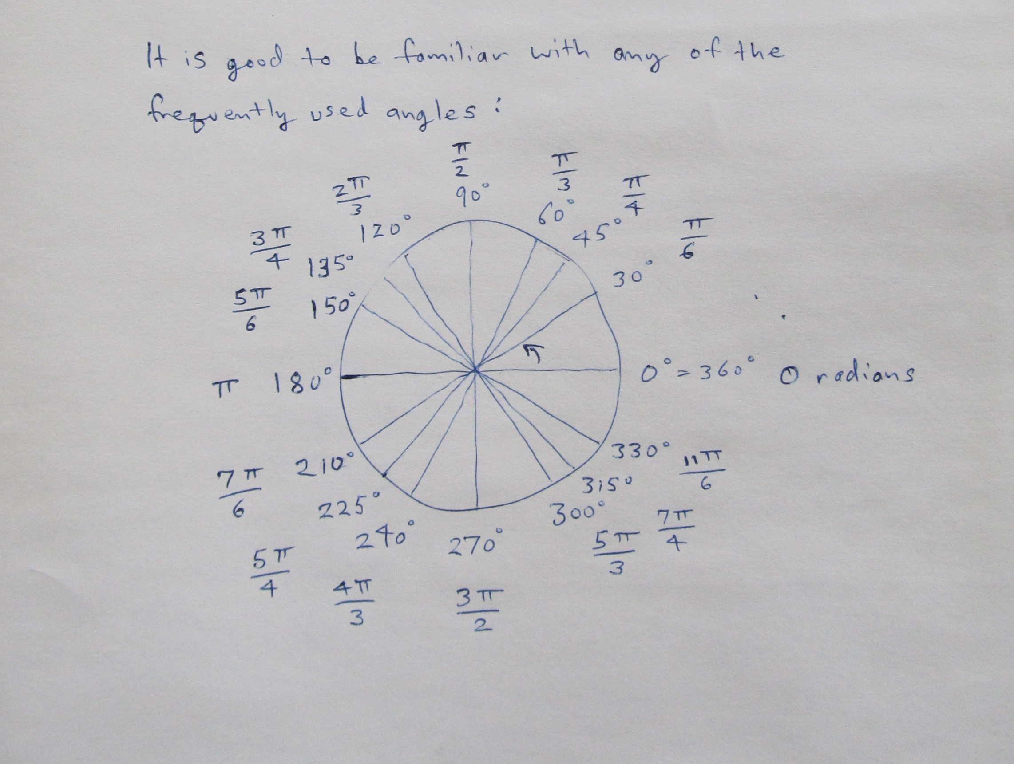

Slide 27
COMPLEMENTS AND SUPPLEMENTS
Two positive angles are complements (or complementary angles) if the sum of their measures is 90º.
Two positive angles are supplements (or supplementary angles) if the sum of their measures is 180º.

Slide 28
EXAMPLE 5
Finding Complements and Supplements
Find the complement and the supplement of the given angle or explain why the angle has no complement or supplement.
Solution
complement
supplement
θ does not have a complement.

Slide 29
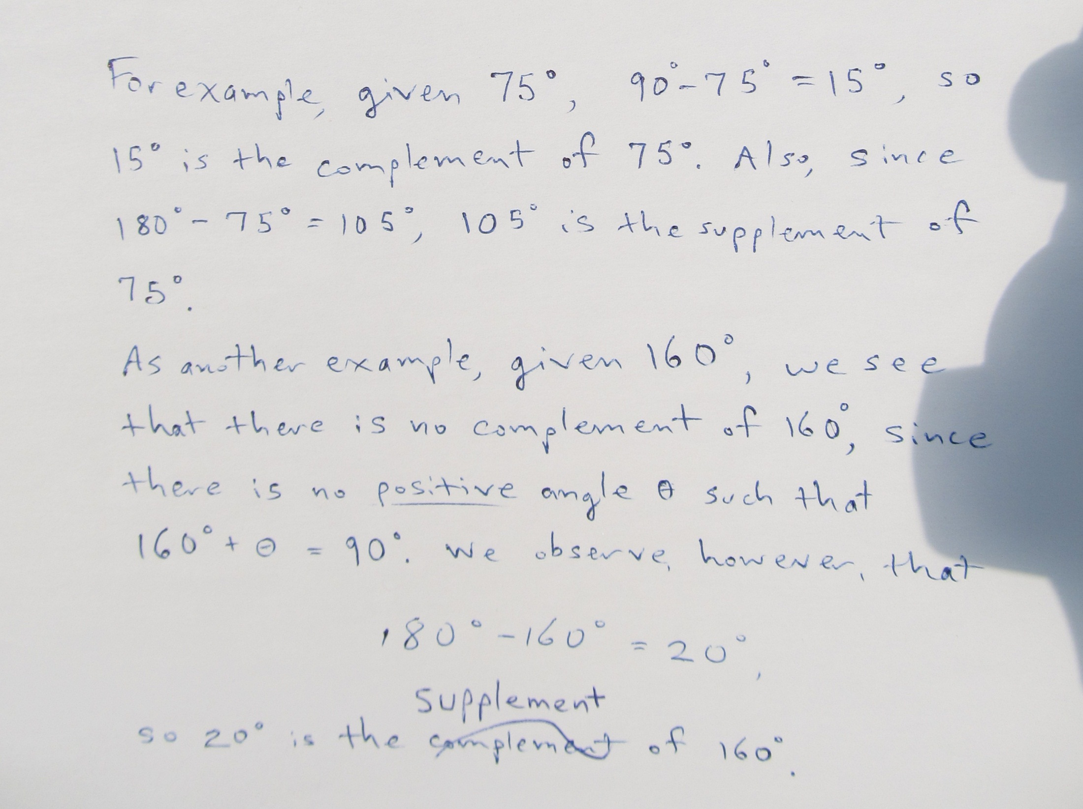

Slide 30
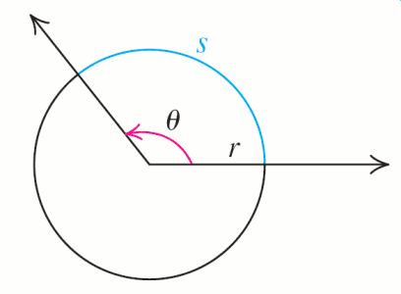
ARC LENGTH FORMULA
where r is the radius of the circle and θ is in radians.

Slide 31
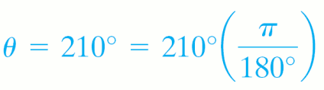
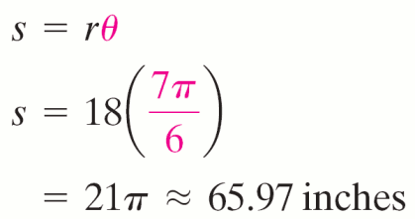

EXAMPLE 6
Finding Arc Length of a Circle
A circle has a radius of 18 inches. Find the length of the arc intercepted by a central angle with measure 210º.
Solution

Slide 32
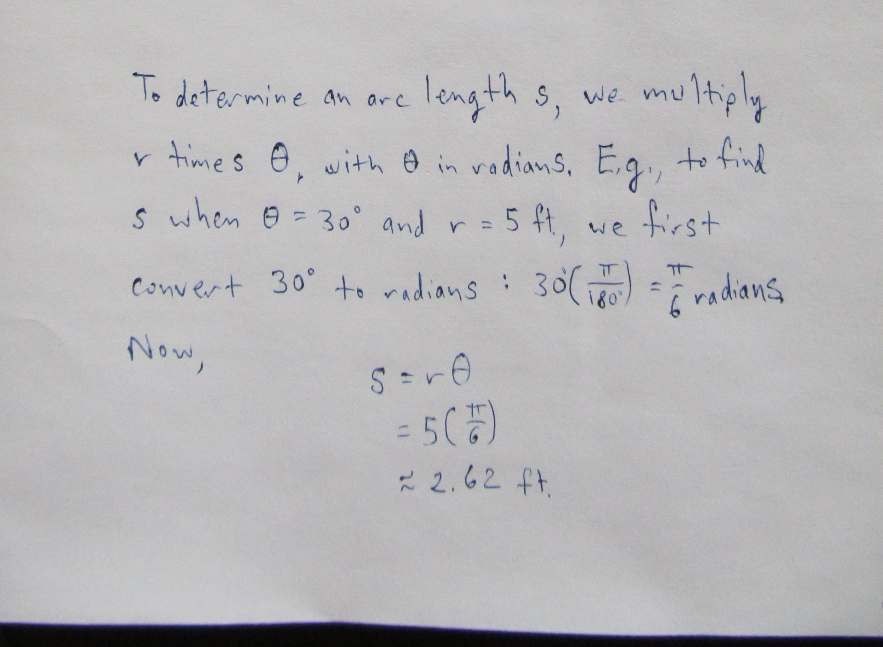

Slide 33
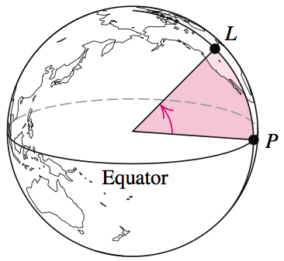
EXAMPLE 7
Finding the Distance between Cities
We obtain the latitude of a location L anywhere on Earth by first finding the point of intersection, P, between the meridian through L and the equator.
The latitude of L is the angle formed by rays drawn from the center of the Earth to points L and P, with the ray through P being the initial ray.

Slide 34
EXAMPLE 7
Finding the Distance between Cities
(Continued)
Billings, Montana, is due north of Grand Junction, Colorado. Find the distance between Billings (latitude 45º48′ N) and Grand Junction (latitude 39º7′ N). Use 3960 miles as the radius of Earth.
Solution
Because Billings is due north of Grand Junction, the same meridian passes through both cities.

Slide 35
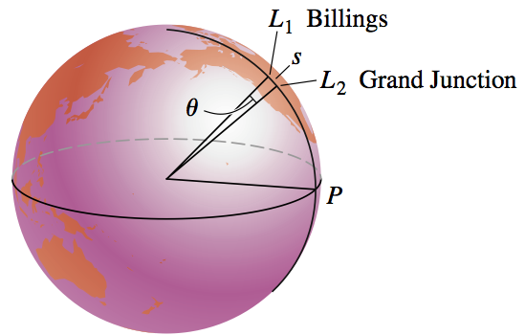
EXAMPLE 7
Finding the Distance between Cities
Solution continued
The distance between cities is the length of the arc, s, on this meridian subtended by the central angle, θ, that is the difference in their latitudes.

Slide 36
EXAMPLE 7
Finding the Distance between Cities
Solution continued
Measure of angle θ is 45º48′ – 39º7′ = 6º41′
Convert this to radians.
Use the arc length formula

Slide 37
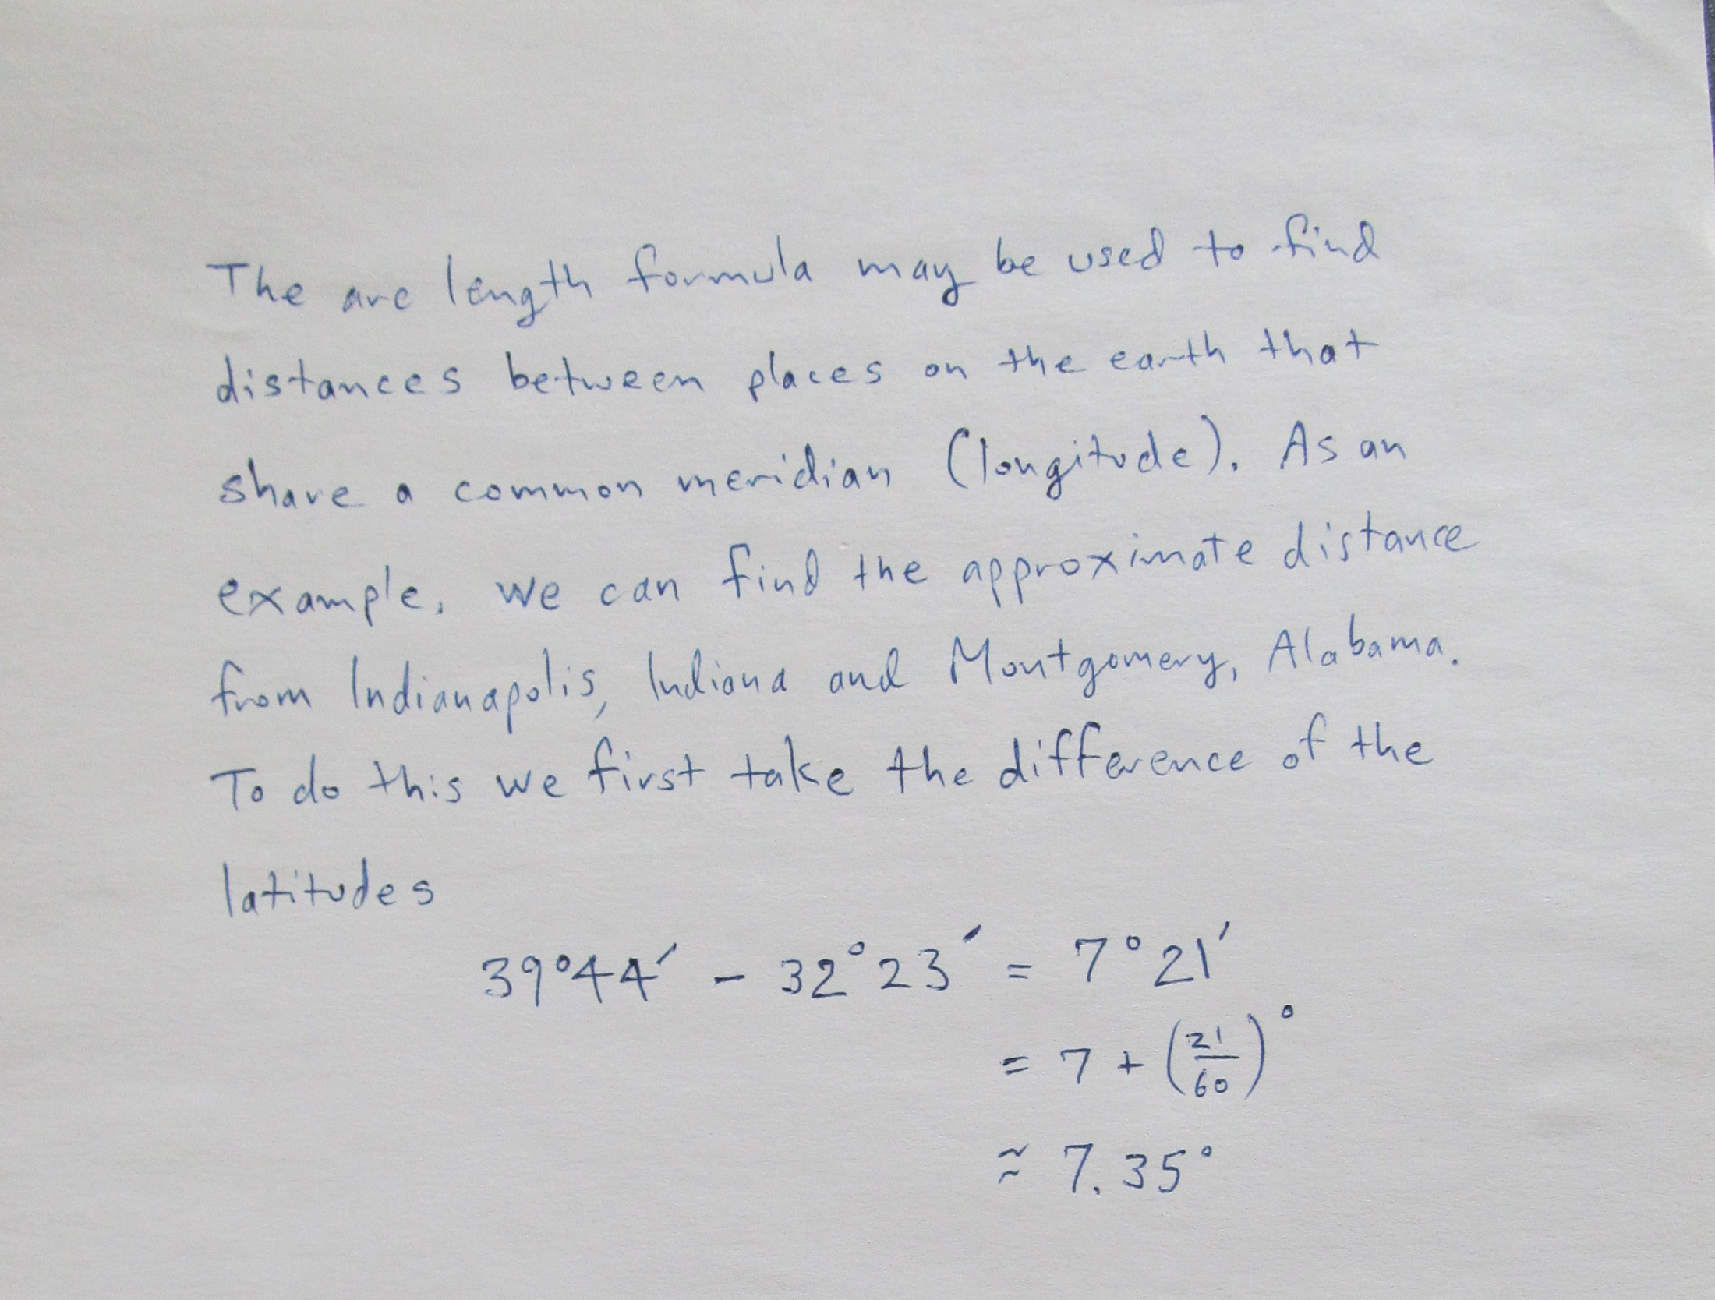

Slide 38
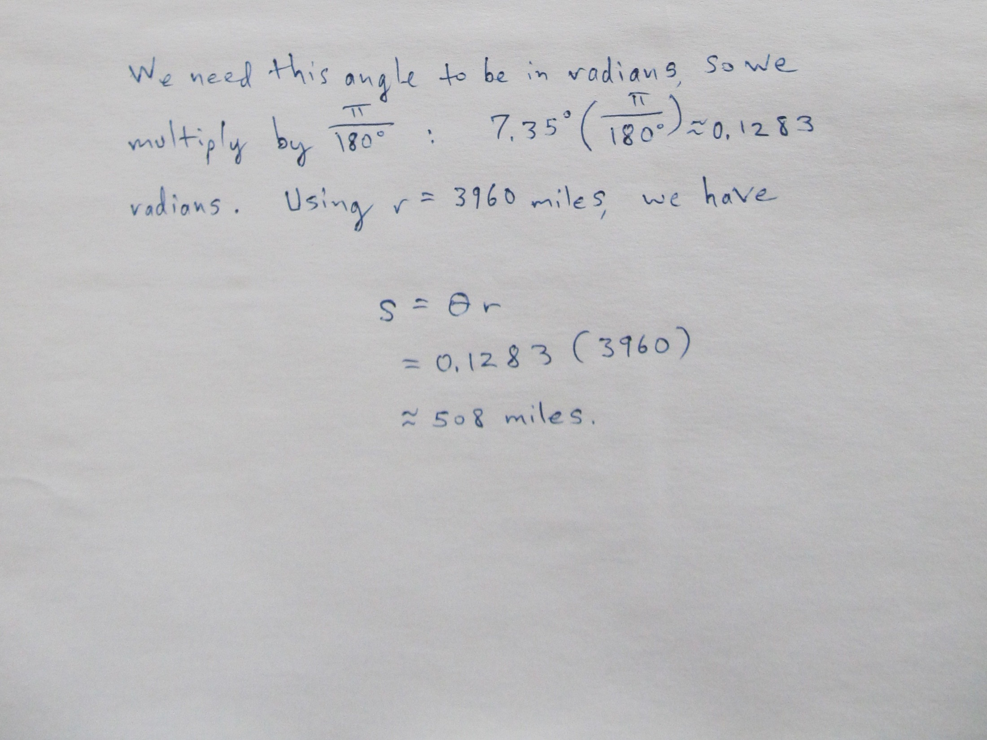

Slide 39
LINEAR AND ANGULAR SPEED
Suppose an object travels around a circle of radius r. If the object travels through an angle of θ radians and an arc of length s, in time t, then
is the (average) linear speed of the object; and
is the (average) angular speed of the object.
Further, since s = rθ (replacing s by rθ in 1. and using 2.), we have

Slide 40
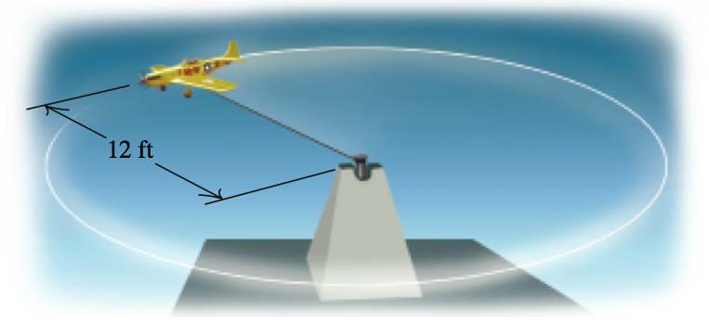
Finding Angular and Linear Speed from Revolutions per Minute
EXAMPLE 8
A model plane is attached to a swivel so that it flies in a circular path at the end of a 12-foot wire at the rate of 15 revolutions per minute. Find the angular speed and the linear speed of the plane.

Slide 41
Finding Angular and Linear Speed from Revolutions per Minute
EXAMPLE 8
Solution
Because angular speed is measured in radians per unit of time, we must first convert revolutions per minute into radians per minute.
1 revolution = 2π rad;
15 revolutions = 15 ∙ 2π rad = 30π rad.
Thus the angular speed ω = 30π rad/min.
Linear speed v = rω = 12 ∙ 30π ft/min or approximately 1131 ft/min.

Slide 42
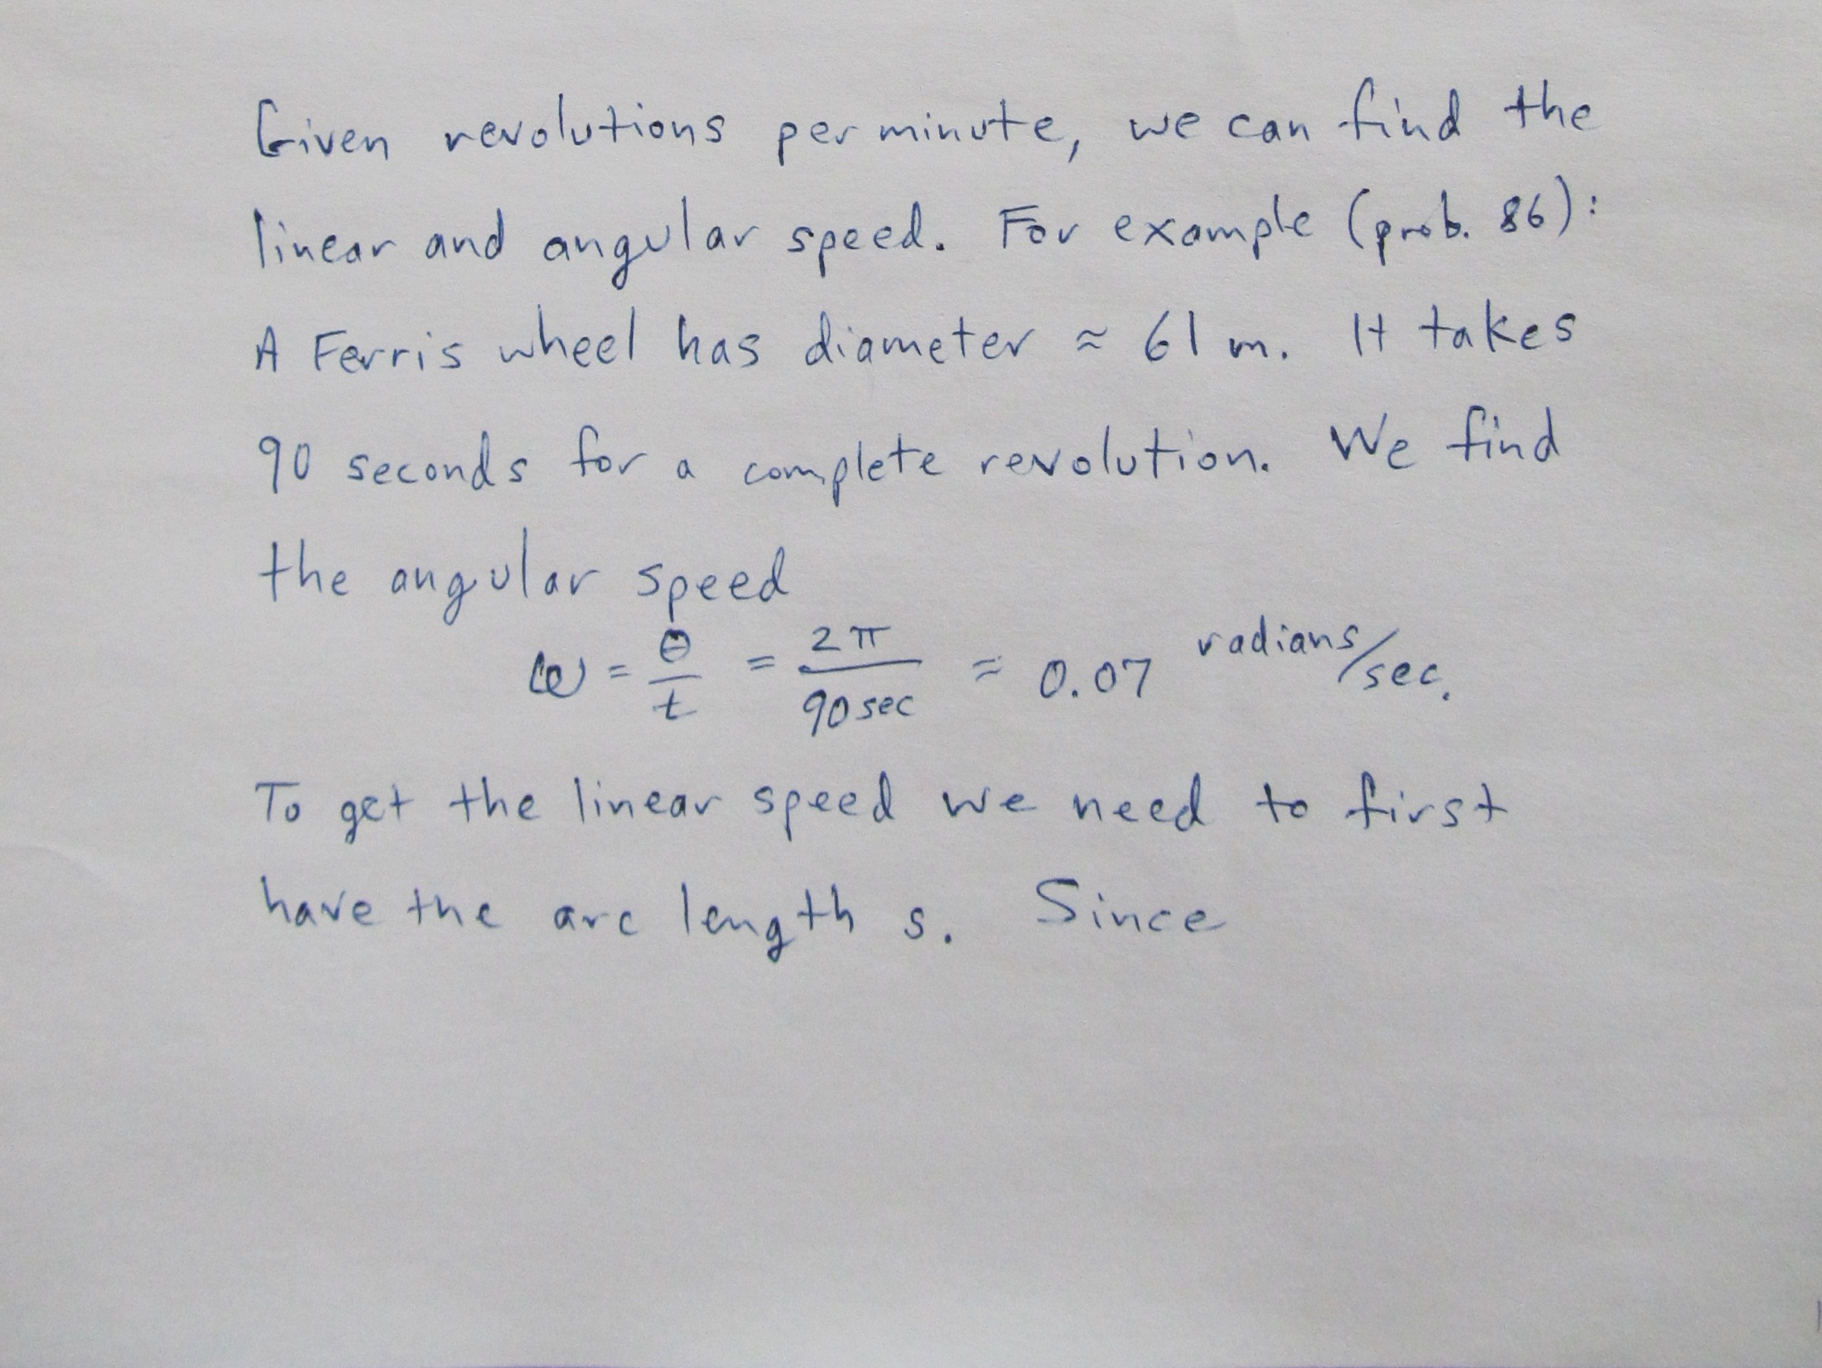

Slide 43
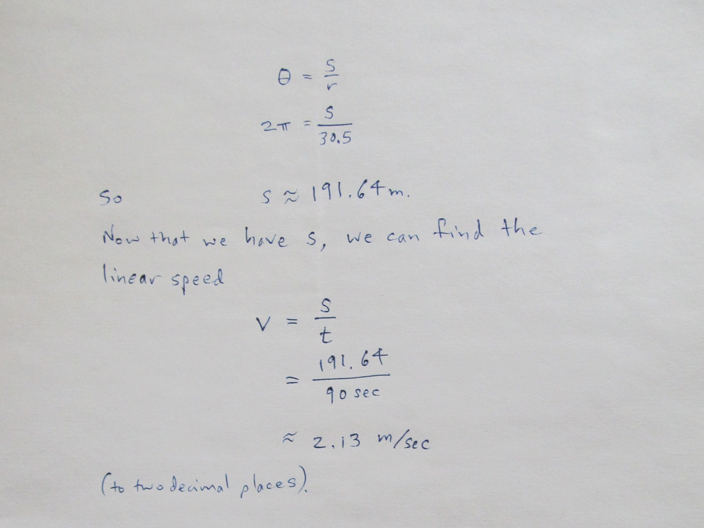

Slide 44
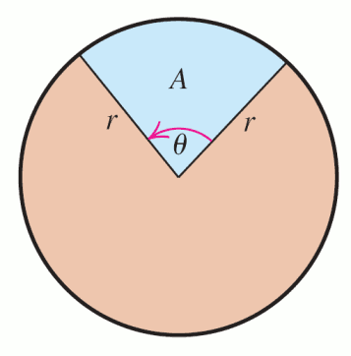
AREA OF A SECTOR
The area A of a sector of a circle of radius r formed by a central angle with radian measure θ is:

Slide 45
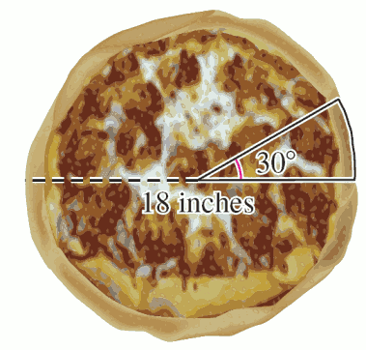
EXAMPLE 9
Finding the Area of a Sector of a Circle
How many square inches of pizza have you eaten (rounded to the nearest square inch) if you eat a sector of an 18-inch diameter pizza whose edges form a 30º angle?

Slide 46
EXAMPLE 9
Finding the Area of a Sector of a Circle
Solution
Convert 30º to radians.
Radius is half of the diameter = 9 inches.
You have eaten about 21 square inches of pizza.

Slide 47
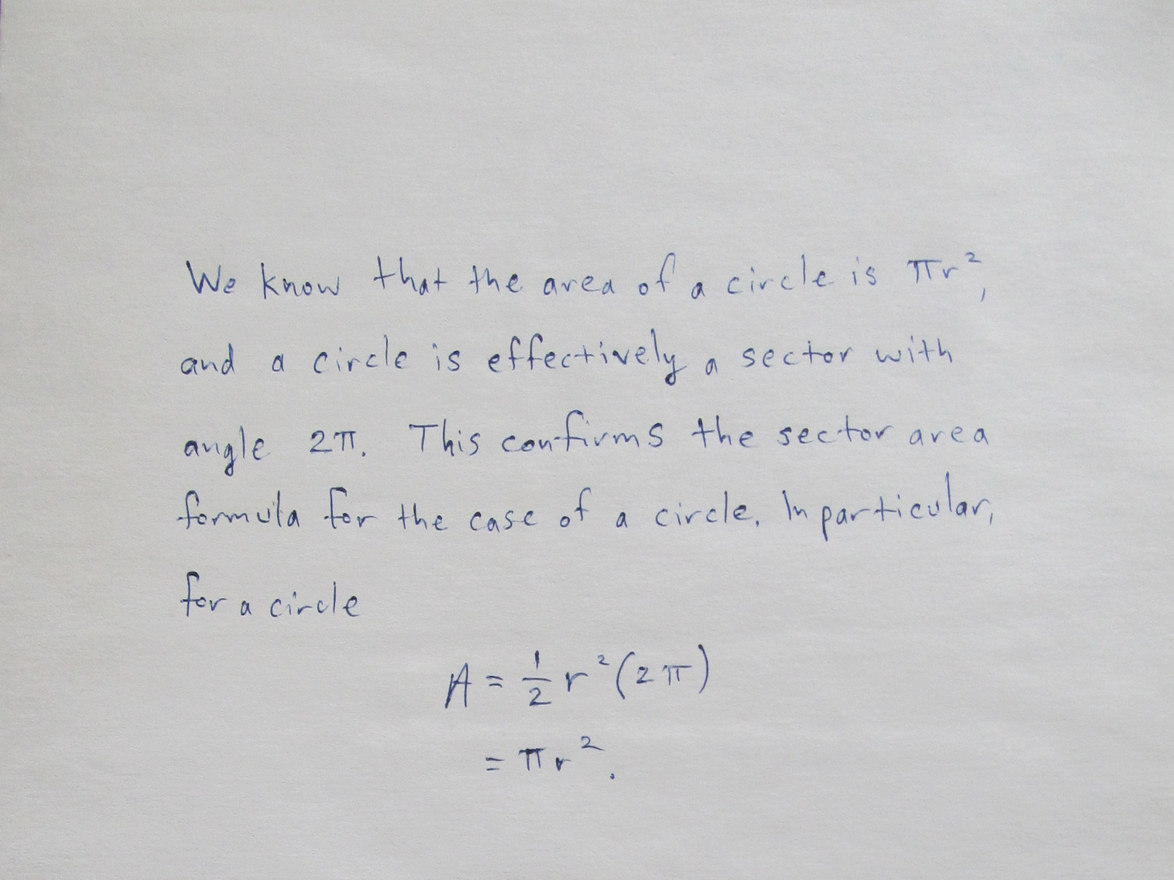

Slide 48
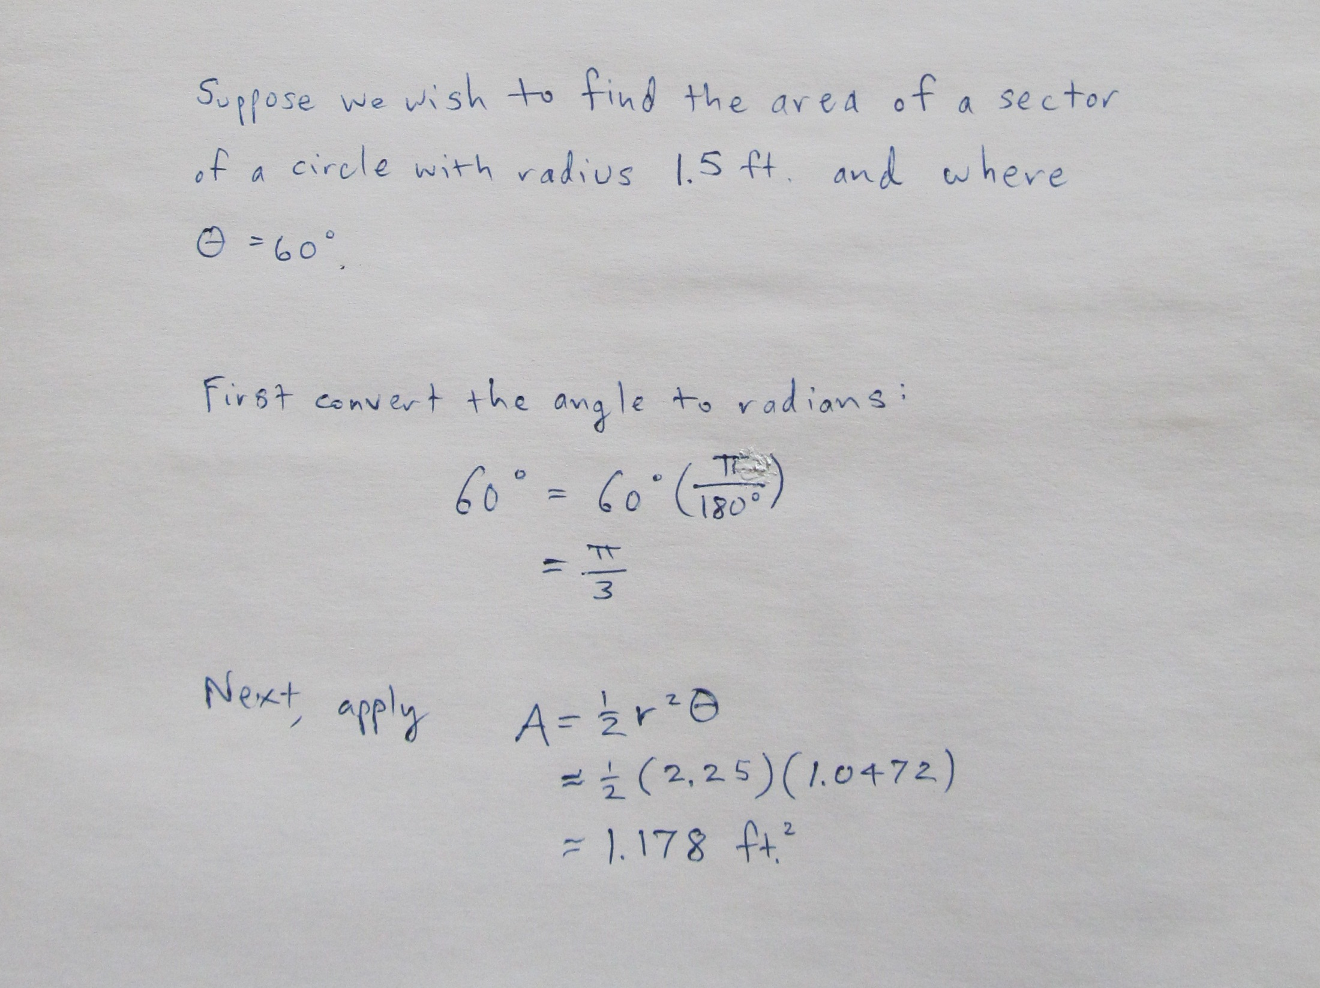

Slide 49
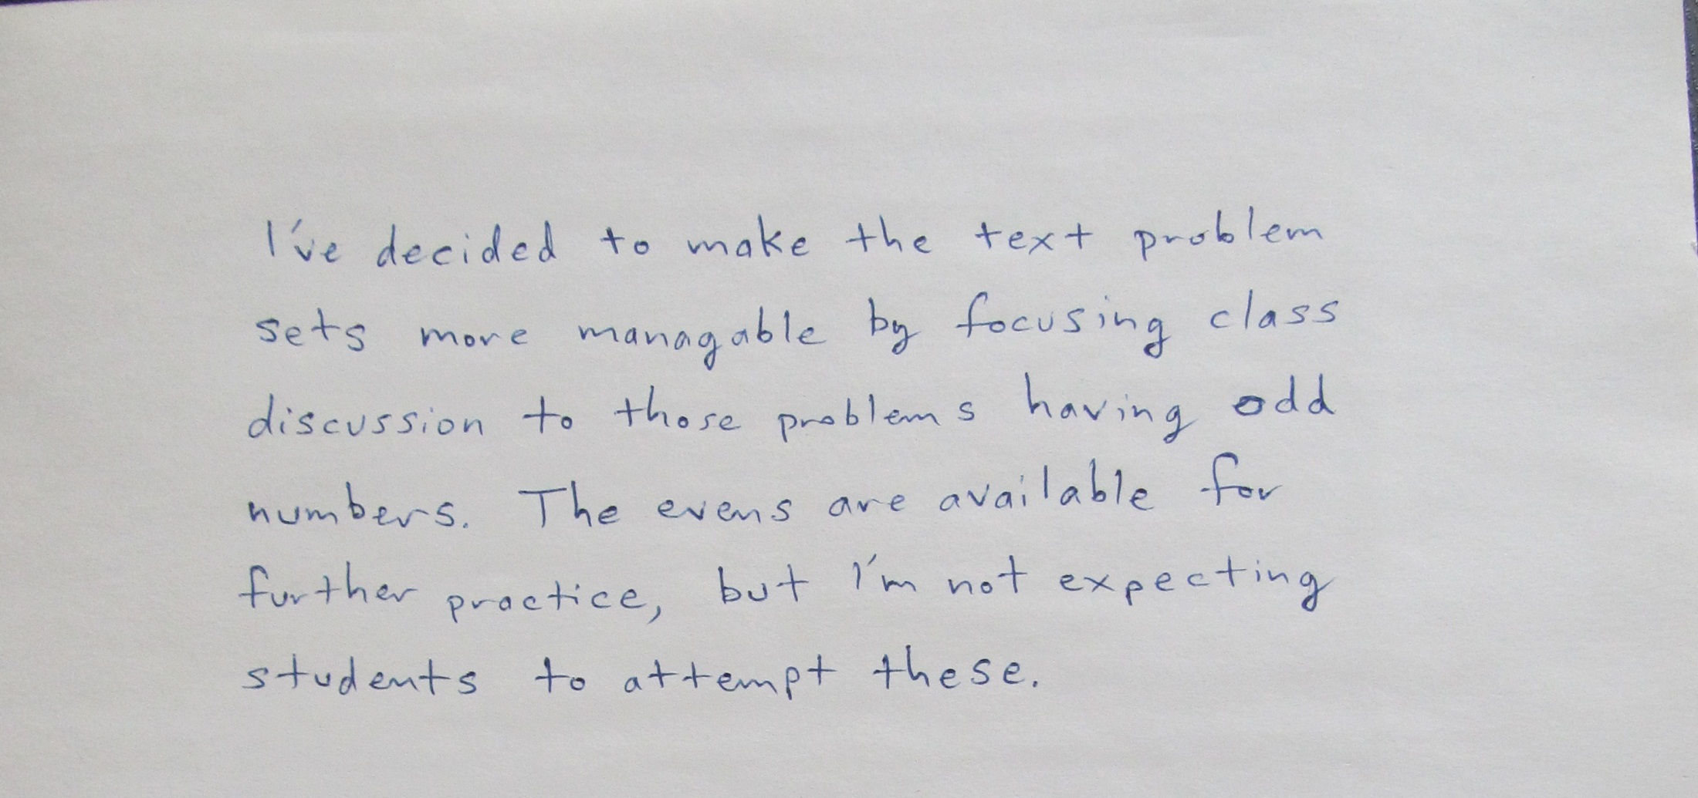

Slide 50


