Slide 1
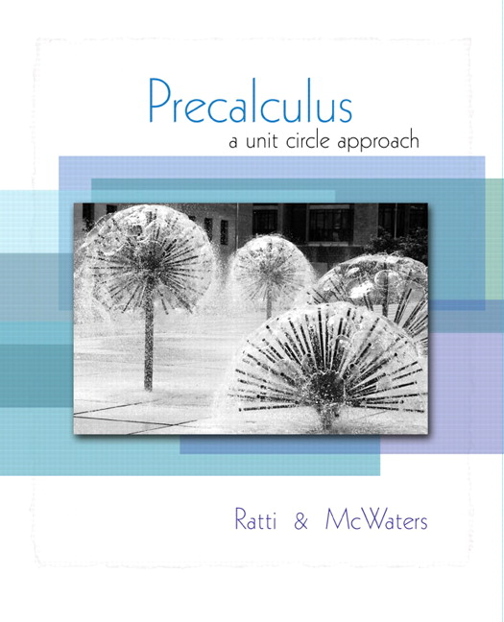


Chapter 4
Trigonometric
Functions
© 2010 Pearson Education, Inc.
All rights reserved

Slide 2
The Unit Circle; Trigonometric Functions of an Angle
SECTION 4.2
1
Define the trigonometric functions using the unit circle.
Find exact trigonometric function values using a point on the unit circle.
Find trigonometric function values of quadrantal angles.
Find trigonometric function values of any angle.
Approximate trigonometric function values using a calculator.
2
3
4
5

Slide 3
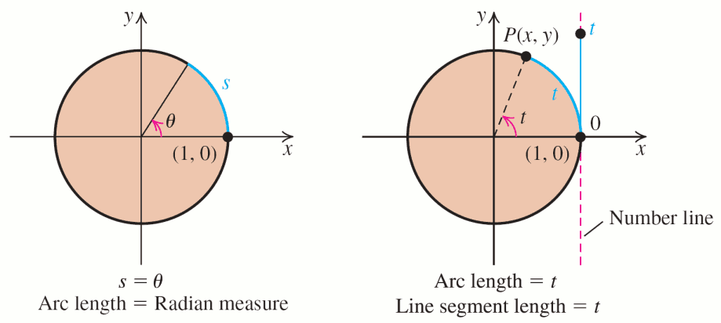
THE UNIT CIRCLE
In a unit circle, r = 1; so the length, s, of the intercepted arc is s = 1 ∙ θ or s = θ. That is, the radian measure and the arc length are identical.

Slide 4
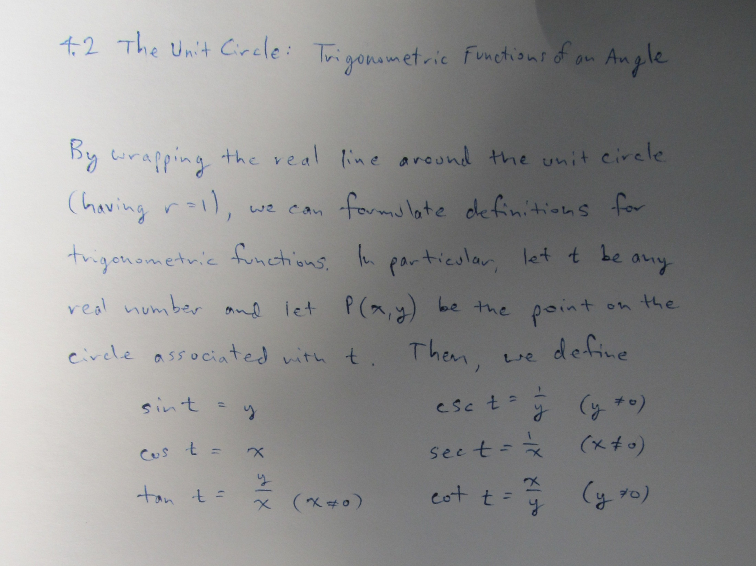

Slide 5
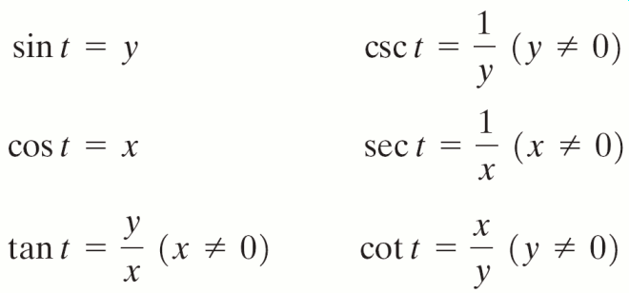
UNIT CIRCLE DEFINITIONS OF THE TRIGONOMETRIC FUNCTIONS OF
REAL NUMBERS
Let t be any real number and let P(x, y) be the point on the unit circle associated with t. Then

Slide 6
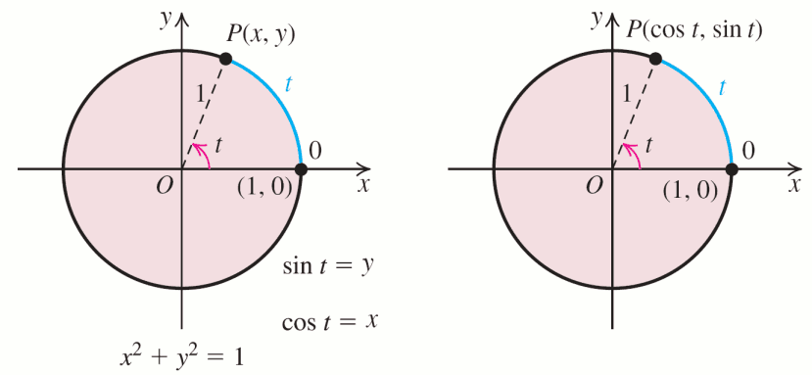
POINTS ON THE UNIT CIRCLE
A point P on the unit circle associated with a real number t has coordinates (cos t, sin t) because x = cos t and y = sin t.

Slide 7
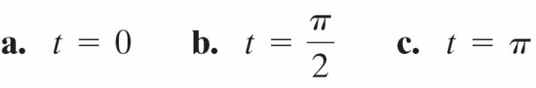

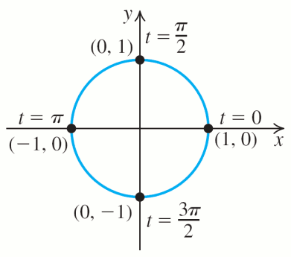
EXAMPLE 1
Evaluating Trigonometric Functions
Find the values (if any) of the six trigonometric functions of each value of t.

Slide 8
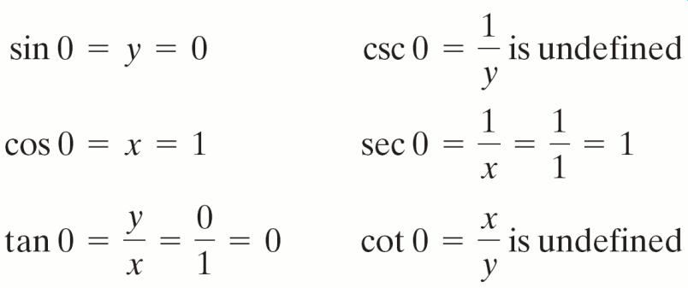
EXAMPLE 1
Evaluating Trigonometric Functions
Solution
a. t = 0 corresponds to the point (x, y) = (1, 0).

Slide 9

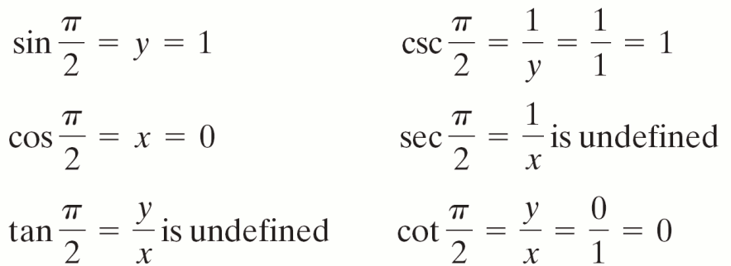
EXAMPLE 1
Evaluating Trigonometric Functions
Solution continued
b.

Slide 10
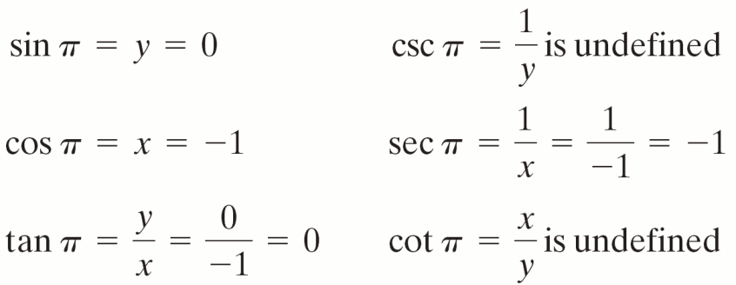
EXAMPLE 1
Evaluating Trigonometric Functions
Solution continued
c. t = π corresponds to the point (x, y) = (−1, 0).

Slide 11

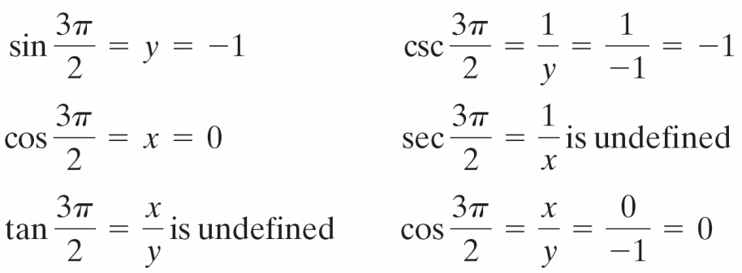
EXAMPLE 1
Evaluating Trigonometric Functions
Solution continued
d.

Slide 12
EXAMPLE 1
Evaluating Trigonometric Functions
Solution continued
e. t = −3π corresponds to the same point, (−1, 0), as t = π.

Slide 13
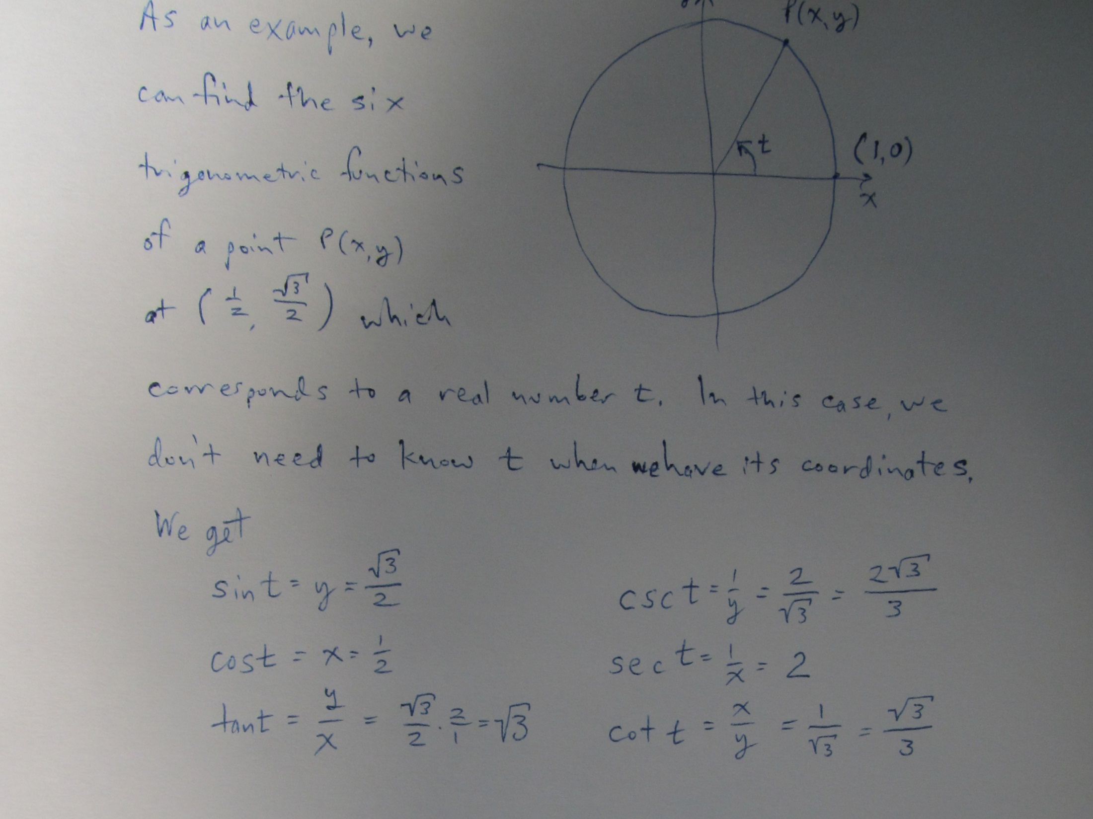

Slide 14
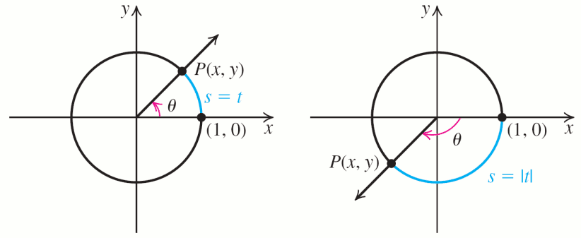
TRIGONOMETRIC FUNCTIONS
OF AN ANGLE
Given an angle θ in standard position, let P(x, y) be the point where the terminal ray of θ intersects the unit circle.

Slide 15
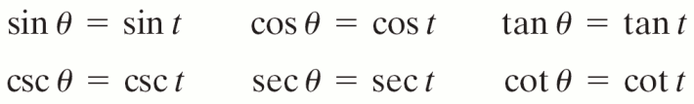
TRIGONOMETRIC FUNCTIONS
OF AN ANGLE
If θ is an angle with radian measure t, then
If θ is given in degrees, convert θ to radians before using these equations.

Slide 16

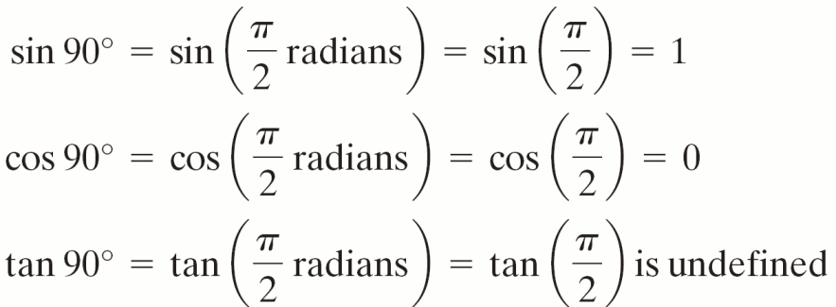
Finding the Trigonometric Function Values
of a Quadrantal Angle
EXAMPLE 2
Find the trigonometric function values of 90º.
Solution
, so

Slide 17
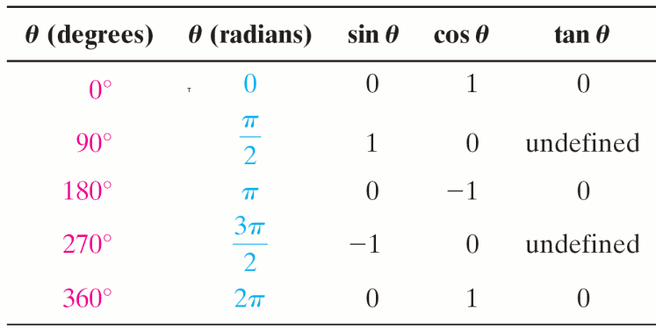
TRIGONOMETRIC FUNDTIONS OF QUADRANTAL ANGLES

Slide 18
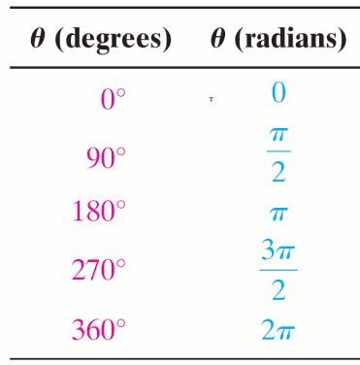
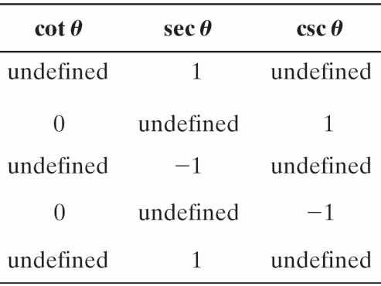
TRIGONOMETRIC FUNDTIONS OF QUADRANTAL ANGLES

Slide 19
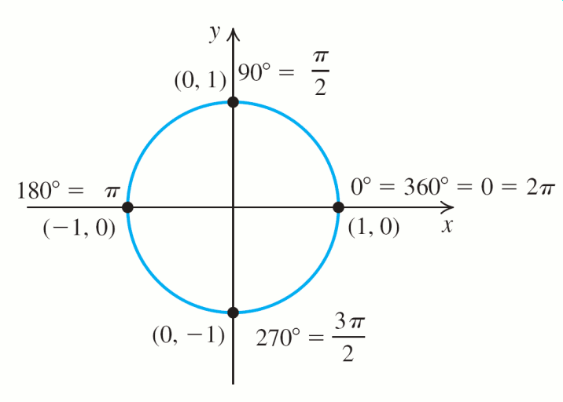
QUADRANTAL ANGLES

Slide 20
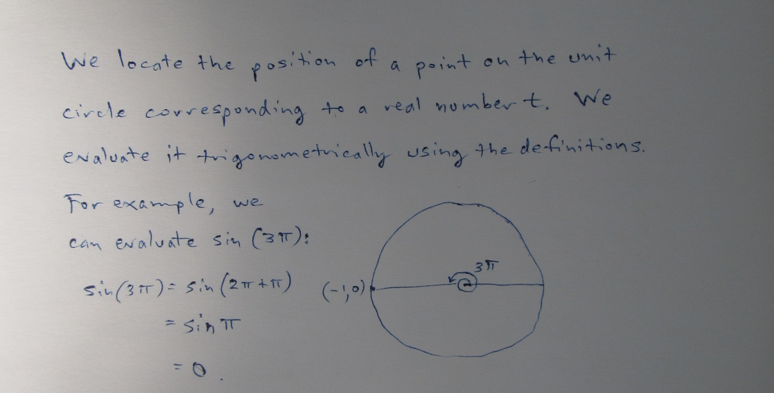

Slide 21
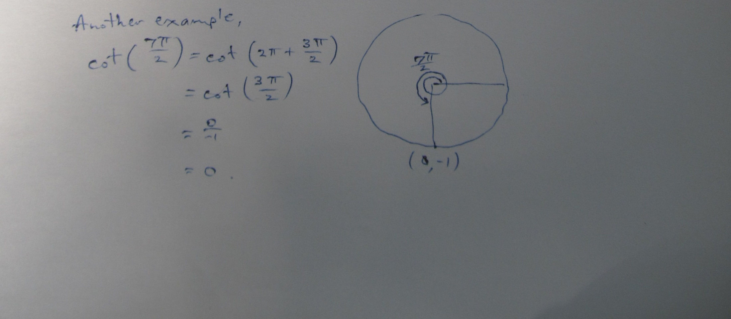
There’s every reason to draw a circle .

Slide 22
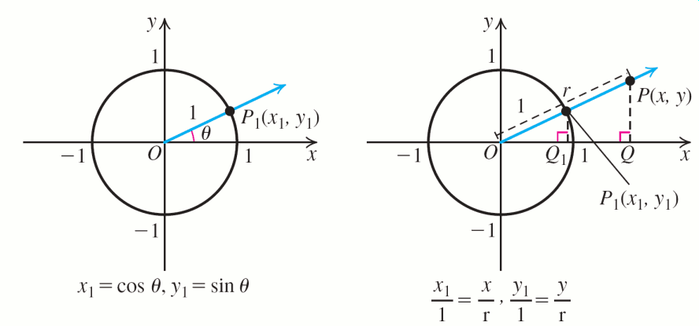
TRIGONOMETRIC VALUES OF AN ANGLE θ

Slide 23

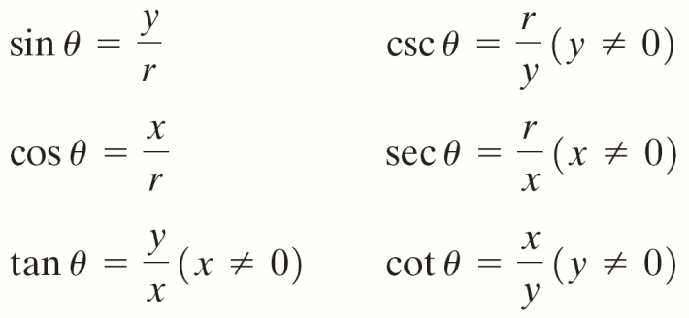
VALUES OF TRIGONOMETRIC VALUES OF AN ANGLE θ
Let P(x, y) be any point on the terminal ray of an angle in standard position (other than the origin) and let r = Then r > 0, and

Slide 24
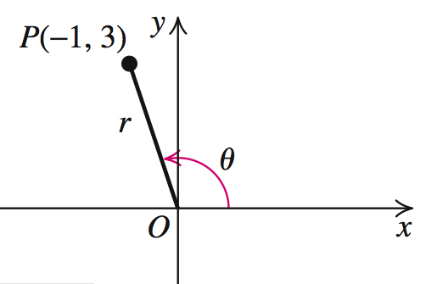
EXAMPLE 3
Finding Trigonometric Function Values
Suppose that θ is an angle whose terminal side contains the point P(–1, 3). Find the exact values of the six trigonometric functions of θ.
Solution

Slide 25
EXAMPLE 3
Finding Trigonometric Function Values
Solution continued

Slide 26
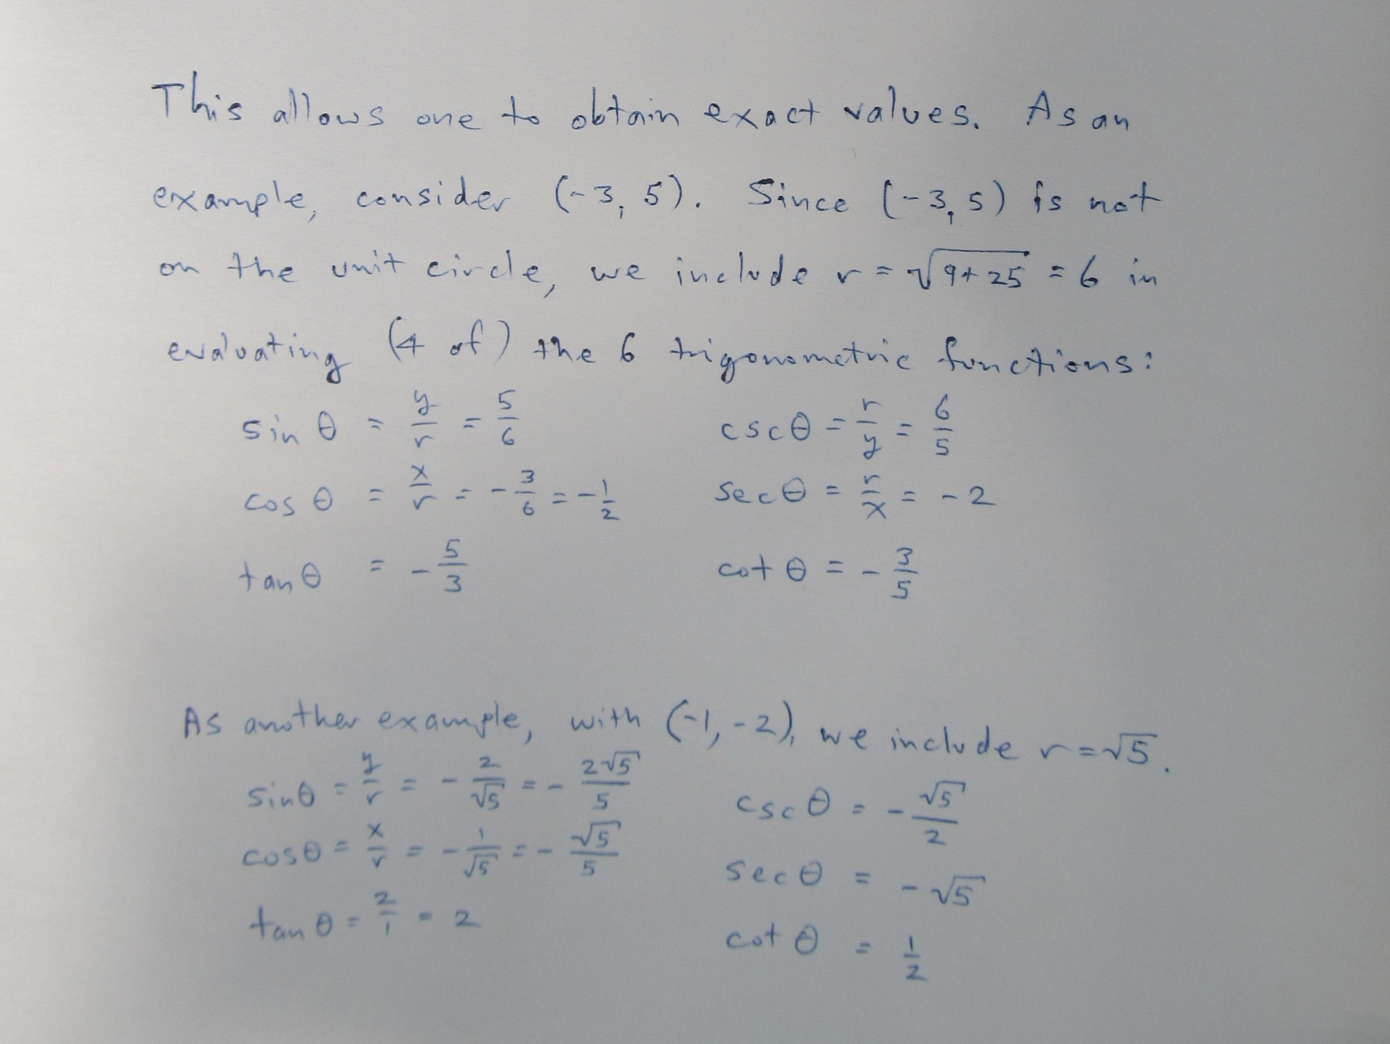

Slide 27
As a note on exact values, it is always better to use these throughout a general evaluation and only round your result.
Calculators are not always correct.
You should certainly be able to determine the lengths of a right triangle with angles of 45 degrees and 30 and 60…

Slide 28
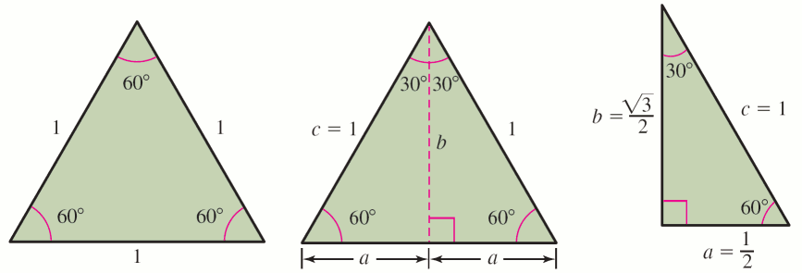
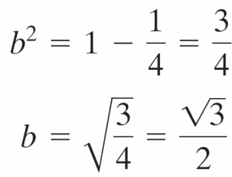
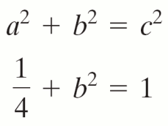
TRIGONOMETRIC FUNCTION VALUES FOR AND

Slide 29
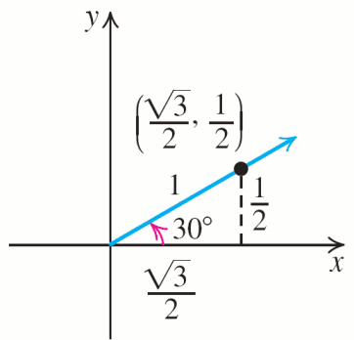
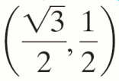

Finding Exact Trigonometric Function
Values of
EXAMPLE 4
Find the exact trigonometric function values of
Solution
The point (x, y) =
is on the terminal side of

Slide 30
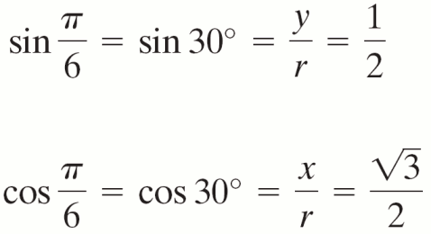
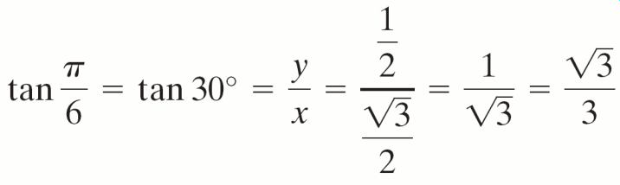
Finding Exact Trigonometric Function
Values of
EXAMPLE 4
Solution continued

Slide 31
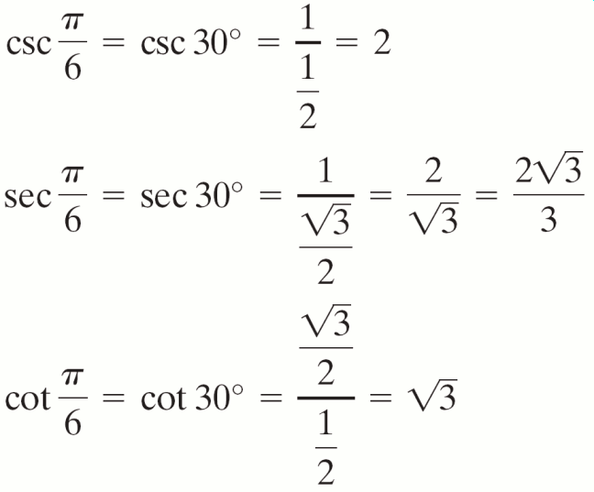
Finding Exact Trigonometric Function
Values of
EXAMPLE 4
Solution continued

Slide 32
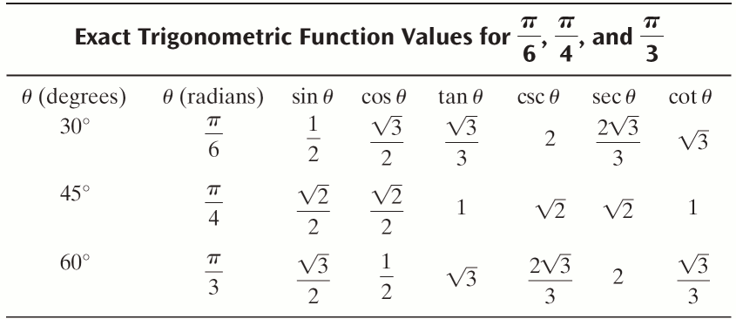
MORE TRIGONOMETRIC FUNCTION VALUES

Slide 33
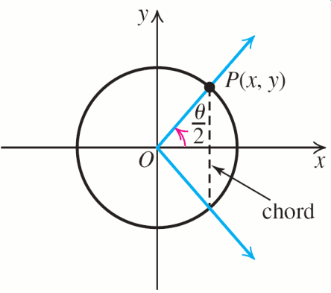
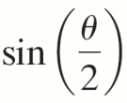
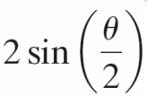
EXAMPLE 5
Finding Chord Length on the Unit Circle
Find the length of the chord of the unit circle intercepted by an angle of θ radians.
Solution
y =
= half the length of the chord.
So, = 2y
= length of chord

Slide 34
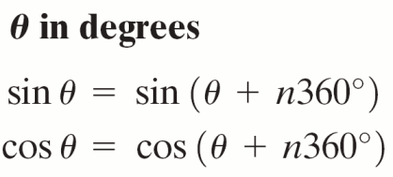
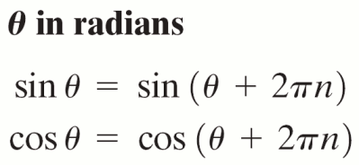
TRIGONOMETRIC FUNCTION VALUES OF COTERMINAL ANGLES
These equations hold for any integer n.

Slide 35
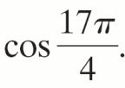



EXAMPLE 6
Trigonometric Function Values of Coterminal Angles
Find the exact values for
a. sin 2580º b.
Solution
2580° = 60° + 2520° = 60° + 7(360°); so sin 2580º = sin 60º =
so

Slide 36

EXAMPLE 7
Approximating Trigonometric Function Values Using a Calculator
Use a calculator to find the approximate value of each expression. Round your answers to two decimal places.
a. sin 71º b. tan c. sec 1.3
Solution
Set the MODE to degrees.
sin 71º ≈ 0.9455185756 ≈ 0.95

Slide 37

EXAMPLE 7
Approximating Trigonometric Function Values Using a Calculator
Solution continued
b. Set the MODE to radians.
tan ≈ −1.253960338 ≈ −1.25
c. Set the MODE to radians.
sec 1.3 = ≈ 3.738334127 ≈ 3.74

