Slide 1
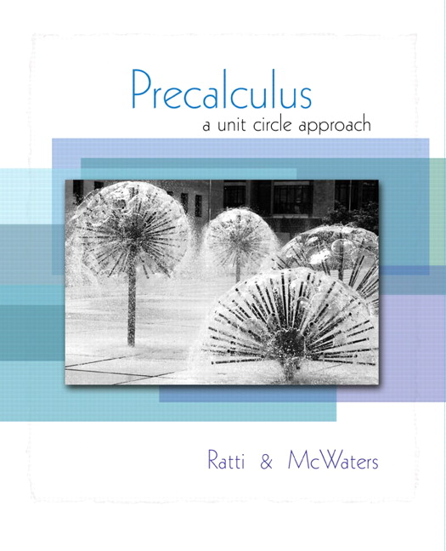


Chapter 4
Trigonometric
Functions
© 2010 Pearson Education, Inc.
All rights reserved

Slide 2
Some Properties of the Trigonometric Functions
SECTION 4.3
1
Determine the signs of the trigonometric functions in each quadrant.
Find a reference angle.
Use basic trigonometric identities.
2
3

Slide 3
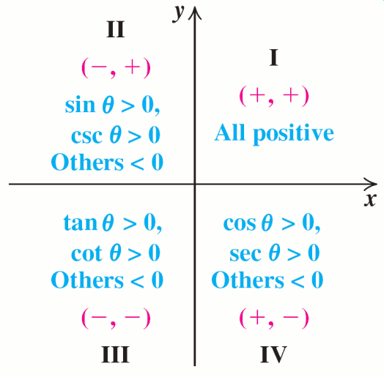
SIGNS OF THE TRIGONOMETRIC FUNCTIONS

Slide 4
The signs of the trigonometric functions are determined by the quadrant in the terminal side falls. This is clear if we see that above the x-axis, y>0, etc.

Slide 5
EXAMPLE 1
Determining the Quadrant in Which an Angle Lies
If tan θ > 0 and cos θ < 0 in which quadrant does lie?
Solution
Because tan θ > 0, θ lies either in quadrant I or in quadrant III. However, cos θ > 0 for θ in quadrant I; so θ must lie in
quadrant III.
It doesn’t hurt to sketch this diagram.
R&M suggest “All Students Take Calculus.”

Slide 6
EXAMPLE 2
Evaluating Trigonometric Functions
Solution
Since tan θ > 0 and cos θ < 0, θ lies in Quadrant III; both x and y must be negative

Slide 7
EXAMPLE 2
Evaluating Trigonometric Functions
Solution continued

Slide 8
DEFINITION OF A REFERENCE ANGLE
Let θ be an angle in standard position that is not a quadrantal angle.
The reference angle for θ is the positive acute angle θ′ formed by the terminal side of θ and the positive or negative x-axis.

Slide 9
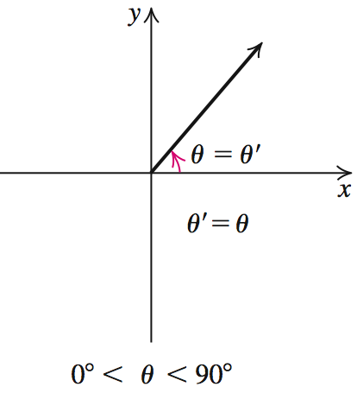
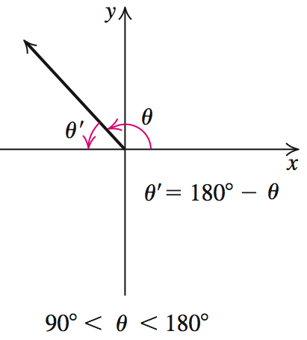
DEFINITION OF A REFERENCE ANGLE

Slide 10
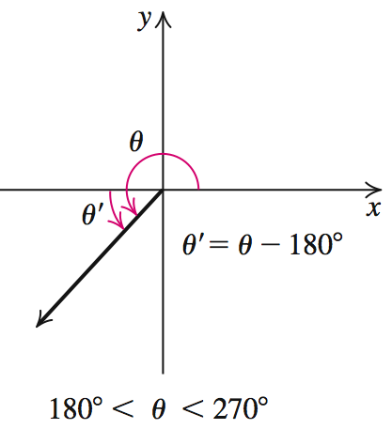
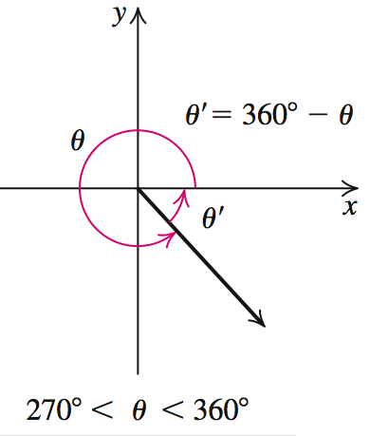
DEFINITION OF A REFERENCE ANGLE
Again, there’s no reason not to sketch these to verify that we have the desired reference angle (always positive).

Slide 11

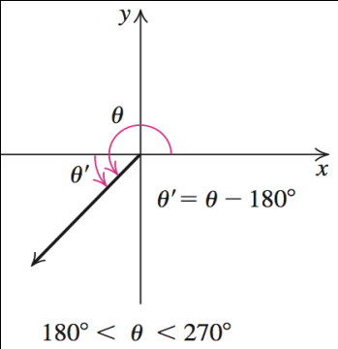
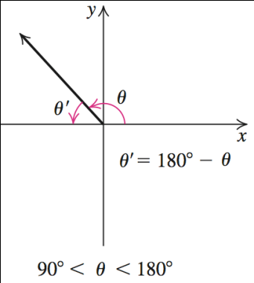
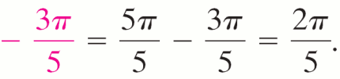
EXAMPLE 3
Identifying Reference Angles
Find the reference angle θ′ for each angle θ.
a. θ = 250º b. θ = c. θ = 5.75
Solution
Because 250º lies in quadrant III,
θ′ = θ − 180º. So, θ = 250º − 180º = 70º.
Because lies in quadrant II, θ′ = π − θ.
θ′ = π

Slide 12

EXAMPLE 3
Identifying Reference Angles
Solution continued
c. θ is in radians. ≈ 4.71 and 2π ≈ 6.28; so θ lies in quadrant IV and θ′ = 2π − θ;
  θ′ = 2π – 5.75 ≈ 6.28 – 5.75 = 0.53.

Slide 13
PROCEDURE FOR USING REFERENCE ANGLES TO FIND TRIGONOMETRIC FUNCTION VALUES
Step 1 If the θ > 360º, then find a coterminal angle for θ between 0º and 360º. Otherwise, go to Step 2.
Step 2 Find the reference angle θ′ for the angle resulting in Step 1. Write the trigonometric function of θ′ .

Slide 14
PROCEDURE FOR USING REFERENCE ANGLES TO FIND TRIGONOMETRIC FUNCTION VALUES
Step 3 Choose the correct sign for the trigonometric function based on the quadrant in which θ lies.

Slide 15
EXAMPLE 5
Using the Reference Angle to Find Values of Trigonometric Functions
Find the exact value of each expression.
Solution
Step 1 0º < 330º < 360º; find its reference angle
Step 2 330º is in Q IV, its reference angle θ′ is

Slide 16
EXAMPLE 5
Using the Reference Angle to Find Values of the Trigonometric Function
Solution continued
Step 3 In Q IV, tan is negative, so
b. Step 1
is between 0 and 2π coterminal with

Slide 17
Using the Reference Angle to Find Values of the Trigonometric Function
EXAMPLE 5
Solution continued
Step 2
is in Q IV, its reference angle θ′ is
Step 3 In Q IV, sec > 0, so

Slide 18
EXAMPLE 6
The Flight of a Golf Ball
A golf ball is hit on a level fairway with an initial velocity of 128 ft/sec and an initial angle of flight of 30º.
Find its range (the horizontal distance it traveled before hitting the ground) and its maximum height.
Solution
Use the height equation h = v₀t sin θ − 16t2 with v₀ = 128 and θ = 30º.

Slide 19
EXAMPLE 6
The Flight of a Golf Ball
Solution continued
h = 128t sin 30° − 16t2
Replace sin 30° with and simplify.
h = 64t − 16t2 = 16t(t – 4)
The graph of this equation is a parabola; the portion of the graph with h(t) > 0 represents the flight path of the ball.

Slide 20
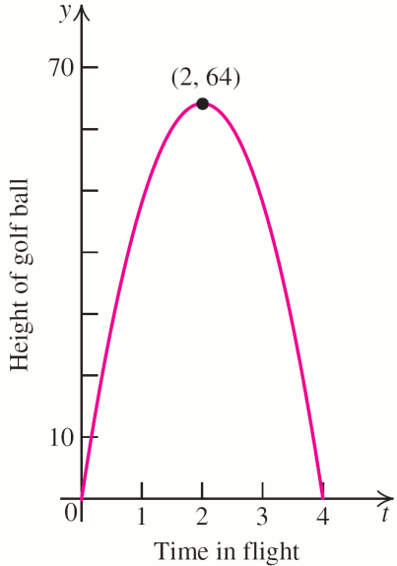

EXAMPLE 6
The Flight of a Golf Ball
Solution continued
Find the vertex:
and
h(2) = 64(2) – 16(2)2 = 64;
so the vertex is (2, 64) and
the maximum height is 64 ft.
Since h(4) = 0 the ball is in
flight for 4 seconds.

Slide 21
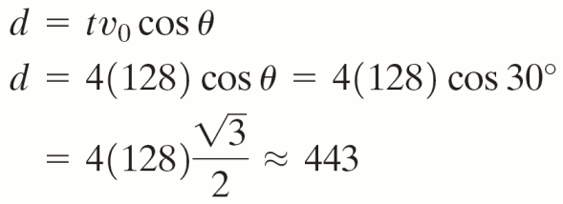
EXAMPLE 6
The Flight of a Golf Ball
Solution continued
The range is the distance, d, traveled after 4 seconds:
The ball reaches a maximum height of 64 feet and has a range of 443 feet.

Slide 22
BASIC TRIGONOMETRIC IDENTITIES
Quotient Identities
Pythagorean Identities
Reciprocal Identities

Slide 23
Finding the Exact Value of a Trigonometric Function Using the Pythagorean Identities
EXAMPLE 7
Solution
a. Use Pythagorean identity involving sin t.

Slide 24
Finding the Exact Value of a Trigonometric Function Using the Pythagorean Identities
EXAMPLE 7
Solution

Slide 25
Finding the Exact Value of a Trigonometric Function Using the Pythagorean Identities
EXAMPLE 7
Solution continued
Use Pythagorean identity involving sec t.

