Slide 1
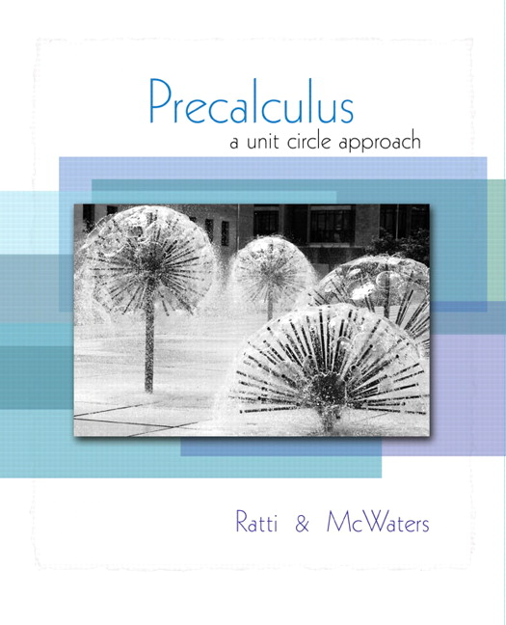


Chapter 4
Trigonometric
Functions
© 2010 Pearson Education, Inc.
All rights reserved

Slide 2
Graphs of the Sine and Cosine Functions
SECTION 4.4
Define periodic functions.
Graph the sine and cosine functions.
Find the amplitude and period of sinusoidal functions.
Find the phase shifts and graph sinusoidal functions of the forms y = a sin b(x – c)
and y = a cos b(x – c).
1
2
3
4

Slide 3
DEFINITION OF A PERIODIC FUNCTION
A function f is said to be periodic if there is a positive number p such that f (x + p) = f (x) for every x in the domain of f.
The smallest value of p (if there is one) for which f (x + p) = f (x) is called the period of f. The graph of f over any interval of length p is called one cycle of the graph.

Slide 4
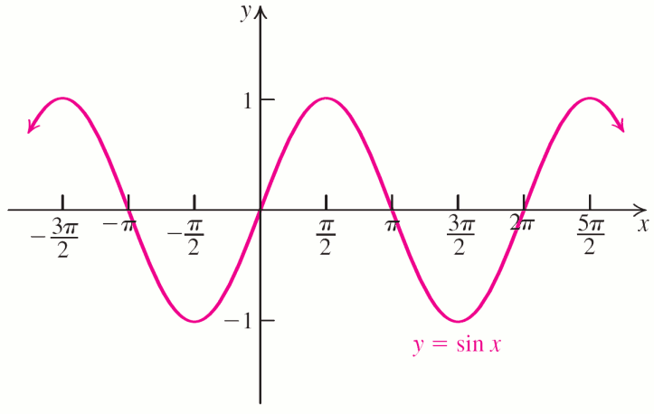
GRAPH OF THE SINE FUNCTION
Plotting y = sin x for common values of x and connecting the points with a smooth curve yields:

Slide 5
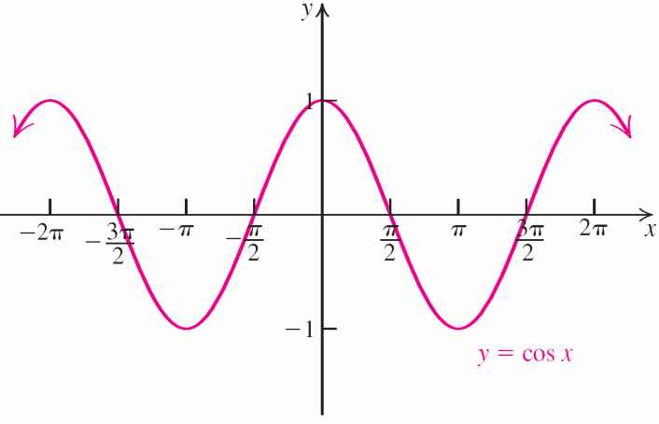
GRAPH OF THE COSINE FUNCTION
Plotting y = cos x for common values of x and connecting the points with a smooth curve yields:

Slide 6
PROPERTIES OF THE SINE
AND COSINE FUNCTIONS
Sine Function
Cosine Function
Period: 2π
Domain: (–∞, ∞)
Range: [–1, 1]
Odd: sin (–t) = –sin t
Period: 2π
Domain: (–∞, ∞)
Range: [–1, 1]
Even: cos (–t) = cos t

Slide 7
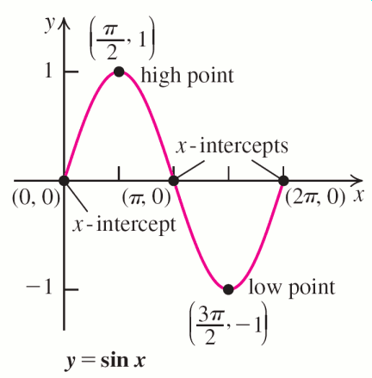
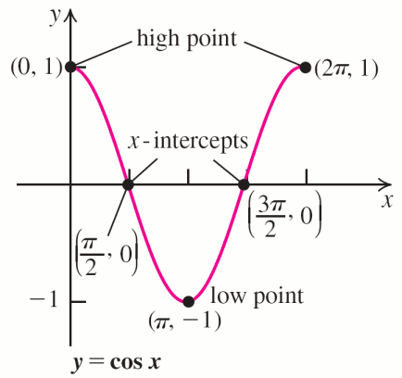
KEY POINTS OF THE SINE
AND COSINE GRAPHS

Slide 8
Definitions
The graphs of the sine and cosine functions and their transformations are called sinusoidal graphs or curves.
In equations of the form y = a sin bx and y = a cos bx, the number |a| is called the amplitude, which is the function’s largest value.

Slide 9

EXAMPLE 1
Graphing y = a sin x
Graph y = 3 sin x, and y = sin x
on the same coordinate system over the
interval [−2π, 2π].
Solution
Begin with the graph of y = sin x and multiply the y-coordinate of each point (including the key points) on this graph by 3 to get the graph of y = 3 sin x.

Slide 10

EXAMPLE 1
Graphing y = a sin x
Solution continued
This stretches the graph vertically by a factor of 3 without changing the x-intercepts.
Then, multiply the y-coordinate of each
point on the graph of y = sin x by to get
the graph of This compresses the graph.

Slide 11
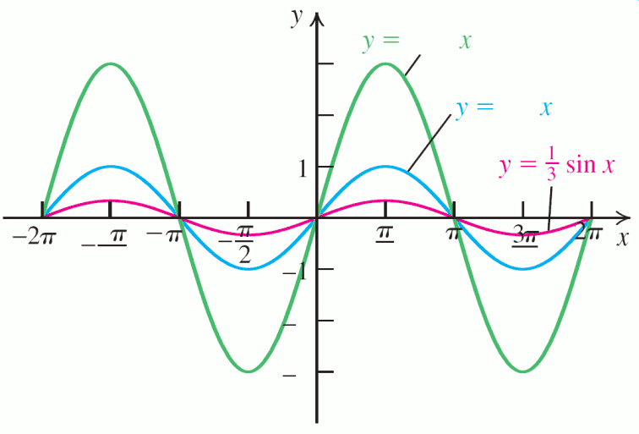
EXAMPLE 1
Graphing y = a sin x
Solution continued
3x
sin x
3
x
2
sin x
3
2
2
2
2
a is amplitude
3

Slide 12
EXAMPLE 2
Graphing y = a cos x
Graph y = −2 cos x over the interval [−2π, 2π]. Find the amplitude and range of the function.
Solution
Begin with the graph of y = cos x and multiply the
y-coordinate of each point on this graph by 2 to get the graph of y = 2 cos x.
Next, reflect the graph in the x-axis to produce the graph of y = −2 cos x.
The amplitude is |a| = 2, the largest value attained by
y = −2 cos x; the smallest function value attained is −2.

Slide 13
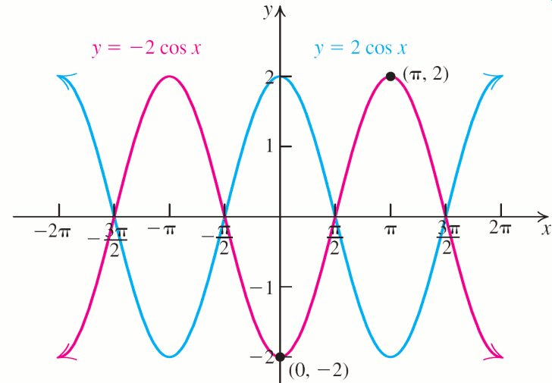
EXAMPLE 2
Graphing y = a cos x
Solution continued
Therefore, the range of y = −2 cos x is [−2, 2].

Slide 14


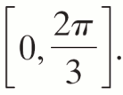
EXAMPLE 3
Graphing y = sin bx
Sketch one cycle of the graphs of y = sin 3x,
and y = sin x on the same coordinate system.
Solution
Begin with the graph of y = sin x and divide
its period, 2π, by 3 to get the period
of y = sin 3x. One cycle of y = sin 3x will be compressed into the interval

Slide 15

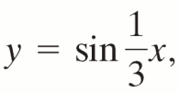


EXAMPLE 3
Graphing y = sin bx
Solution continued
Divide this interval into four equal parts to find the x-coordinates for the key points:
(y values do not change.)
To find the period of divide 2π by
to get 6π. This yields an interval of [0, 6π]
with these x-coordinates for the key points:

Slide 16
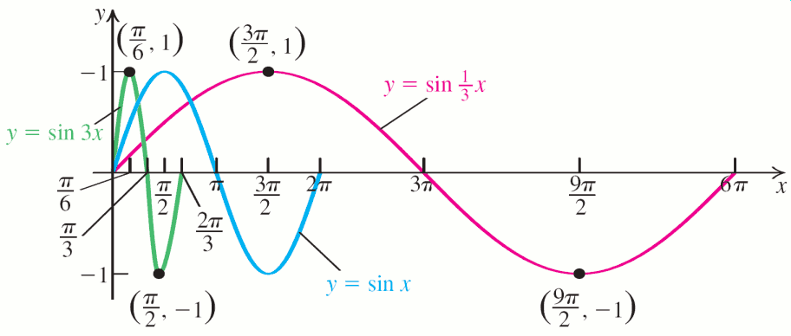
EXAMPLE 3
Graphing y = sin bx
Solution continued
b is compression

Slide 17
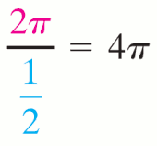
EXAMPLE 4
Graphing y = a cos bx
Graph over a one-period interval.
Solution
b<1 means expansion
Amplitude is 3.
Period is .
Divide the period, 4π, into four quarters:
0 to π
π to 2π
2π to 3π
3π to 4π
The five endpoints give the highest and lowest points and the x-intercepts of the graph.

Slide 18
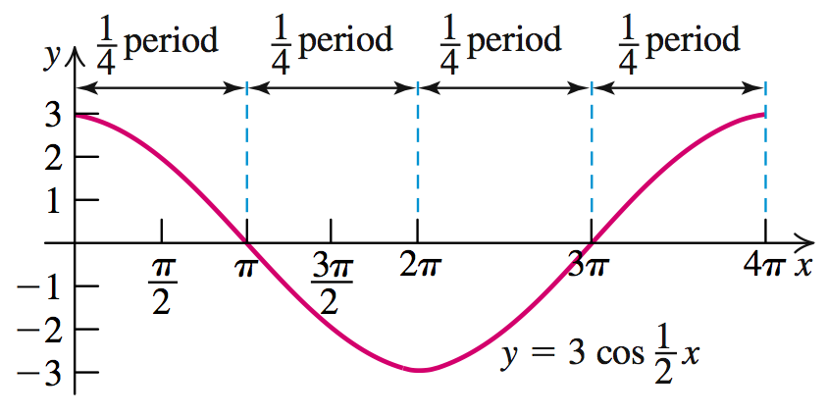
EXAMPLE 4
Graphing y = a cos bx
Solution continued

Slide 19
CHANGING THE AMPLITUDE AND PERIOD OF THE SINE AND COSINE FUNCTIONS
The functions y = a sin bx and y = a cos bx (b > 0) have amplitude |a| and period
If a > 0, the graphs of y = a sin bx and y = a cos bx are similar to the graphs of y = sin x and y = cos x , respectively, with two changes.
1. The range is [–a, a].
2. One cycle is completed over the interval

Slide 20
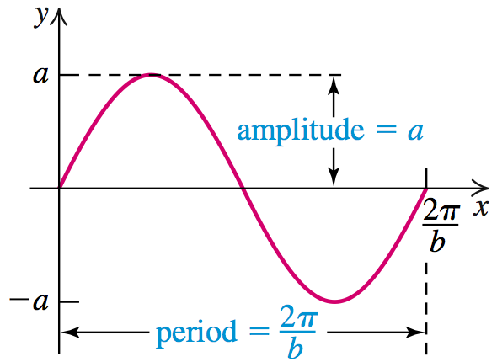
CHANGING THE AMPLITUDE AND PERIOD OF THE SINE AND COSINE FUNCTIONS
Again notice that when b>1, we compress the period. When b<1, we algebraically have expansion.

Slide 21
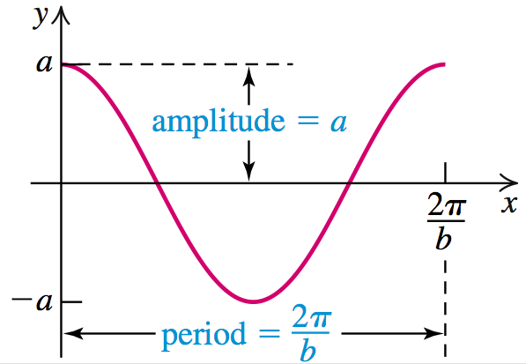
CHANGING THE AMPLITUDE AND PERIOD OF THE SINE AND COSINE FUNCTIONS
If a < 0, the graphs are the reflections of y = |a| sin bx and y = |a| cos bx, respectively, in the x-axis.

Slide 22
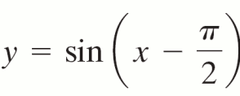
EXAMPLE 5
Graphing y = a sin (x – c)
Graph over a one-period
interval.
Solution
The graph of f (x – c) is the graph of f (x) shifted right c units if c > 0 and left |c| units if c < 0.
The negative sign on c in the expression x-c means that when c itself is positive, the graph is shifted to the right. This example is a good model to remember.

Slide 23


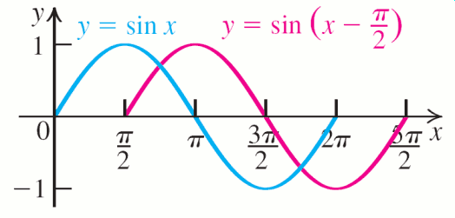
EXAMPLE 5
Graphing y = a sin (x – c)
Solution continued
; so the graph of is
the graph of y = sin x shifted right units.
In the red equation, notice that positive pi/2 is needed to get the point at (pi/2, 0).

Slide 24
PROCEDURE FOR GRAPHING y = a sin b(x – c) AND y = a cos b(x – c)
Step 1 Find the amplitude, period, and phase shift.
amplitude = |a|
period =
phase shift = c
Step 2 The starting point for the cycle is x = c. The interval over which one complete
cycle occurs is

Slide 25
PROCEDURE FOR GRAPHING y = a sin b(x – c) AND y = a cos b(x – c)
Step 3 Divide the interval
into four
equal parts, each of length
This requires 5
points: a starting point c,

Slide 26
PROCEDURE FOR GRAPHING y = a sin b(x – c) AND y = a cos b(x – c)
Step 4 If a > 0, for y = a sin b(x – c), sketch one cycle of the sine curve, starting at (c, 0),
through the points

Slide 27
PROCEDURE FOR GRAPHING y = a sin b(x – c) AND y = a cos b(x – c)
Step 4 continued
For y = a cos b(x – c), sketch one cycle of the cosine curve, starting at (c, a),
through the points

Slide 28
PROCEDURE FOR GRAPHING y = a sin b(x – c) AND y = a cos b(x – c)
Step 4 continued
For a < 0, reflect the graph of
y = |a| sin b(x – c) or y = |a| cos b(x – c), in the x-axis.

Slide 29
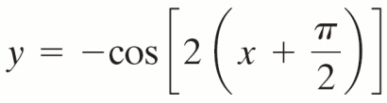
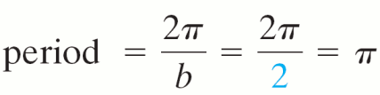

EXAMPLE 7
Graphing y = a sin b(x – c)
Graph over a one-period
interval.
Solution
Step 1 amplitude = |a| = |−1| = 1

Slide 30
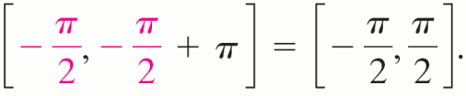


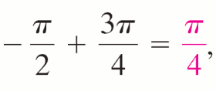
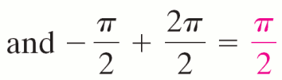
EXAMPLE 7
Graphing y = a sin b(x – c)
Solution continued
Step 2 One cycle is graphed over the interval
Step 4
x-coordinates of the five key points:

Slide 31
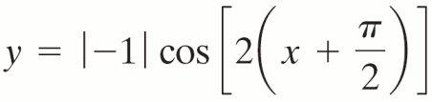
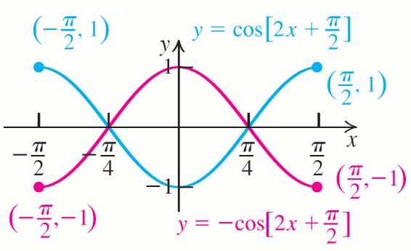
EXAMPLE 7
Graphing y = a sin b(x – c)
Solution continued
Step 4 Because a = −1 < 0, graph
and reflect this graph in the x-axis.
π]
π]

Slide 32
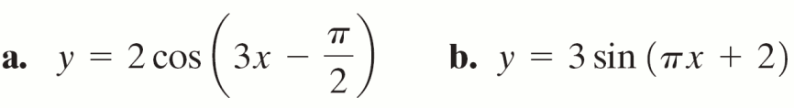
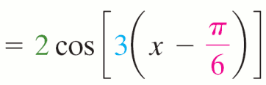
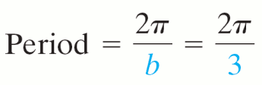

EXAMPLE 8
Finding Period and Phase Shift
Find the period and the phase shift of each function.
Solution
a. Use the distributive property to rewrite:
y

Slide 33
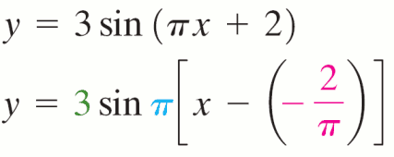

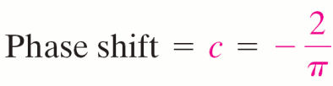
EXAMPLE 8
Finding Period and Phase Shift
Solution continued
b. Use the distributive property to rewrite:

Slide 34
EXAMPLE 9
Graphing y = a sin b(x – k)
Graph over a one-period interval.
Solution
Rewrite is as:
Amplitude = 3
Phase shift
Period
One cycle
Starting point

Slide 35
EXAMPLE 9
Graphing y = a sin b(x – k)
Solution continued

Slide 36
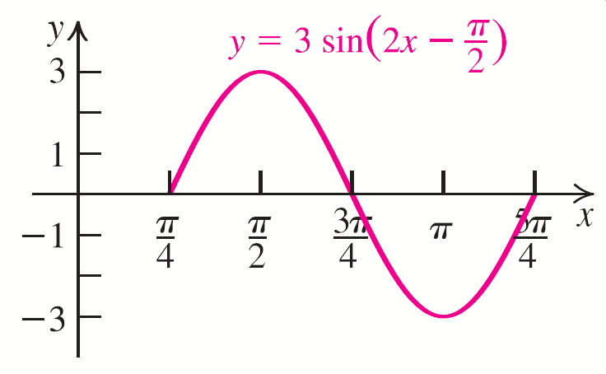
EXAMPLE 9
Graphing y = a sin b(x – k)
Solution continued

Slide 37
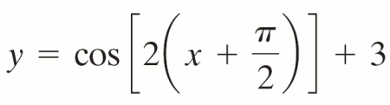
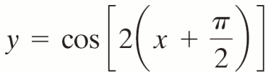
EXAMPLE 10
Graphing y = a cos b(x – c) + d
Graph over a one-
period interval.
Solution
Shift the graph of from
Example 7 up three units.
Any additional d is the usual shift of a graph.

Slide 38
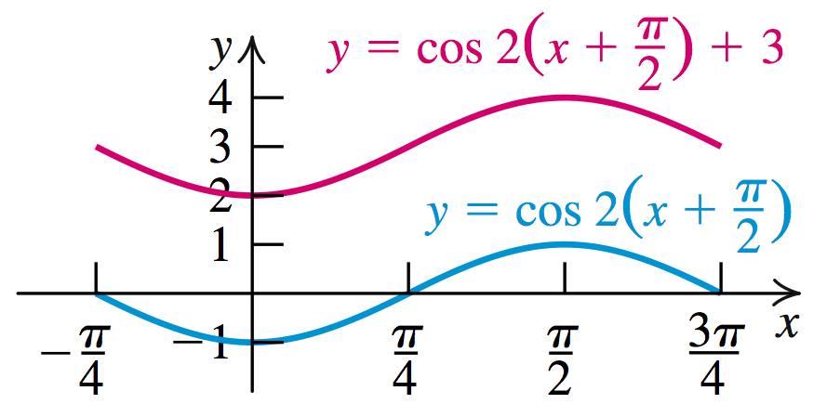
EXAMPLE 10
Graphing y = a cos b(x – c) + d
Solution continued

Slide 39
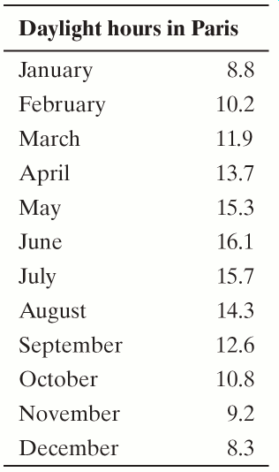
EXAMPLE 11
Modeling the Number of Daylight Hours in Paris
The table gives the average number of daylight hours in Paris each month.
Let y represent the number of daylight hours in Paris in month x to find a function of the form
y = a sin [b(x – c)] + d that models the hours of daylight throughout the year.

Slide 40
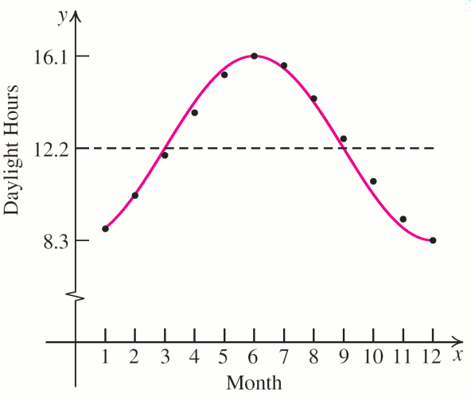
EXAMPLE 11
Modeling the Number of Daylight Hours in Paris
Solution
Plot the values in the table and then sketch a function that models the points graphed.

Slide 41





EXAMPLE 11
Modeling the Number of Daylight Hours in Paris
Solution continued
Amplitude = a =
d = (highest value + lowest value)
Because the weather repeats every 12 months the
period = 12; so .

Slide 42

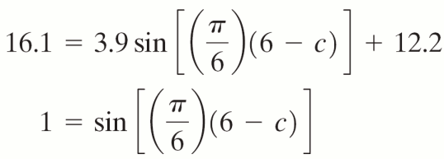
EXAMPLE 11
Modeling the Number of Daylight Hours in Paris
Solution continued
This gives:
To find the phase shift, substitute the x and y values of the maximum into this equation and solve for c. The maximum value for y is 16.1 in June (x = 6).

Slide 43



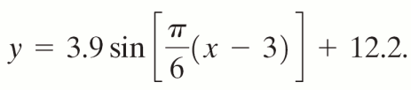
EXAMPLE 11
Modeling the Number of Daylight Hours in Paris
Solution continued
= 1 at So and
c = 3, yielding the final equation:

Slide 44
SIMPLE HARMONIC MOTION
An object whose position relative to an equilibrium position at time t can be described by either
is said to be in simple harmonic motion.

Slide 45
SIMPLE HARMONIC MOTION
The amplitude, |a| is the maximum distance the object attains from its equilibrium position.
The period of the motion, is the time it takes for the object to complete one full cycle.
The frequency of the motion is and gives the number of cycles completed per unit time.

Slide 46
Simple Harmonic Motion of a Ball Attached to a Spring
EXAMPLE 12
Suppose that a ball attached to a spring is pulled down 6 inches and released and the resulting simple harmonic motion has a period of 8 seconds.
Write an equation for the ball’s simple harmonic motion.
Solution
Choose between y = a sin ωt or y = a cos ωt. For t = 0, y = a sin ω · 0 = 0 and y = a cos ω · 0 = a. Because we pulled the ball down in order to start, a is negative.

Slide 47
Simple Harmonic Motion of a Ball Attached to a Spring
EXAMPLE 12
Solution continued
If we start tracking the ball’s motion when we release it after pulling it down 6 inches, we should choose a = –6 and y = –6 cos ωt. We have the form of the equation of motion:
So the equation of the ball’s simple harmonic
motion is

