Slide 1
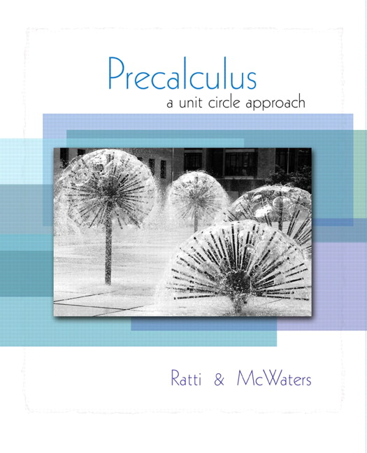


Chapter 4
Trigonometric
Functions
© 2010 Pearson Education, Inc.
All rights reserved

Slide 2
Graphs of the Other Trigonometric Functions
SECTION 4.5a
Graph the tangent and cotangent function.
Graph the cosecant and secant functions.
1
2
It’s the graphing of these last three functions that we are omitting. We must, of course, still be able to work with any and all of these functions and their inverses, which we’ll look at next.

Slide 3
TANGENT FUNCTION
The tangent function differs form the sine and cosine function in three significant ways:
1. The tangent function has period π.
2. The tangent is 0 when sin x = 0 and is undefined when cos x = 0. It is undefined at
3. The tangent has no amplitude; no minimum and maximum y-values. Range is (–∞, ∞).

Slide 4
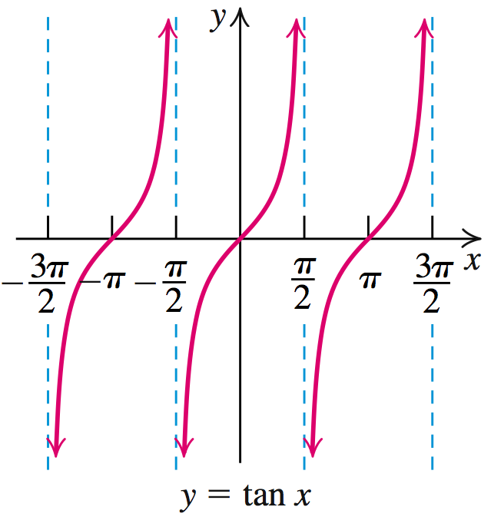
GRAPH OF THE TANGENT FUNCTION
Plotting y = tan x for common values of x and connecting the points with a smooth curve yields:

Slide 5
TANGENT AND COTANGENT FUNCTIONS
Both functions are odd:
tan (–x) = – tan x
cot (–x) = – cot x
Both functions have the same sign everywhere they are both defined.
When |tan x| is large, |cot x| is small, and conversely.

Slide 6

MAIN FACTS ABOUT y = tan x
y = tan x
Period
π
Domain
All real numbers except odd multiples of
Range
(–∞, ∞)
Vertical Asymptote
x = odd multiples of

Slide 7
MAIN FACTS ABOUT y = tan x
y = tan x
x-intercepts
At integer multiples of π
Symmetry
tan (–x) = –tan x odd function, symmetric with respect to the origin

Slide 8

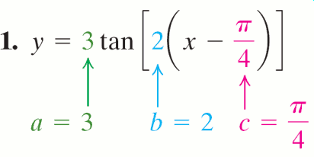



Graphing y = a tan b(x – c)
EXAMPLE 1
OBJECTIVE Graph a function of the form y = a tan [b(x – c)], where b > 0, by finding the period and phase shift.
Step 1 Find the following:
vertical stretch factor = |a|
period =
phase shift = c
EXAMPLE Graph
.
–
vertical stretch factor = |3| = 3
period = phase shift =

Slide 9
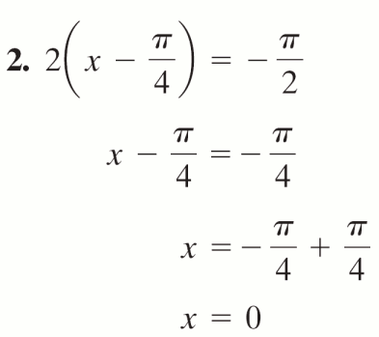

Graphing y = a tan b(x – c)
EXAMPLE 1
OBJECTIVE Graph a function of the form y = a tan [b(x – c)], where b > 0, by finding the period and phase shift.
Step 2 Locate two adjacent vertical asymptotes. For y = a tan [b(x – c)] solve
b(x – c) = – and
b(x – c) = .
EXAMPLE Graph
.

Slide 10
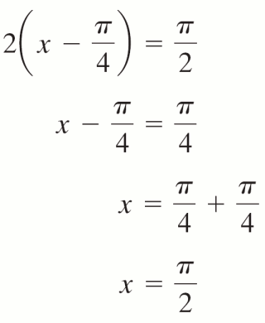
Graphing y = a tan b(x – c)
EXAMPLE 1
OBJECTIVE Graph a function of the form y = a tan [b(x – c)], where b > 0, by finding the period and phase shift.
Step 2 continued Locate two adjacent vertical asymptotes. For y = a tan [b(x – c)] solve
b(x – c) = – and
b(x – c) = .
EXAMPLE Graph
.

Slide 11






Graphing y = a tan b(x – c)
EXAMPLE 1
OBJECTIVE Graph a function of the form y = a tan [b(x – c)], where b > 0, by finding the period and phase shift.
Step 3 Divide the interval on the x-axis between the two vertical asymptotes into four equal parts,
each of length
EXAMPLE Graph
.
3. has a length of
and Division pts:

Slide 12
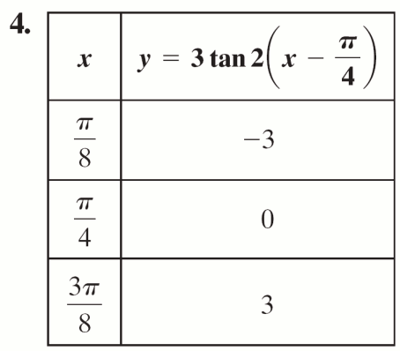
Graphing y = a tan b(x – c)
EXAMPLE 1
OBJECTIVE Graph a function of the form y = a tan [b(x – c)], where b > 0, by finding the period and phase shift.
Step 4 Evaluate the function at the three x values found in Step 3 that are the division points of the interval.
EXAMPLE Graph
.

Slide 13
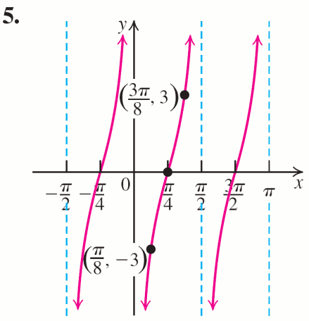
Graphing y = a tan b(x – c)
EXAMPLE 1
OBJECTIVE Graph a function of the form y = a tan [b(x – c)], where b > 0, by finding the period and phase shift.
Step 5 Sketch the vertical asymptotes using the values found in Step 2. Connect the points in Step 4 with a smooth curve in the standard shape of a cycle for the given function. Repeat the graph to the left and
right over intervals of length .
EXAMPLE Graph
.

Slide 14
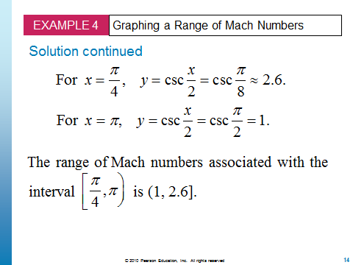
Be aware that we should still be able to resolve the numerical portion of a problem like Example 4.
The graph would tell us about the tendency of the values over the interval, but we can get the range without graphing.

