Slide 1
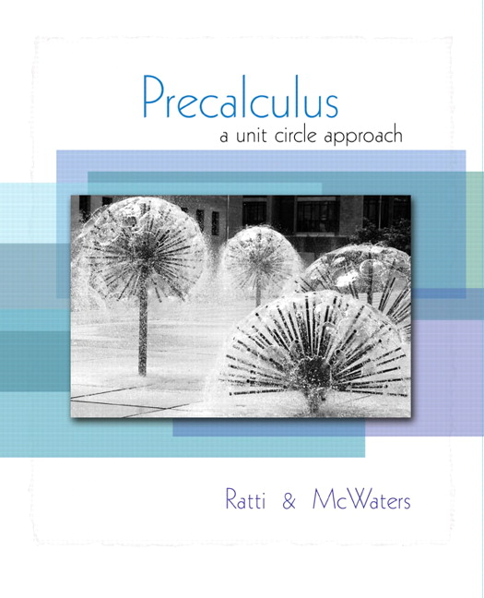


Chapter 4
Trigonometric
Functions
© 2010 Pearson Education, Inc.
All rights reserved

Slide 2
Inverse Trigonometric Functions
SECTION 4.6
Graph and apply the inverse sine function.
Graph and apply the inverse cosine function.
Graph and apply the inverse tangent function.
Evaluate inverse trigonometric functions using a calculator.
Find exact values of composite functions involving the inverse trigonometric functions.
1
2
3
4
5

Slide 3
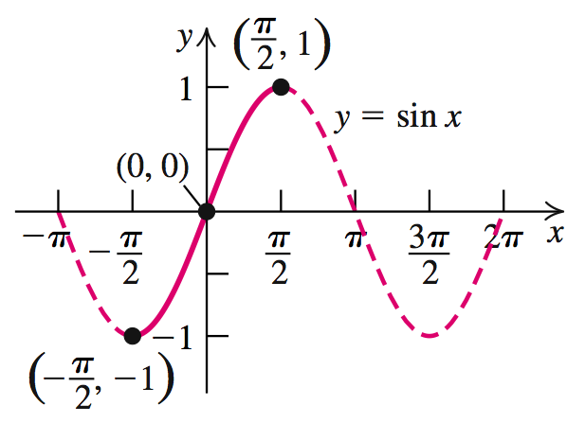
INVERSE SINE FUNCTION
If we restrict the domain of y = sin x to the
interval ,
then it is a one-to-one function and its inverse is also a function.

Slide 4
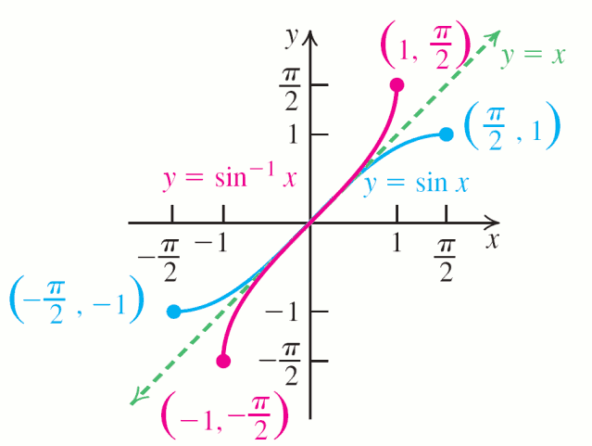
INVERSE SINE FUNCTION
The inverse function for y = sin x,
is called the inverse sine, or arcsine,
function.
The graph is obtained by reflecting the graph of y = sin x, for
in the line y = x.

Slide 5
INVERSE SINE FUNCTION
y = sin–1 x means sin y = x,
where –1 ≤ x ≤ 1 and
Read y = sin–1 x as “y equals inverse sine at x.”
The domain of y = sin–1 x is [–1, 1].
The range of y = sin–1 x is

Slide 6
EXAMPLE 1
Finding the Exact Value for y = sin–1 x
Find the exact values of y.
Solution

Slide 7
EXAMPLE 1
Finding the Exact Value for y = sin–1 x
Solution continued
c. Since 3 is not in the domain of the inverse sine function, which is [–1, 1], sin–1 3 does not exist.

Slide 8
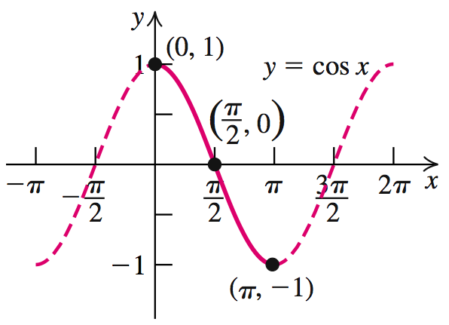
INVERSE COSINE FUNCTION
If we restrict the domain of y = cos x to the
interval [0, π], then it is a one-to-one function and its inverse is also a function.

Slide 9
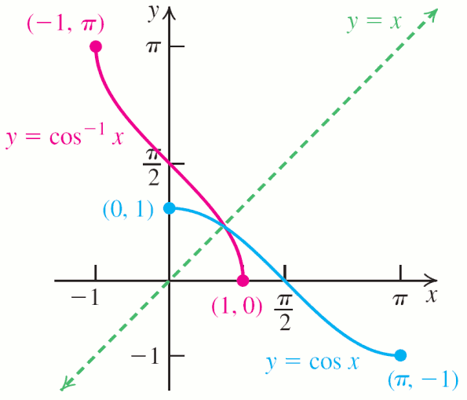
INVERSE COSINE FUNCTION
The inverse function for y = cos x,
is called the inverse cosine, or arccosine, function.
The graph is obtained by reflecting the graph of y = cos x, with
in the line y = x.

Slide 10
INVERSE COSINE FUNCTION
y = cos–1 x means cos y = x,
where –1 ≤ x ≤ 1 and
Read y = cos–1 x as “y equals inverse cosine at x.”
The domain of y = cos–1 x is [–1, 1].
The range of y = cos–1 x is

Slide 11
EXAMPLE 2
Finding the Exact Value for cos–1 x
Find the exact values of y.
Solution

Slide 12
EXAMPLE 2
Finding the Exact Value for cos–1 x
Solution continued

Slide 13
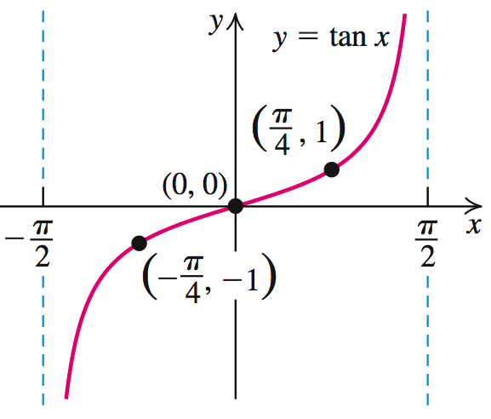
INVERSE TANGENT FUNCTION
If we restrict the domain of y = tan x to the interval
, then
it is a one-to-one function and its inverse is also a function.

Slide 14
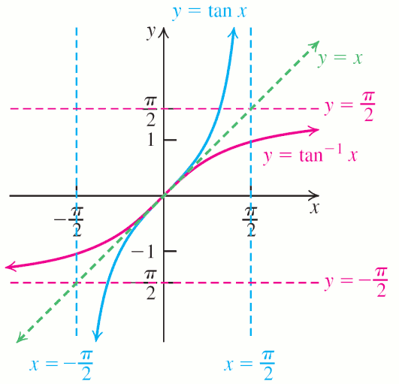
INVERSE TANGENT FUNCTION
The inverse function for y = tan x,
is called the inverse tangent, or arctangent, function.
The graph is obtained by reflecting the graph of y = tan x, with
in the
line y = x.

Slide 15
INVERSE TANGENT FUNCTION
y = tan–1 x means tan y = x,
where –∞ ≤ x ≤ ∞ and
Read y = tan–1 x as “y equals inverse tangent at x.”
The domain of y = tan–1 x is [–∞, ∞].
The range of y = tan–1 x is

Slide 16
EXAMPLE 3
Finding the Exact Value for tan–1 x
Find the exact values of y.
Solution

Slide 17
EXAMPLE 3
Finding the Exact Value for tan–1 x
Solution continued

Slide 18
INVERSE COTANGENT FUNCTION
y = cot–1 x means cot y = x,
where –∞ ≤ x ≤ ∞ and
INVERSE COSECANT FUNCTION
y = csc–1 x means csc y = x,
where |x| ≥ 1 and
INVERSE SECANT FUNCTION
y = sec–1 x means sec y = x,
where |x| ≥ 1 and

Slide 19



EXAMPLE 4
Finding the Exact Value for csc–1 x
Find the exact for y = csc−1 2.
Solution
Since and we have y = csc−1 2 =

Slide 20
USING A CALCULATOR WITH INVERSE TRIGONOMETRIC FUNCTIONS
To find csc–1 x find
To find sec–1 x find
To find cot–1 x start by finding
If x ≥ 0, this is the correct value.
If x < 0, add π to get the correct value.

Slide 21
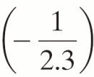
Using a Calculator to Find the Values of Inverse Functions
EXAMPLE 5
Use a calculator to find the value of y in radians rounded to four decimal places.
c. y = cot−1 (−2.3)
Solution
Set the calculator to Radian mode.
c. y = cot−1 (−2.3) = π + tan−1 ≈ 2.7315

Slide 22
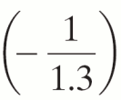
Using a Calculator to Find the Values of Inverse Functions
EXAMPLE 6
Use a calculator to find the value of y in degrees rounded to four decimal places.
c. y = cot−1 (−1.3)
Solution
Set the calculator to Degree mode.
c. y = cot−1 (−1.3) = 180º + tan−1
≈ 142.4314º

Slide 23
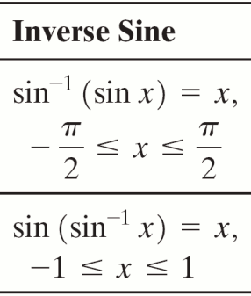
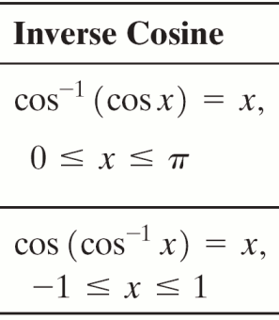
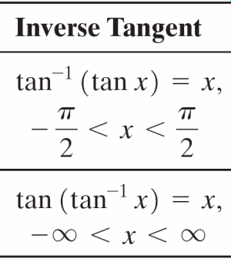
COMPOSITION OF TRIGONOMETRIC AND INVERSE TRIGONOMETRIC FUNCTIONS

Slide 24
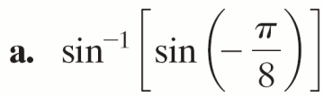
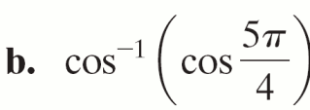

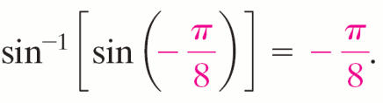
Finding the Exact Value of sin−1 (sin x) and cos−1 (cos x)
EXAMPLE 7
Find the exact value of
Solution
a. Because we have

Slide 25

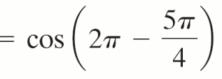

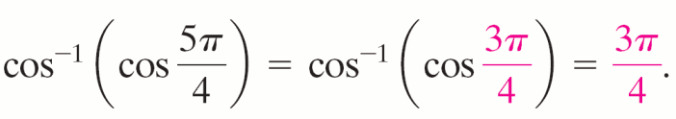
Finding the Exact Value of sin−1 (sin x) and cos−1 (cos x)
EXAMPLE 7
Solution continued
b. is not in the interval [0, π], but
cos .
So,

Slide 26
Finding the Exact Value of a Composite Trigonometric Expression
EXAMPLE 8
Find the exact value of
Solution
a. Let θ represent the radian measure of the
angle in
with
Since tan θ is positive, θ must be positive,

Slide 27
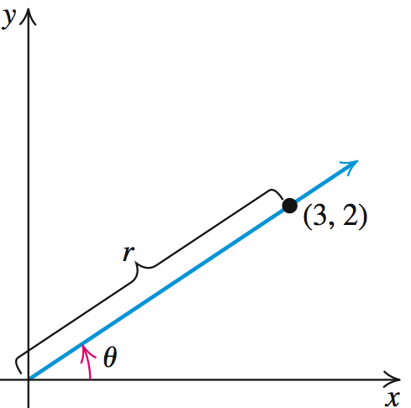
Finding the Exact Value of a Composite Trigonometric Expression
EXAMPLE 8
Solution continued
So x = 3 and y = 2.

Slide 28
Finding the Exact Value of a Composite Trigonometric Expression
EXAMPLE 8
Find the exact value of
Solution
b. Let θ represent the radian measure of the
angle in
with
Since cos θ is negative, we have

Slide 29
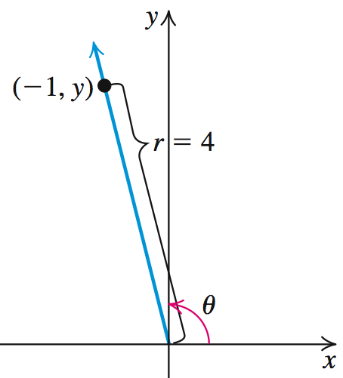
Finding the Exact Value of a Composite Trigonometric Expression
EXAMPLE 8
Solution continued
So x = –1 and r = 4.

Slide 30
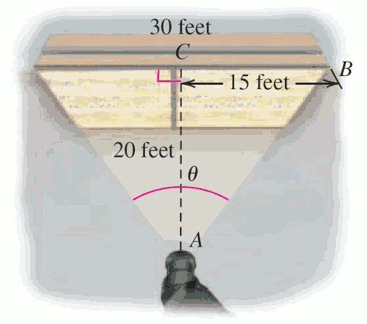
Finding the Rotation Angle for a Security Camera
EXAMPLE 9
A security camera is to be installed 20 feet away from the center of a jewelry counter. The counter is 30 feet long.
What angle, to the
nearest degree, should
the camera rotate
through so that it scans
the entire counter?

Slide 31
Finding the Rotation Angle for a Security Camera
EXAMPLE 9
Solution
The counter center , the camera , and a counter end form a right triangle.
The angle at vertex A
is where θ is the
angle through which the camera rotates.

Slide 32
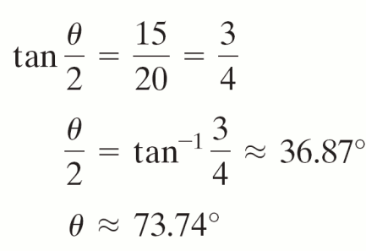
Finding the Rotation Angle for a Security Camera
EXAMPLE 9
Solution continued
Set the camera to 74º rotate through to scan the entire counter.

