Slide 1
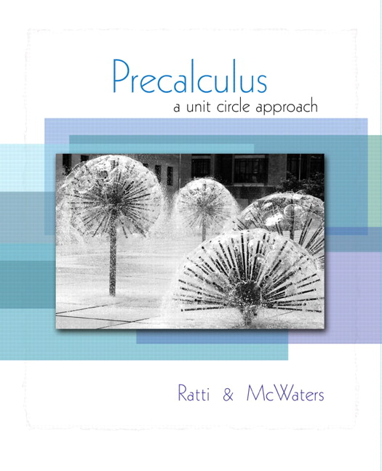


Chapter 5
Analytic
Trigonometry
© 2010 Pearson Education, Inc.
All rights reserved

Slide 2
Trigonometric Identities and Equations
SECTION 5.1
Use fundamental trigonometric identities to evaluate trigonometric functions.
Simplify a complicated trigonometric expression.
Prove that a given equation is not an identity.
Verify a trigonometric identity.
1
2
3
4

Slide 3
FUNDAMENTAL TRIGONOMETRIC IDENTITIES
1. Reciprocal Identities
2. Quotient Identities

Slide 4
FUNDAMENTAL TRIGONOMETRIC IDENTITIES
3. Pythagorean Identities
4. Even - Odd Identities

Slide 5


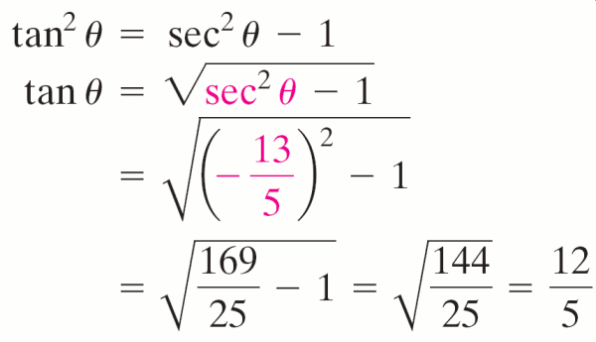
EXAMPLE 1
Using a Pythagorean Identity
If find tan θ.
Solution
Since
Because θ is in quadrant III, tan θ is positive.

Slide 6
Using the Fundamental Trigonometric Identities
EXAMPLE 2
If find the values of the remaining trigonometric functions.
Solution
x is in QIII
csc is negative

Slide 7
Using the Fundamental Trigonometric Identities
EXAMPLE 2
Solution continued

Slide 8
Expressing All Trigonometric Functions in Terms of Sines and Cosines
EXAMPLE 3
Write in terms of sines and cosines and then simplify the resulting expression.
Solution

Slide 9
Expressing All Trigonometric Functions in Terms of Sines and Cosines
EXAMPLE 3
Solution continued

Slide 10
EXAMPLE 4
Proving That an Equation Is Not an Identity
Prove is not an identity.
Solution
Let x = 0. Then sin 0 = 0 and cos 0 = 1.
Left side = (sin 0 – cos 0)2 = (0 – 1)2 = 1
Right side = sin2 0 – cos2 0 = 02 – 12 = –1
For x = 0, the equation’s two sides are not equal; so it is not an identity.

Slide 11
VERIFYING TRIGONOMETRIC IDENTITIES
To verify that an equation is an identity, transform one side of the equation into the other side by a sequence of steps, each of which produces an identity. The steps involved can be algebraic manipulations or can use known identities.
Note that in verifying an identity, we do not just perform the same operation on both sides of the equation.

Slide 12
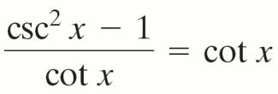
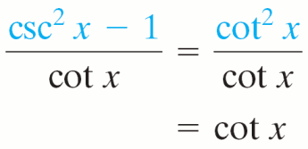
EXAMPLE 5
Verifying an Identity
Verify the identity:
Solution
Start with the left side:
The left side of the equation is equal to the right side; this verifies the identity.

Slide 13
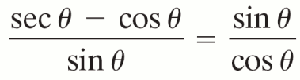
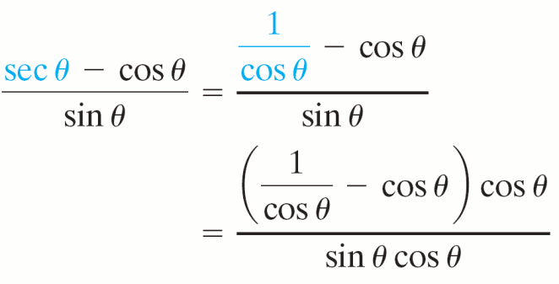
EXAMPLE 6
Verifying an Identity
Verify the identity:
Solution
Start with the left side:

Slide 14
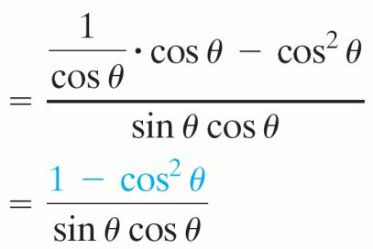
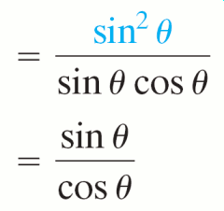
EXAMPLE 6
Verifying an Identity
Solution continued
The left side is identical to the right side; the given equation is an identity.

Slide 15
Verifying by Rewriting with Sines and Cosines
EXAMPLE 7
Verify the identity:
Solution
Start with the more complicated left side.

Slide 16
Verifying by Rewriting with Sines and Cosines
EXAMPLE 7
Solution continued
Because the left side is identical to the right side, the given equation is an identity.

Slide 17
Verifying by Rewriting with Sines and Cosines
EXAMPLE 7
Solution continued
Here’s another way to verify this identity.
Factor the left side.
Rewriting expressions using only sines and cosines is not necessarily the quickest way to verify an identity, but it may help if you are stuck.

Slide 18
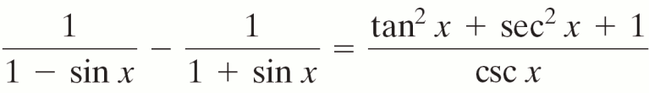
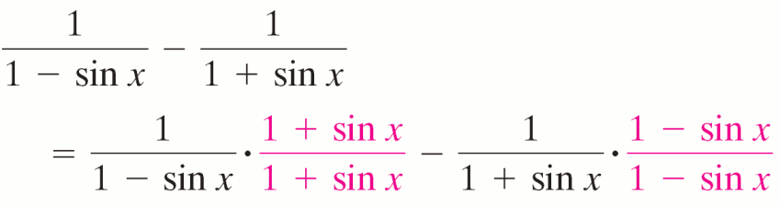
Verifying an Identity by Transforming Both Sides Separately
EXAMPLE 8
Verify the identity:
Solution
Start with the left side.

Slide 19
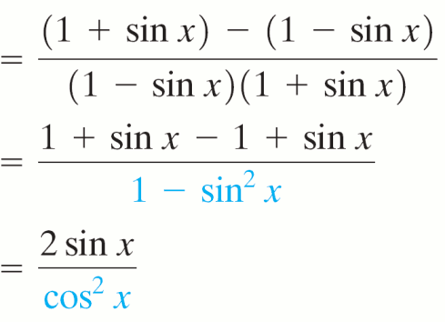
Verifying an Identity by Transforming Both Sides Separately
EXAMPLE 8
Solution continued
Now try to convert the right side to the same form.

Slide 20
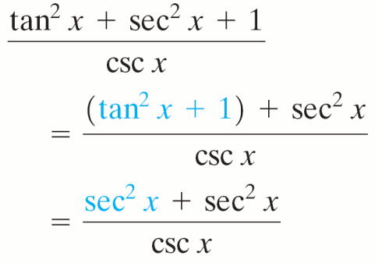
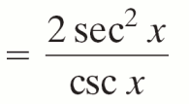
Verifying an Identity by Transforming Both Sides Separately
EXAMPLE 8
Solution continued

Slide 21
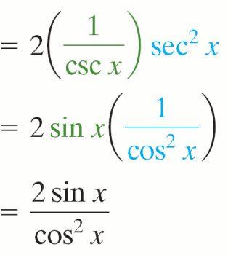
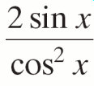
Verifying an Identity by Transforming Both Sides Separately
EXAMPLE 8
Solution continued
Because both sides of the original equation
are equal to , the
identity is verified.

Slide 22
EXAMPLE 9
Verifying an Identity by Using a Conjugate
Verify the identity:
Solution
Start with the left side.

Slide 23
Guidelines for Verifying Trigonometric Identities
Algebra Operations
Review the procedure for combining fractions by finding the least common denominator.
Fundamental Trigonometric Identities
Review the fundamental trigonometric identities. Look for an opportunity to apply the fundamental trigonometric identities when working on either side of the identity to be verified. Become thoroughly familiar with alternative forms of fundamental identities.

Slide 24
Guidelines for Verifying Trigonometric Identities
Start with the more complicated side.
If one side of an identity is more complex than the other side, it is generally helpful to start with the more complicated side and simplify it until it becomes identical to the other side.
Stay focused on the final expression.
While working on one side of the identity, stay focused on your goal of converting it to the form on the other side.

Slide 25
Guidelines for Verifying Trigonometric Identities
Option: Convert to sines and cosines.
Writing one side of the identity in terms of sines and cosines is often helpful.
Option: Work on both sides.
Sometimes, it is helpful to work separately on both sides of the equation to transform each side to the same equivalent expression.

Slide 26
Guidelines for Verifying Trigonometric Identities
Option: Use conjugates.
In expressions containing 1 + sin x, 1 – sin x, 1 + cos x, 1 – cos x, sec x + tan x, and so on, it is often helpful to multiply both the numerator and the denominator by the appropriate conjugate and then use one of the forms of the Pythagorean identities.

