Slide 1
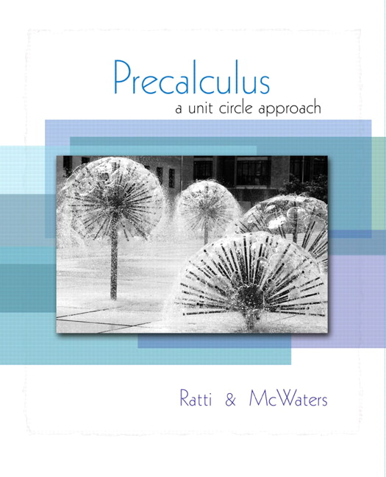


Chapter 5
Analytic
Trigonometry
© 2010 Pearson Education, Inc.
All rights reserved

Slide 2
Trigonometric Equations
SECTION 5.2
1
Solve trigonometric equations of the form a sin (x − c) = k, a cos (x − c) = k, and a sin (x − c) = k
Solve trigonometric equations involving multiple angles.
Solve trigonometric equations by using the zero-product property.
Solve trigonometric equations that contain more than one trigonometric function.
Solve trigonometric equations by squaring both sides.
2
3
4
5

Slide 3
TRIGONOMETRIC EQUATIONS
A trigonometric equation is an equation that contains a trigonometric function with a variable.
Equations that are true for all values in the domain of the variable are called identities.
Solving a trigonometric equation means to find its solution set.

Slide 4
EXAMPLE 1
Solving a Trigonometric Equation
Find all solutions of each equation. Express all solutions in radians.

Slide 5



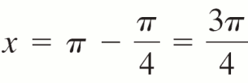
EXAMPLE 1
Solving a Trigonometric Equation
Solution
First find all solutions in [0, 2π).
We know and sin x > 0 only in quadrants I and II.
QI and QII angles with reference angles of are: and

Slide 6


EXAMPLE 1
Solving a Trigonometric Equation
Solution continued
Since sin x has a period of 2π, all solutions of the equation are given by
or
for any integer n.

Slide 7
EXAMPLE 1
Solving a Trigonometric Equation
Solution
First find all solutions in [0, 2π).
We know and cos x < 0 only in quadrants II and III.
QII and QIII angles with reference angles of are: and

Slide 8
EXAMPLE 1
Solving a Trigonometric Equation
Solution continued
Since cos x has a period of 2π, all solutions of the equation are given by
or
for any integer n.

Slide 9
EXAMPLE 1
Solving a Trigonometric Equation
Solution
Because tan x has a period of π, first find all solutions in [0, π).
We know and tan x < 0 only in quadrant II.
The QII angle with a reference angle of is:

Slide 10
EXAMPLE 1
Solving a Trigonometric Equation
Solution continued
Since tan x has a period of π, all solutions of the equation are given by
for any integer n.

Slide 11
EXAMPLE 3
Solving a Linear Trigonometric Equation
Find all solutions in the interval [0, 2π) of the equation:
Solution
Replace
by θ in the given equation.
We know
sinθ > 0 in Q I and II

Slide 12
EXAMPLE 3
Solving a Linear Trigonometric Equation
Solution continued
or
Solution set in [0, 2π) is

Slide 13
EXAMPLE 4
Solving a Trigonometric Equation Containing Multiple Angles
Find all solutions of the equation in the interval [0, 2π).
Solution
Recall
cosθ > 0 in Q I and IV,
so
The period of cos x is 2π. Replace θ with 3x.
So
or

Slide 14
EXAMPLE 4
Solving a Trigonometric Equation Containing Multiple Angles
Solution continued
Or
or
To find solutions in the interval [0, 2π), try:
n = –1
n = 0
n = 1

Slide 15
EXAMPLE 4
Solving a Trigonometric Equation Containing Multiple Angles
Solution continued
n = 2
n = 3
Values resulting from n = –1 are too small.
Values resulting from n = 3 are too large.
Solutions we want correspond to n = 0, 1, and 2.
Solution set is

Slide 16
EXAMPLE 7
Solving a Quadratic Trigonometric Equation
Find all solutions of the equation
Express the solutions in radians.
Solution
Factor
No solution because –1 ≤ sinθ ≤ 1.

Slide 17
EXAMPLE 7
Solving a Quadratic Trigonometric Equation
Solution continued
So,
are the only two
solutions in the interval [0, 2π).
Since sinθ has a period of 2π, the solutions are
for any integer n.

Slide 18
EXAMPLE 8
Solving a Trigonometric Equation Using Identities
Find all the solutions of the equation
in the interval [0, 2π).
Solution
Use the Pythagorean identity to rewrite the equation in terms of cosine only.

Slide 19
EXAMPLE 8
Solving a Trigonometric Equation Using Identities
Solution continued
Use the quadratic formula to solve this equation.

Slide 20
EXAMPLE 8
Solving a Trigonometric Equation Using Identities
Solution continued
So,
No solution because –1 ≤ cosθ ≤ 1.
cosθ < 0 in QII, QIII

Slide 21
EXAMPLE 8
Solving a Trigonometric Equation Using Identities
Solution continued
Solution set in the interval [0, 2π) is

Slide 22
EXAMPLE 9
Solving a Trigonometric Equation by Squaring
Find all the solutions in the interval [0, 2π) to the equation
Solution
Square both sides and use identities to convert to an equation containing only sin x.

Slide 23
EXAMPLE 9
Solving a Trigonometric Equation by Squaring
Solution continued

Slide 24
EXAMPLE 9
Solving a Trigonometric Equation by Squaring
Solution continued
Possible solutions are:
Solution set in the interval [0, 2π) is

