Slide 1



Chapter 5
Analytic
Trigonometry
© 2010 Pearson Education, Inc.
All rights reserved

Slide 2
Sum and Difference Formulas
SECTION 5.3
1
Use the sum and difference formulas for cosine.
Know and use cofunction identities.
Use the sum and difference formulas for sine.
Use the sum and difference formulas for tangent.
2
3
4

Slide 3
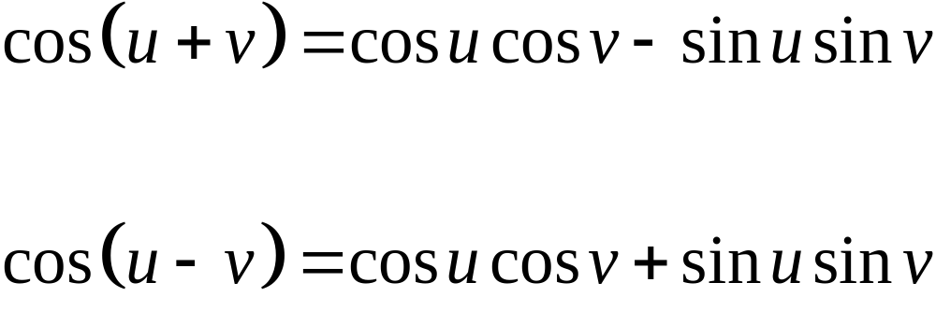
SUM AND DIFFERENCE FORMULAS
FOR COSINE
You will be provided with a total of three sum and difference equations. They each represent a pair of equations

Slide 4
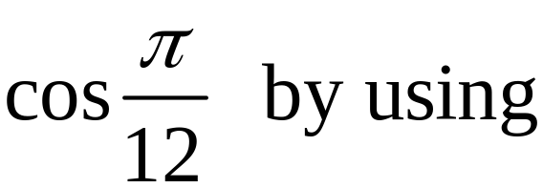
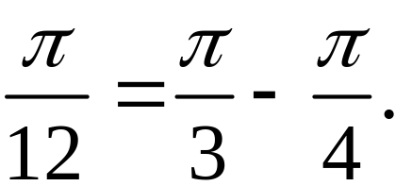
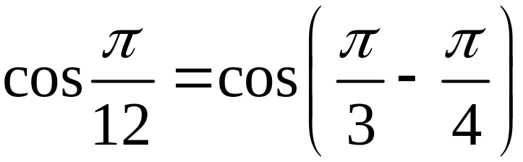
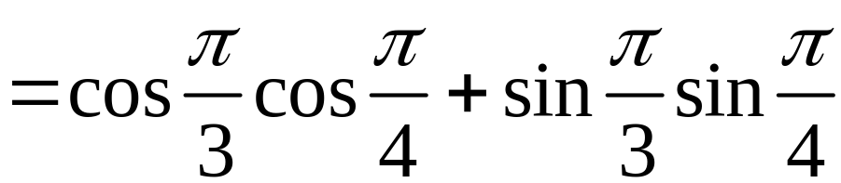
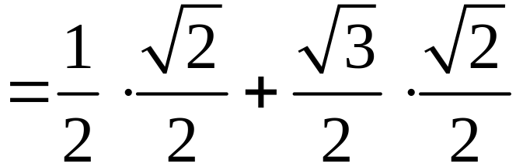
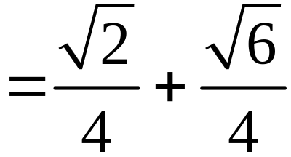
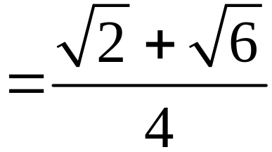
EXAMPLE 1
Using the Difference Formula for Cosine
Find the exact value of
Solution

Slide 5
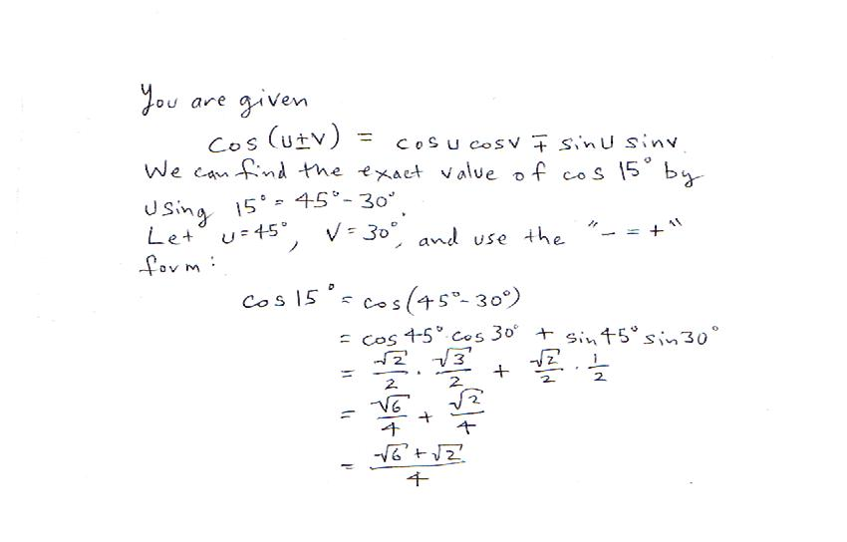

Slide 6
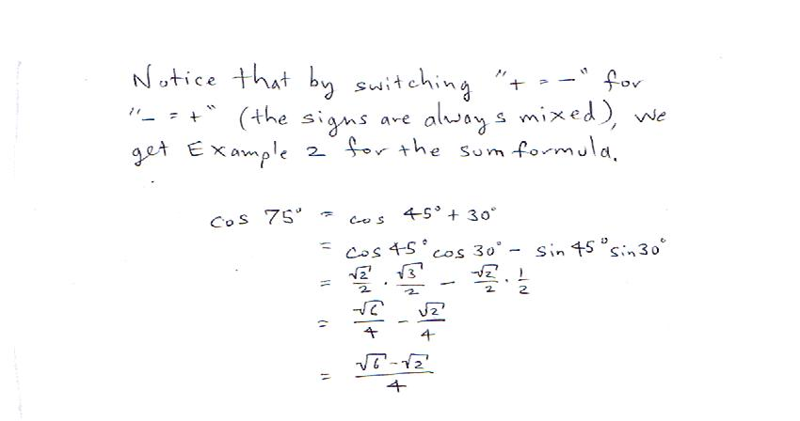

Slide 7
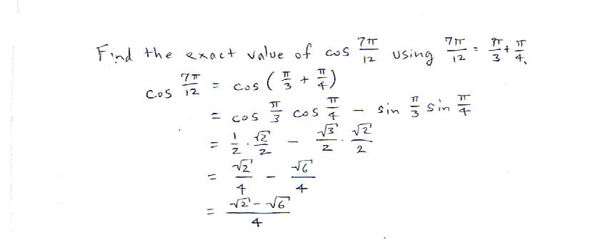
Compare this with Example 1.

Slide 8
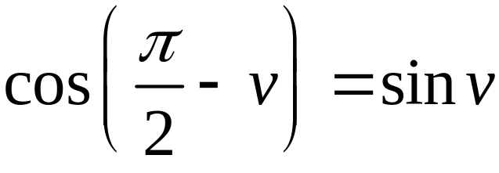
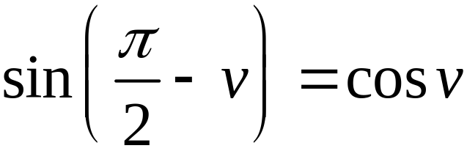

BASIC COFUNCTION IDENTITIES
If v is any real number or angle measured in radians, then
If angle v is measured in degrees, then replace by 90º in these identities.

Slide 9
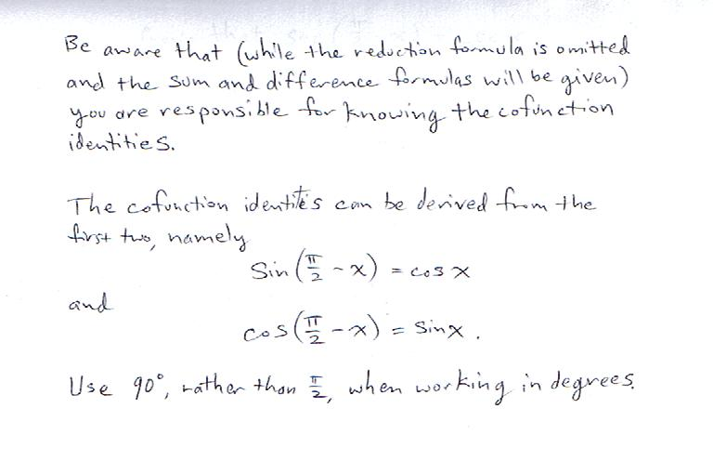

Slide 10
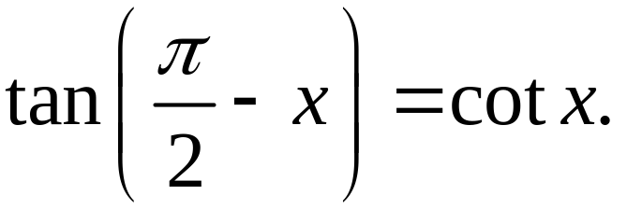
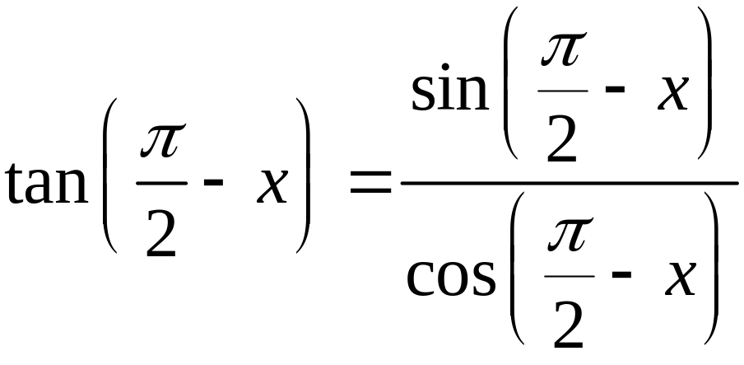
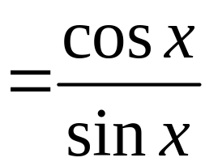

EXAMPLE 3
Using Cofunction Identities
Prove that for any real number x,
Solution

Slide 11
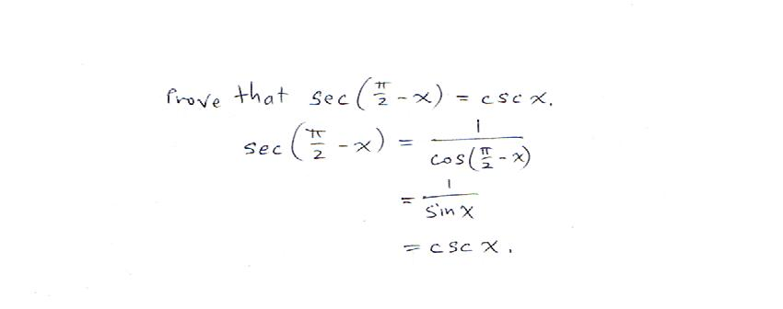

Slide 12
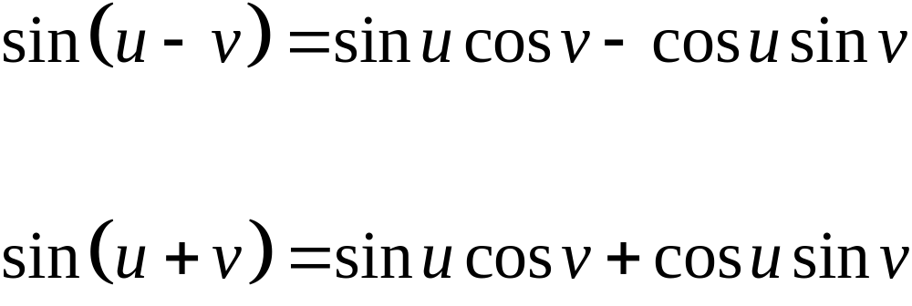
SUM AND DIFFERENCE FORMULAS
FOR SINE

Slide 13
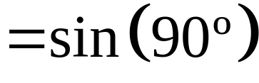

EXAMPLE 5
Using the Sum Formula for Sine
Find the exact value of
without using a calculator.
Solution
This expression is the right side of the sum formula for sine (u + v), where u = 63º and v = 27º.

Slide 14
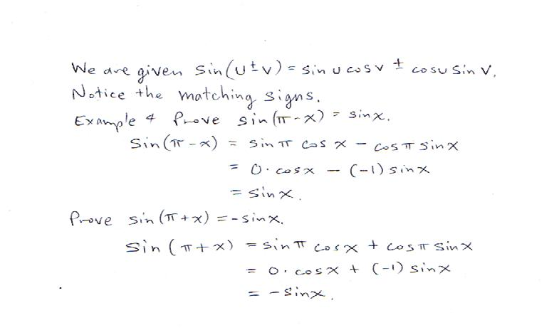

Slide 15
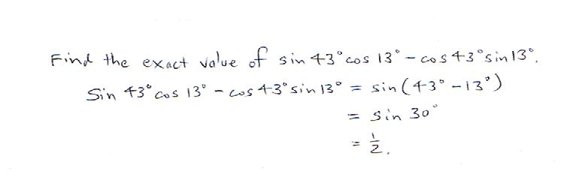

Slide 16
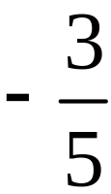

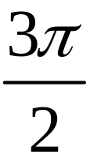
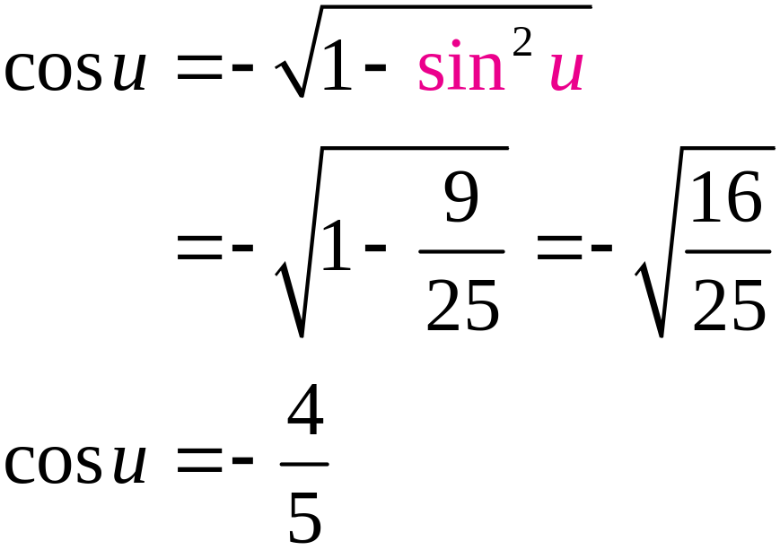
EXAMPLE 6
Finding the Exact Value of a Sum
Let sin u = and cos v = , with π < u < and < v < 2π. Find the exact value of sin (u + v).
Solution
Find cos u.
In QIII, cos < 0.

Slide 17
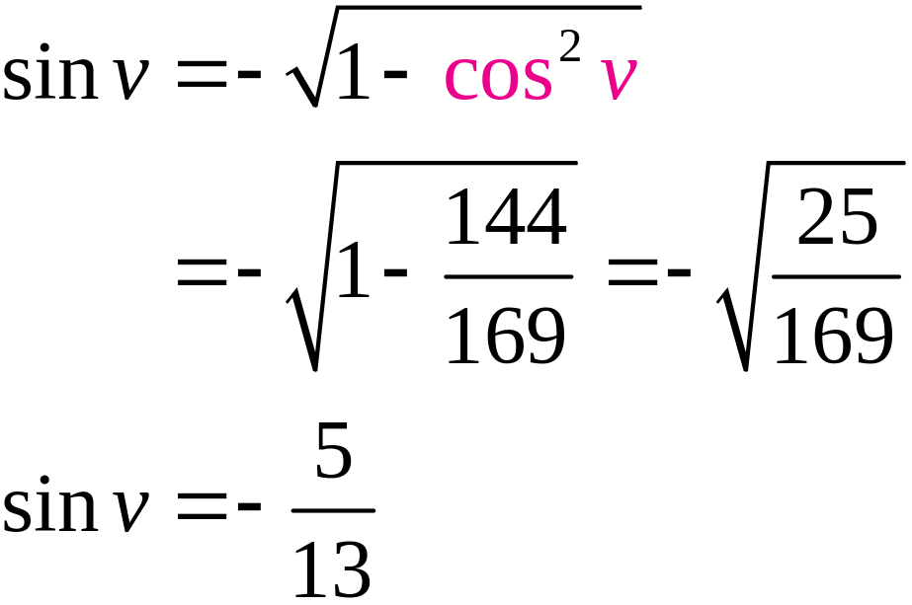
EXAMPLE 6
Finding the Exact Value of a Sum
Solution continued
Find sin v.
In QIV, sin < 0.

Slide 18
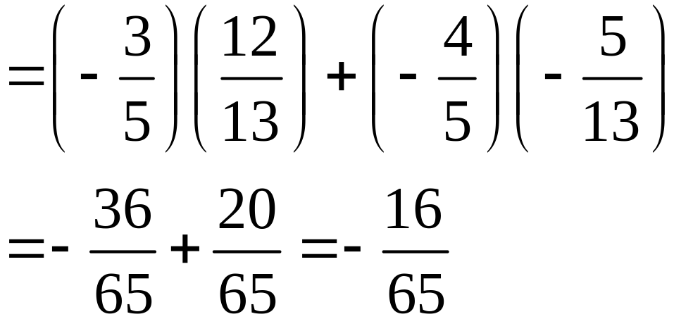
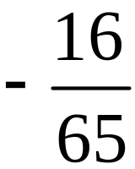
EXAMPLE 6
Finding the Exact Value of a Sum
Solution continued
sin (u + v) = sin u cos v + cos u sin v
The exact value of sin (u + v) is .

Slide 19
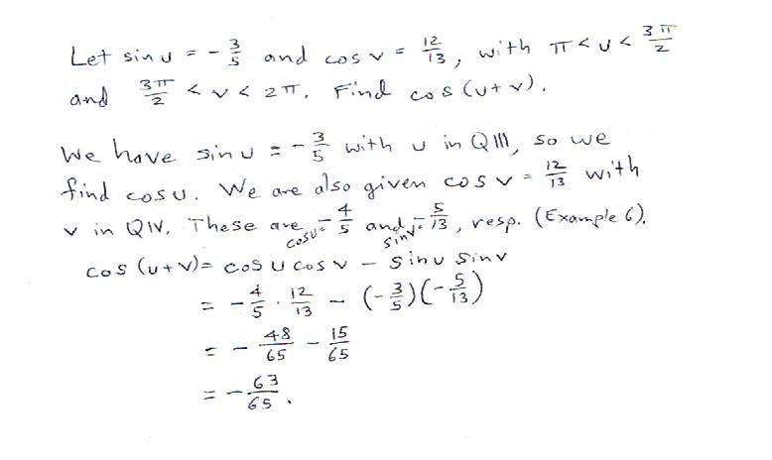

Slide 20
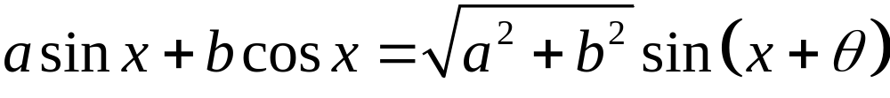
Omit per Dept: REDUCTION FORMULA
If (a, b) is any point on the terminal side of an angle θ (radians) in standard position, then
for any real number x.

Slide 21
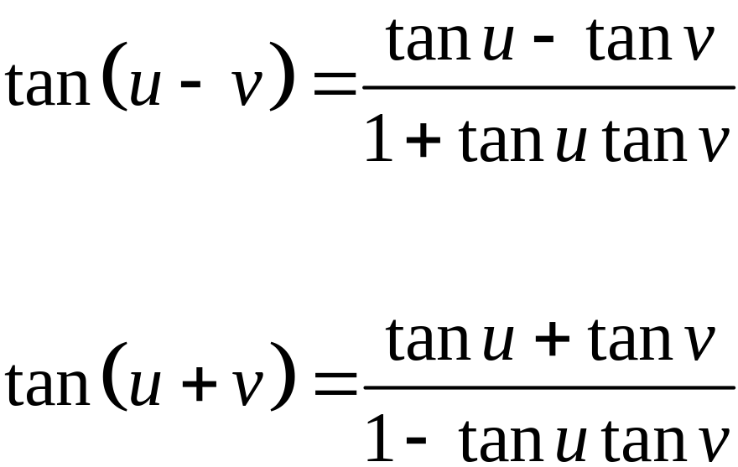
SUM AND DIFFERENCE FORMULAS
FOR TANGENT

Slide 22
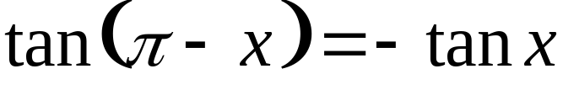
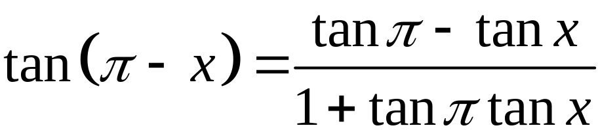
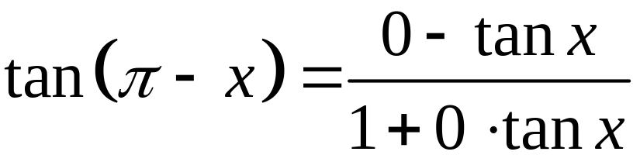

EXAMPLE 11
Verifying an Identity
Verify the identity:
Solution
Apply the difference formula.
Therefore the given equation is an identity.

Slide 23
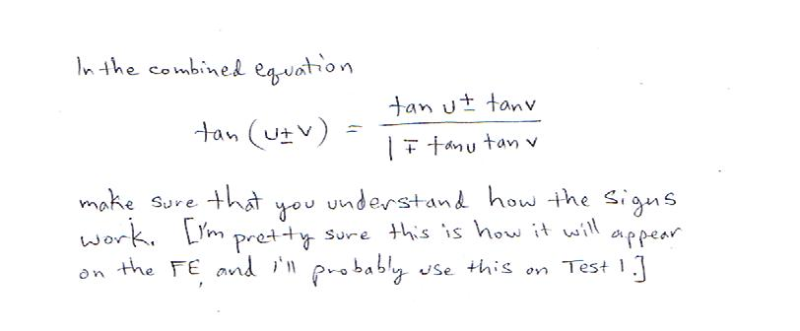

Slide 24
