Slide 1



Chapter 5
Analytic
Trigonometry
© 2010 Pearson Education, Inc.
All rights reserved

Slide 2
Double-Angle and Half-Angle Formulas
SECTION 5.4
1
Use double-angle formulas.
Use power-reducing formulas.
Use half-angle formulas.
Solve trigonometric equations involving multiple angles and half-angles.
2
3
4

Slide 3



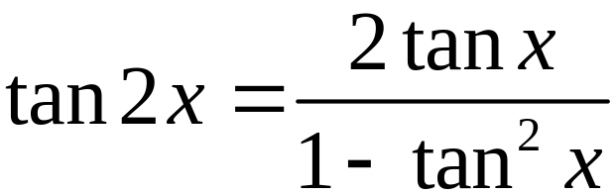

DOUBLE-ANGLE FORMULAS

Slide 4
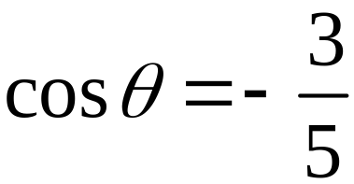



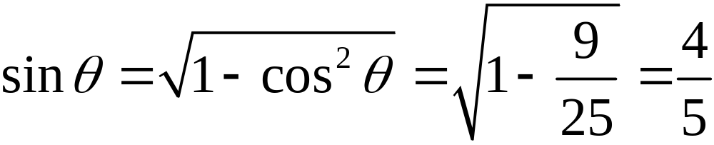
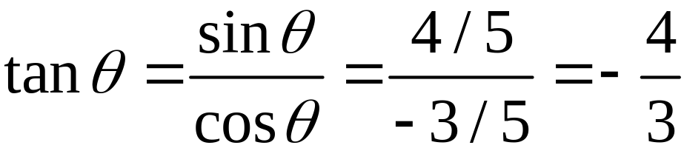
EXAMPLE 1
Using Double-Angle Formulas
If and θ is in quadrant II, find the exact value of each expression.
Solution
Use identities to find sin θ and tan θ.
θ is in QII so sin > 0.

Slide 5

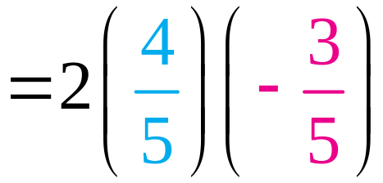
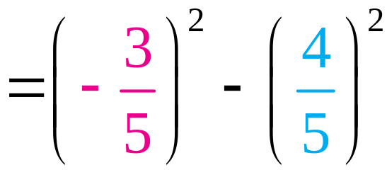
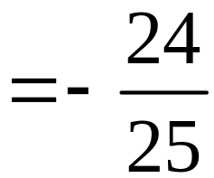
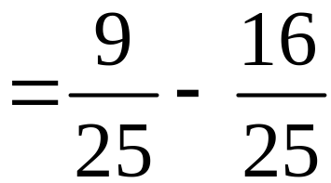
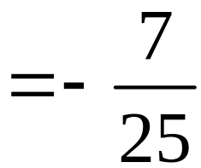
EXAMPLE 1
Using Double-Angle Formulas
Solution continued

Slide 6
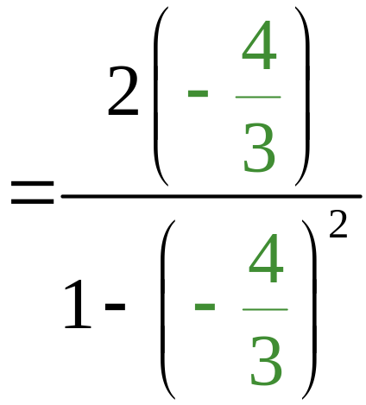
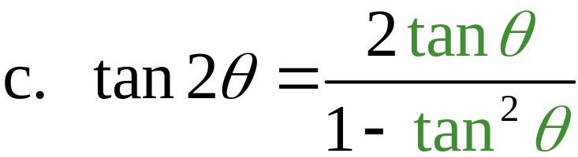
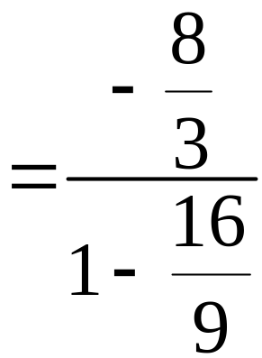
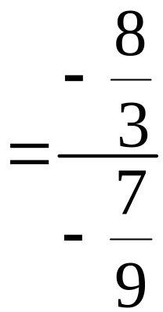
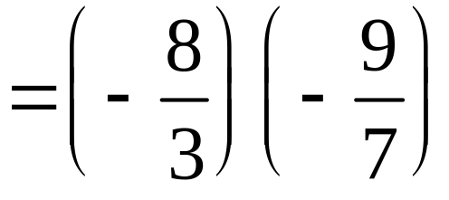
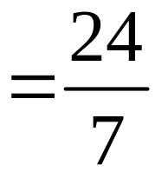
EXAMPLE 1
Using Double-Angle Formulas
Solution continued

Slide 7
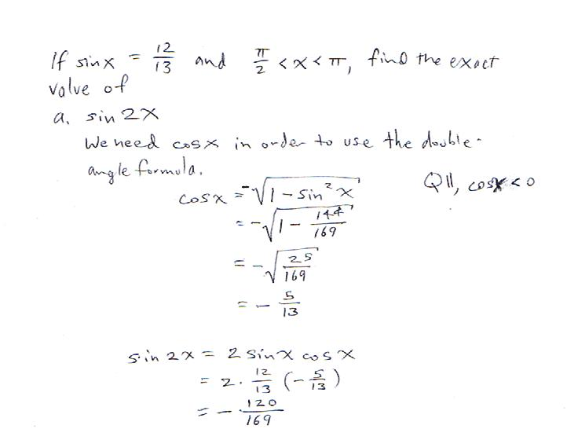

Slide 8
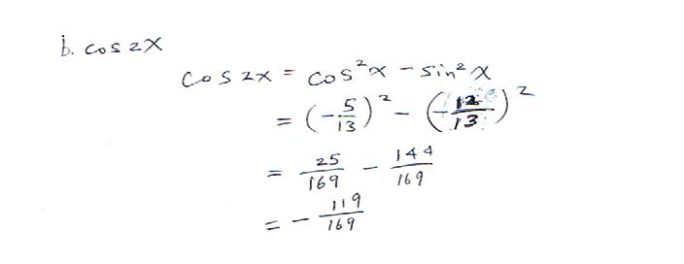

Slide 9
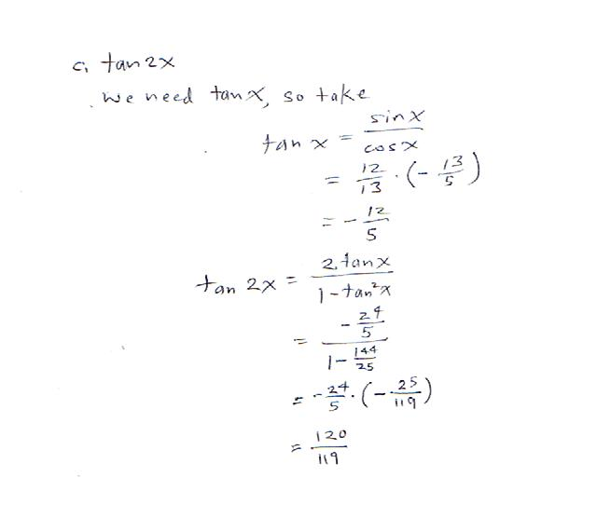

Slide 10
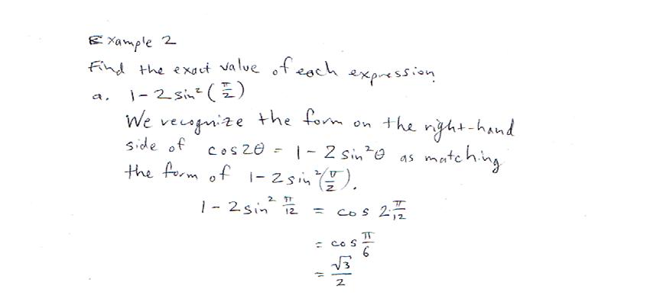

Slide 11
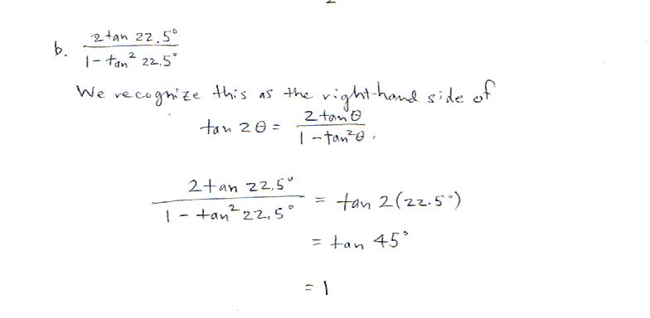

Slide 12
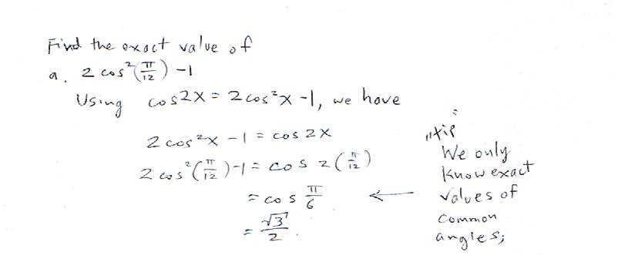

Slide 13
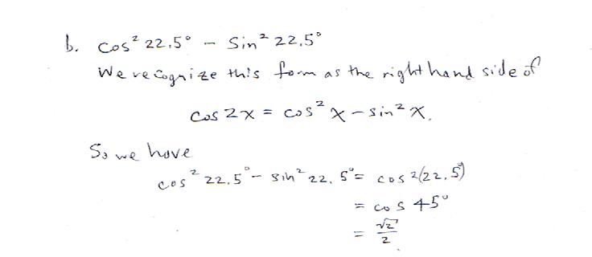

Slide 14
EXAMPLE 3
Finding a Triple-Angle Formula for Sine
Verify the identity sin 3x = 3 sin x – 4 sin3 x.
We choose the sine-squared form since we’re looking for a sine-cubed term.
Solution
sin 3x = sin (2x + x)
= sin 2x cos x + cos 2x sin x
= (2 sin x cos x) cos x + (1 – 2 sin2 x) sin x
= 2 sin x cos2 x + sin x – 2 sin3 x
= 2 sin x (1 – sin2 x) + sin x – 2 sin3 x
= 2 sin x – 2 sin3 x + sin x – 2 sin3 x
= 3 sin x – 4 sin3 x

Slide 15
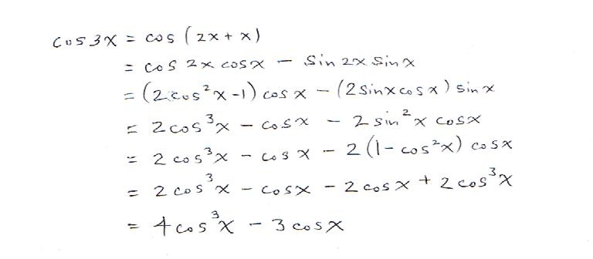

Slide 16
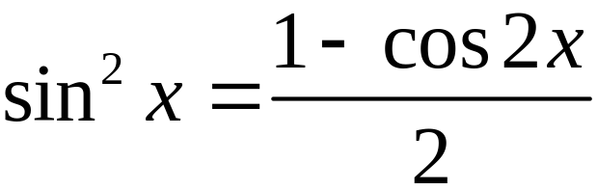
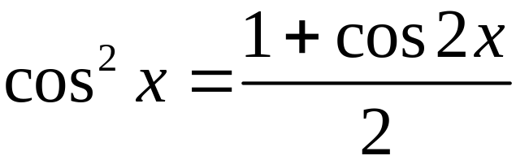
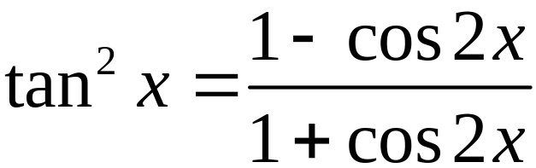
Omit: POWER REDUCING FORMULAS

Slide 17
Examples 4 and 5 omitted

Slide 18
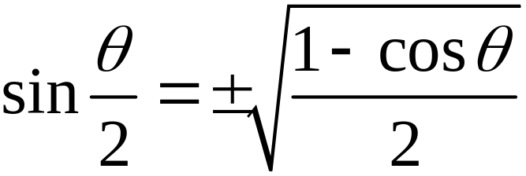
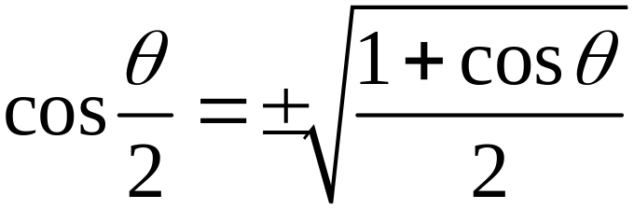
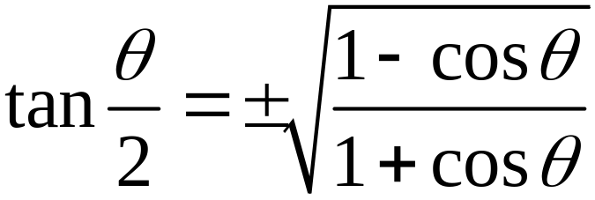

HALF-ANGLE FORMULAS
The sign, + or –, depends on the quadrant in which lies. (Know this detail about sign.)
You will be provided with these three half-angle formulas.

Slide 19
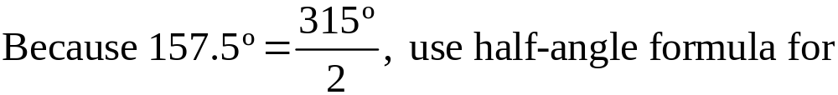
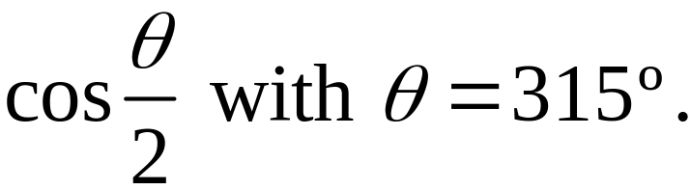
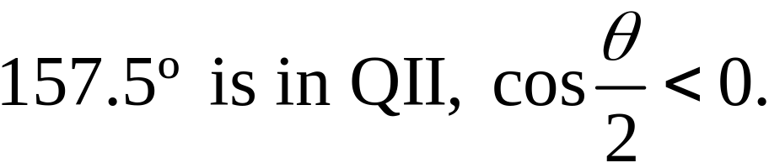
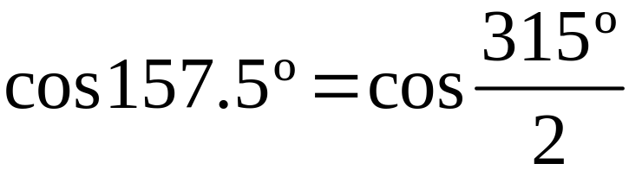
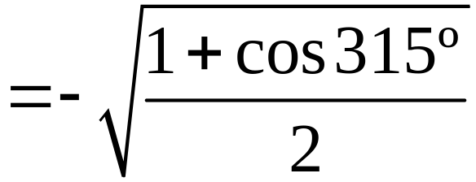
EXAMPLE 6
Using Half-Angle Formulas
Use a half-angle formula to find the exact value of cos 157.5º.
Solution
Important

Slide 20
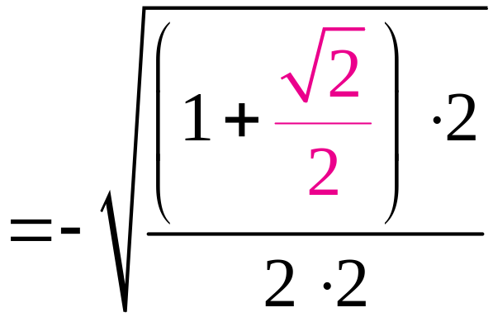
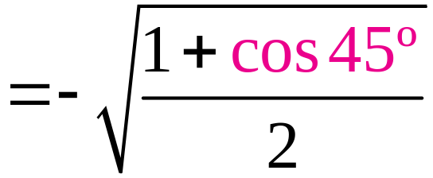
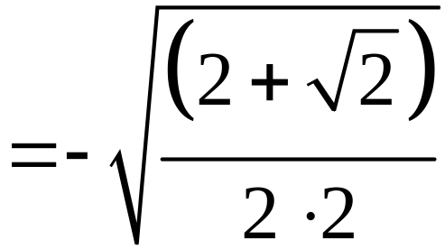
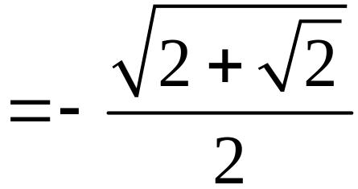
EXAMPLE 6
Using Half-Angle Formulas
Solution continued

Slide 21
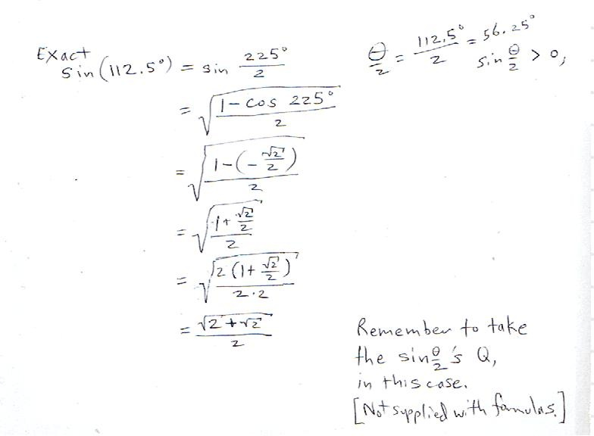

Slide 22
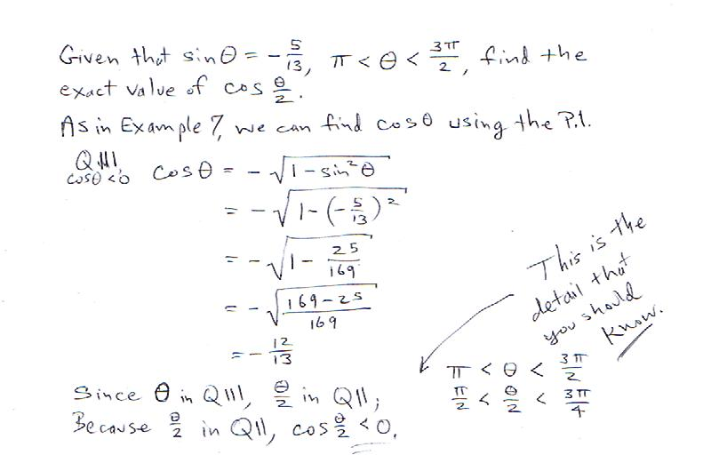

Slide 23
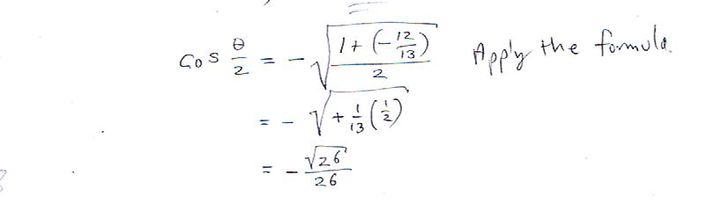

Slide 24
Omit Example 8.

Slide 25


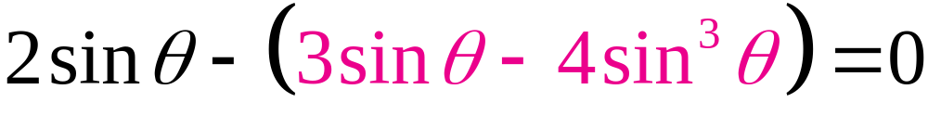

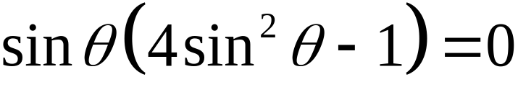
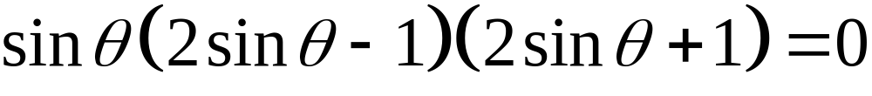
Solving a Trigonometric Equation Involving Multiple Angles
EXAMPLE 9
Find all solutions in the interval [0, 2π) of the equation
Solution

Slide 26



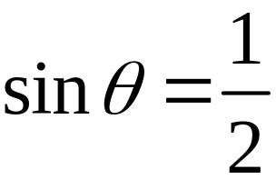
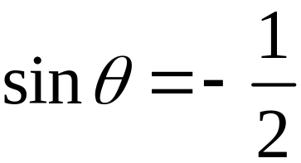
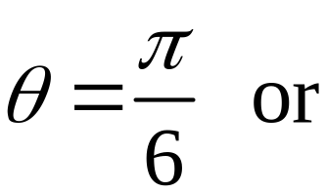
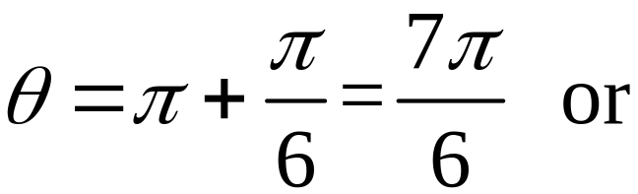

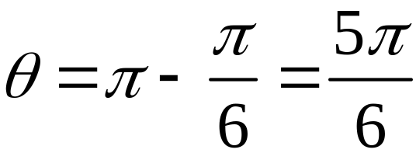
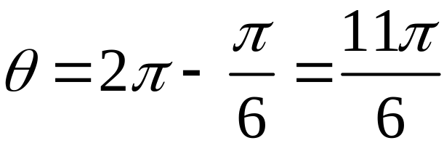


Solving a Trigonometric Equation Involving Multiple Angles
EXAMPLE 9
Solution continued
or
or

Slide 27


Slide 28




Solving a Trigonometric Equation Involving Half-Angles
EXAMPLE 10
Find all solutions in the interval [0, 2π) of the equation
Solution
For x to be a solution in the interval [0, 2π), the value of must be in the interval [0, π).

Slide 29








Solving a Trigonometric Equation Involving Half-Angles
EXAMPLE 10
Solution continued
or

Slide 30

When using a graphing utility, restrict the domain to the interval of interest, as in the example using this problem . .

Slide 31
We are omitting Section 5.5 Product-to-Sum and Sum-to-Product Formulas.
Beside the omitted power reduction formulas and the Sum-and-Difference and Half-Angle Formulas that you will be given, you are to commit to memory the remaining formulas on page 386.
You are not responsible for knowing the eight formulas listed at the top of page 387 (from section 5.5).

Slide 32

the text on the left,
These are the only formulas you will be given for Test I (and the FE for this portion of the material). They are placed together on the final page.
You must know or be able to derive any of the others you may need.
Recall that we had several from Chapter 4, also.

