Slide 1



Chapter 6
Applications of
Trigonometric Functions
© 2010 Pearson Education, Inc.
All rights reserved

Slide 2
Right-Triangle Trigonometry
SECTION 6.1
1
Express the trigonometric functions using a right triangle.
Evaluate trigonometric functions of angles in a right triangle.
Solve right triangles.
Use right-triangle trigonometry in applications.
2
3
4
This material validates the need to be proficient with the P. I. and his various contortions.

Slide 3
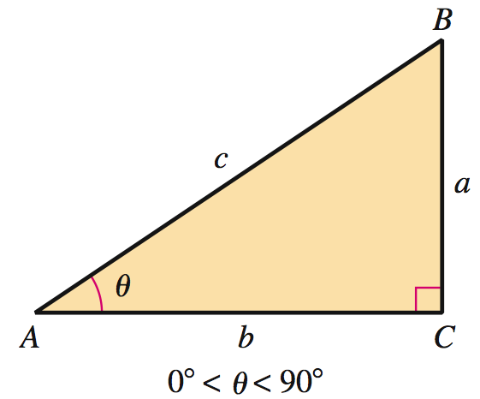
TRIGONOMETRIC RATIOS AND FUNCTIONS
a = length of the side opposite θ
b = length of the side adjacent to θ
c = length of the hypotenuse

Slide 4
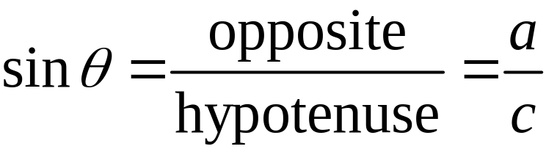
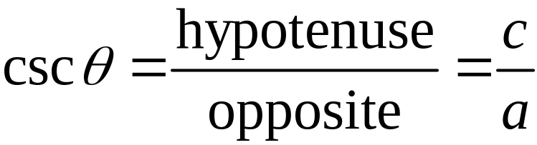
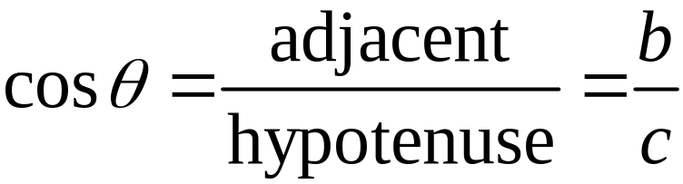
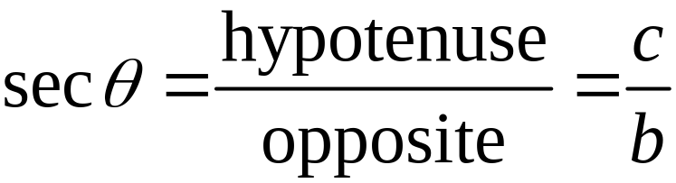
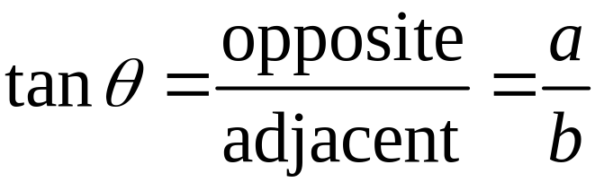
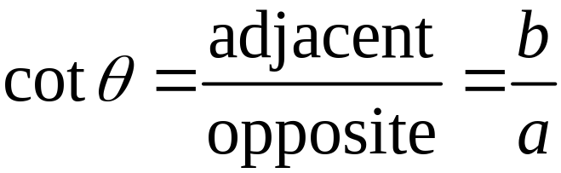
TRIGONOMETRIC FUNCTIONS OF AN ANGLE θ IN A RIGHT TRIANGLE
Remember: s o h c a h t o a

Slide 5
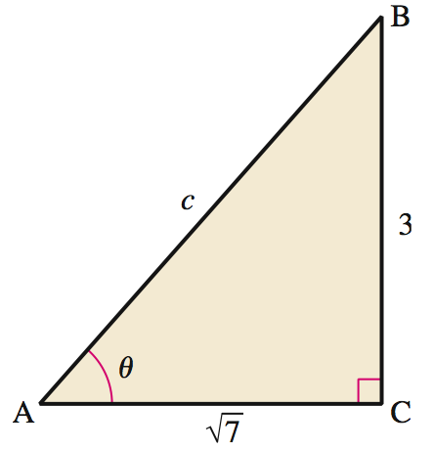
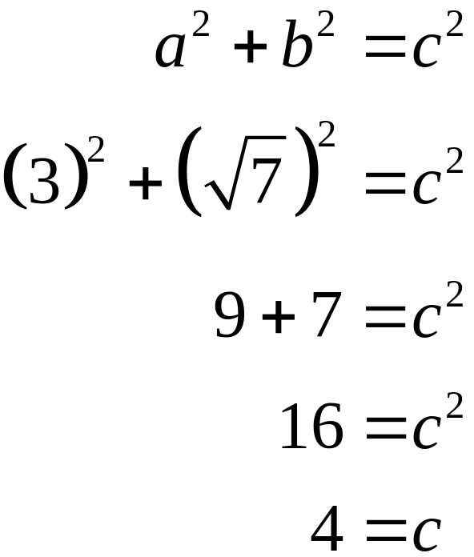
Finding the Values of Trigonometric Functions
EXAMPLE 1
Find the exact values for the six trigonometric functions of the angle θ in the figure.
Solution

Slide 6
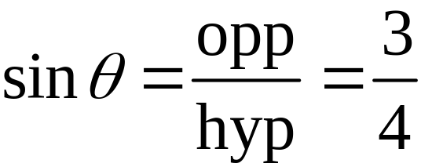
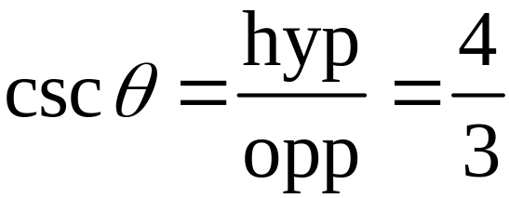
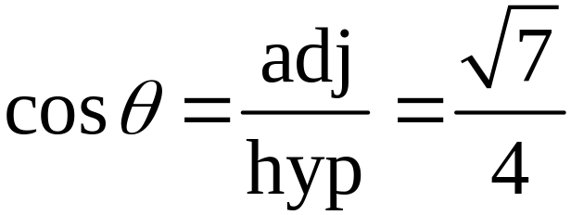
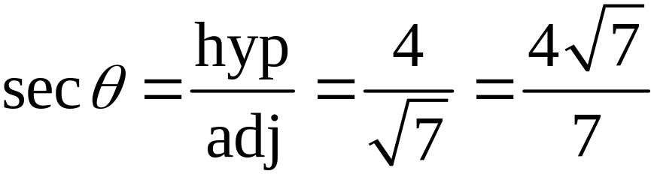
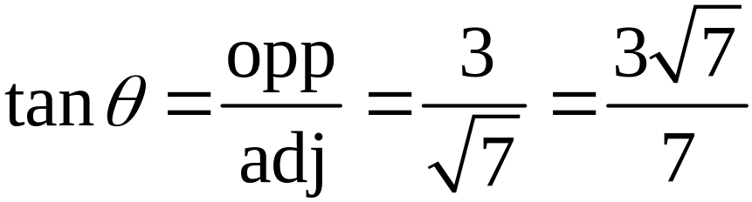
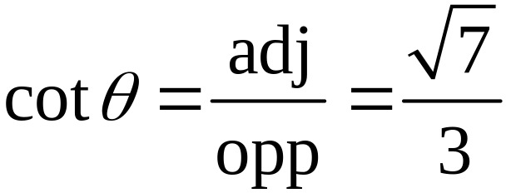
Finding the Values of Trigonometric Functions
EXAMPLE 1
Solution continued

Slide 7

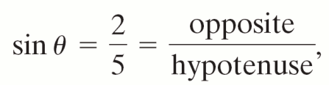
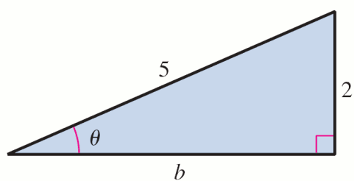
Finding the Remaining Trigonometric Function Values from a Given Value
EXAMPLE 2
Find the other five trigonometric function values of θ, given that θ is an acute angle of the right
triangle with sin θ = .
Solution
Because we draw a
right triangle with hypotenuse
of length 5 and the side
opposite θ of
length 2.

Slide 8
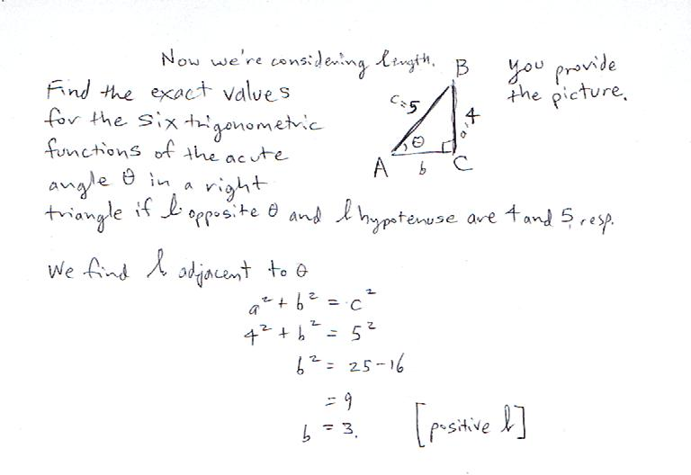

Slide 9
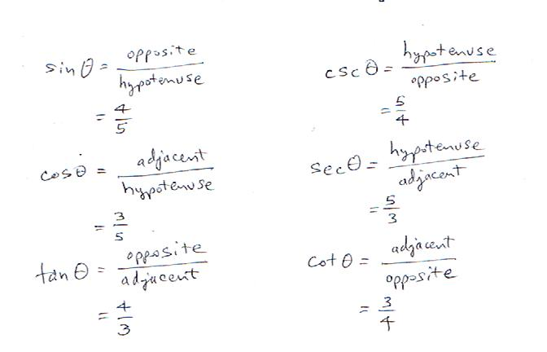

Slide 10
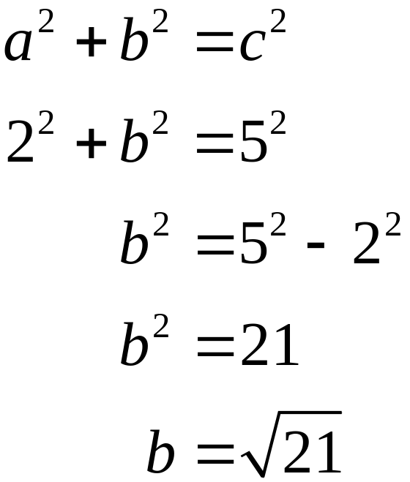
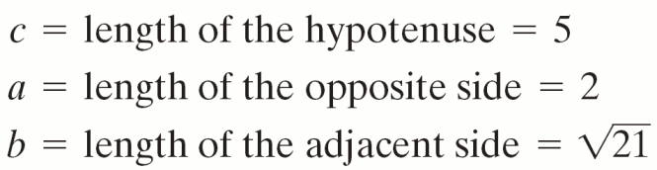
Finding the Remaining Trigonometric Function Values from a Given Value
EXAMPLE 2
Solution continued

Slide 11
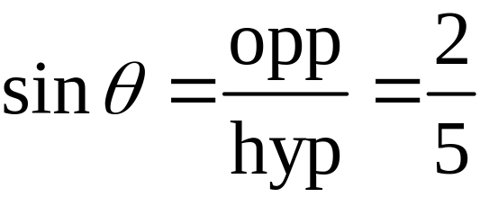
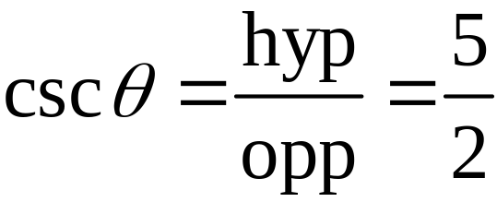
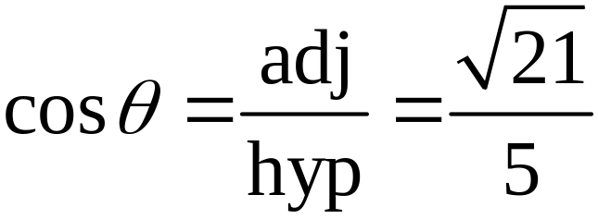
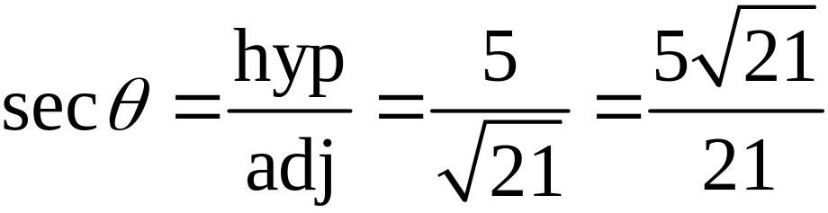
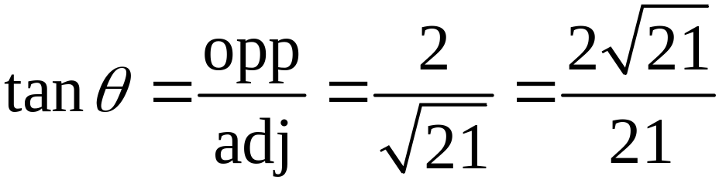
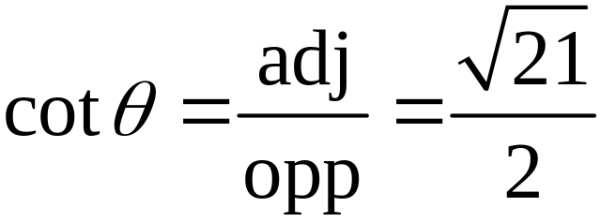
Finding the Remaining Trigonometric Function Values from a Given Value
EXAMPLE 2
Solution continued

Slide 12
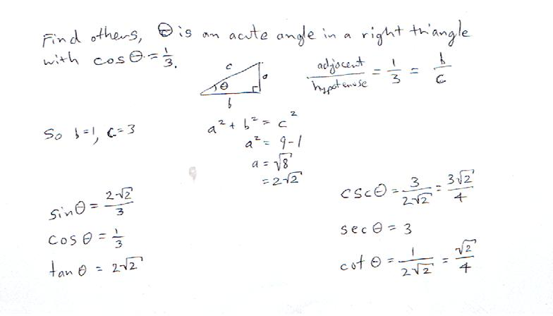

Slide 13
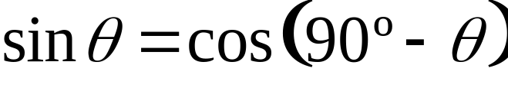
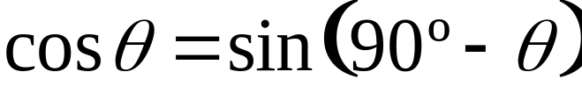
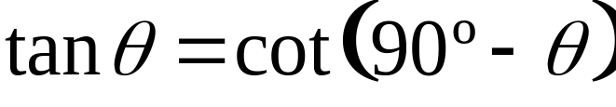
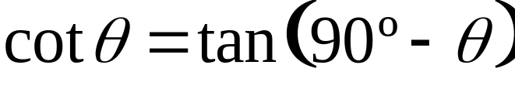
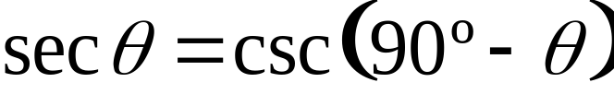
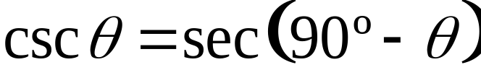
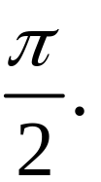
COMPLEMENTARY ANGLES
The value of any trigonometric function of an acute angle θ is equal to the cofunction of the complement of θ. This is true whether θ is measured in degrees or in radians.
θ in degrees
If θ is measured in radians, replace 90º with

Slide 14
Finding Trigonometric Function Values of a Complementary Angle
EXAMPLE 3
Solution

Slide 15
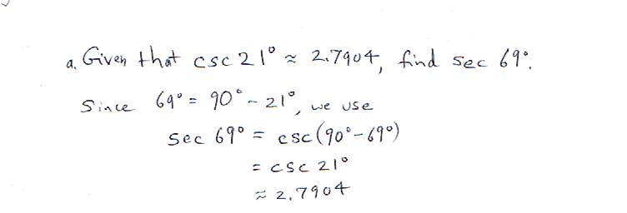

Slide 16
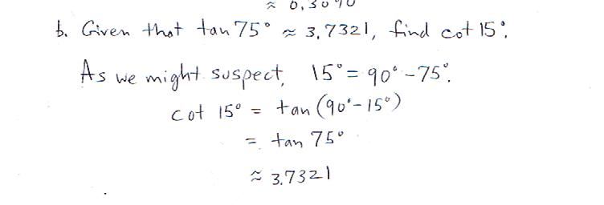

Slide 17
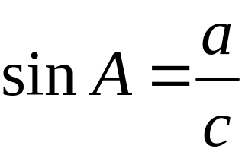
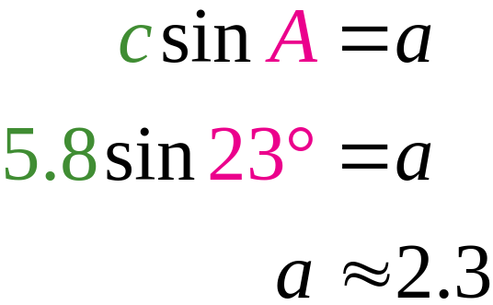
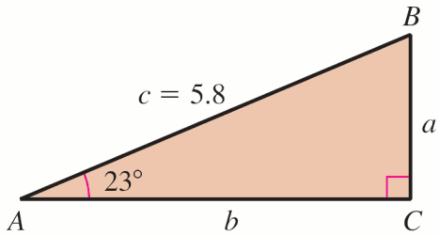
EXAMPLE 4
Solving a Right Triangle, Given One Acute Angle and One Side
Solve right triangle ABC if A = 23º and c = 5.8.
Solution
Sketch triangle ABC.
To find a:

Slide 18
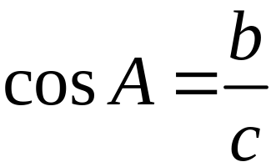
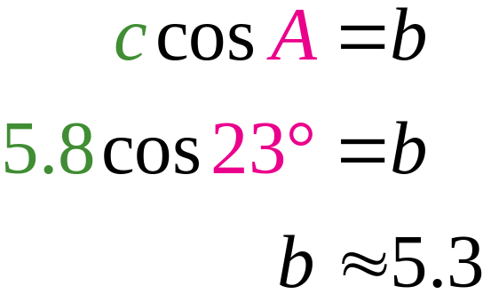
EXAMPLE 4
Solving a Right Triangle, Given One Acute Angle and One Side
Solution continued
To find b:
To find B: B = 90º – 23º = 67º

Slide 19
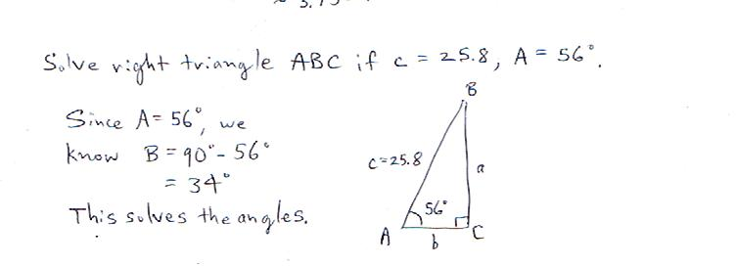

Slide 20
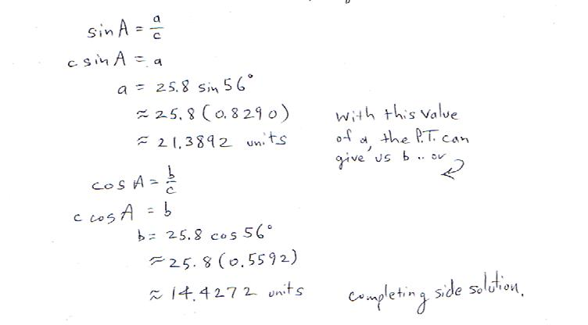

Slide 21
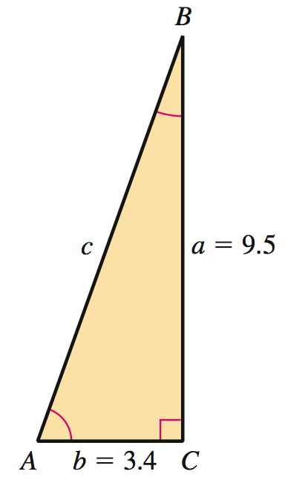
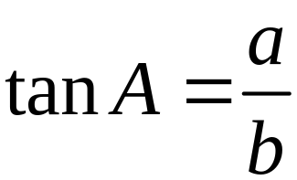
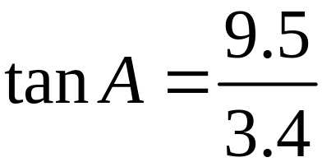
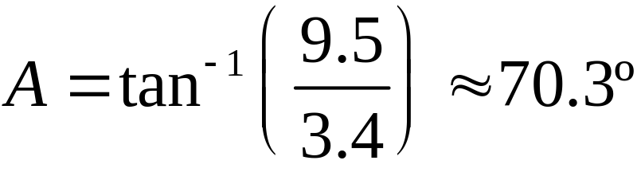
EXAMPLE 5
Solving a Right Triangle Given Two Sides
Solve right triangle ABC if a = 9.5 and b = 3.4.
Solution
Sketch triangle ABC.
To find A:

Slide 22
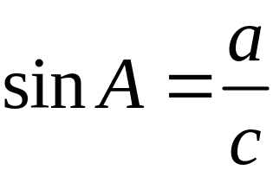

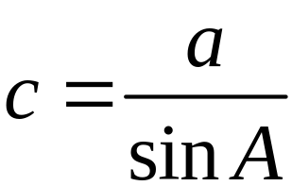


EXAMPLE 5
Solving a Right Triangle Given Two Sides
Solution continued
To find c :
To find B: B ≈ 90º – 70.3º = 19.7º

Slide 23


Slide 24


Slide 25
EXAMPLE 7
Measuring the Height of Mount Kilimanjaro
A surveyor wants to measure the height of Mount Kilimanjaro by using the known height of a nearby mountain.
The nearby location is at an altitude of 8720 feet, the distance between that location and Mount Kilimanjaro’s peak is 4.9941 miles, and the angle of elevation from the lower location is 23.75º.
Use this information to find the approximate height of Mount Kilimanjaro.

Slide 26

EXAMPLE 7
Measuring the Height of Mount Kilimanjaro

Slide 27


EXAMPLE 7
Measuring the Height of Mount Kilimanjaro
Solution
The sum of the side length h and the location height of 8720 feet gives the approximate height of Mount Kilimanjaro. Let h be measured in miles. Use the definition of sin θ, for θ = 23.75º.

Slide 28

EXAMPLE 7
Measuring the Height of Mount Kilimanjaro
Solution continued
1 mile = 5280 feet
Thus, the height of Mount Kilimanjaro

Slide 29


Slide 30
EXAMPLE 8
Finding the Width of a River
To find the width of a river, a surveyor sights straight across the river from a point A on her side to a point B on the opposite side.
She then walks 200 feet upstream to a point C. The angle θ that the line of sight from point C to point B makes with the river bank is 58º.
How wide is the river?
Despite being verbose, such problems can appear on a test/FE. The problem could be presented more explicitly . . In any case, we draw a diagram . .

Slide 31

EXAMPLE 8
Finding the Width of a River
Once you set it up, make sure that the information provided agrees with what your diagram depicts.

Slide 32

EXAMPLE 8
Finding the Width of a River
Solution
A, B, and C are the vertices of a right triangle with acute angle 58º. w is the width of the river.
The river is about 320 feet wide at the point A.

Slide 33


Slide 34

Finding the Rotation Angle for a Security Camera
EXAMPLE 9
A security camera is to be installed 20 feet away from the center of a jewelry counter. The counter is 30 feet long.
What angle, to the
nearest degree, should
the camera rotate
through so that it scans
the entire counter?

Slide 35
Finding the Rotation Angle for a Security Camera
EXAMPLE 9
Solution
The counter center , the camera , and a counter end form a right triangle.
The angle at vertex A
is where θ is the
angle through which the camera rotates.

Slide 36

Finding the Rotation Angle for a Security Camera
EXAMPLE 9
Solution continued
Set the camera to rotate 74º through to scan the entire counter.

Slide 37


Slide 38



This is the “size and align” way to brutishly remove the erroneous tan(x) pieces.
Notice that tan(x) together with one of the sinusoidal functions extends to the limits of 2-space. (Actually, tax(x) does this itself.)
Imagine a window for every n pi / 2.
You can see that tan(x) is in a real sense “infinitely discon-tinuous.”
3pi/2
-3pi/2
-pi/2
pi/2

