Slide 1



Chapter 6
Applications of
Trigonometric Functions
© 2010 Pearson Education, Inc.
All rights reserved

Slide 2
The Law of Sines
SECTION 6.2
1
Learn vocabulary and conventions for solving triangles.
Derive the Law of Sines.
Solve AAS and ASA triangles by using the Law of Sines.
Solve for possible triangles in the ambiguous SSA case.
Find the area of an SAS triangle.
2
3
4
5

Slide 3
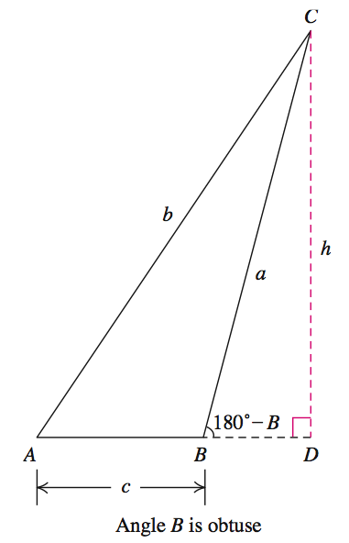
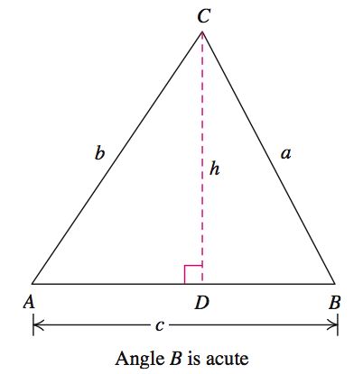
LAW OF SINES
The following diagrams illustrate the Law of Sines.
In either case
sinA = h/b
h = b sinA
sinB = h/a sin(180-B) = sinB
h= a sinB
Then find the other
altitudes . .
a sinB = b sinA
(sinB)/b = (sinA)/a

Slide 4
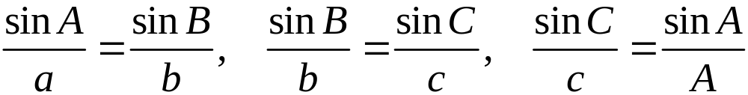
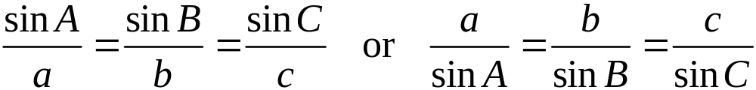
LAW OF SINES
In any triangle ABC, with sides of length a, b, and c,
A
a
We can rewrite these relations in compact notation:

Slide 5
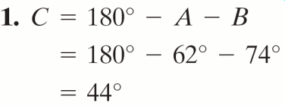
EXAMPLE 1
Solving the AAS and ASA Triangles
OBJECTIVE Solve a triangle given two angles and a side.
Step 1 Find the measure of the third angle by subtracting the measures of the known angles from 180º
EXAMPLE Solve triangle ABC with A = 62º, c = 14 feet, B = 74º. Round side lengths to the nearest tenth.
© 2010 Pearson Education, Inc. All rights reserved
5
Notes:
5

Slide 6
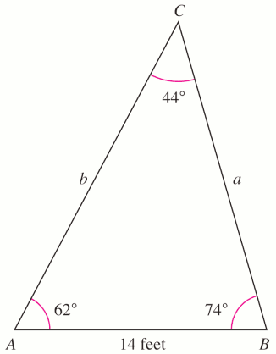
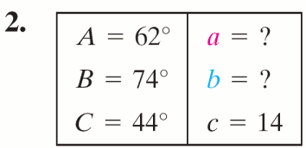
EXAMPLE 1
Solving the AAS and ASA Triangles
OBJECTIVE Solve a triangle given two angles and a side.
Step 2 Make a chart of the six parts of the triangle, indicating the known parts and the parts to be computed.
Make a sketch of the triangle.
EXAMPLE Solve triangle ABC with A = 62º, c = 14 ft, B = 74º. Round side lengths to the nearest tenth.
© 2010 Pearson Education, Inc. All rights reserved
6
Notes:
6

Slide 7
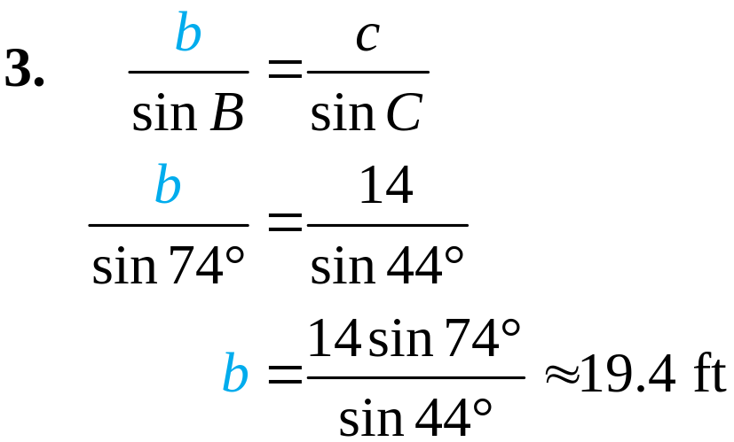
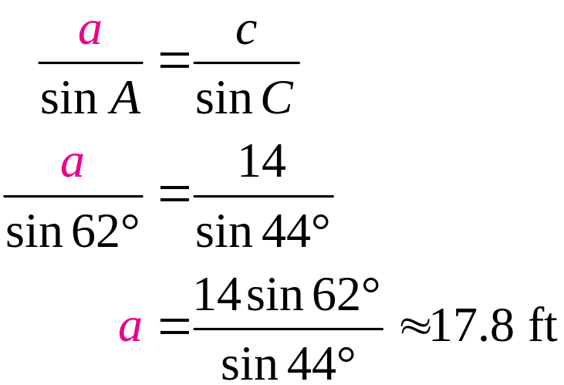
EXAMPLE 1
Solving the AAS and ASA Triangles
OBJECTIVE Solve a triangle given two angles and a side.
Step 3 Select two ratios of the Law of Sines in which three of the four quantities are known. Solve for the fourth quantity. Use the form of the Law of Sines in which the unknown quantity is in the numerator.
EXAMPLE Solve triangle ABC with A = 62º, c = 14 feet, B = 74º. Round side lengths to the nearest tenth.
© 2010 Pearson Education, Inc. All rights reserved
7
Notes:
7

Slide 8
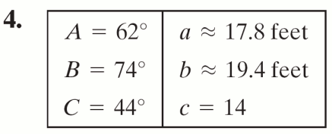
EXAMPLE 1
Solving the AAS and ASA Triangles
OBJECTIVE Solve a triangle given two angles and a side.
Step 4 Show the solution by completing the chart.
EXAMPLE Solve triangle ABC with A = 62º, c = 14 feet, B = 74º. Round side lengths to the nearest tenth.
© 2010 Pearson Education, Inc. All rights reserved
8
Notes:
8

Slide 9
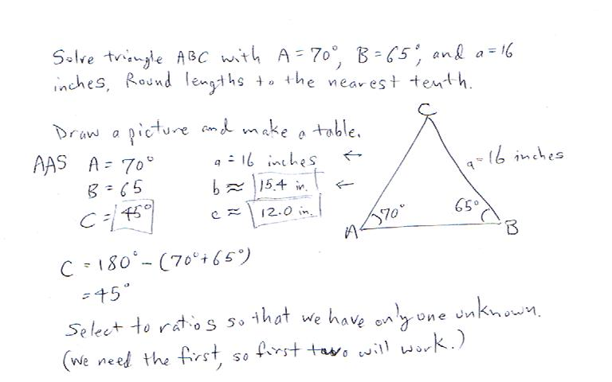

Slide 10
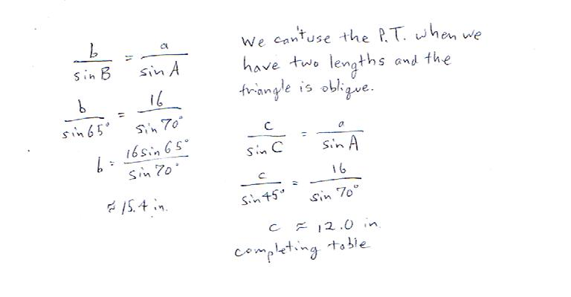

Slide 11
EXAMPLE 2
Height of a Mountain
From a point on a level plain at the foot of a mountain, a surveyor finds the angle of elevation of the peak of the mountain to be 20º.
She walks 3465 meters closer (on a direct line between the first point and the base of the mountain) and finds the angle of elevation to be 23º.
Estimate the height of the mountain to the nearest meter.

Slide 12
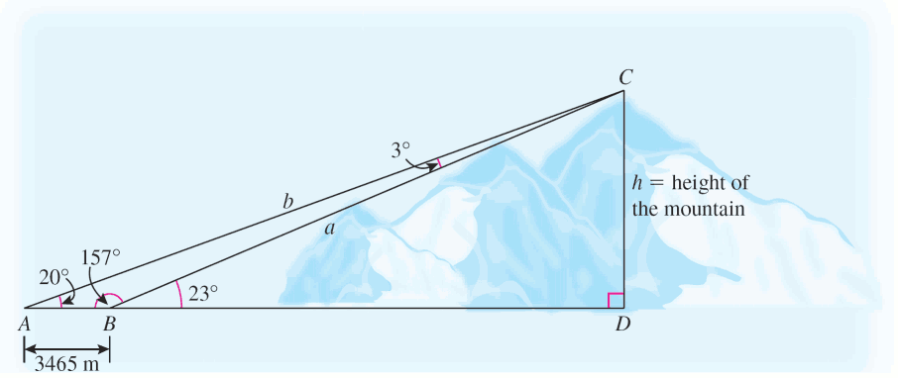
EXAMPLE 2
Height of a Mountain
Solution

Slide 13
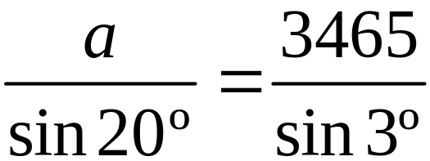
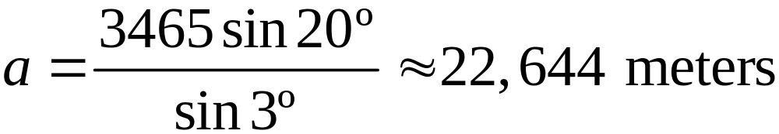
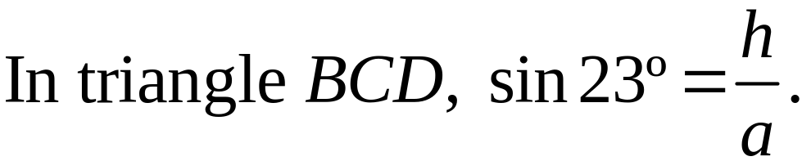
EXAMPLE 2
Height of a Mountain
Solution continued
The mountain is approximately 8848 meters high.

Slide 14
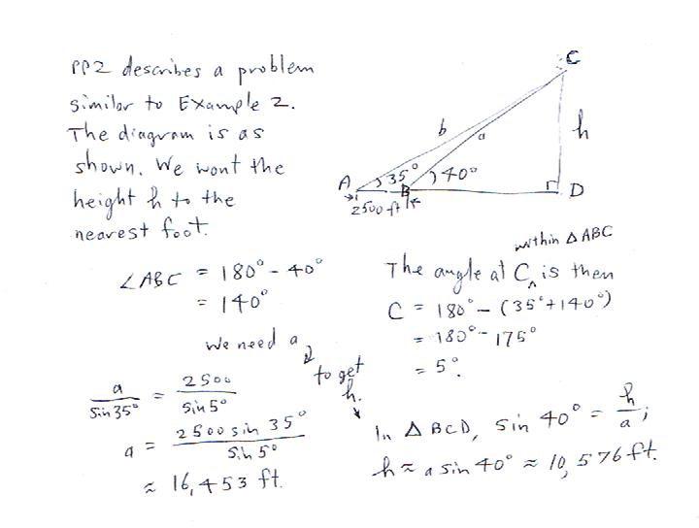

Slide 15
SOLVING SSA TRIANGLES
(THE AMBIGUOUS CASE)
If the lengths of two sides of a triangle and the measure of the angle opposite one of these sides are given, then depending on the measurements, there may be
1. No such triangle
2. One such triangle
3. Two such triangles
For this reason, Case 2 is called the ambiguous case.

Slide 16
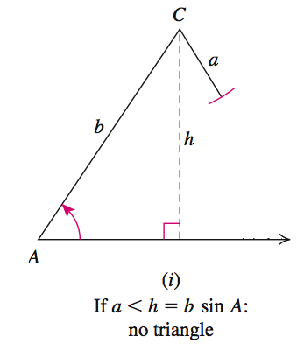
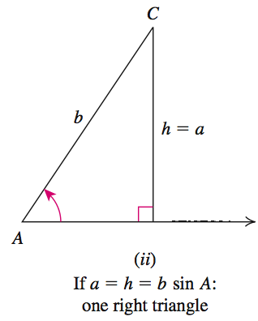
SOLVING SSA TRIANGLES
(THE AMBIGUOUS CASE)
A is an acute angle.

Slide 17
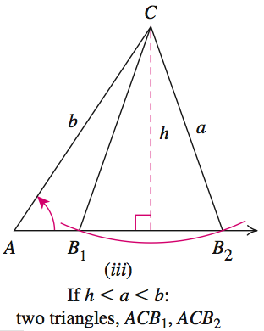
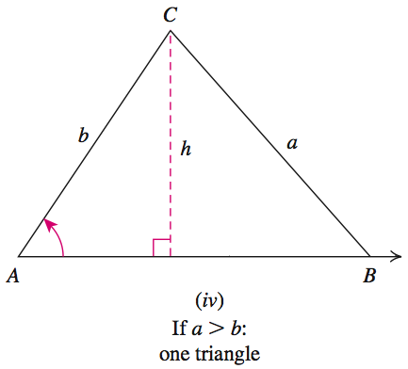
SOLVING SSA TRIANGLES
(THE AMBIGUOUS CASE)
A is an acute angle.

Slide 18
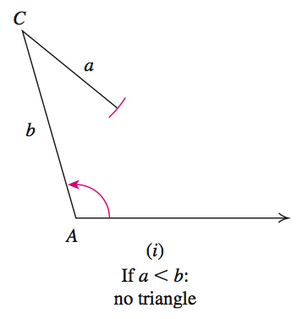
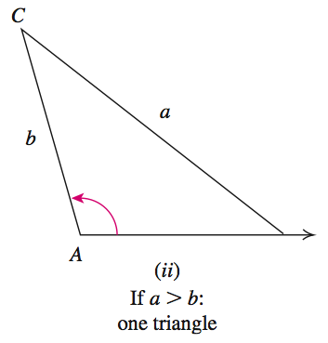
SOLVING SSA TRIANGLES
(THE AMBIGUOUS CASE)
A is an obtuse angle.

Slide 19
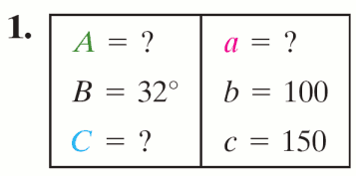
EXAMPLE 3
Solving the SSA Triangles
OBJECTIVE Solve a triangle if two sides and an angle opposite one of them is given.
Step 1 Make a chart of the six parts, the known and the unknown parts.
EXAMPLE Solve triangle ABC with B = 32º, b = 100 feet, and c = 150 feet. Round each answer to the nearest tenth.
© 2010 Pearson Education, Inc. All rights reserved
19
Notes:
19

Slide 20
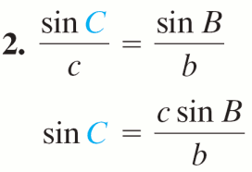
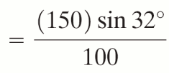

EXAMPLE 3
Solving the SSA Triangles
OBJECTIVE Solve a triangle if two sides and an angle opposite one of them is given.
Step 2 Apply the Law of Sines to the two ratios in which three of the four quantities are known. Solve for the sine of the fourth quantity. Use the form of the Law of Sines in which the unknown quantity is in the numerator.
EXAMPLE Solve triangle ABC with B = 32º, b = 100 feet, and c = 150 feet. Round each answer to the nearest tenth.
© 2010 Pearson Education, Inc. All rights reserved
20
Notes:
20

Slide 21
EXAMPLE 3
Solving the SSA Triangles
OBJECTIVE Solve a triangle if two sides and an angle opposite one of them is given.
Step 3 If the sine of the angle, say θ, in Step 2 is greater than 1, there is no triangle with the given measurements. If sin θ is between 0 and 1, go to Step 4.
EXAMPLE Solve triangle ABC with B = 32º, b = 100 feet, and c = 150 feet. Round each answer to the nearest tenth.
3. sin C ≈ 0.7949 < 1 so go to Step 4.
© 2010 Pearson Education, Inc. All rights reserved
21
Notes:
21

Slide 22
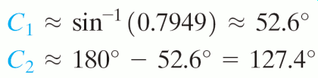
EXAMPLE 3
Solving the SSA Triangles
OBJECTIVE Solve a triangle if two sides and an angle opposite one of them is given.
Step 4 Let sin θ be x, with 0 < x ≤ 1. If x ≠ 1, then θ has two possible values: (i) θ₁ = sin−1 x, so 0 < θ₁ < 90º
(ii) θ₂ = 180º − sin−1 x.
EXAMPLE Solve triangle ABC with B = 32º, b = 100 feet, and c = 150 feet. Round each answer to the nearest tenth.
4. There are two possible values of C:
© 2010 Pearson Education, Inc. All rights reserved
22
Notes:
22

Slide 23

EXAMPLE 3
Solving the SSA Triangles
OBJECTIVE Solve a triangle if two sides and an angle opposite one of them is given.
Step 5 If x ≠ 1 with (known angle) + θ₁ < 180º and (known angle) + θ₂ < 180º, then there are two triangles. Otherwise, there is only one triangle, and if x = 1, it is a right triangle
EXAMPLE Solve triangle ABC with B = 32º, b = 100 feet, and c = 150 feet. Round each answer to the nearest tenth.
We have two triangles with the given measurements.
© 2010 Pearson Education, Inc. All rights reserved
23
Notes:
23

Slide 24

EXAMPLE 3
Solving the SSA Triangles
OBJECTIVE Solve a triangle if two sides and an angle opposite one of them is given.
Step 6 Find the third angle of the triangle(s).
EXAMPLE Solve triangle ABC with B = 32º, b = 100 feet, and c = 150 feet. Round each answer to the nearest tenth.
© 2010 Pearson Education, Inc. All rights reserved
24
Notes:
24

Slide 25
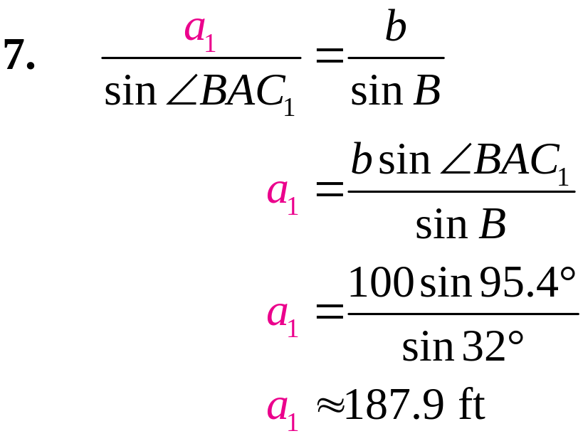
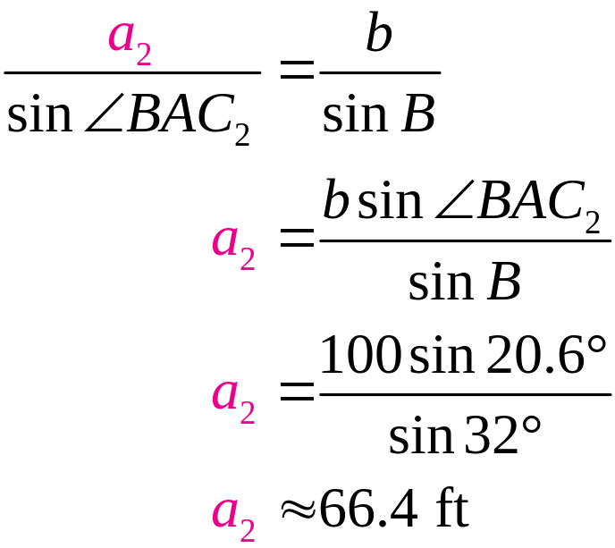
EXAMPLE 3
Solving the SSA Triangles
OBJECTIVE Solve a triangle if two sides and an angle opposite one of them is given.
Step 7 Use the Law of Sines to find the remaining side(s).
EXAMPLE Solve triangle ABC with B = 32º, b = 100 feet, and c = 150 feet. Round each answer to the nearest tenth.
© 2010 Pearson Education, Inc. All rights reserved
25
Notes:
25

Slide 26
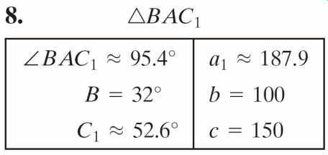
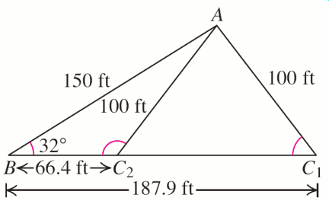
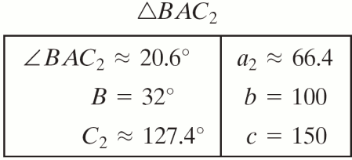
EXAMPLE 3
Solving the SSA Triangles
OBJECTIVE Solve a triangle if two sides and an angle opposite one of them is given.
Step 8 Show the solution(s).
EXAMPLE Solve triangle ABC with B = 32º, b = 100 feet, and c = 150 feet. Round each answer to the nearest tenth.
© 2010 Pearson Education, Inc. All rights reserved
26
Notes:
26

Slide 27
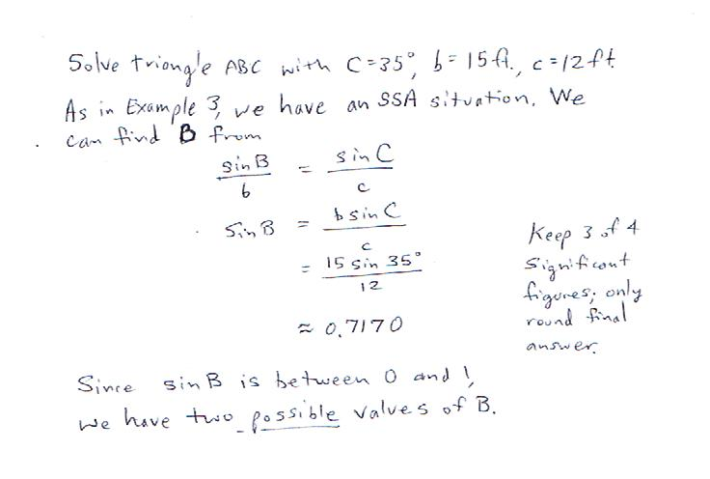

Slide 28
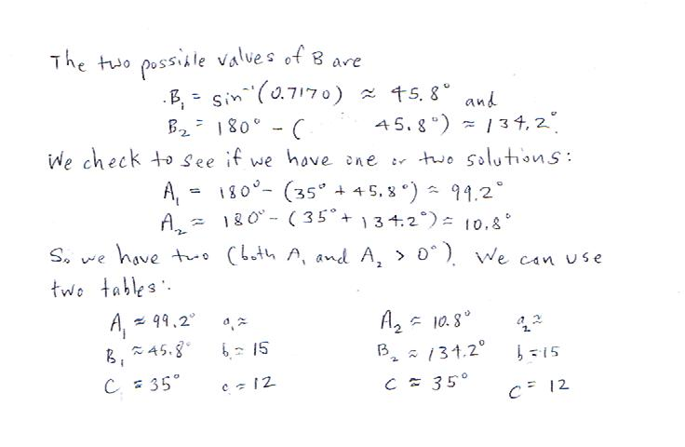

Slide 29
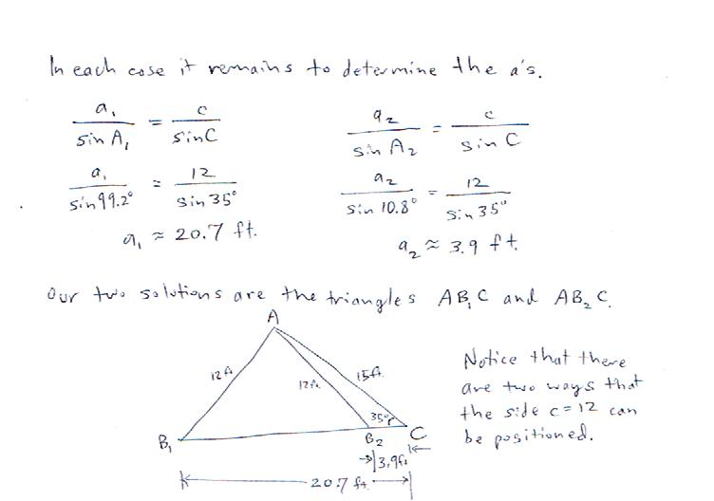

Slide 30
EXAMPLE 4
Solving an SSA Triangle (No Solution)
Solve triangle ABC with A = 50º, a = 8 inches, and b = 15 inches.
Solution
Step 1 Make a chart.
A = 50º
a = 8
B = ?
b = 15
C = ?
c = ?

Slide 31
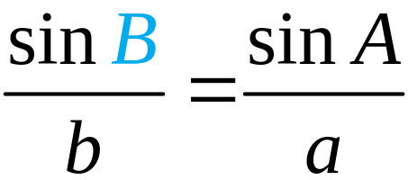
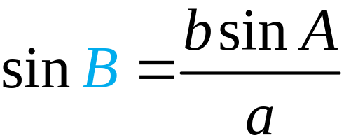
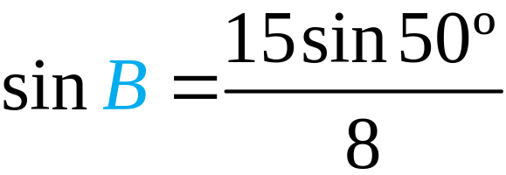

EXAMPLE 4
Solving an SSA Triangle (No Solution)
Solution continued
Step 2 Apply the Law of Sines.
Step 3 Since sin B ≈ 1.44 > 1, we conclude that no triangle has the given measurements.

Slide 32
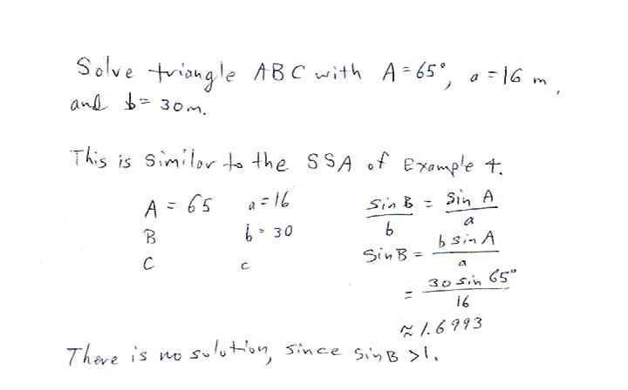

Slide 33
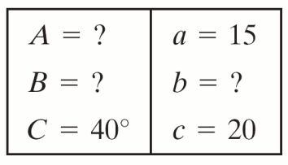
EXAMPLE 5
Solving an SSA Triangle (One Solution)
Solve triangle ABC with C = 40º, c = 20 meters, and a = 15 meters.
Solution
Step 1 Make a chart.

Slide 34
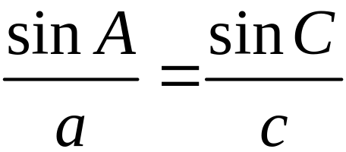
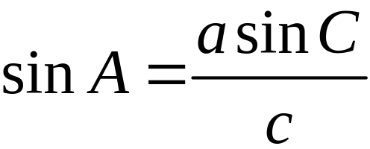
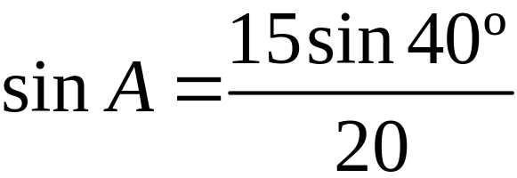

EXAMPLE 5
Solving an SSA Triangle (One Solution)
Solution continued
Step 2 Apply the Law of Sines.
Step 3 sin A ≈ 0.4821 < 1 so go to Step 4.

Slide 35
EXAMPLE 5
Solving an SSA Triangle (One Solution)
Solution continued
Step 4 A = sin−1 0.4821 ≈ 28.8º. Two possible values of A are A₁ ≈ 28.8º and
A₂ ≈ 180º − 28.8º = 151.2º.
Step 5 Since
C + A₂ = 40º + 151.2º = 191.2º > 180º, there is no triangle with vertex A₂.
Step 6 The third angle at B has measure
≈ 180º − 40º − 28.8º = 111.2º.

Slide 36
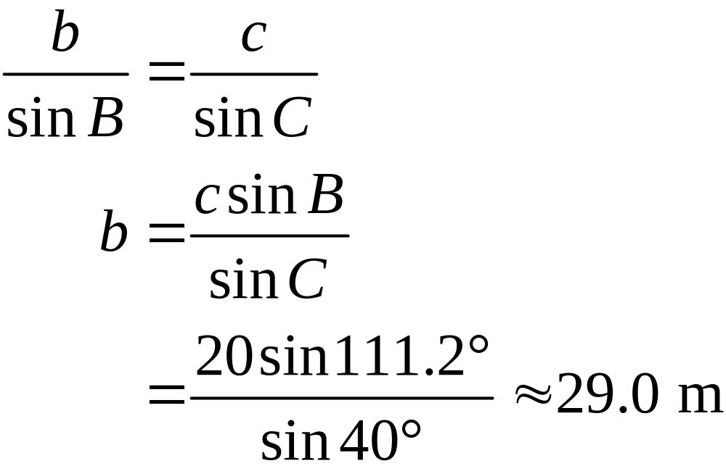
EXAMPLE 5
Solving an SSA Triangle (One Solution)
Solution continued
Step 7 Find the remaining side length.

Slide 37
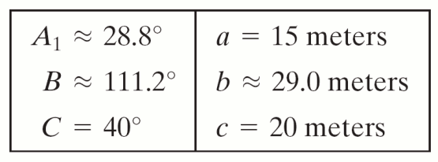
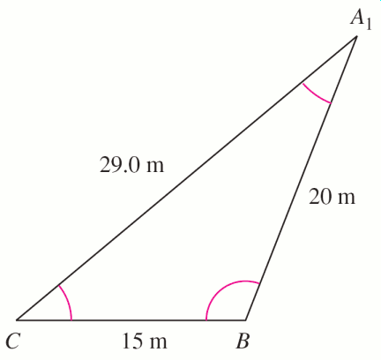
EXAMPLE 5
Solving an SSA Triangle (One Solution)
Solution continued
Step 8 Show the solution.

Slide 38
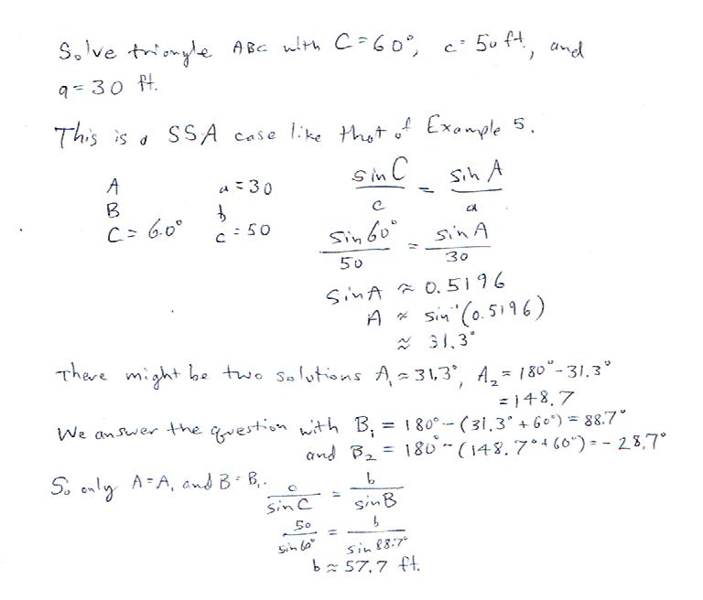

Slide 39
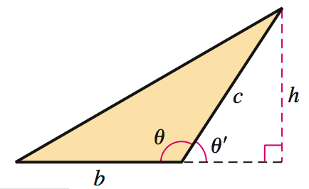
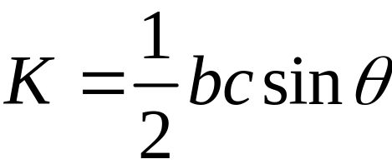
AREA OF A TRIANGLE
In any triangle, if θ is the included angle between sides b and c, the area K of the triangle is given by

Slide 40
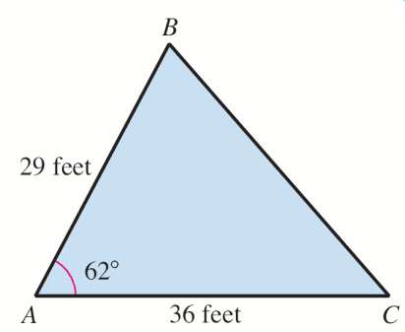

EXAMPLE 7
Finding the Area of a Triangle
Find the area of the triangle ABC.
Solution

Slide 41


