Slide 1



Chapter 6
Applications of
Trigonometric Functions
© 2010 Pearson Education, Inc.
All rights reserved

Slide 2
The Law of Cosines
SECTION 6.3
1
Derive the Law of Cosines.
Use the Law of Cosines to solve SAS triangles.
Use the Law of Cosines to solve SSS triangles.
Use Heron’s formula to find the area of a triangle.
2
3
4

Slide 3
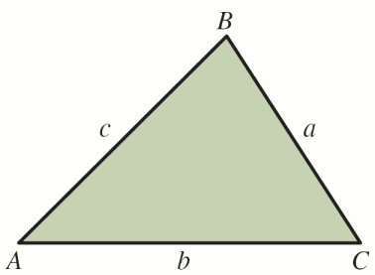
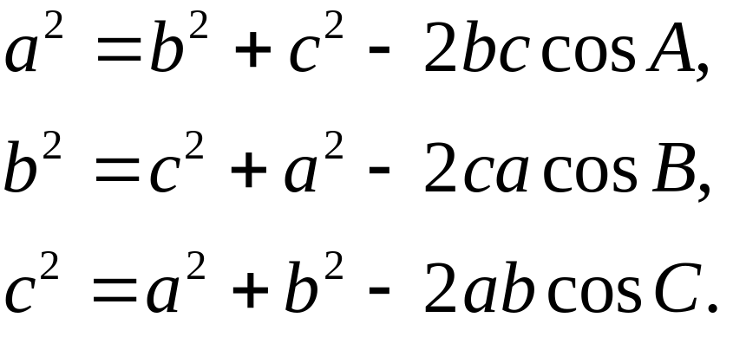
LAW OF COSINES
In triangle ABC, with sides of lengths a, b, and c,
In words, the square of any side of a triangle is equal to the sum of the squares of the length of the other two sides, less twice the product of the lengths of the other sides and the cosine of their included angle.

Slide 4
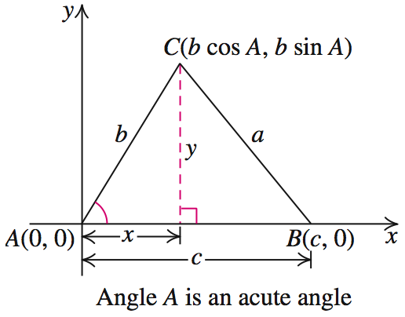
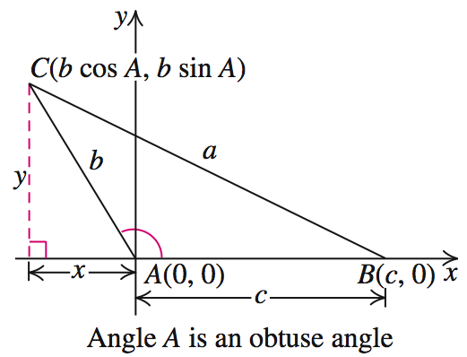
LAW OF COSINES
The following diagrams illustrate the Law of Cosines.

Slide 5
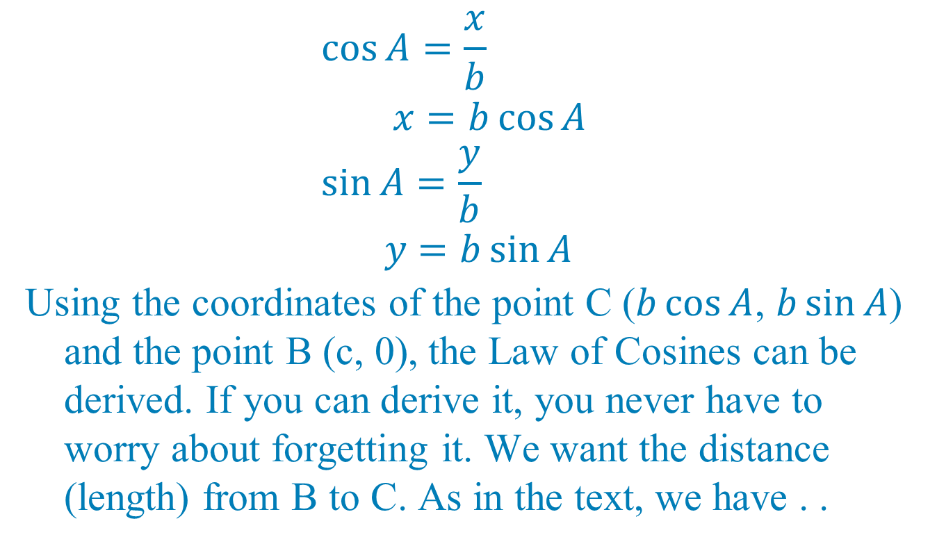
$$\cos{A=\frac{x}{\begin{aligned}b\end{aligned}}} \\ x=b\cos{A} \\ \sin{A=\frac{y}{b} } \\ y=b\sin{A}$$
Using the coordinates of the point C ($b\cos{A}$, $b\sin{A}$) and the point B (c, 0), the Law of Cosines can be derived. If you can derive it, you never have to worry about forgetting it. We want the distance (length) from B to C. As in the text, we have . .

Slide 6
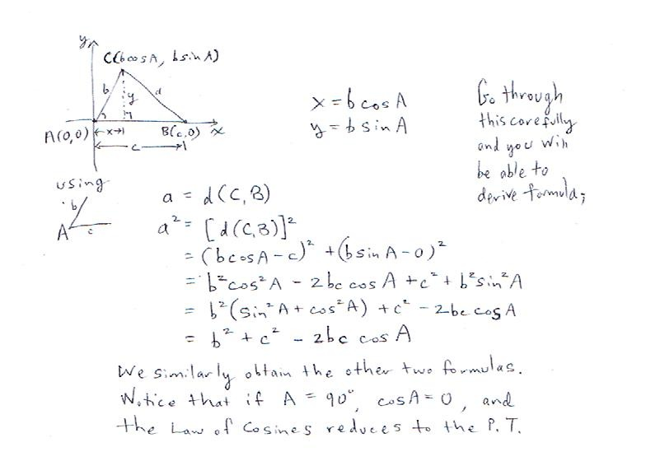
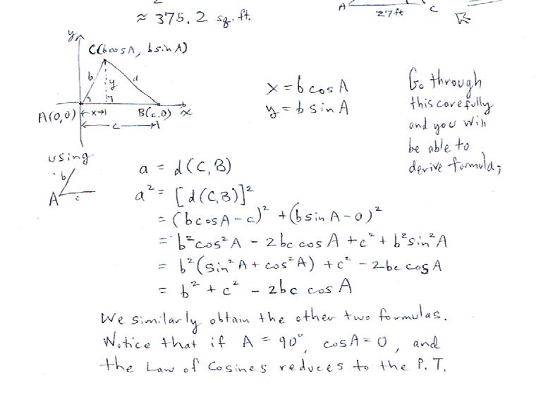

Slide 7
Notice that each letter appears twice with the lead matching the final uppercase angle letter. Each equation has a kind of symmetry.
Notice that the negative portion is very similar to the area formula.
You are expected to know all of the formulas presented in Chapters 6 and 7. (None of these will be provided on Test II or the FE.)

Slide 8
SOLVING SAS TRIANGLES
Step 1 Use the appropriate form of the Law of Cosines to find the side opposite the given angle.
Step 2 Use the Law of Sines to find the angle opposite the shorter of the two given sides. Note that this angle is always an acute angle. (Since at most one obtuse angle.)
Step 3 Use the angle sum formula to find the third angle.
Step 4 Write the solution.

Slide 9
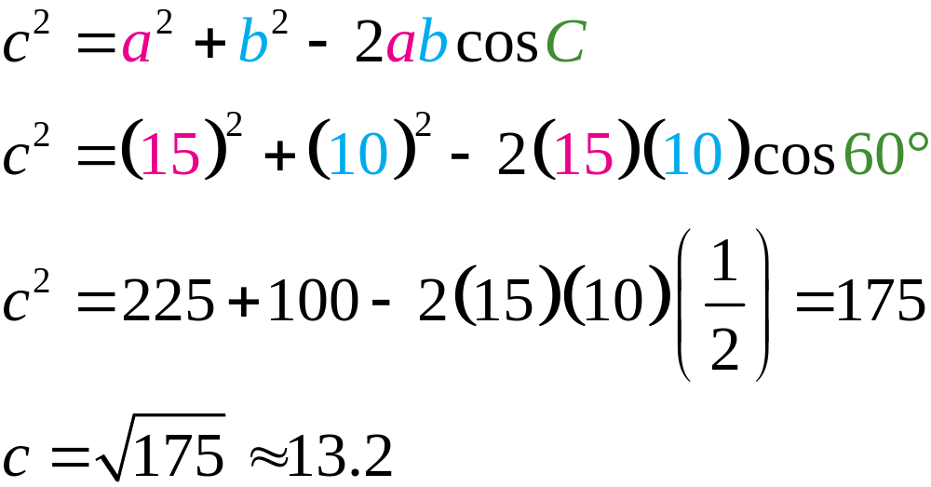
EXAMPLE 1
Solving the SAS Triangles
Solve triangle ABC with a = 15 in, b = 10 in, and C = 60º. Round each answer to the nearest tenth.
If you set up a table, you can see that you have a SAS situation.
No two lines leave only one unknown (like SSS).
Solution
Step 1 Find side c opposite angle C.

Slide 10
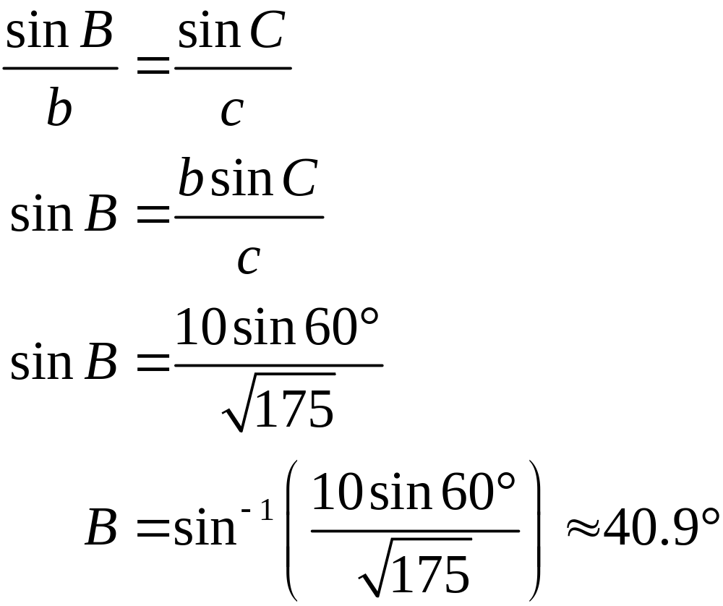
EXAMPLE 1
Solving the SAS Triangles
Solution continued
Step 2 Find angle B.

Slide 11
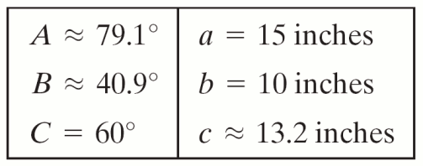
EXAMPLE 1
Solving the SAS Triangles
Solution continued
Step 3 Use the angle sum formula to find the third angle.
Step 4 The solution of triangle ABC is:

Slide 12
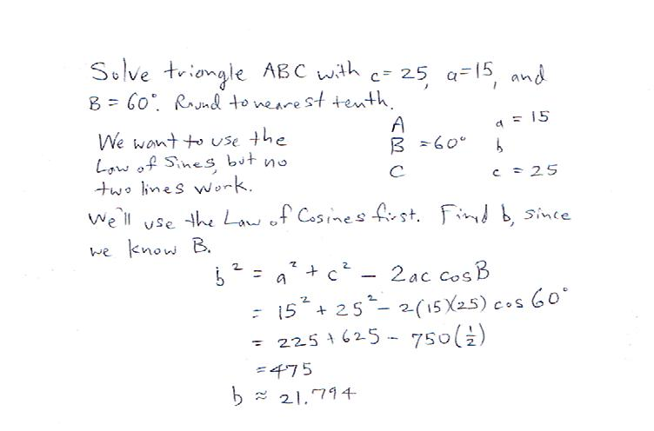

Slide 13
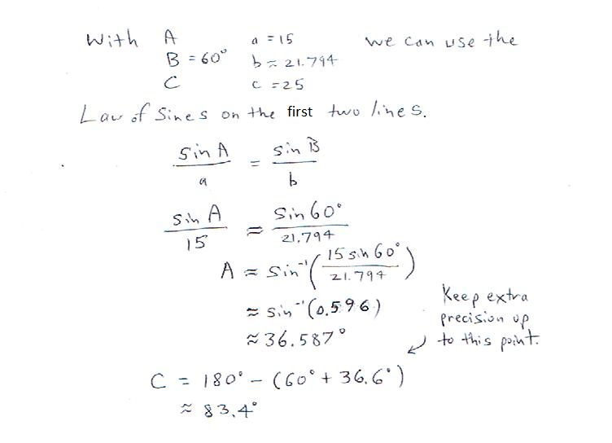

Slide 14
EXAMPLE 2
Using the Law of Cosines
Suppose that a Boeing 747 is flying over Disney World headed due south at 552 mi/hr. Twenty minutes later, an F-16 passes over Disney World with a bearing of N 37º E at a speed of 1250 mi/hr.
Find the distance between the two planes 3 hours after the F-16 passes over Disney World. Round the answer to the nearest tenth.

Slide 15
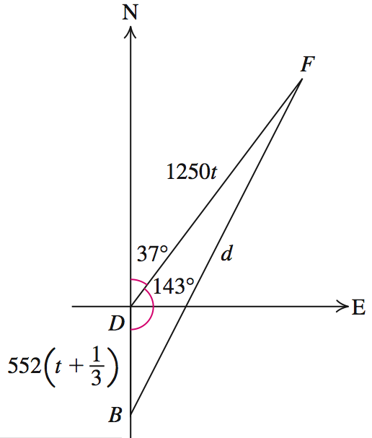
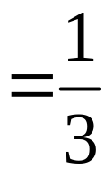
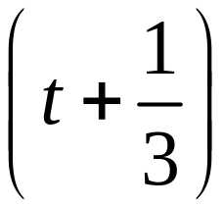
EXAMPLE 2
Using the Law of Cosines
Solution
Suppose the F-16 has been traveling for t hours after passing over Disney World. Then, because the Boeing 747 had a head start of 20 minutes
hour, the Boeing 747 has
been traveling
hours due south.
The distance between the two planes is d.

Slide 16
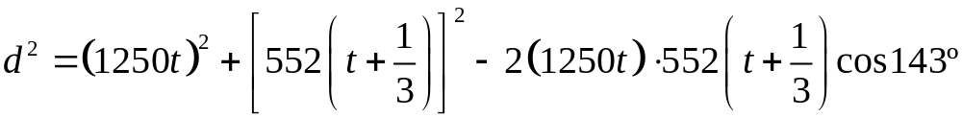


EXAMPLE 2
Using the Law of Cosines
Solution continued
Using the Law of Cosines in triangle FDB, we have
Substitute t = 3.

Slide 17
SOLVING SSS TRIANGLES
Step 1 Use the Law of Cosines to find the angle opposite the longest side.
Step 2 Use the Law of Sines to find either of the two remaining acute angles. (Or use Law of Cosines on another.)
Step 3 Use the angle sum formula to find the third angle.
Step 4 Write the solution.

Slide 18
If you are provided with explicit measures for lengths and angles, then the problem is somewhat trivialized. You need only properly write down the desired form of the Law of Cosines and plug the numbers in.
You must, of course, pay attention to detail and put things in their correct places.
This is your applications chapter, so it’s reasonable to see some application problems everywhere (TII, etc).
Remember that the Law of Cosines can be used for
SAS and SSS situations.

Slide 19
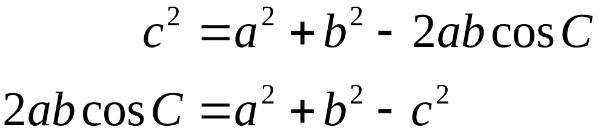
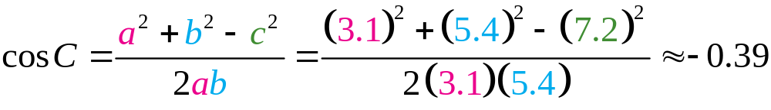
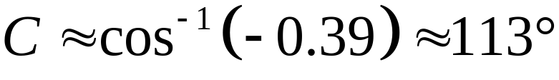
EXAMPLE 3
Solving the SSS Triangles
Solve triangle ABC with a = 3.1, b = 5.4, and
c = 7.2. Round answers to the nearest tenth.
Solution
Step 1 Because c is the longest side, find C.

Slide 20
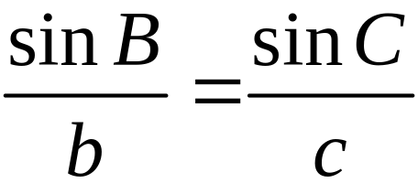
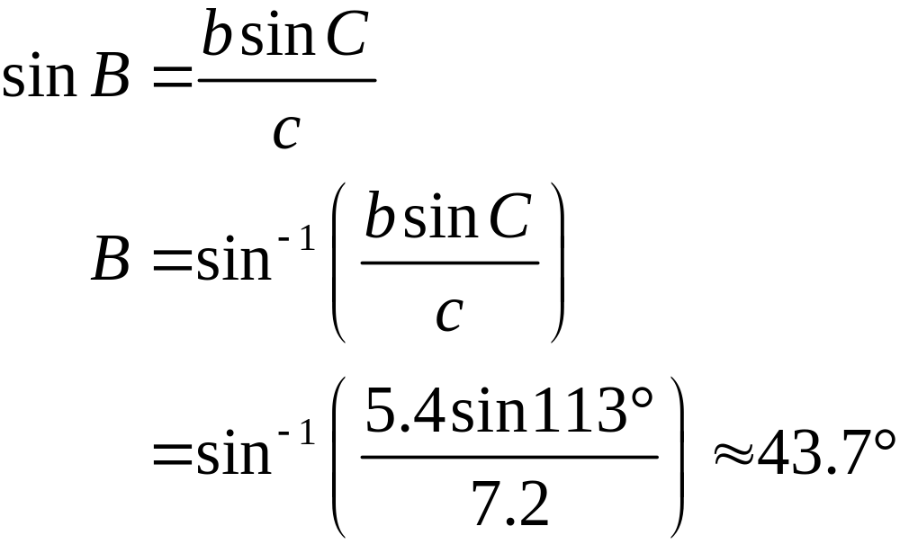
EXAMPLE 3
Solving the SSS Triangles
Solution continued
Step 2 Find angle B.

Slide 21
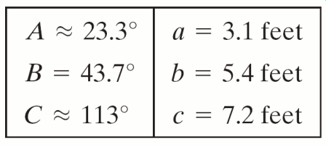
EXAMPLE 3
Solving the SSS Triangles
Solution continued
Step 3 A ≈ 180º − 43.7º − 113º = 23.3º
Step 4 Write the solution.

Slide 22
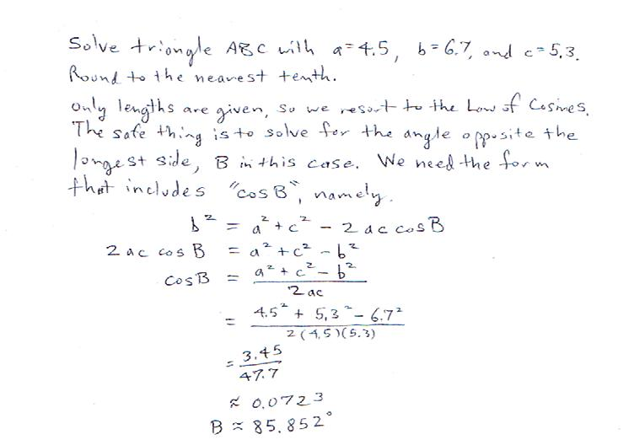

Slide 23
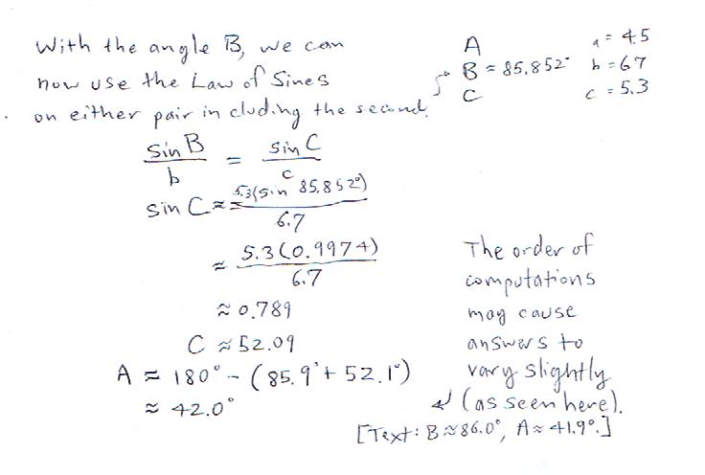

Slide 24

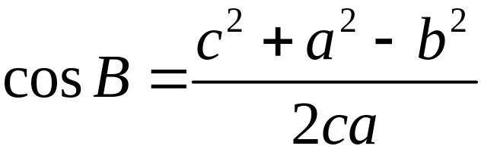
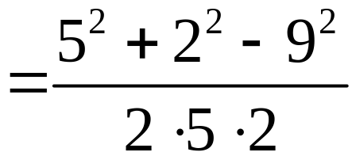

EXAMPLE 4
Solving an SSS Triangle
Solve triangle ABC with a = 2 m, b = 9 m, and
c = 5 m. Round each answer to the nearest tenth.
Solution
Step 1 Find B, the angle opposite the longest side.
Range of the cosine function is [–1, 1]; there is no angle B with cos = −2.6; the triangle cannot exist.

Slide 25
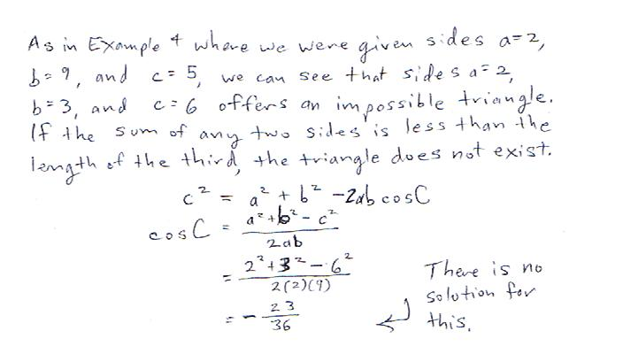

Slide 26
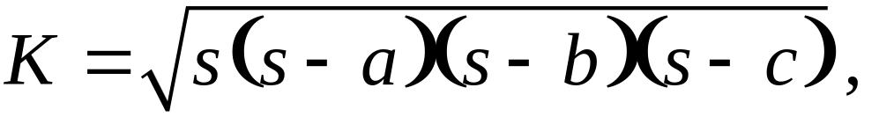
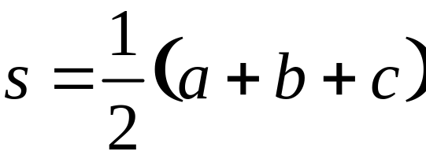
HERON’S FORMULA FOR SSS TRIANGLES
The area K of a triangle with sides of lengths a, b, and c is given by
where
is the semiperimeter.

Slide 27
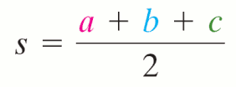
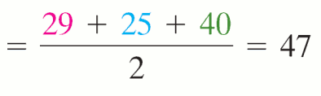
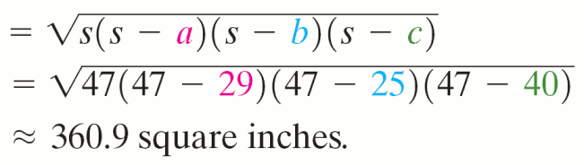
EXAMPLE 5
Using Heron’s Formula
Find the area of triangle ABC with a = 29 in, b = 25 in, and c = 40 in. Round the answer to the nearest tenth.
Solution
First find s:
Area

Slide 28
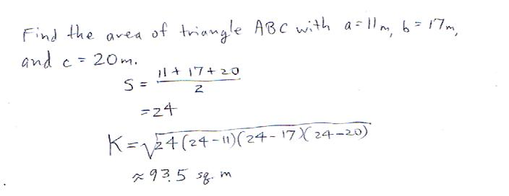

Slide 29
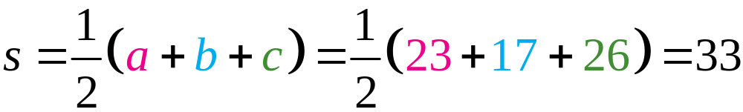
EXAMPLE 6
Using Heron’s Formula
A triangular swimming pool has side lengths 23 feet, 17 feet, and 26 feet. How many gallons of water will fill the pool to a depth of 5 feet? Round answer to the nearest whole number.
Solution
To calculate the volume of water in the swimming pool, we first calculate the area of the triangular surface.
We have a = 23, b = 17, and c = 26.

Slide 30
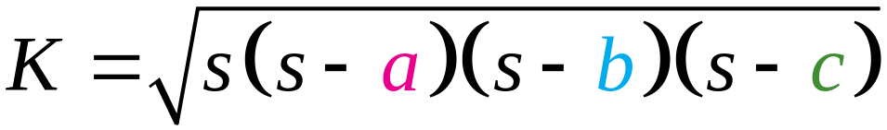
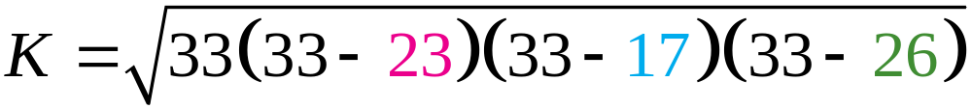



EXAMPLE 6
Using Heron’s Formula
Solution continued
By Heron’s formula, the area K of the triangular surface is
Volume of water in pool = surface area × depth

Slide 31
EXAMPLE 6
Using Heron’s Formula
Solution continued
One cubic foot contains approximately 7.5 gallons of water.
So 961.25 × 7.5 ≈ 7209 gallons of water will fill the pool.

Slide 32
