Slide 1



Chapter 6
Applications of
Trigonometric Functions
© 2010 Pearson Education, Inc.
All rights reserved

Slide 2
Polar Coordinates
SECTION 6.6
Plot points using polar coordinates.
Convert points between polar and rectangular forms.
Convert equations between rectangular and polar forms.
Graph Observe the symmetry in polar equations and their graphs.
1
2
3
4

Slide 3
POLAR COORDINATES
In a polar coordinate system, we draw a horizontal ray, called the polar axis, in the plane; its endpoint is called the pole.
A point P in the plane is described by an ordered pair of numbers (r, θ), the polar coordinates of P.

Slide 4
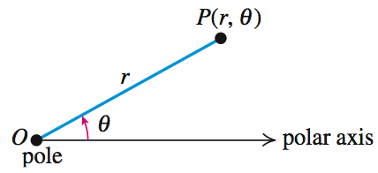
POLAR COORDINATES
The point P(r, θ) in the polar coordinate system.
r is the “directed distance” from the pole O to the point P.
θ is a directed angle from the polar axis to the line segment OP.

Slide 5
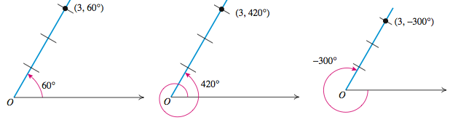
POLAR COORDINATES
The polar coordinates of a point are not unique. The polar coordinates (3, 60º), (3, 420º), and (3, −300º) all represent the same point.
In general, if a point P has polar coordinates (r, θ), then for any integer n,
(r, θ + n · 360º) or (r, θ + 2nπ)
are also polar coordinates of P.

Slide 6
EXAMPLE 1
Finding Different Polar Coordinates
a. Plot the point P with polar coordinates (3, 225º).
Find another pair of polar coordinates of P for which the following is true.
b. r < 0 and 0º < θ < 360º
c. r < 0 and –360º < θ < 0º
d. r > 0 and –360º < θ < 0º

Slide 7
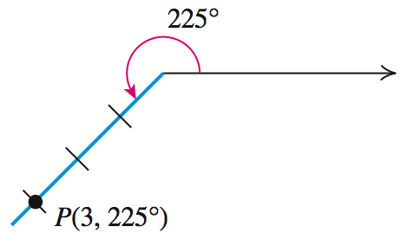
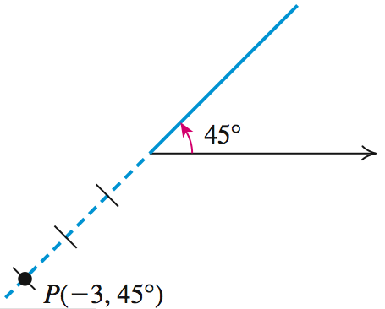
EXAMPLE 1
Finding Different Polar Coordinates
Solution
a.
b. r < 0 and 0º < θ < 360º

Slide 8
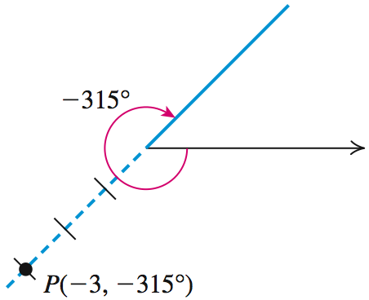
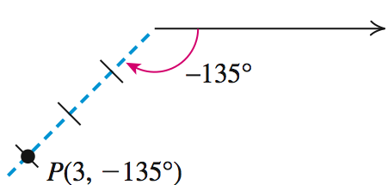
EXAMPLE 1
Finding Different Polar Coordinates
Solution continued
c. r < 0 and –360º < θ < 0º
d. r > 0 and –360º < θ < 0º

Slide 9
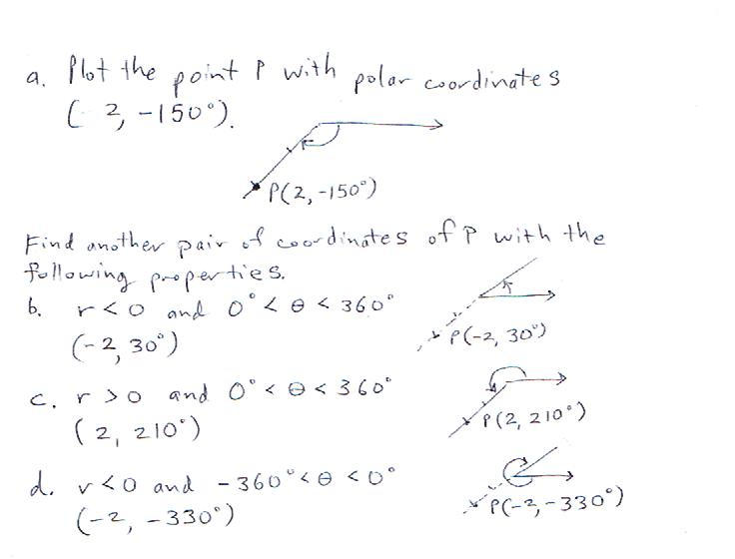

Slide 10
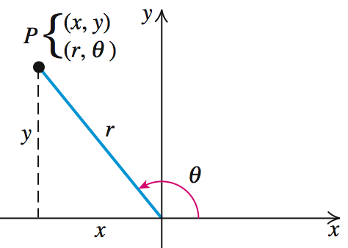
POLAR AND RECTANGULAR COORDINATES
Let the positive x-axis of the rectangular coordinate system serve as the polar axis and the origin as the pole for the polar coordinate system.
Each point P has both polar coordinates (r, θ) and rectangular coordinates (x, y).

Slide 11
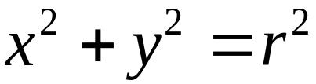
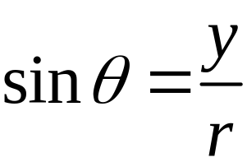
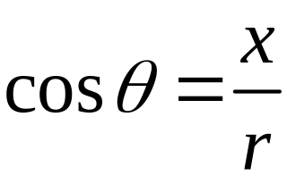
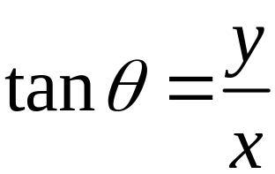
RELATIONSHIP BETWEEN
POLAR AND RECTANGULAR COORDINATES

Slide 12


CONVERTING FROM
POLAR TO RECTANGULAR COORDINATES
To convert the polar coordinates (r, θ) of a point to rectangular coordinates, use the equations

Slide 13
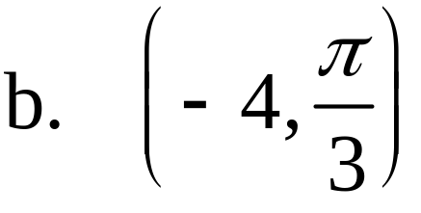
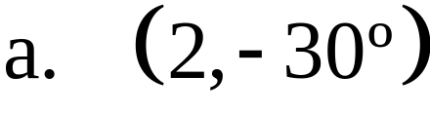


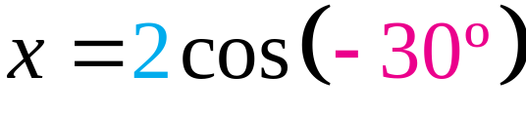
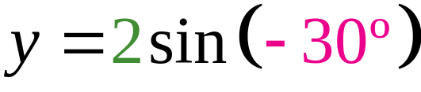
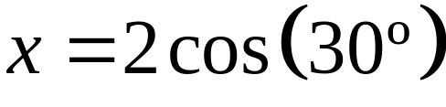

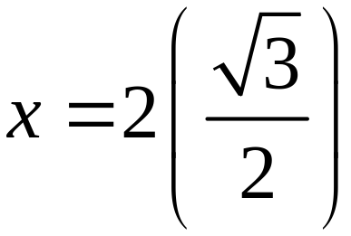
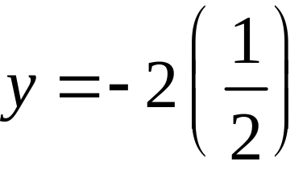
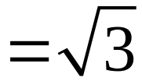

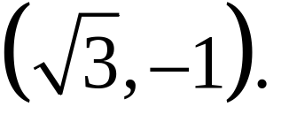
Converting from Polar to Rectangular Coordinates
EXAMPLE 2
Convert the polar coordinates of each point to rectangular coordinates.
Solution
The rectangular coordinates of (2, –30º) are

Slide 14

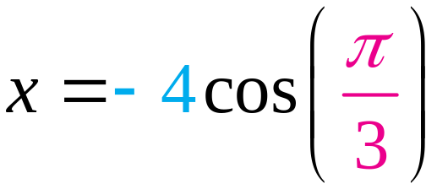
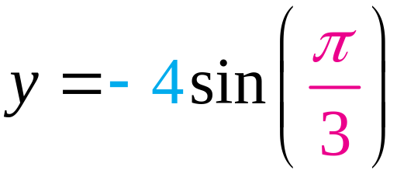
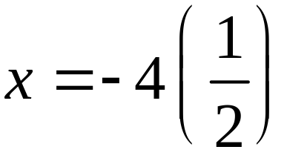
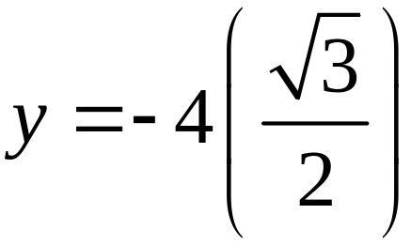

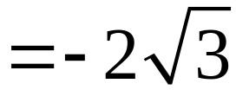
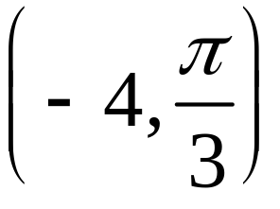
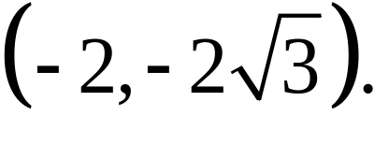
Converting from Polar to Rectangular Coordinates
EXAMPLE 2
Solution continued
The rectangular coordinates of
are

Slide 15
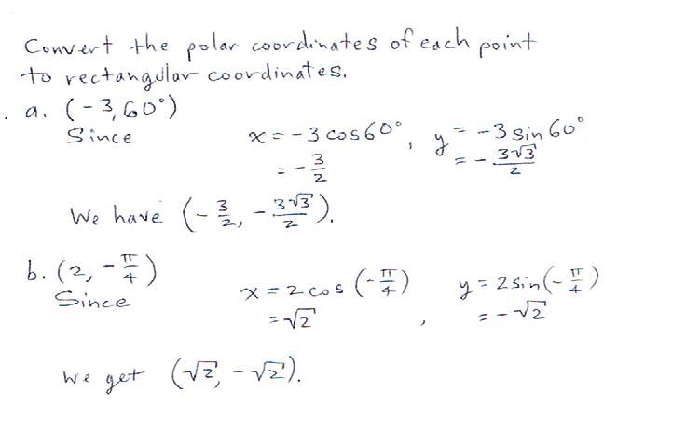

Slide 16
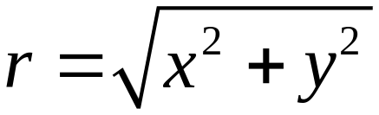
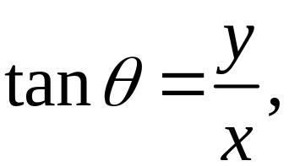
CONVERTING FROM
RECTANGULAR TO POLAR COORDINATES
To convert the rectangular coordinates (x, y) of a point to polar coordinates:
1. Find the quadrant in which the given point (x, y) lies.
2. Use
to find r.
3. Find θ by using
and choose θ so
that it lies in the same quadrant as (x, y).

Slide 17
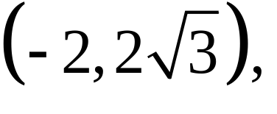
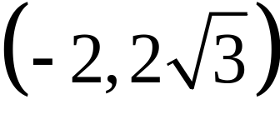
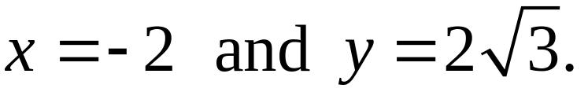
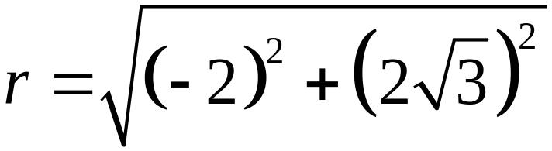
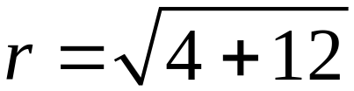
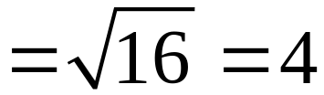
Convert from Rectangular to Polar Coordinates
EXAMPLE 3
Find polar coordinates (r, θ) of the point P whose rectangular coordinates are
with r > 0 and 0 ≤ θ < 2π.
Solution
( - , + )
1. The point P
lies in quadrant II with
2.

Slide 18
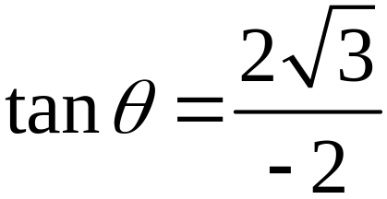
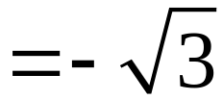
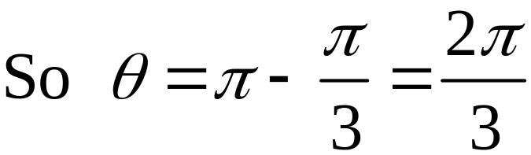
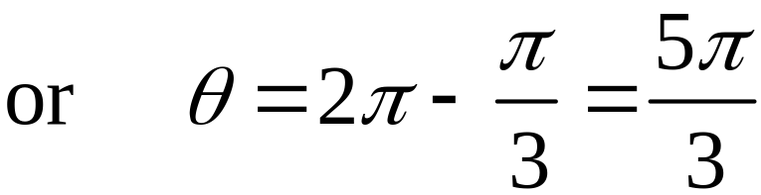
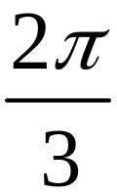
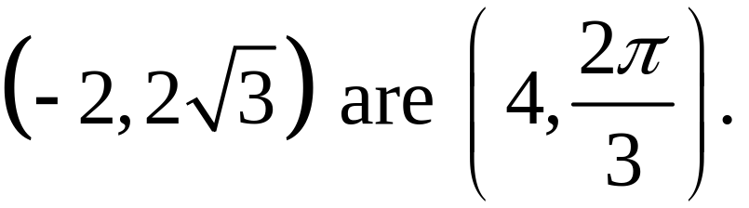
Convert from Rectangular to Polar Coordinates
EXAMPLE 3
Solution continued
3.
Choose because it lies in quadrant II.
The polar coordinates of

Slide 19
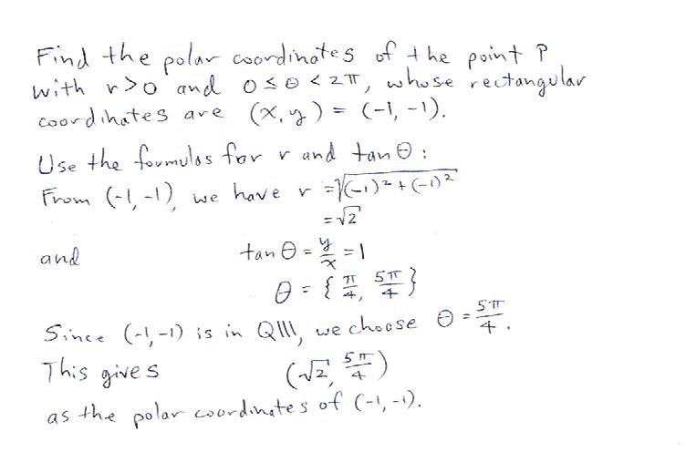

Slide 20



EQUATIONS IN
RECTANGULAR AND POLAR FORMS
An equation that has the rectangular coordinates x and y as variables is called a rectangular (or Cartesian) equation.
An equation where the polar coordinates r and θ are the variables is called a polar equation.
Some examples of polar equations are

Slide 21
CONVERTING AN EQUATION FROM
RECTANGULAR TO POLAR FORM
To convert a rectangular equation to a polar equation,
replace x by r cos θ and y by r sin θ,
and then simplify where possible.

Slide 22
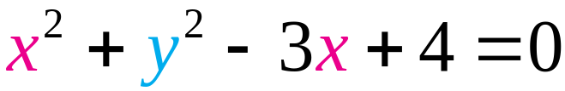
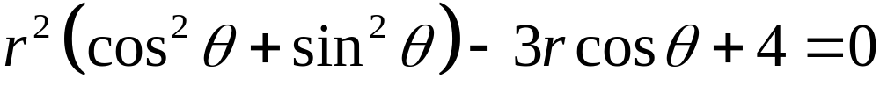

Converting an Equation from Rectangular to Polar Form
EXAMPLE 5
Convert the equation x2 + y2 – 3x + 4 = 0 to polar form.
Solution
The equation
is the polar form
of the given rectangular equation .

Slide 23
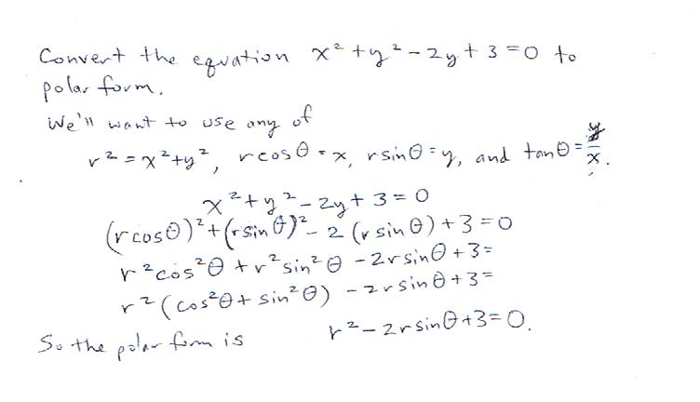

Slide 24
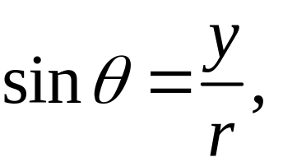
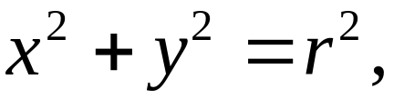
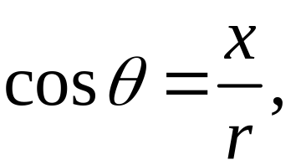

CONVERTING AN EQUATION FROM
POLAR TO RECTANGULAR FORM
Converting an equation from polar to rectangular form will frequently require some ingenuity in order to use the substitutions

Slide 25








Converting an Equation from Polar to Rectangular Form
EXAMPLE 6
Convert each polar equation to a rectangular equation and identify its graph.
Solution
Circle: center (0, 0) radius = 3

Slide 26




Converting an Equation from Polar to Rectangular Form
EXAMPLE 6
Solution continued
Line through the origin with a slope of 1.

Slide 27




Converting an Equation from Polar to Rectangular Form
EXAMPLE 6
Solution continued
Horizontal line with y-intercept = 1.

Slide 28






Converting an Equation from Polar to Rectangular Form
EXAMPLE 6
Solution continued
Circle: Center (1, 0) radius = 1

Slide 29


Slide 30


Slide 31

THE GRAPH OF A POLAR EQUATION
To graph a polar equation we plot points in polar coordinates. The graph of a polar equation
is the set of all points P(r, θ) that have at least one polar coordinate representation that satisfies the equation.
Make a table of several ordered pair solutions (r, θ) of the equation, plot the points and join them with a smooth curve.
You won’t be graphing, but it’s nice to know what a machine is doing if it’s creating a graph for you.

Slide 32
We are not going to concern ourselves with the graphing techniques developed on pp 455-460.
It can’t harm us to be familiar with the various shapes obtained from various polar graphs, however.
The “common” polar graphs shown on page 461 are ones that are frequently encountered in applications. The rest of nature likes to display similar shapes. We can see a limacon in a peacock feather, or a spiral in anything living.

Slide 33

SYMMETRY IN POLAR EQUATIONS
Symmetry with respect to the polar axis
Replace (r, θ) by (r, –θ)
or
(–r, π – θ).
Note the symmetries in the graphs shown below. It is often the symmetry of a graph that makes it interesting.

Slide 34


SYMMETRY IN POLAR EQUATIONS
Symmetry with respect to the line
Replace (r, θ) by (r, π – θ)
or
(–r, –θ).
You don’t have to be concerned about the details of this.

Slide 35

SYMMETRY IN POLAR EQUATIONS
Symmetry with respect to the pole
Replace (r, θ) by (r, π + θ)
or
(–r, θ).
Be aware of the various forms of symmetry and be able to recognize it in the polar equation.

Slide 36
















EXAMPLE 8
Sketching the Graph of a Polar Equation
Sketch the graph of the polar equation
Solution
cos (–θ) = cos θ, so the graph is symmetric in the polar axis, so compute values for 0 ≤ θ ≤ π.

Slide 37


EXAMPLE 8
Sketching the Graph of a Polar Equation
Solution continued
This type of curve is called a cardioid
because it resembles a heart.

Slide 38

EXAMPLE 9
Graphing a Polar Equation
OBJECTIVE Sketch the graph of a polar equation r = f (θ) where f is a periodic function.
Step 1 Test for Symmetry.
EXAMPLE Sketch the graph of r = cos 2θ.
1. Replace θ with −θ
cos (−2θ) = cos 2θ
Replace θ with π − θ
cos 2(π − θ) = cos (2π − 2θ)
= cos 2θ
The graph is symmetric about the polar axis and about the line
© 2010 Pearson Education, Inc. All rights reserved
38
Notes:
38

Slide 39

EXAMPLE 9
Graphing a Polar Equation
OBJECTIVE Sketch the graph of a polar equation r = f (θ) where f is a periodic function.
Step 2 Analyze the behavior of r, symmetric from Step 1.
EXAMPLE Sketch the graph of r = cos 2θ.
2.
© 2010 Pearson Education, Inc. All rights reserved
39
Notes:
39

Slide 40



EXAMPLE 9
Graphing a Polar Equation
OBJECTIVE Sketch the graph of a polar equation r = f (θ) where f is a periodic function.
Step 2 continued Then find selected points.
EXAMPLE Sketch the graph of r = cos 2θ.
2. continued Because the curve is symmetric about θ = 0 and
find selected points for
© 2010 Pearson Education, Inc. All rights reserved
40
Notes:
40

Slide 41


EXAMPLE 9
Graphing a Polar Equation
OBJECTIVE Sketch the graph of a polar equation r = f (θ) where f is a periodic function.
Step 3 Sketch the graph of r = f (θ) using the points (r, θ) found in Step 2.
EXAMPLE Sketch the graph of r = cos 2θ.
© 2010 Pearson Education, Inc. All rights reserved
41
Notes:
41

Slide 42


EXAMPLE 9
Graphing a Polar Equation
OBJECTIVE Sketch the graph of a polar equation r = f (θ) where f is a periodic function.
Step 4 Use symmetries to complete the graph.
EXAMPLE Sketch the graph of r = cos 2θ.
© 2010 Pearson Education, Inc. All rights reserved
42
Notes:
42

Slide 43

LIMAÇONS
Polar axis symmetry

Slide 44

LIMAÇONS

Slide 45


ROSE CURVES
If n is odd, the rose has n petals.
If n is even, the rose has 2n petals
Symmetry with respect to the line
Ө = $\frac{π}{2}$
Polar axis symmetry

Slide 46

ROSE CURVES
If n is odd, the rose has n petals.
If n is even, the rose has 2n petals
Centrally symmetric
(wrt pole)

Slide 47



CIRCLES

Slide 48



LEMNISCATES

Slide 49




SPIRALS
Try these with a graphing utility (it’s not difficult).
It seems shameful not to at least look at them.

