Slide 1



Chapter 7
Systems of Equations
and Inequalities
© 2010 Pearson Education, Inc.
All rights reserved

Slide 2
Systems of Linear Equations in Two Variables
SECTION 7.1
1
Verify a solution to a system of equations.
Solve a system of equations by the graphical method.
Solve a system of equations by the substitution method.
Solve a system of equations by the elimination method.
Solve applied problems by solving systems of equations.
2
3
4
5

Slide 3
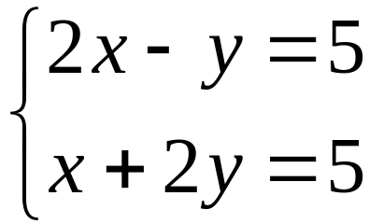
Definitions
A set of equations with common variables is called a system of equations.
If each equation is linear, then it is a system of linear equations or a linear system of equations.
If at least one equation is nonlinear, then it is called a nonlinear system of equations.
Here’s a system of two linear equations in two variables

Slide 4
Definitions
A system of equations is sometimes referred to as a set of simultaneous equations.
A solution of a system of equations in two variables x and y is an ordered pair of numbers (a, b) such that when x is replaced by a and y is replaced by b, all resulting equations in the system are true.
The solution set of a system of equations is the set of all solutions of the system.

Slide 5
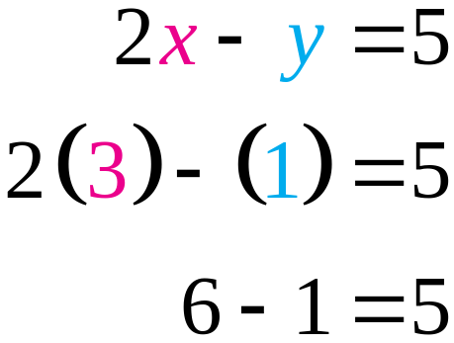
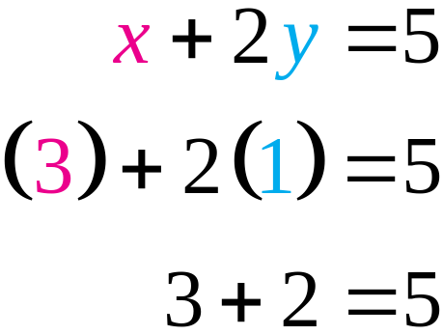
EXAMPLE 1
Verifying a Solution
Verify that the ordered pair (3, 1) is the solution
of the system of linear equations
Solution
Replace x with 3 and y with 1.
(3, 1) satisfies both equations, so it is the solution.

Slide 6
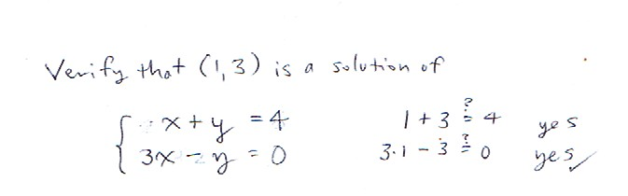

Slide 7
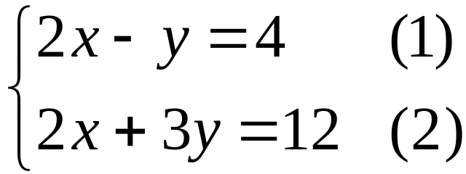
EXAMPLE 2
Solving a System by the Graphical Method
Use the graphical method to solve the system of
equations
Solution
Step 1 Graph both equations on the same coordinate axes.

Slide 8
EXAMPLE 2
Solving a System by the Graphical Method
Solution continued
(i) Find intercepts of equation (1).
a. Set x = 0 in 2x – y = 4 and solve for y:
2(0) – y = 4, or y = –4
so the y-intercept is –4.
b. Set y = 0 in 2x – y = 4 and solve for x:
2x – 0 = 4, or x = 2
so the x-intercept is 2.
(ii) Find intercepts of equation (2).
x-intercept is 6; y-intercept is 4

Slide 9
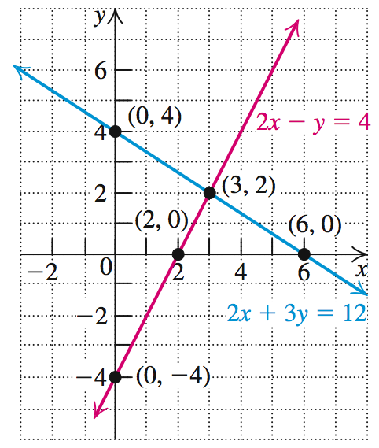
EXAMPLE 2
Solving a System by the Graphical Method
Solution continued
Step 2 Find the point(s) of intersection of the two graphs.
The point of intersection of the two graphs is (3, 2).

Slide 10
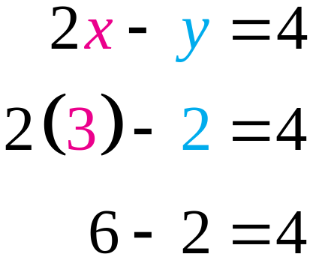
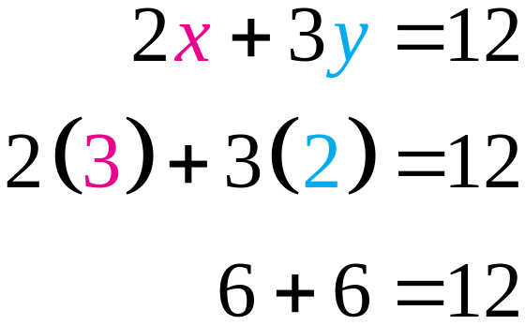
EXAMPLE 2
Solving a System by the Graphical Method
Solution continued
Step 3 Check your solution(s).
Replace x with 3 and y with 2.
Step 4 Write the solution set for the system.
The solution set is {(3, 2)}.

Slide 11
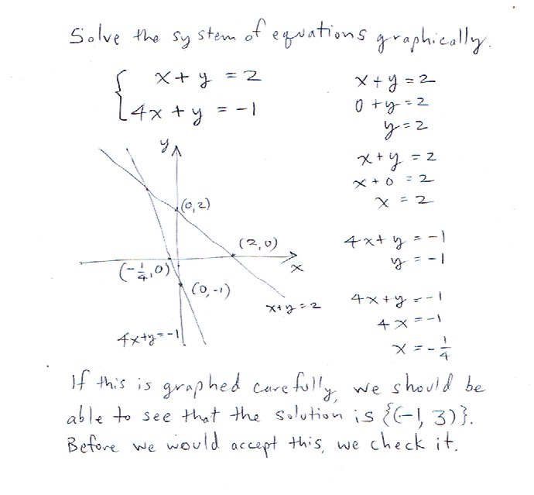

Slide 12
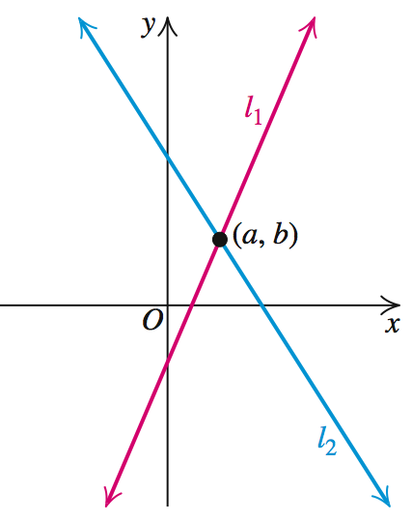
SOLUTIONS OF SYSTEMS OF EQUATIONS
The solution set of a system of two linear equations in two variables can be classified in one of the following ways.
1. One solution. The system is consistent and the equations are said to be independent.

Slide 13
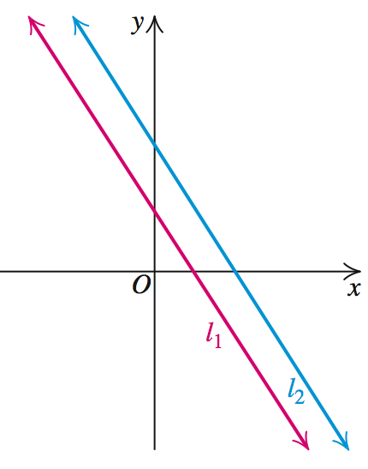
SOLUTIONS OF SYSTEMS OF EQUATIONS
2. No solution. The lines are parallel. The system is inconsistent.

Slide 14
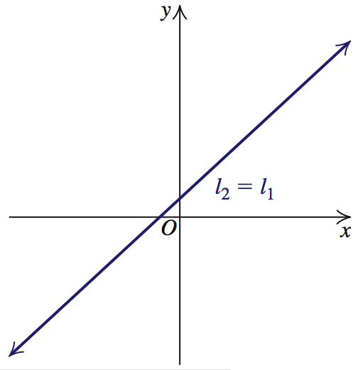
SOLUTIONS OF SYSTEMS OF EQUATIONS
3. Infinitely many solutions. The lines coincide. The system is consistent and the equations are said to be dependent.

Slide 15
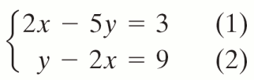
EXAMPLE 3
The Substitution Method
OBJECTIVE Reduce the solution of the system to the solution of one equation in one variable by substitution.
Step 1 Choose one of the equations and express one of its variables in terms of the other variable.
EXAMPLE Solve the system.
1. In equation (2), express y in terms of x.
y = 2x + 9
© 2010 Pearson Education, Inc. All rights reserved
15
Notes:
15

Slide 16
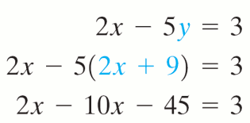
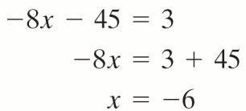
EXAMPLE 3
The Substitution Method
OBJECTIVE Reduce the solution of the system to the solution of one equation in one variable by substitution.
Step 2 Substitute the expression found in Step 1 into the other equation to obtain an equation in one variable.
Step 3 Solve the equation obtained in Step 2.
EXAMPLE Solve the system.
2.
3.
© 2010 Pearson Education, Inc. All rights reserved
16
Notes:
16

Slide 17

EXAMPLE 3
The Substitution Method
OBJECTIVE Reduce the solution of the system to the solution of one equation in one variable by substitution.
Step 4 Substitute the value(s) you found in Step 3 back into the expression you found in Step 1. The result is the solution(s).
EXAMPLE Solve the system.
4.
The solution set is {(−6, −3)}.
They’re preparing us for multiple numbers of solutions.
© 2010 Pearson Education, Inc. All rights reserved
17
Notes:
17

Slide 18
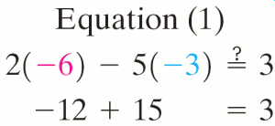
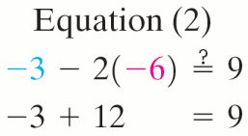
EXAMPLE 3
The Substitution Method
OBJECTIVE Reduce the solution of the system to the solution of one equation in one variable by substitution.
Step 5 Check your answer(s) in the original equations.
EXAMPLE Solve the system.
5. Check: x = −6 and y = −3
There is every reason to check your solution(s). You must be meticulous with the signs and the substitutions of variables. The method itself is rather trivial, but it’s easy to make mistakes along the way.
© 2010 Pearson Education, Inc. All rights reserved
18
Notes:
18

Slide 19
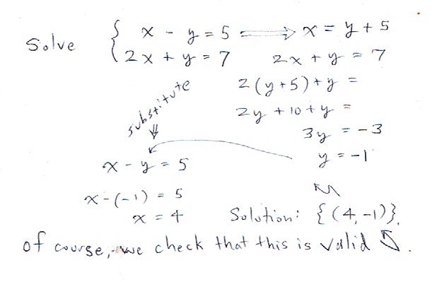

Slide 20
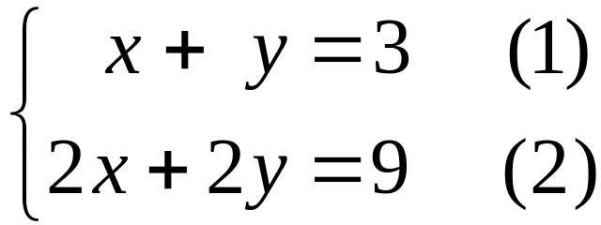
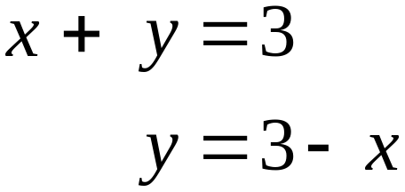
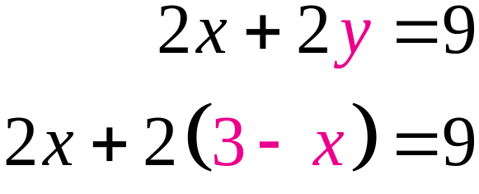
EXAMPLE 4
Attempting to Solve an Inconsistent System of Equations
Solve the system of equations.
Solution
Step 1 Solve equation (1) for y in terms of x.
Step 2 Substitute into equation (2).

Slide 21
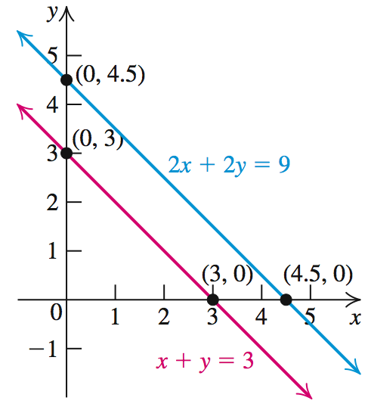
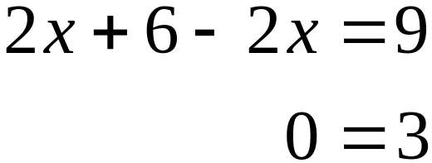
EXAMPLE 4
Attempting to Solve an Inconsistent System of Equations
Solution continued
Step 3 Solve for x.
Since the equation 0 = 3 is false, the system is inconsistent. The lines are parallel, do not intersect and the system has no solution.

Slide 22
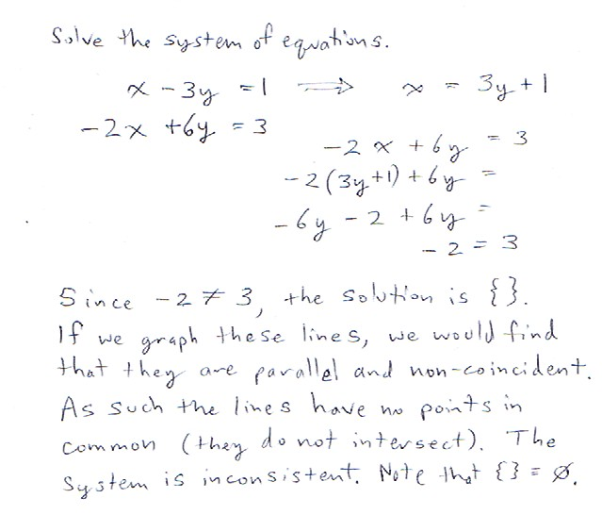

Slide 23
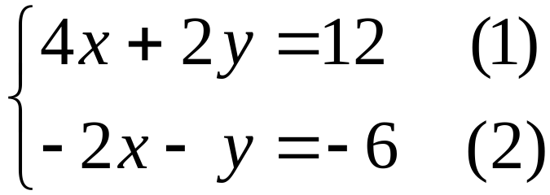
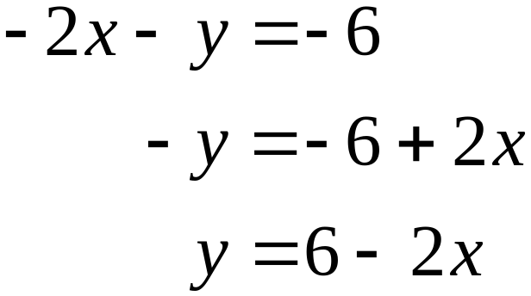
EXAMPLE 5
Solving a Dependent System
Solve the system of equations.
Solution
Step 1 Solve equation (2) for y in terms of x.

Slide 24
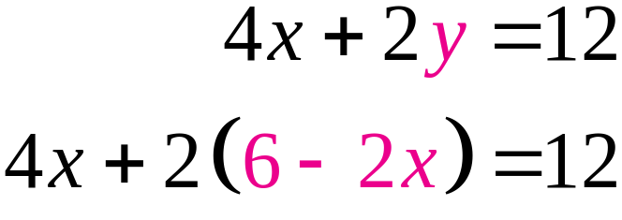
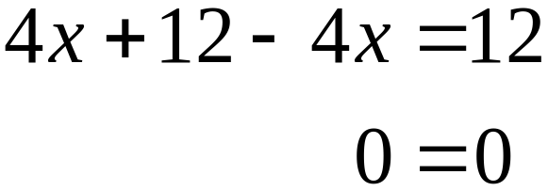
EXAMPLE 5
Solving a Dependent System
Solution continued
Step 2 Substitute (6 – 2x) for y in equation (1).
Step 3 Solve for x.
The equation 0 = 0 is true for every value of x. Thus, any value of x can be used in the equation y = 6 – 2x for back substitution.

Slide 25
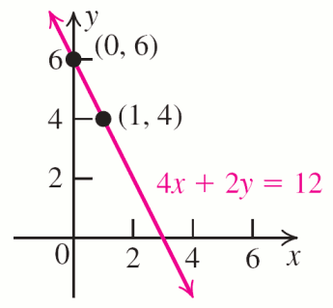
EXAMPLE 5
Solving a Dependent System
Solution continued
The solutions are of the form (x, 6 – 2x) and the solution set is {(x, 6 – 2x)}.
The solution set consists of all ordered pairs (x, y) lying on the line with equation 4x + 2y = 12. The system has infinitely many solutions.

Slide 26
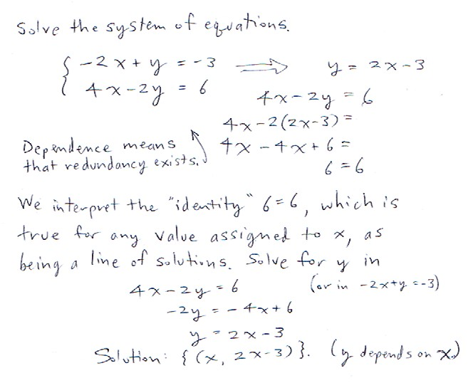

Slide 27
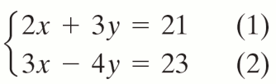

EXAMPLE 6
The Elimination Method
OBJECTIVE Solve a system of two linear equations by first eliminating one variable.
Step 1 Adjust the coefficients. If necessary, multiply both equations by appropriate numbers to get two new equations in which the coefficients of the variable to be eliminated are opposites.
EXAMPLE Solve the system.
1. Select y as the variable to be eliminated.
Multiply equation (1) by 4 and equation (2) by 3.
© 2010 Pearson Education, Inc. All rights reserved
27
Notes:
27

Slide 28
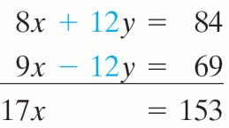
EXAMPLE 6
The Elimination Method
OBJECTIVE Solve a system of two linear equations by first eliminating one variable.
Step 2 Add the resulting equations to get an equation in one variable.
EXAMPLE Solve the system.
2.
© 2010 Pearson Education, Inc. All rights reserved
28
Notes:
28

Slide 29
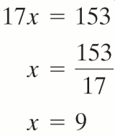
EXAMPLE 6
The Elimination Method
OBJECTIVE Solve a system of two linear equations by first eliminating one variable.
Step 3 Solve the resulting equation.
EXAMPLE Solve the system.
3.
© 2010 Pearson Education, Inc. All rights reserved
29
Notes:
29

Slide 30
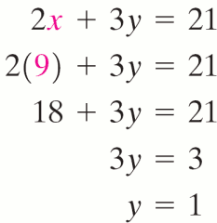
EXAMPLE 6
The Elimination Method
OBJECTIVE Solve a system of two linear equations by first eliminating one variable.
Step 4 Back-substitute the value you found into one of the original equations to solve for the other variable.
EXAMPLE Solve the system.
4.
© 2010 Pearson Education, Inc. All rights reserved
30
Notes:
30

Slide 31
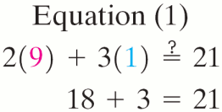
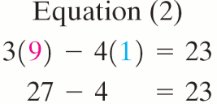
EXAMPLE 6
The Elimination Method
OBJECTIVE Solve a system of two linear equations by first eliminating one variable.
Step 5 Write the solution set from Steps 3 and 4.
Step 6 Check your solution(s) in the original equations (1) and (2).
EXAMPLE Solve the system.
5. The solution set is {(9, 1)}.
6. Check x = 9 and y = 1.
© 2010 Pearson Education, Inc. All rights reserved
31
Notes:
31

Slide 32
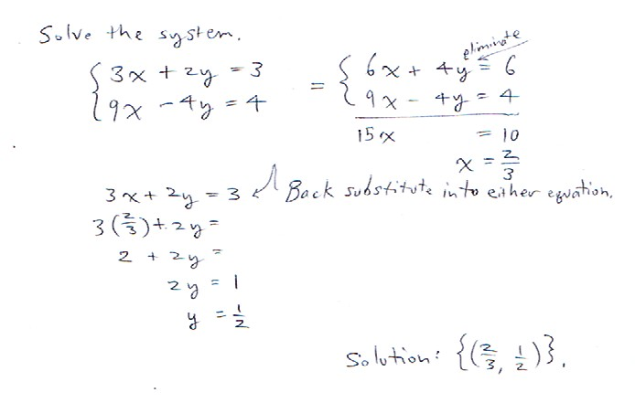

Slide 33
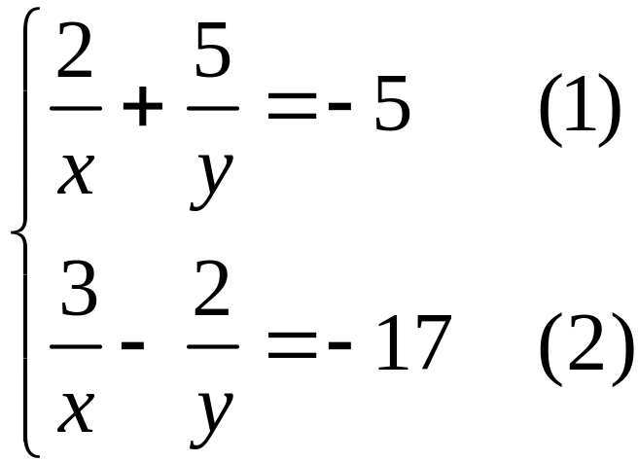


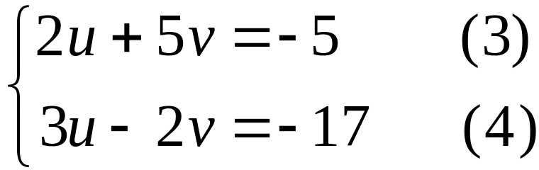
EXAMPLE 7
Using the Elimination Method
Solve the system.
Solution
Replace by u and by v.
Equations (1) and
(2) become:

Slide 34
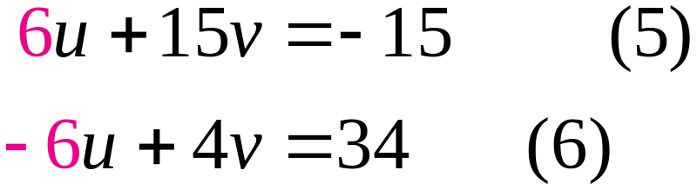


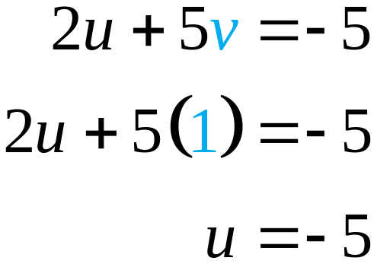
EXAMPLE 7
Using the Elimination Method
Solution continued
Step 1 Select the variable u for elimination.
Step 2
Step 3
Step 4 Back-substitute v = 1 in equation (3).

Slide 35
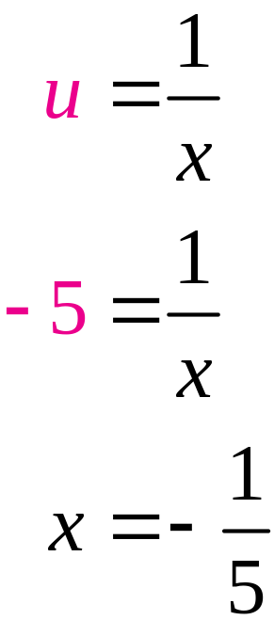
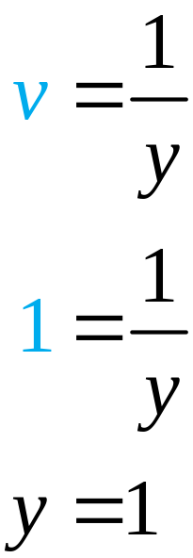
EXAMPLE 7
Using the Elimination Method
Solution continued
Step 5 Solve for x and y, the variables in the original system.

Slide 36
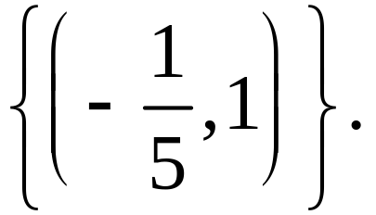
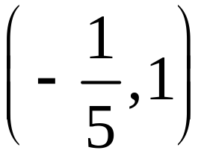
EXAMPLE 7
Using the Elimination Method
Solution continued
Step 5 continued
The solution set is
Step 6 You can verify that the ordered pair
is indeed the solution of the
original system of equations (1) and (2).

Slide 37
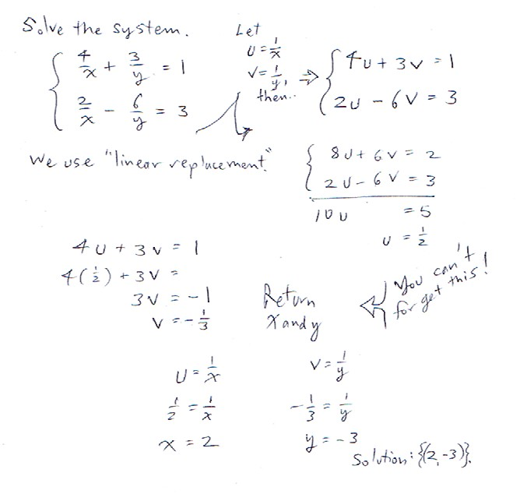

Slide 38
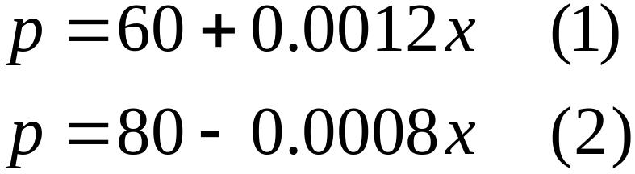
EXAMPLE 8
Finding the Equilibrium Point
Find the equilibrium point if the supply and demand functions for a new brand of digital video recorder (DVR) are given by the system
where p is the price in dollars and x is the number of units.
Solution
Substitute the value of p from equation (1) into equation (2) and solve the resulting equation.

Slide 39
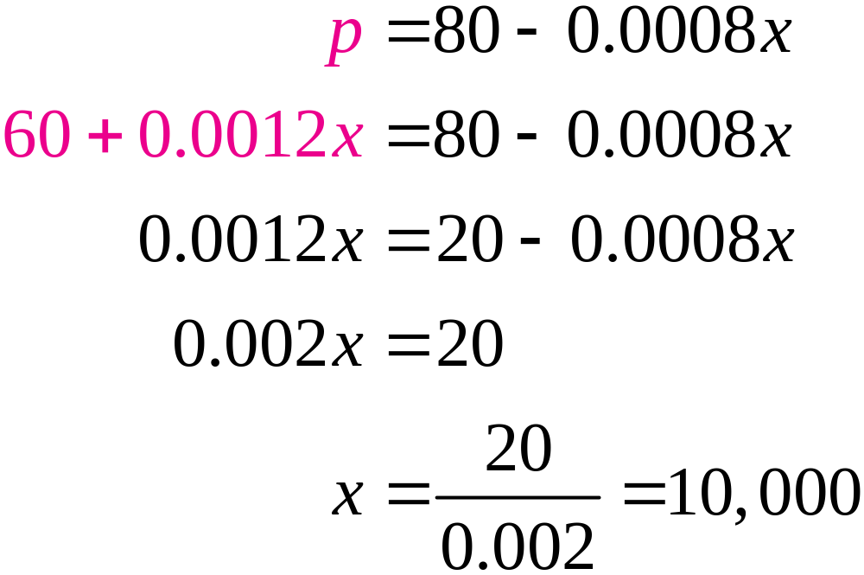
EXAMPLE 8
Finding the Equilibrium Point
Solution continued
To find the price p back-substitute x = 10,000.

Slide 40
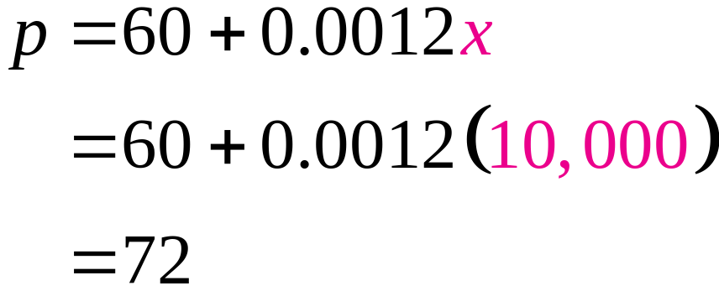
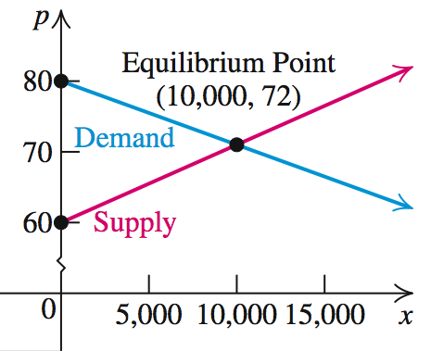
EXAMPLE 8
Finding the Equilibrium Point
Solution continued
The equilibrium point is (10,000, 72).
You can verify that this point satisfies both equations.

Slide 41


