Slide 1



Chapter 7
Systems of Equations
and Inequalities
© 2010 Pearson Education, Inc.
All rights reserved

Slide 2
Systems of Linear Equations in Three Variables
SECTION 7.2
1
Solve a system of linear equations in three variables.
Classify systems as consistent and inconsistent.
Solve nonsquare systems.
Interpret linear systems in three variables geometrically.
Use linear systems in applications.
2
3
4
5

Slide 3

Definitions
A linear equation in the variables x₁, x₂, …, x_{n} is an equation that can be written in the form.
where b and the coefficients a₁, a₂, …, a_{n}, are real numbers. The subscript n may be any positive integer.

Slide 4
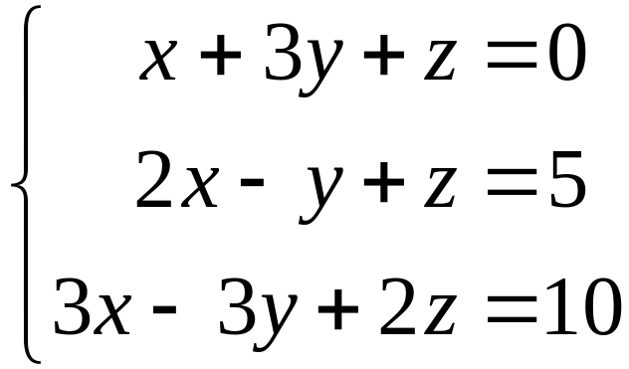
Definitions
A system of linear equations (or a linear system) in three variables is a collection of two or more linear equations involving the same variables. For example,
is a system of three linear equations in three variables x, y, and z.

Slide 5
Definitions
An ordered triple (a, b, c) is a solution of a system of three equations in three variables x, y, and z if each equation in the system is a true statement when a, b, and c are substituted for x, y, and z respectively.

Slide 6
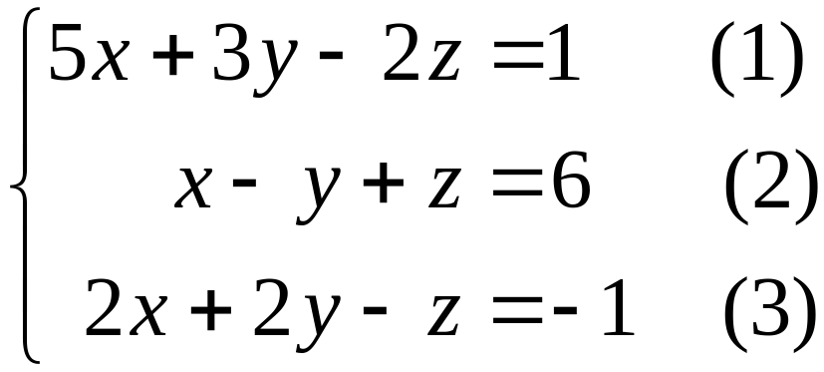
EXAMPLE 1
Verifying a Solution
Determine whether the ordered triple (2, –1, 3) is a solution of the given linear system
Solution
Replace x with 2 and y with –1, and z by 3 in all three equations.

Slide 7
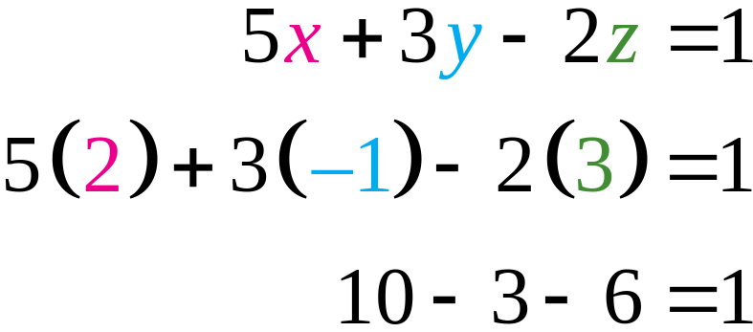
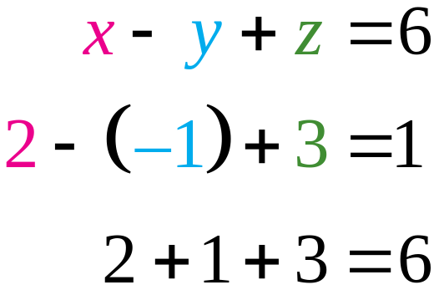
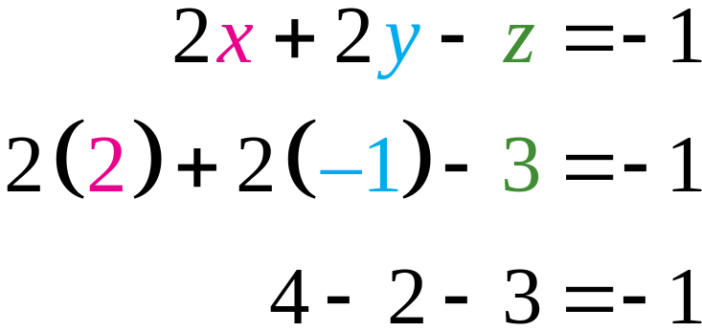
EXAMPLE 1
Verifying a Solution
Solution continued
(2, –1, 3) satisfies all three equations, so it is a solution of the system.

Slide 8
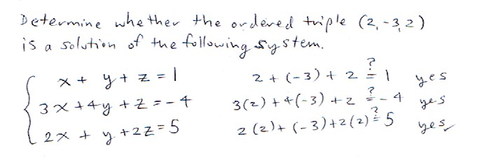

Slide 9
OPERATIONS THAT PRODUCE EQUIVALENT SYSTEMS
1. Interchange the position of any two equations.
2. Multiply any equation by a nonzero constant.
3. Add a nonzero multiple of one equation to another.
A procedure called the Gaussian elimination method is used to convert to triangular form.

Slide 10
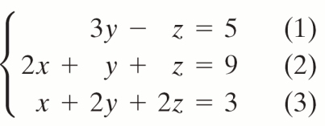
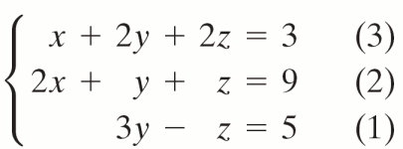
EXAMPLE 2
The Gaussian Elimination Method
OBJECTIVE Solve a system of three equations in three variables by first converting the system to triangular form.
Step 1 Rearrange the equations, if necessary, to obtain an x-term with a nonzero coefficient in the first equation. Then multiply the first equation by the reciprocal of the coefficient of the x-term to get 1 as a leading coefficient.
EXAMPLE Solve the system of equations.
1. Interchange (1) and (3).
© 2010 Pearson Education, Inc. All rights reserved
10
Notes:
10

Slide 11
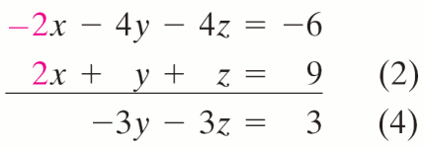
EXAMPLE 2
The Gaussian Elimination Method
OBJECTIVE Solve a system of three equations in three variables by first converting the system to triangular form.
Step 2 By adding appropriate multiples of the first equation, eliminate any x-terms from the second and third equations. Then multiply the resulting second equation by the reciprocal of the coefficient of the y-term to get 1 as a leading coefficient.
EXAMPLE Solve the system of equations.
2. Add −2 times equation (3) to equation (2)
© 2010 Pearson Education, Inc. All rights reserved
11
Notes:
11

Slide 12

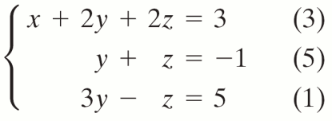
EXAMPLE 2
The Gaussian Elimination Method
OBJECTIVE Solve a system of three equations in three variables by first converting the system to triangular form.
Step 2 By adding appropriate multiples of the first equation, eliminate any x-terms from the second and third equations. Then multiply the resulting second equation by the reciprocal of the coefficient of the y-term to get 1 as a leading coefficient.
EXAMPLE Solve the system of equations.
2. continued Multiply
equation (4) by .
© 2010 Pearson Education, Inc. All rights reserved
12
Notes:
12

Slide 13
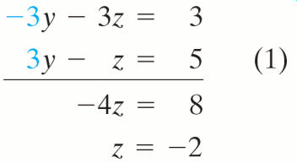
EXAMPLE 2
The Gaussian Elimination Method
OBJECTIVE Solve a system of three equations in three variables by first converting the system to triangular form.
Step 3 Add an appropriate multiple of the second equation from Step 2 to eliminate any y-term from the third equation. Then solve the resulting equation for z.
EXAMPLE Solve the system of equations.
3. Add −3 times equation (5) to equation (1).
© 2010 Pearson Education, Inc. All rights reserved
13
Notes:
13

Slide 14
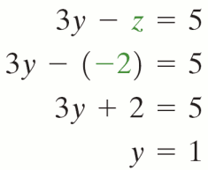
EXAMPLE 2
The Gaussian Elimination Method
OBJECTIVE Solve a system of three equations in three variables by first converting the system to triangular form.
Step 4 Back-substitute the value of z from Step 3 into one of the equations in Step 3 that contains only y and z and solve for y.
EXAMPLE Solve the system of equations.
4.
© 2010 Pearson Education, Inc. All rights reserved
14
Notes:
14

Slide 15
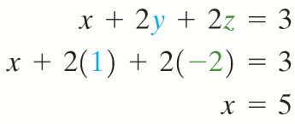
EXAMPLE 2
The Gaussian Elimination Method
OBJECTIVE Solve a system of three equations in three variables by first converting the system to triangular form.
Step 5 Back-substitute the values of y and z from Steps 3 and 4 in any equation containing x, y, and z and solve for x.
EXAMPLE Solve the system of equations.
5.
© 2010 Pearson Education, Inc. All rights reserved
15
Notes:
15

Slide 16
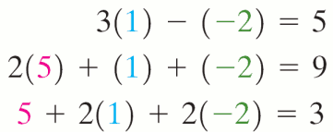
EXAMPLE 2
The Gaussian Elimination Method
OBJECTIVE Solve a system of three equations in three variables by first converting the system to triangular form.
Step 6 Write the solution set.
Step 7 Check your answer in the original equations.
EXAMPLE Solve the system of equations.
6. The solution set is {(5, 1, −2)}
7. Check: Verify the solution by substituting x = 5, y = 1, and z = −2 in each of the original equations.
© 2010 Pearson Education, Inc. All rights reserved
16
Notes:
16

Slide 17
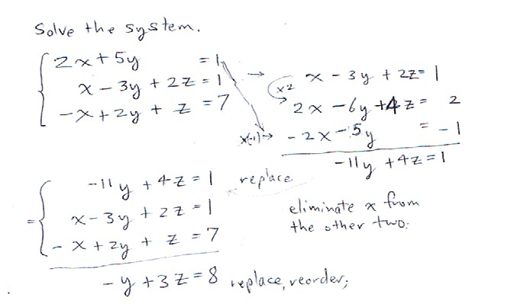

Slide 18
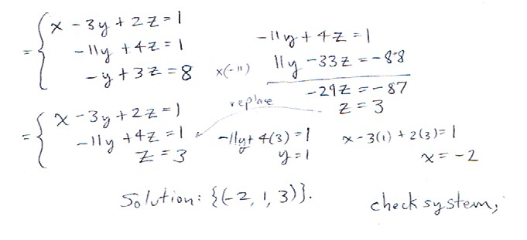

Slide 19
INCONSISTENT SYSTEM
If in the process of converting a linear system to triangular form, an equation of the form 0 = a occurs, where a ≠ 0, then the system has no solution and is inconsistent.

Slide 20
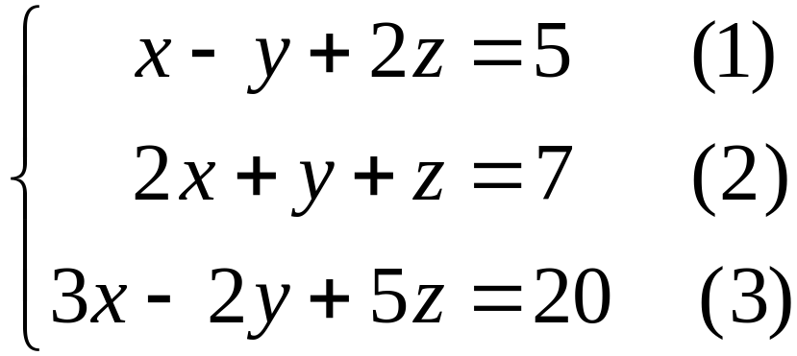
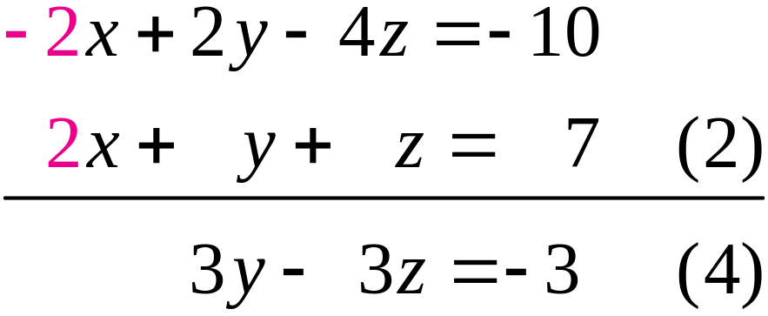
EXAMPLE 3
Attempting to Solve a Linear System with No solution
Solve the system of equations.
Solution
Steps 1-2 To eliminate x from equation (2), add –2 times equation (1) to equation (2).

Slide 21
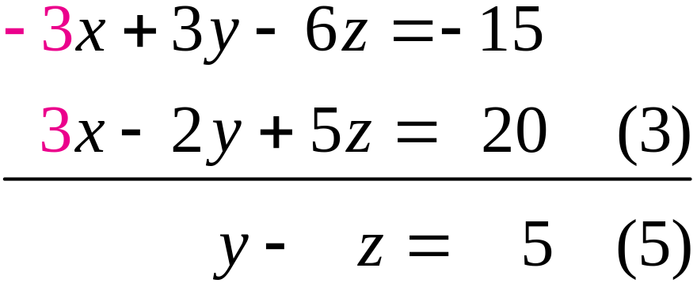
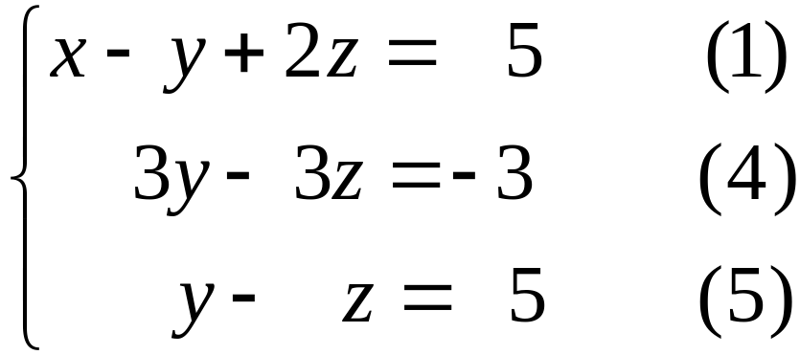
EXAMPLE 3
Attempting to Solve a Linear System with No solution
Solution continued
Next add –3 times equation (1) to equation (3) to eliminate x from equation (3).
We now have the following system:

Slide 22


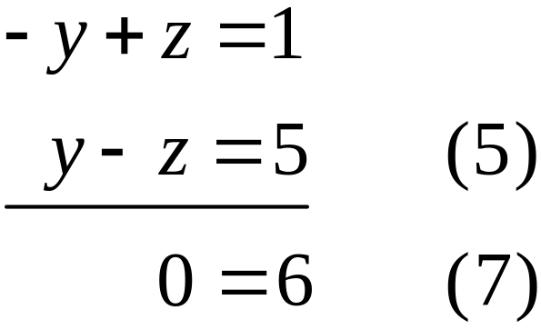
EXAMPLE 3
Attempting to Solve a Linear System with No solution
Solution continued
Step 3 Multiply equation (4) by to obtain
To eliminate y from equation (5), add –1 times equation (6) to equation (5).

Slide 23
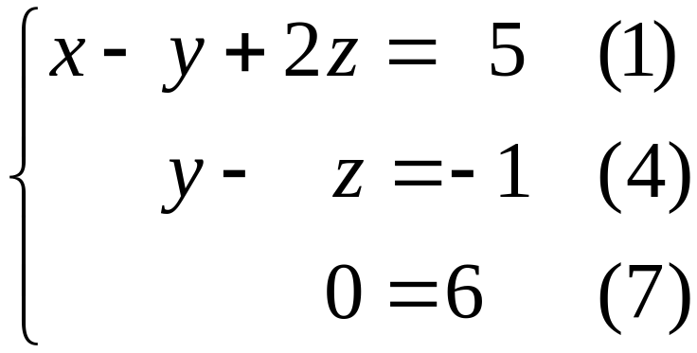

EXAMPLE 3
Attempting to Solve a Linear System with No solution
Solution continued
We now have the system in triangular form:
This system is equivalent to the original system. Since equation (7) is false, we conclude that the solution set of the system is and the system is inconsistent.

Slide 24
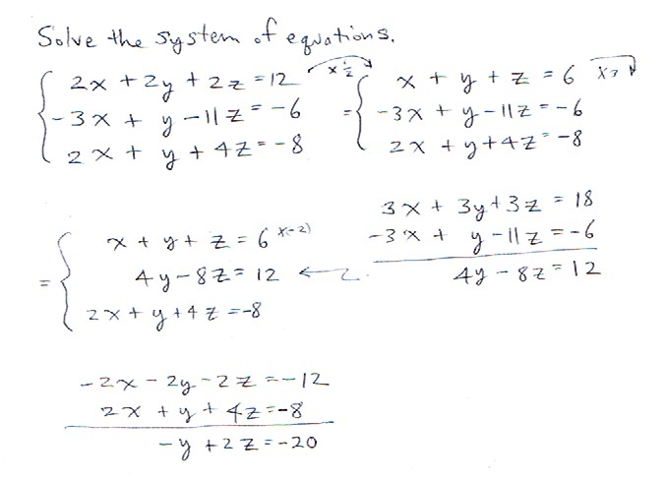

Slide 25
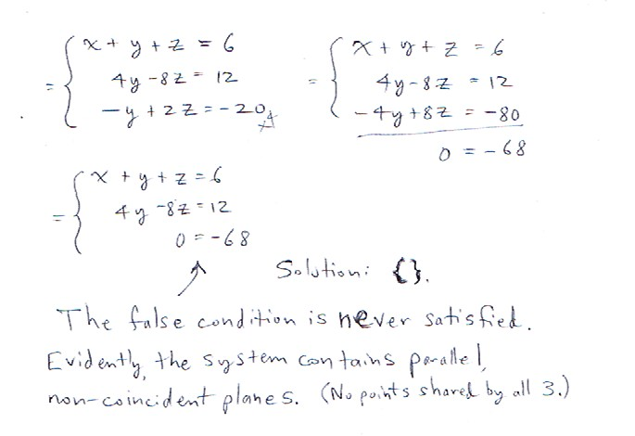

Slide 26
DEPENDENT EQUATIONS
If in the process of converting a linear system to triangular form,
an equation of the form 0 = a (a ≠ 0) does not occur, but
an equation of the form 0 = 0 does occur, then the system of equations has infinitely many solutions and the equations are dependent.

Slide 27
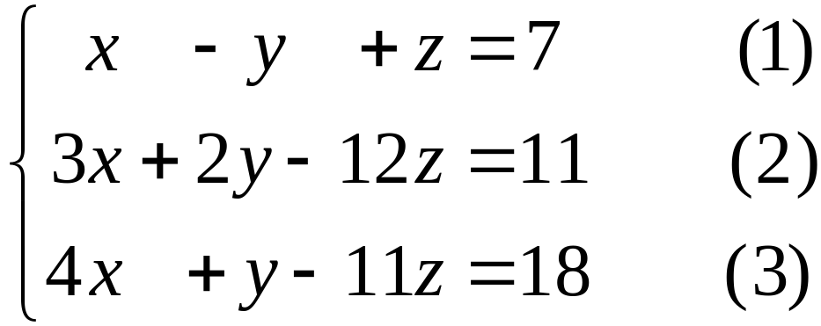
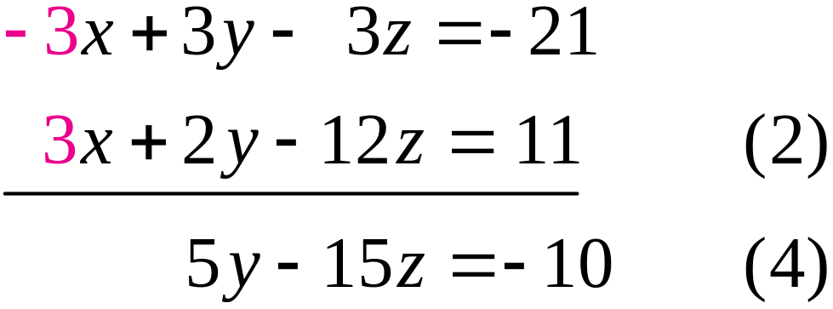
EXAMPLE 4
Solving a System with Infinitely Many Solutions
Solve the system of equations.
Solution
Steps 1-2 Eliminate x from equation (2) by adding –3 times equation (1) to equation (2).

Slide 28
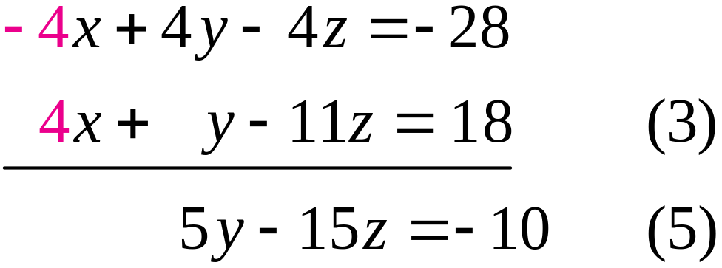
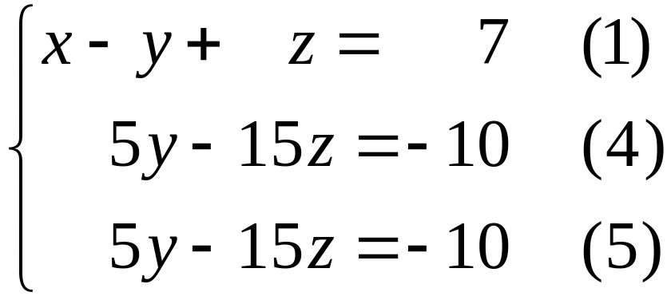
EXAMPLE 4
Solving a System with Infinitely Many Solutions
Solution continued
Eliminate x from equation (3) by adding –4 times equation (1) to equation (3).
We now have the equivalent system.

Slide 29
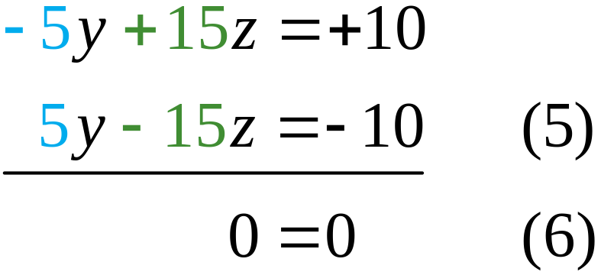
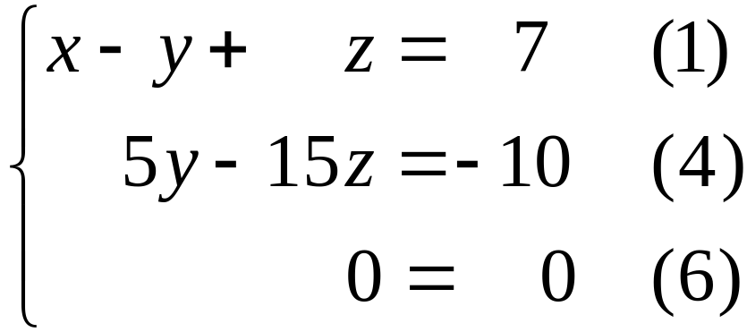
EXAMPLE 4
Solving a System with Infinitely Many Solutions
Solution continued
Step 3 To eliminate y from equation (5), add –1 times equation (4) to equation (5).
We finally have the system in triangular form.

Slide 30
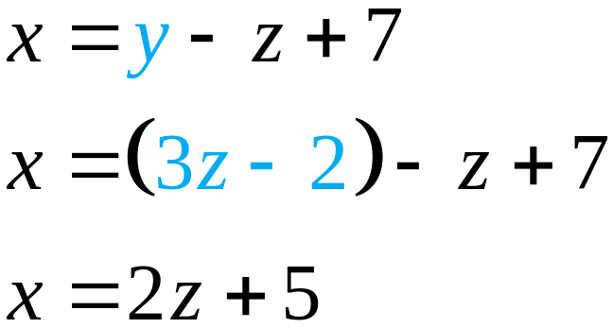
EXAMPLE 4
Solving a System with Infinitely Many Solutions
Solution continued
The equation 0 = 0 may be interpreted as 0z = 0, which is true for every value of z. Solving equation (4) for y, we have y = 3z – 2. Substituting into equation (1) and solving for x.
Thus every triple (x, y, z) = (2z + 5, 3z – 2, z) is a solution of the system for each value of z.

Slide 31
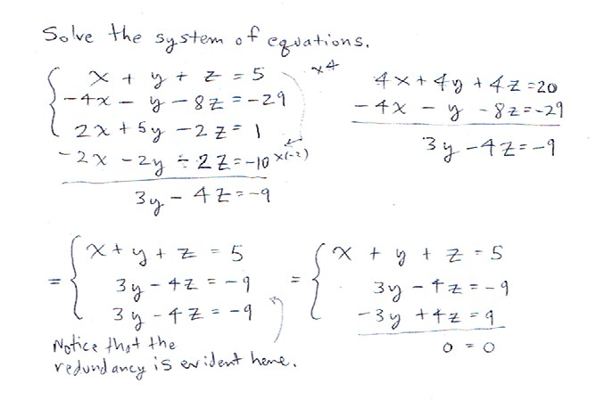

Slide 32
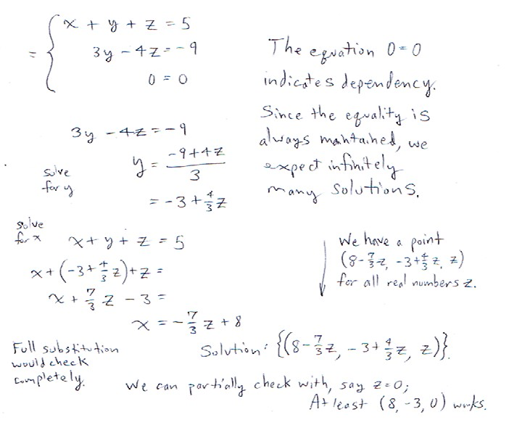

Slide 33
NONSQUARE SYSTEMS
Sometimes in a linear system, the number of equations is not the same as the number of variables.
Such systems are called nonsquare linear systems.

Slide 34
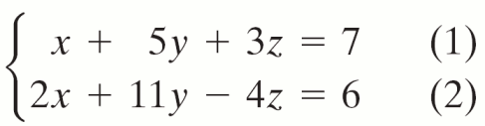
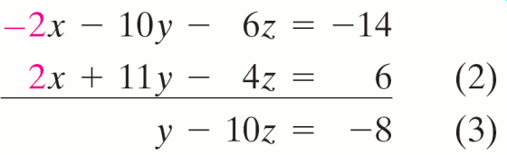
EXAMPLE 5
Solving a Nonsquare Linear System
Solve the system of equations.
Solution
Steps 1-2 Eliminate x from equation (2) by adding –2 times equation (1) to equation (2).

Slide 35
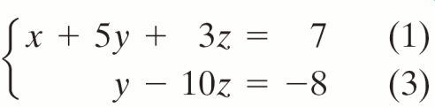
EXAMPLE 5
Solving a Nonsquare Linear System
Solution continued
We now have the equivalent system.
Steps 3-4 Since there is no third equation, steps 3 and 4 are not needed.
Step 5 Solve equation (3) for y in terms of z to obtain y = 10z – 8.

Slide 36
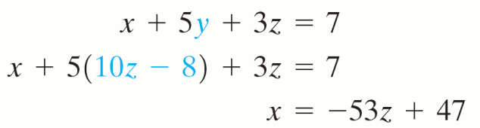
EXAMPLE 5
Solving a Nonsquare Linear System
Solution continued
Step 6 Back-substitute y = 10z – 8 into equation (1) and solve for x.
z determines both the x and y values. The system has infinitely many solutions, one for each real number z. The solution set is {(−53z + 47), (10z – 8, z)}.

Slide 37
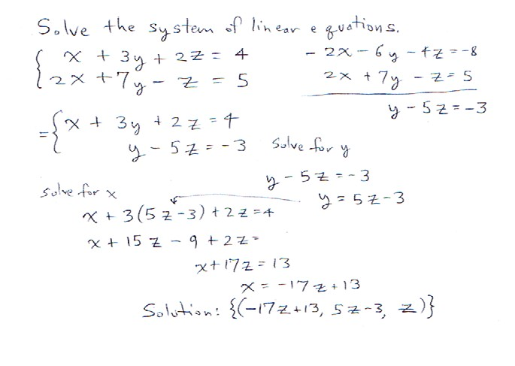

Slide 38
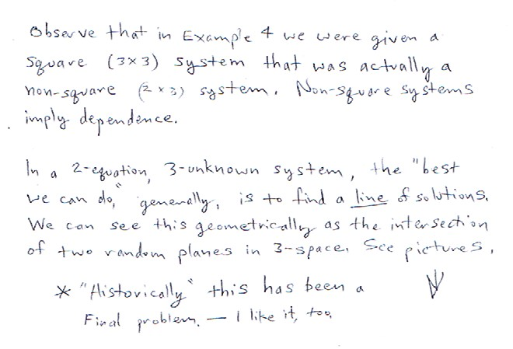

Slide 39
GEOMETRIC INTERPRETATION
The graph of a linear equation in three variables, such as ax + by + cz = d (where a, b, and c are not all zero), is a plane in three-dimensional space. Following are the possible situations for a system of three linear equations in three variables.

Slide 40
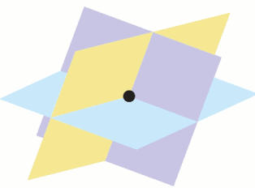

GEOMETRIC INTERPRETATION
a. Three planes intersect in a single point. The system has only one solution.
b. Three planes intersect in one line. The system has infinitely many solutions.

Slide 41


GEOMETRIC INTERPRETATION
Three planes coincide with each other.
The system has infinitely many solutions.
d. There are three parallel planes. The system has no solution.

Slide 42


GEOMETRIC INTERPRETATION
e. Two parallel planes are intersected by a third plane. The system has no solution.
f. Three planes have no point in common. The system has no solution.

Slide 43
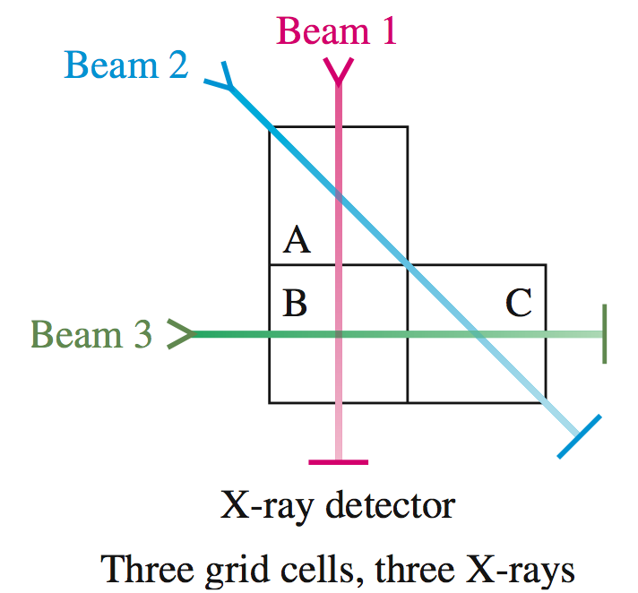
EXAMPLE 6
A CAT Scan with Three Grid Cells
Let A, B, and C be three grid cells as shown. A CAT scanner reports the data on the following slide for a patient named Monica:

Slide 44
EXAMPLE 6
A CAT Scan with Three Grid Cells
Beam 1 is weakened by 0.80 unit as it passes through grid cells A and B.
Beam 2 is weakened by 0.55 unit as it passes through grid cells A and C.
Beam 3 is weakened by 0.65 unit as it passes through grid cells B and C.
Using the following table, determine which grid cells contain each of the type of tissue listed.

Slide 45
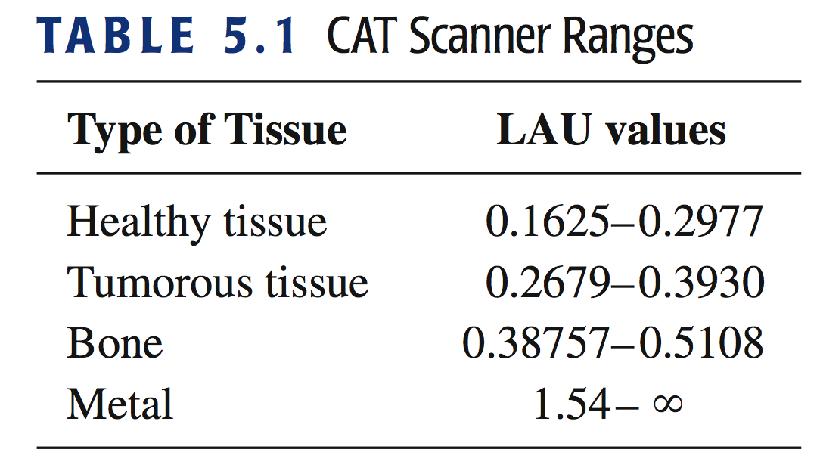
EXAMPLE 6
A CAT Scan with Three Grid Cells
CAT Scanner Ranges

Slide 46
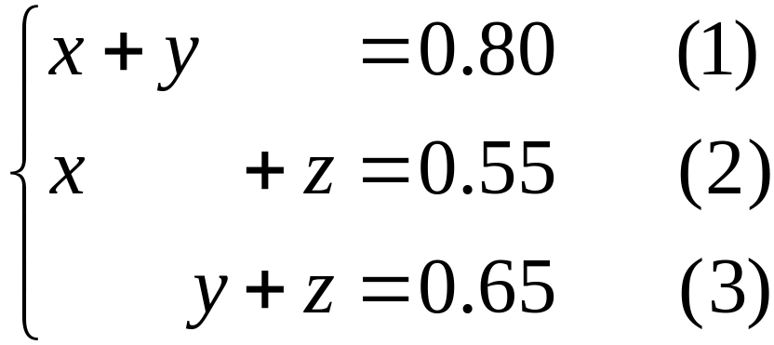
EXAMPLE 6
A CAT Scan with Three Grid Cells
Solution
Suppose grid cell A weakens the beam by x units, grid cell B weakens the beam by y units, and grid cell C weakens the beam by z units. Then we have the system,
To solve this system of equations, we use the elimination procedure.

Slide 47
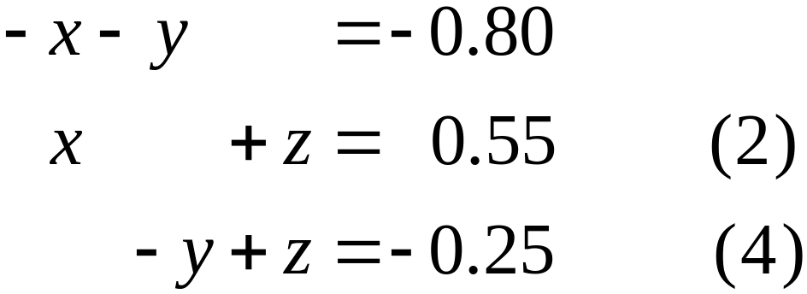
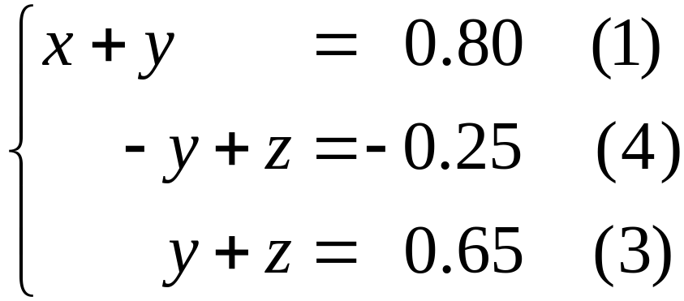
EXAMPLE 6
A CAT Scan with Three Grid Cells
Solution continued
Add –1 times equation (1) to equation (2).
We obtain the equivalent system:

Slide 48
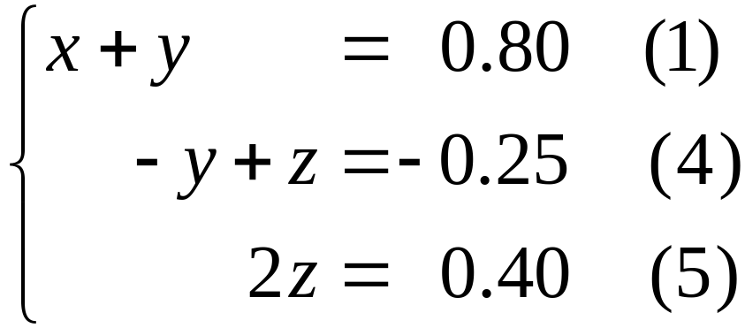

EXAMPLE 6
A CAT Scan with Three Grid Cells
Solution continued
Add equation (4) to equation (3) to get
Multiply equation (5) by to obtain z = 0.20. Back-substitute z = 0.20 into equation (4) to get:

Slide 49
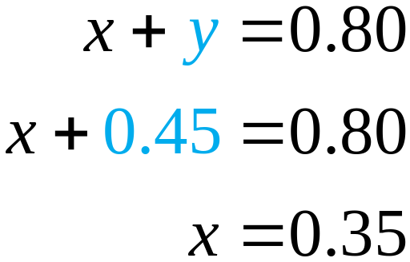
EXAMPLE 6
A CAT Scan with Three Grid Cells
Solution continued
Back-substitute y = 0.45 into equation (1) and solve for x.
Referring to the table, we conclude:
Cell A contains tumorous tissue (x = 0.35),
Cell B contains a bone (y = 0.45), and
Cell C contains healthy tissue (z = 0.20).

Slide 50
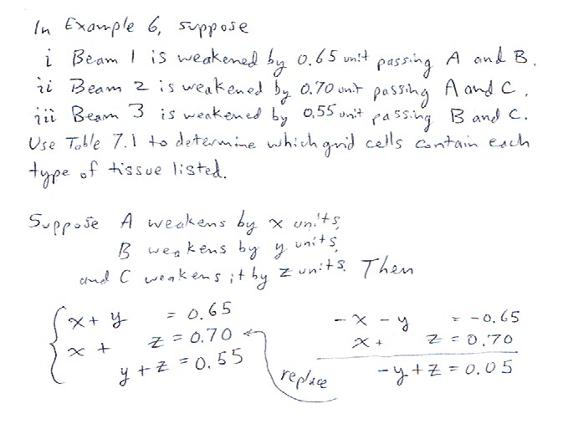

Slide 51
