Slide 1



Chapter 7
Systems of Equations
and Inequalities
© 2010 Pearson Education, Inc.
All rights reserved

Slide 2
Nonlinear Systems of Equations and Inequalities
SECTION 7.4
Solve nonlinear systems of equations.
Solve a nonlinear system of inequalities.
You will not need to know the details of inequalities.
1
2

Slide 3
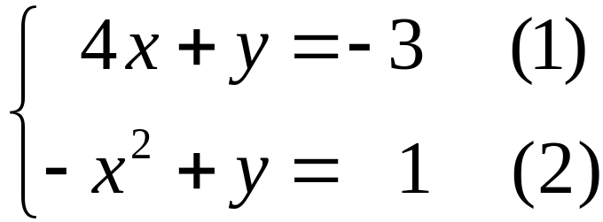
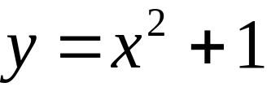
EXAMPLE 1
Using Substitution to Solve a Nonlinear System
Solve the system of equations by the substitution method.
Solution
Step 1 Solve for one variable. Express y in terms of x in equation (2).
Step 2 Substitute. Substitute x2 +1 for y in equation (1).

Slide 4
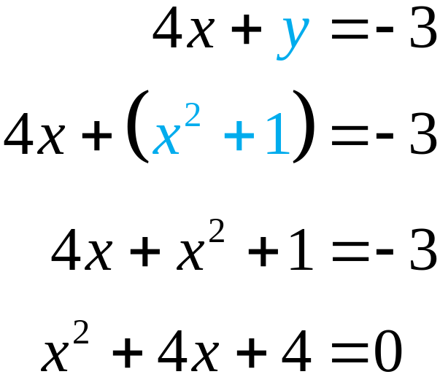
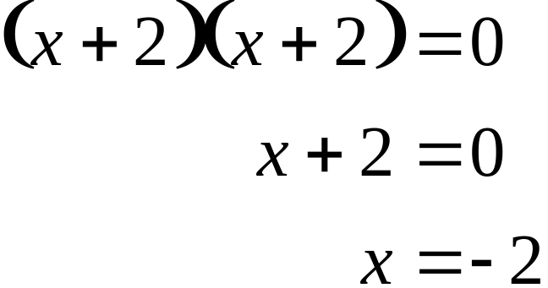
EXAMPLE 1
Using Substitution to Solve a Nonlinear System
Solution continued
Step 3 Solve the equation resulting from step (2).

Slide 5
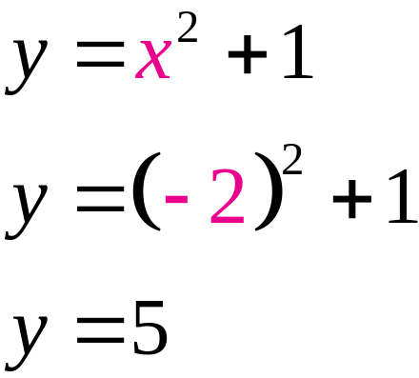
EXAMPLE 1
Using Substitution to Solve a Nonlinear System
Solution continued
Step 4 Back substitution. Substitute x = –2 in equation (3) to obtain the corresponding y-value.
Since x = –2 and y = 5, the apparent solution set of the system is {(–2, 5)}.

Slide 6
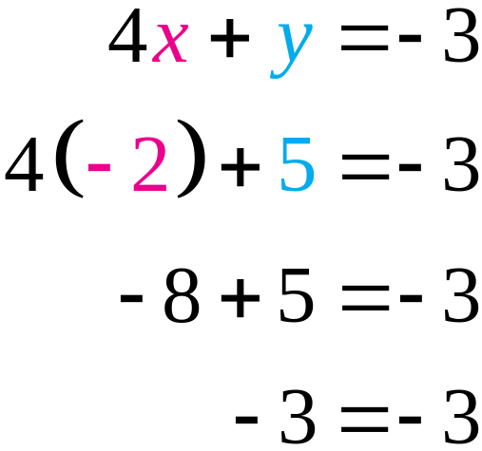
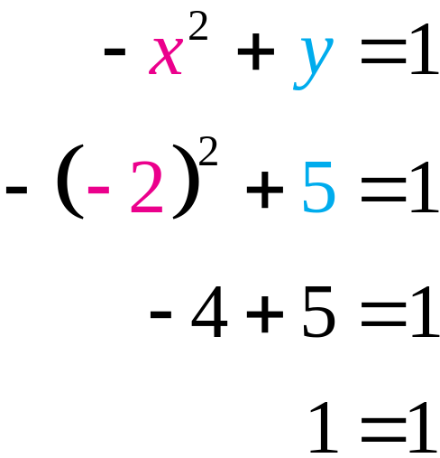
EXAMPLE 1
Using Substitution to Solve a Nonlinear System
Solution continued
Step 5 Check. Replace x with –2 and y with 5 in both equations (1) and (2).
?
?
?
?
Confirm the solution with a graph.

Slide 7
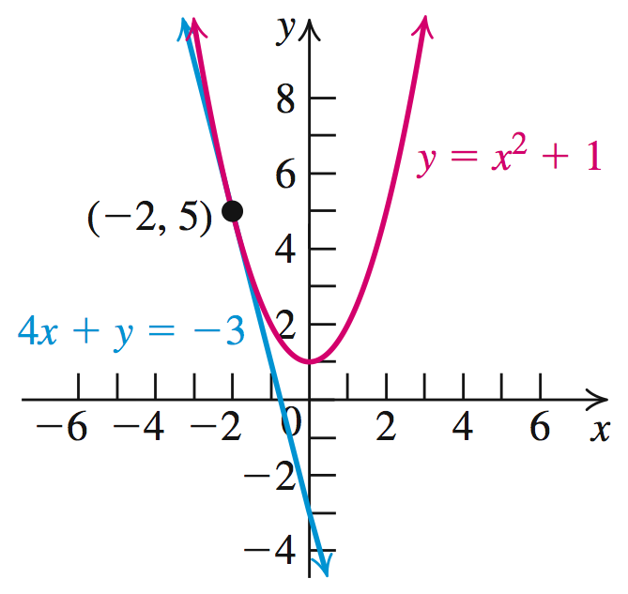
EXAMPLE 1
Using Substitution to Solve a Nonlinear System
Solution continued
The graphs of the line 4x + y = –3 and the parabola y = x 2 + 1 confirm that the solution set is {(–2, 5)}.

Slide 8
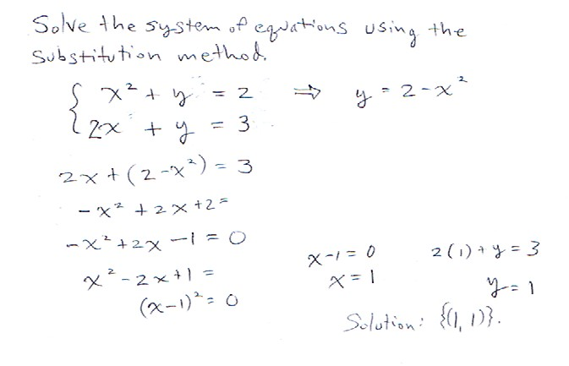

Slide 9
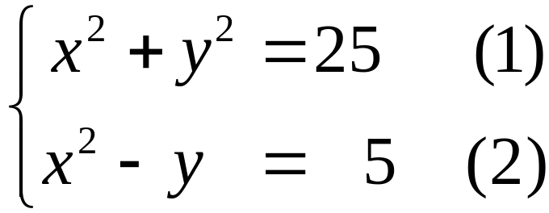
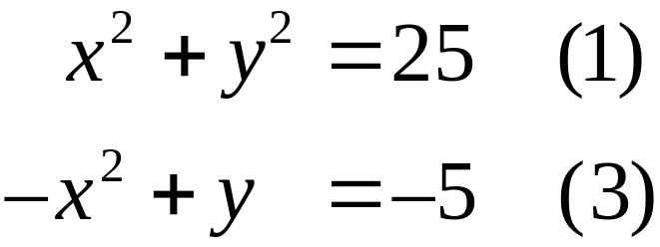
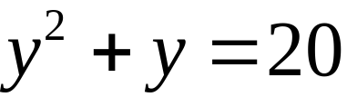
Using Elimination to Solve a Nonlinear System
EXAMPLE 2
Solve the system of equations by the elimination method.
Solution
Step 1 Adjust the coefficients. Multiply equation (2) by –1 to eliminate x.
Step 2

Slide 10
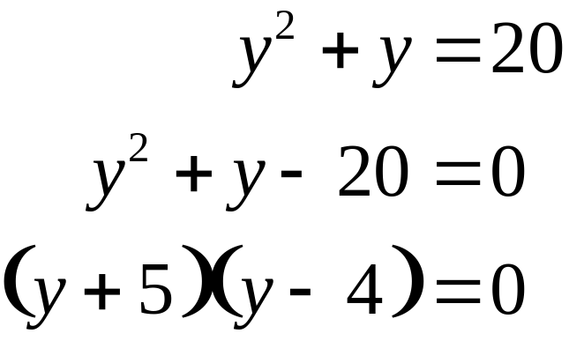
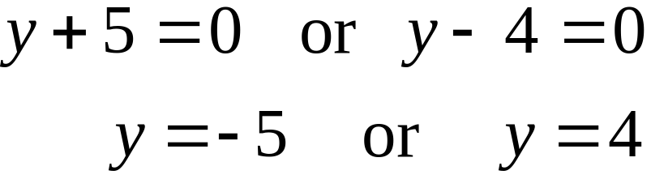
Using Elimination to Solve a Nonlinear System
EXAMPLE 2
Solution continued
Step 3 Solve the equation obtained in Step 2.
Step 4 Back-substitute the values in one of the original equations to solve for the other variable.

Slide 11
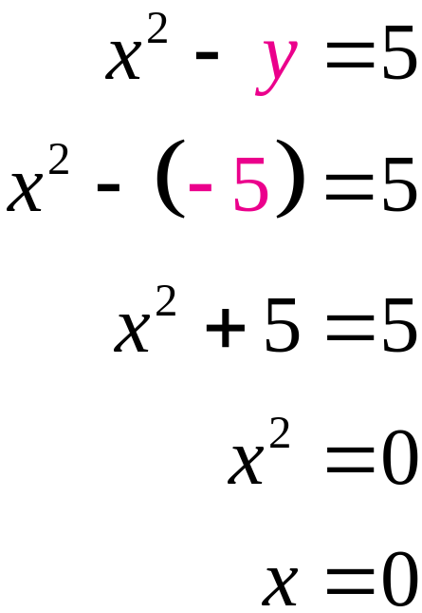
Using Elimination to Solve a Nonlinear System
EXAMPLE 2
Solution continued
(i) Substitute y = –5 in equation (2) & solve for x.
Thus (0, –5) is a solution of the system.

Slide 12
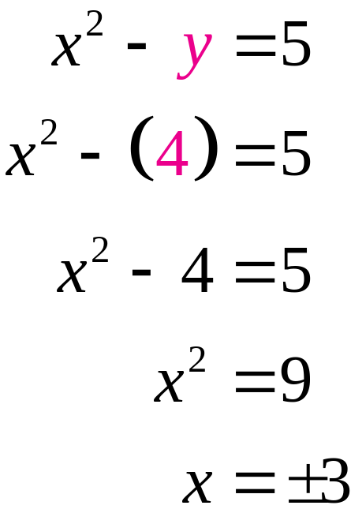
Using Elimination to Solve a Nonlinear System
EXAMPLE 2
Solution continued
(ii) Substitute y = 4 in equation (2) & solve for x.
Thus (3, 4) and (–3, 4) are the solutions of the system.

Slide 13
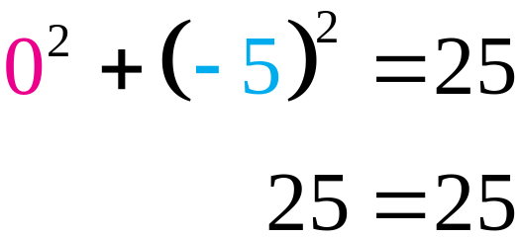
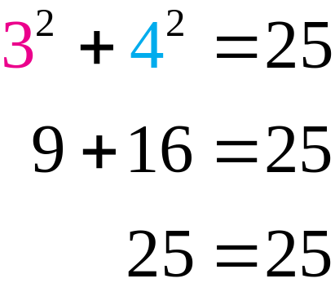
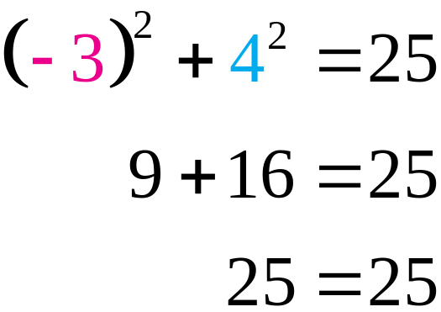
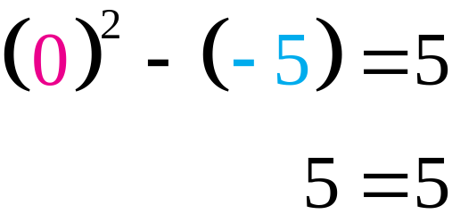
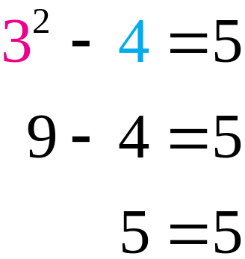
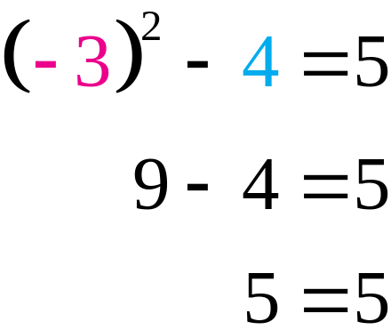
Using Elimination to Solve a Nonlinear System
EXAMPLE 2
Solution continued
Step 5 Check (0, –5), (3, 4), and (–3, 4) in the equations x2 + y2 = 25 and x2 – y = 5.
?
?
?
?
?
?
?
?
?
?

Slide 14
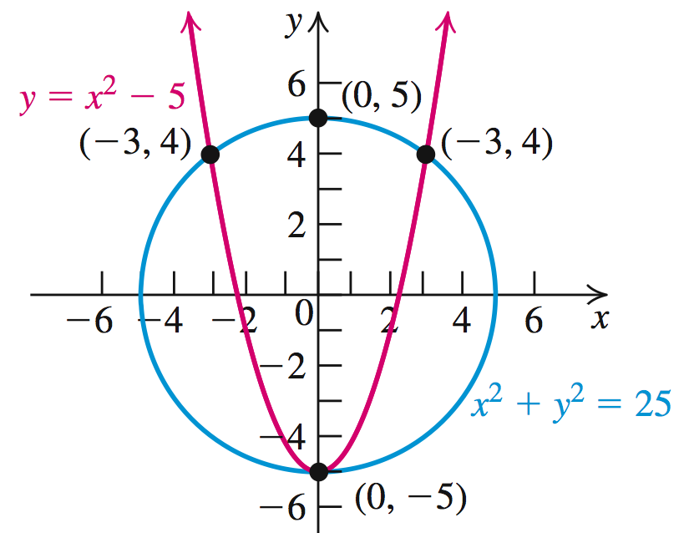
Using Elimination to Solve a Nonlinear System
EXAMPLE 2
Solution continued
The graphs of the circle
x2 + y2 = 25 and the parabola
y = x 2 – 5 confirm that the solution set is
{(0, –5), (3, 4), (–3, 4)}.

Slide 15
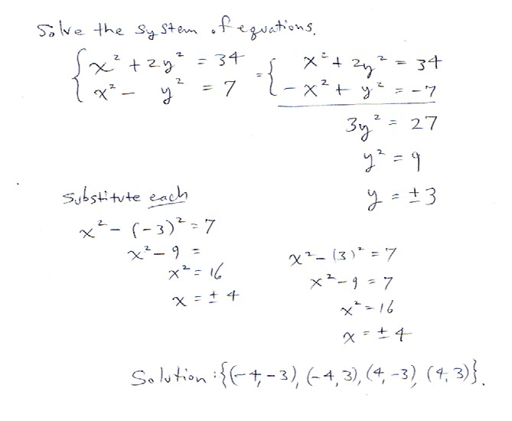

Slide 16
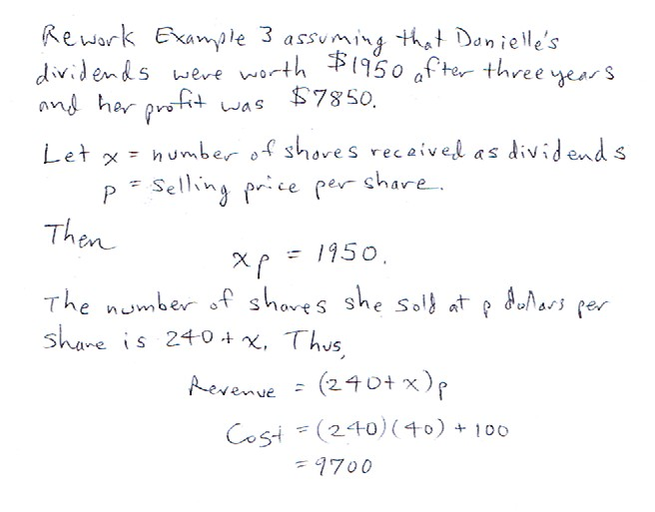
Since the nature of such a problem requires a rather lengthy list of formulas, it is unlikely that this would be a FE problem.
Business majors might wish to look at Example 3 and this related problem. It seems specialized.

Slide 17
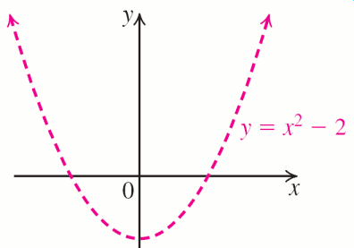
Graphing a Nonlinear Inequality in Two Variables
EXAMPLE 4
OBJECTIVE Graph a nonlinear inequality in two variables.
Step 1 Replace the inequality symbol with an equal (=) sign.
Step 2 Sketch the graph of the corresponding equation in Step 1. Use a dashed curve if the given inequality sign is < or > and a solid curve if the inequality symbol is ≤ or ≥.
EXAMPLE Graph y > x2 – 2.
1. y = x2 – 2
2.
© 2010 Pearson Education, Inc. All rights reserved
17
Notes:
17

Slide 18
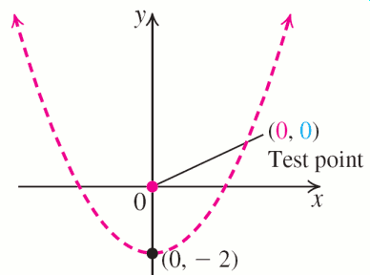
Graphing a Nonlinear Inequality in Two Variables
EXAMPLE 4
OBJECTIVE Graph a nonlinear inequality in two variables.
Step 3 The graph in Step 2 divides the plane into two regions. Select a test point in either region, but not on the graph.
EXAMPLE Graph y > x2 – 2.
3.
© 2010 Pearson Education, Inc. All rights reserved
18
Notes:
18

Slide 19
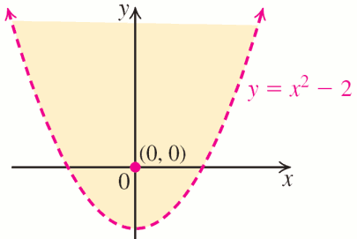
Graphing a Nonlinear Inequality in Two Variables
EXAMPLE 4
OBJECTIVE Graph a nonlinear inequality in two variables.
Step 4 (i) If the coordinates of the test point satisfy the inequality, then so do all of the points in that region. Shade that region.
(ii) If the test point’s coordinates do not satisfy the inequality, shade the region that does not contain the test point.
EXAMPLE Graph y > x2 – 2.
4. 0 > 02 – 2 = –2, so the test point (0, 0) satisfies the inequality .
© 2010 Pearson Education, Inc. All rights reserved
19
Notes:
19

Slide 20
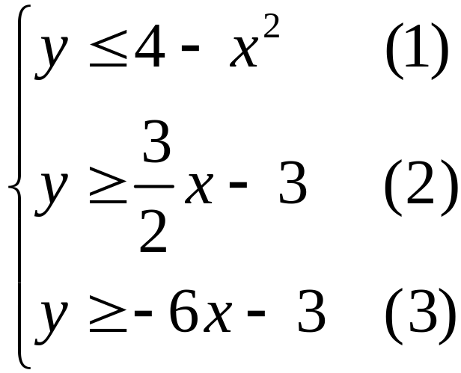
EXAMPLE 5
Solving a Nonlinear System of Inequalities
Graph the solution set of the following system of
inequalities:
Solution
Graph each inequality separately in the same coordinate plane. Since (0, 0) is not a solution of any the corresponding equations, use (0, 0) as a test point for each inequality.

Slide 21
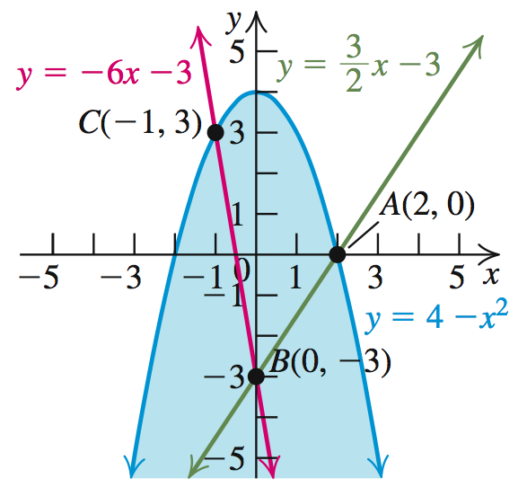
EXAMPLE 5
Solving a Nonlinear System of Inequalities
Solution continued
Step 1 y = 4 – x2
Step 2 Sketch as a solid curve with vertex (0, 4).
Step 3 Test (0, 0). 0 ≤ 4 – 0 is a true statement.
Step 4 Shade the region.

Slide 22
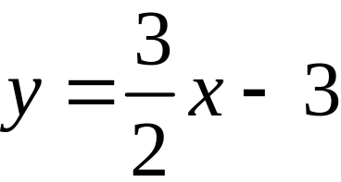
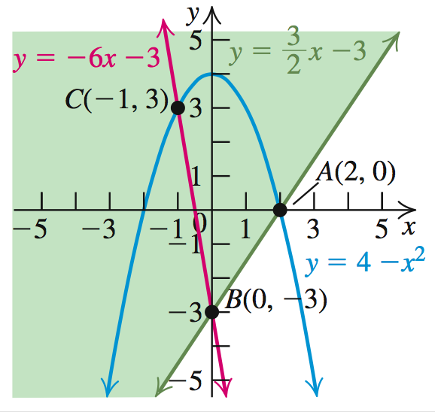
EXAMPLE 5
Solving a Nonlinear System of Inequalities
Solution continued
Step 1
Step 2 Sketch as a solid line through (0, –3) & (2, 0).
Step 3 Test (0, 0). 0 ≥ 0 – 3 is a true statement.
Step 4 Shade the region.

Slide 23
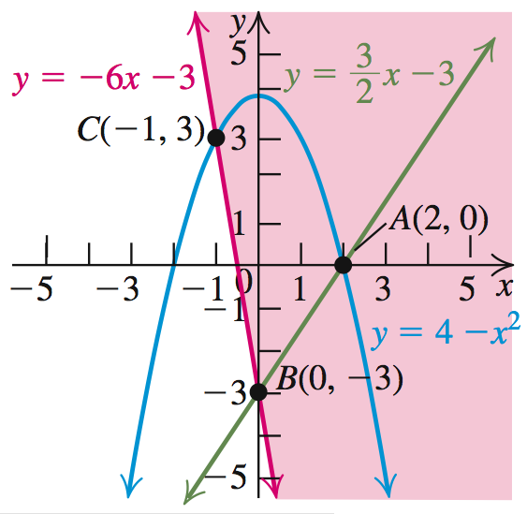
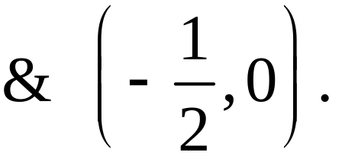
EXAMPLE 5
Solving a Nonlinear System of Inequalities
Solution continued
Step 1 y = –6x – 3
Step 2 Sketch as a solid line through (0, –3)
Step 3 Test (0, 0). 0 ≥ 0 – 3 is a true statement.
Step 4 Shade the region.

Slide 24
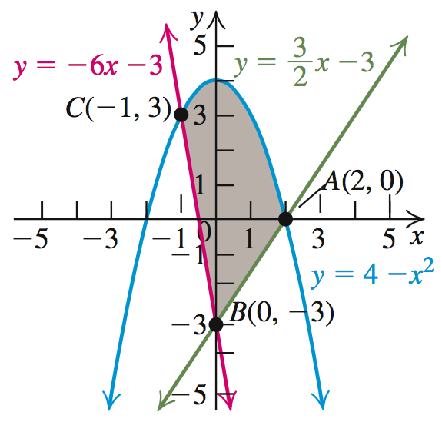
EXAMPLE 5
Solving a Nonlinear System of Inequalities
Solution continued
The region common to all three graphs is the graph of the solution set of the given system of inequalities.

