Slide 1



Chapter 7
Systems of Equations
and Inequalities
© 2010 Pearson Education, Inc.
All rights reserved

Slide 2
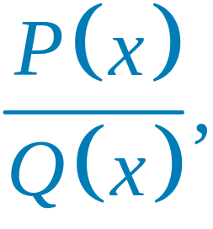
Partial-Fraction Decomposition
SECTION 7.5
Become familiar with partial-fraction decomposition.
Decompose when Q(x) has only distinct linear factors.
Decompose when Q(x) has repeated linear factors.
1
2
3

Slide 3
Partial-Fraction Decomposition
SECTION 7.5
Decompose when Q(x) has distinct irreducible quadratic factors.
Decompose when Q(x) has repeated irreducible quadratic factors.
4
5

Slide 4
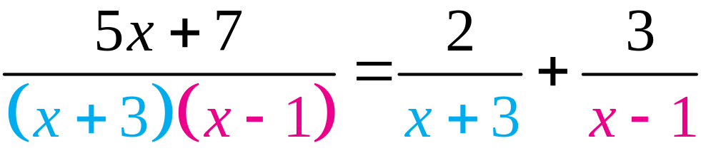
PARTIAL FRACTIONS
Each of the two fractions on the right is called a partial fraction.
Their sum is called the partial-fraction decomposition of the rational expression on the left.

Slide 5
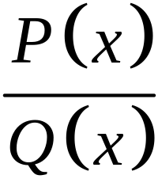
PARTIAL FRACTIONS
A rational expression is called improper if the degree P(x) ≥ degree Q(x) and is called
proper if the degree P(x) < Q(x).
We restrict our discussion of the decomposition of into partial fractions to cases involving proper rational expressions.

Slide 6
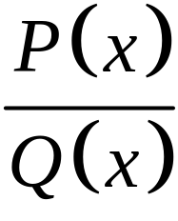
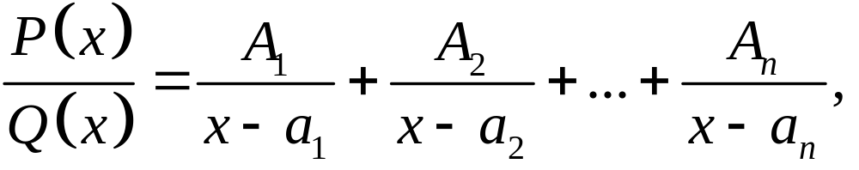
CASE 1: THE DENOMINATOR IS THE PRODUCT OF DISTINCT (NONREPEATED) LINEAR FACTORS
Suppose Q(x) can be factored as
with no factor repeated. The partial-fraction
decomposition of is of the form
where A₁, A₂, …, A_{n}, are constants to be determined.

Slide 7

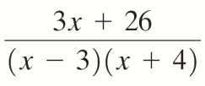

EXAMPLE 1
Partial-Fraction Decomposition
OBJECTIVE Find the partial-fraction decomposition of a rational expression.
Step 1 Write the form of the partial-fraction decomposition with the unknown constants A, B, C,… in the numerators of the decomposition.
EXAMPLE Find the partial fraction decomposition of
1.
© 2010 Pearson Education, Inc. All rights reserved
7
Notes:
7

Slide 8
EXAMPLE 1
Partial-Fraction Decomposition
OBJECTIVE Find the partial-fraction decomposition of a rational expression.
Step 2 Multiply both sides of the equation in Step 1 by the original denominator. Use the distributive property and eliminate common factors. Simplify.
EXAMPLE Find the partial fraction decomposition of
2. Multiply both sides by (x – 3)(x + 4) and simplify to obtain
3x + 26 = (x + 4)A + (x – 3)B.
© 2010 Pearson Education, Inc. All rights reserved
8
Notes:
8

Slide 9

EXAMPLE 1
Partial-Fraction Decomposition
OBJECTIVE Find the partial-fraction decomposition of a rational expression.
Step 3 Write both sides of the equation in Step 2 in descending powers of x and equate the coefficients of like powers of x.
EXAMPLE Find the partial fraction decomposition of
3. 3x + 26 = (A + B)x + 4A – 3B
© 2010 Pearson Education, Inc. All rights reserved
9
Notes:
9

Slide 10
EXAMPLE 1
Partial-Fraction Decomposition
OBJECTIVE Find the partial-fraction decomposition of a rational expression.
Step 4 Solve the linear system resulting from Step 3 for the constants A, B, C,…
EXAMPLE Find the partial fraction decomposition of
4. Solving the system of equations in Step 3, we obtain A = 5 and B = –2.
© 2010 Pearson Education, Inc. All rights reserved
10
Notes:
10

Slide 11
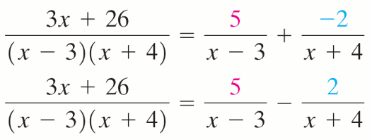
EXAMPLE 1
Partial-Fraction Decomposition
OBJECTIVE Find the partial-fraction decomposition of a rational expression.
Step 5 Substitute the values you found for A, B, C,… into the equation in Step 1 and write the partial-fraction decomposition.
EXAMPLE Find the partial fraction decomposition of
5.
© 2010 Pearson Education, Inc. All rights reserved
11
Notes:
11

Slide 12
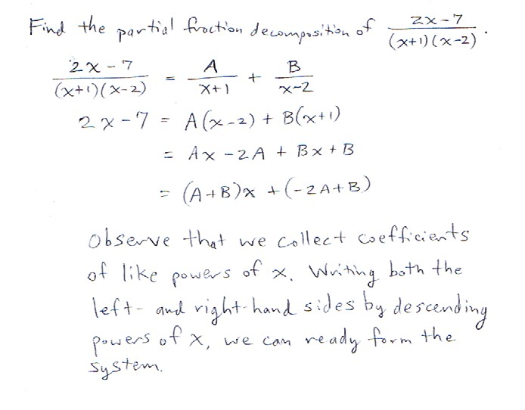

Slide 13
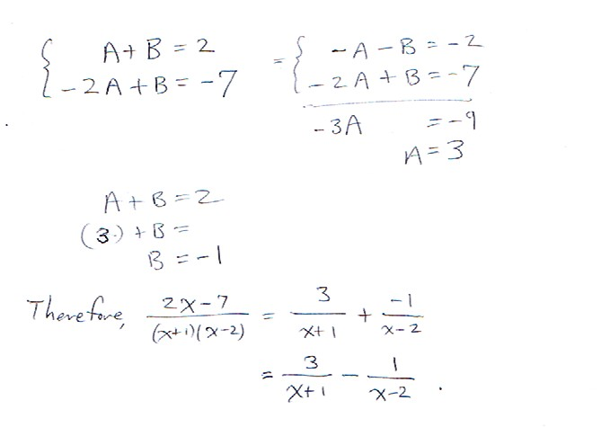

Slide 14
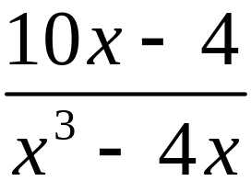
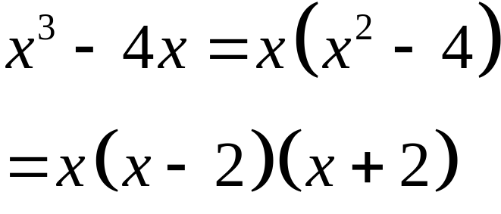
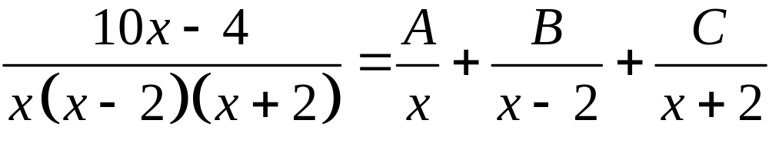
Finding the Partial-Fraction Decomposition When the Denominator has Only Distinct Linear Factors
EXAMPLE 2
Find the partial-fraction decomposition of the expression.
Solution
Factor the denominator.
Step 1 Write the partial-fraction.

Slide 15
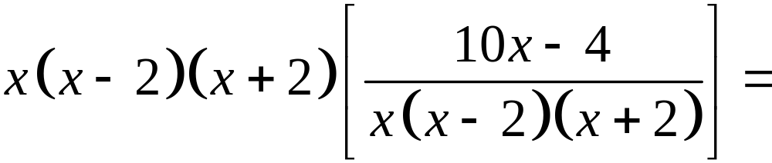

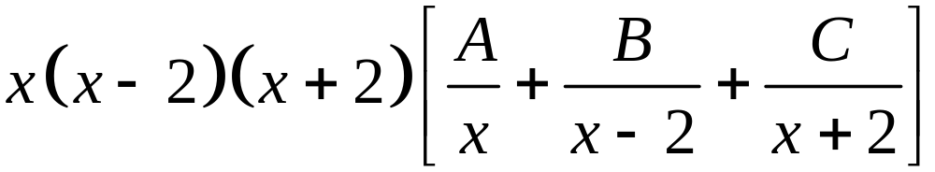
Finding the Partial-Fraction Decomposition When the Denominator has Only Distinct Linear Factors
EXAMPLE 2
Solution continued
Step 2 Multiply by the common denominator.
Distribute

Slide 16
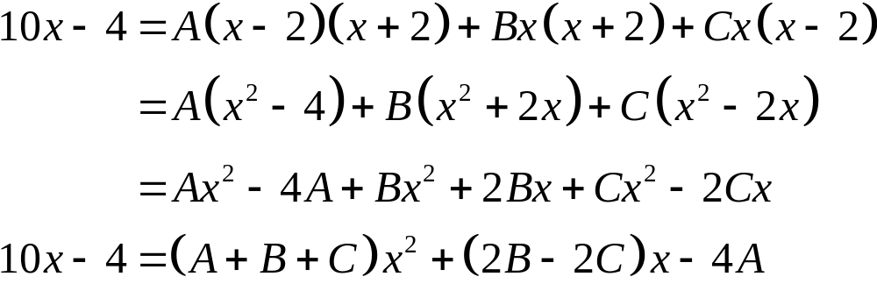
Finding the Partial-Fraction Decomposition When the Denominator has Only Distinct Linear Factors
EXAMPLE 2
Solution continued
Step 3 Now use the fact that two polynomials are equal if and only if the coefficients of the like powers are equal.

Slide 17
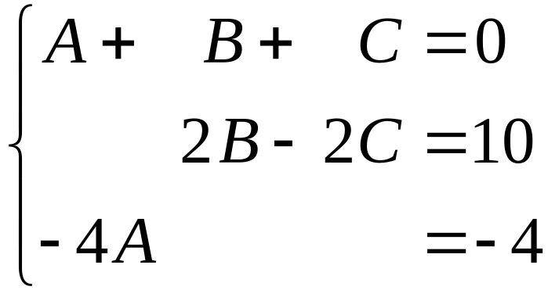
Finding the Partial-Fraction Decomposition When the Denominator has Only Distinct Linear Factors
EXAMPLE 2
Solution continued
Equating corresponding coefficients leads to the system of equations.
Step 4 Solve the system of equations in Step 3 to obtain A = 1, B = 2, and C = –3.

Slide 18
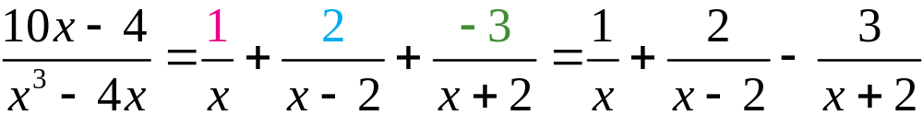
Finding the Partial-Fraction Decomposition When the Denominator has Only Distinct Linear Factors
EXAMPLE 2
Solution continued
Step 5 The partial-fraction decomposition is
An alternative (and sometimes quicker) method of finding the constants is to substitute well-chosen values for x in the equation (identity) found in Step 2.

Slide 19
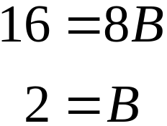
Finding the Partial-Fraction Decomposition When the Denominator has Only Distinct Linear Factors
EXAMPLE 2
Alternative Solution
Start with equation (1) from Step 2.
Substitute x = 2 in equation (1) to cause the terms containing A and C to be 0.

Slide 20
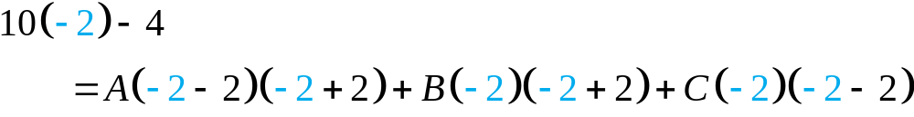
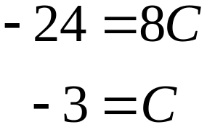
Finding the Partial-Fraction Decomposition When the Denominator has Only Distinct Linear Factors
EXAMPLE 2
Alternative Solution continued
Substitute x = –2 in equation (1) to get

Slide 21
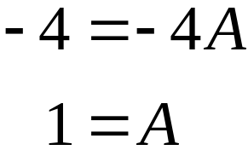
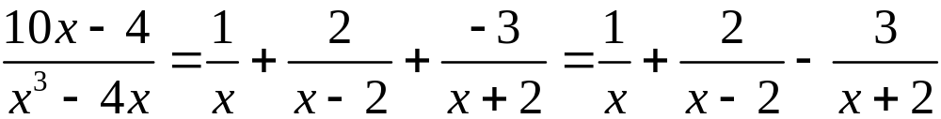
Finding the Partial-Fraction Decomposition When the Denominator has Only Distinct Linear Factors
EXAMPLE 2
Alternative Solution continued
Substitute x = 0 in equation (1) to get
Thus, A = 1, B = 2 and C = –3 and the partial-fraction decomposition is given by

Slide 22
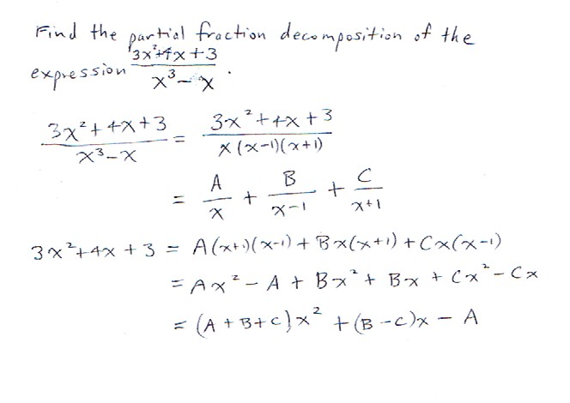

Slide 23
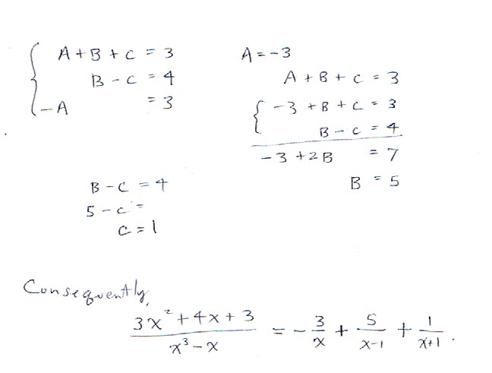

Slide 24
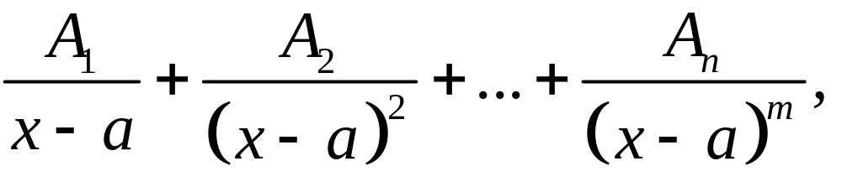
CASE 2: THE DENOMINATOR HAS A REPEATED LINEAR FACTOR
Let (x – a)m be the linear factor (x – a) that is repeated m times in Q(x). Then the portion of the partial-fraction decomposition of
that corresponds to the factor (x – a)m is
where A₁, A₂, …, A_{n}, are constants.

Slide 25
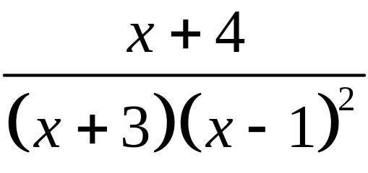
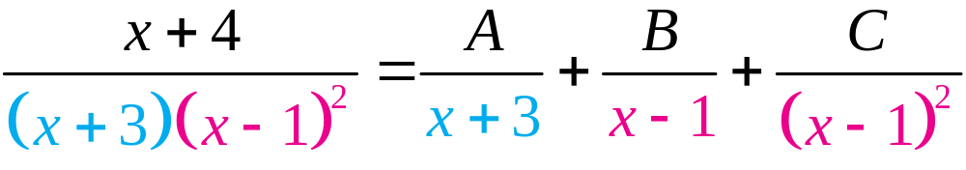
Finding the Partial-Fraction Decomposition When the Denominator has Repeated Linear Factors
EXAMPLE 3
Find the partial-fraction decomposition of the expression.
Solution
Step 1 (x – 1) is repeated twice, (x + 3) is nonrepeating, the partial-fraction decomposition has the form

Slide 26
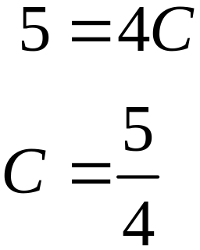
Finding the Partial-Fraction Decomposition When the Denominator has Repeated Linear Factors
EXAMPLE 3
Solution continued
Step 2-4 Multiply by original denominator then use the distributive property to get
Substitute x = 1 in the last equation to obtain

Slide 27
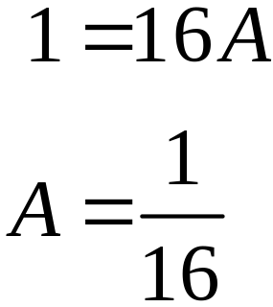
Finding the Partial-Fraction Decomposition When the Denominator has Repeated Linear Factors
EXAMPLE 3
Solution continued
Substitute x = –3 to get A

Slide 28
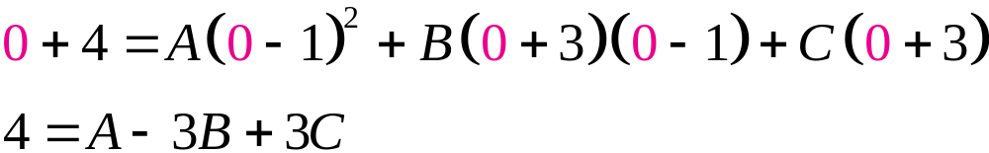
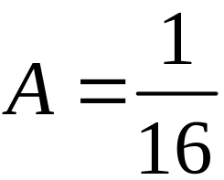
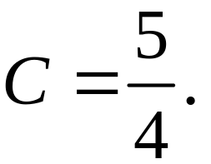
Finding the Partial-Fraction Decomposition When the Denominator has Repeated Linear Factors
EXAMPLE 3
Solution continued
To obtain the value of B, we replace x with any convenient number, say, 0. We have
Now substitute
and

Slide 29
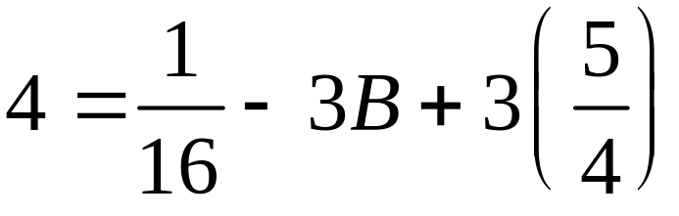
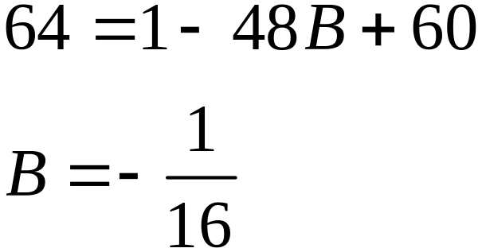
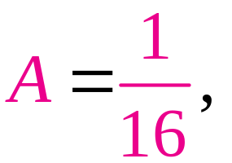
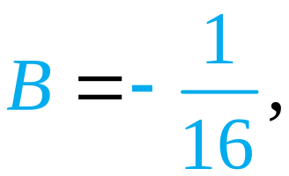
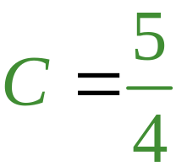
Finding the Partial-Fraction Decomposition When the Denominator has Repeated Linear Factors
EXAMPLE 3
Solution continued
Substitute
and
in the decomposition in Step 1 to obtain the partial-fraction decomposition

Slide 30
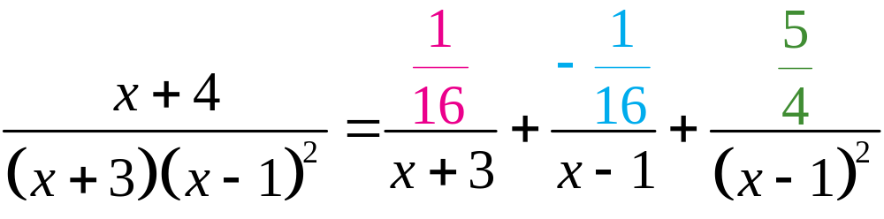
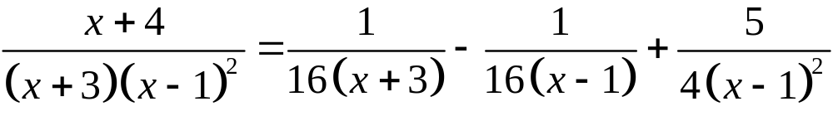
Finding the Partial-Fraction Decomposition When the Denominator has Repeated Linear Factors
EXAMPLE 3
Solution continued
or

Slide 31
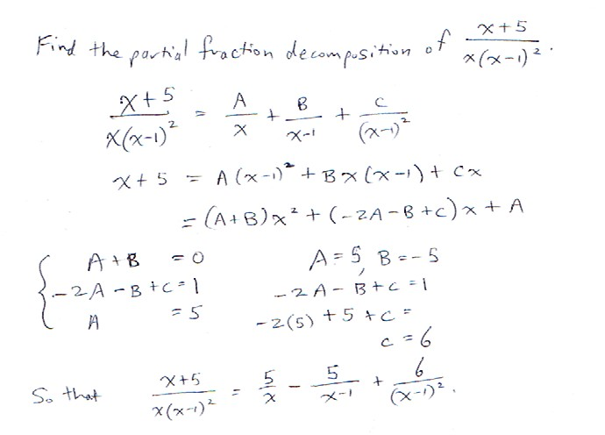

Slide 32
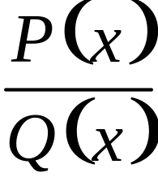
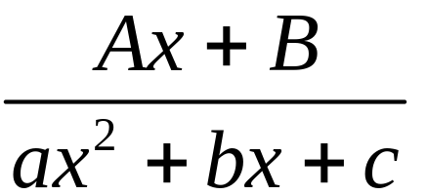
CASE 3: THE DENOMINATOR HAS A DISTINCT(NONREPEATED) IRREDUCIBLE QUADRATIC FACTOR
Suppose ax2 + b + c is an irreducible quadratic factor of Q(x). Then the portion of
the partial-fraction decomposition of
that corresponds to ax2 + bx + c has the form

Slide 33
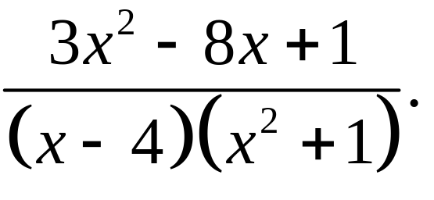
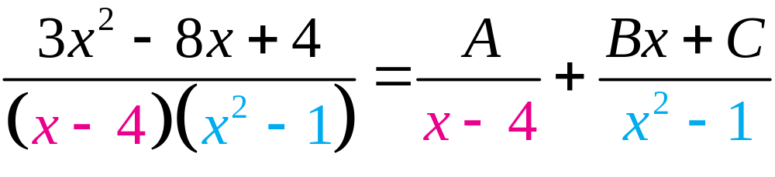
Finding the Partial-Fraction Decomposition When the Denominator Has a Distinct Irreducible Quadratic Factor
EXAMPLE 4
Find the partial-fraction decomposition of
Solution
Step 1 (x – 4) is linear, (x2 + 1) is irreducible; so, the partial-fraction decomposition has the form

Slide 34
Finding the Partial-Fraction Decomposition When the Denominator Has a Distinct Irreducible Quadratic Factor
EXAMPLE 4
Solution continued
Step 2 Multiply both sides of the decomposition in Step 1 by the original denominator, and simplify to obtain
Substitute x = 4 to obtain 17 = 17A, or A = 1.
Step 3 Collect like terms, write both sides of the equation in descending powers of x.

Slide 35
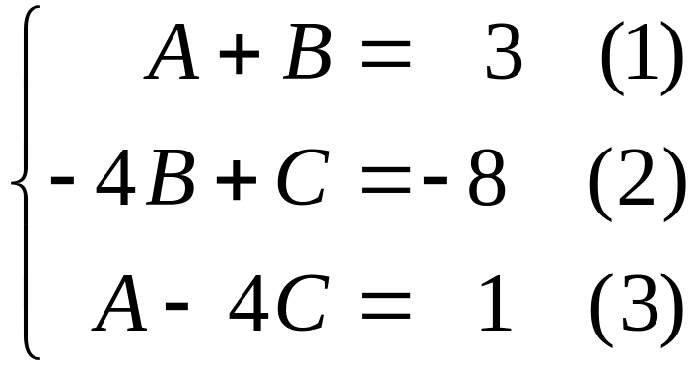
Finding the Partial-Fraction Decomposition When the Denominator Has a Distinct Irreducible Quadratic Factor
EXAMPLE 4
Solution continued
Equate coefficients of the like powers of x to obtain
Step 4 Substitute A = 1 in equation (1) to obtain 1 + B = 3, or B = 2.
Substitute A = 1 in equation (3) to obtain 1 – 4C = 1, or C = 0.

Slide 36
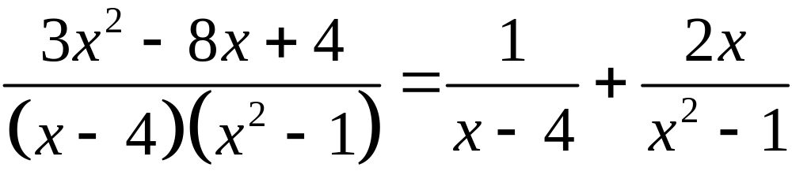
Finding the Partial-Fraction Decomposition When the Denominator Has a Distinct Irreducible Quadratic Factor
EXAMPLE 4
Solution continued
Step 5 Substitute A = 1, B = 2, and C = 0 into the decomposition in Step 1 to get:

Slide 37
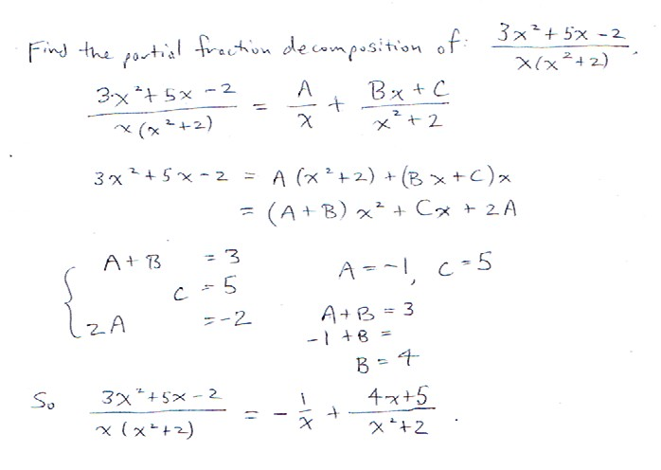

Slide 38
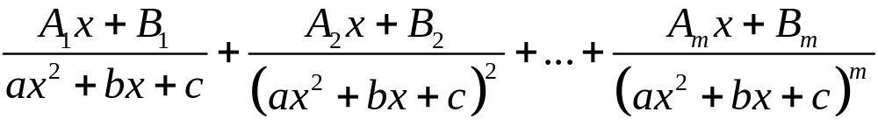
CASE 4: THE DENOMINATOR HAS A REPEATED IRREDUCIBLE QUADRATIC FACTOR
Suppose the denominator Q(x) has a factor (ax2 + bx + c) m where m ≥ 2 is an integer and ax2 + bx + c is irreducible. Then the portion of the
partial-fraction decomposition of that
corresponds to the factor (ax2 + bx + c)m has the form

Slide 39
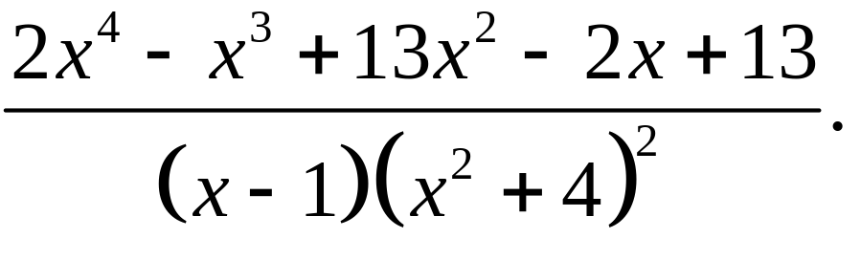
Finding the Partial-Fraction Decomposition When the Denominator Has a Repeated Irreducible Quadratic Factor
EXAMPLE 5
Find the partial-fraction decomposition of

Slide 40
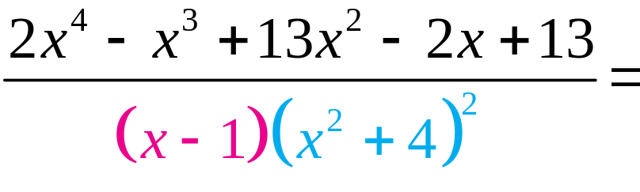

Finding the Partial-Fraction Decomposition When the Denominator Has a Repeated Irreducible Quadratic Factor
EXAMPLE 5
Solution
Step 1 (x – 1) is a nonrepeating linear factor, (x2 + 4) is an irreducible quadratic factor repeated twice, the partial-fraction decomposition has the form

Slide 41

Finding the Partial-Fraction Decomposition When the Denominator Has a Repeated Irreducible Quadratic Factor
EXAMPLE 5
Solution continued
Step 2 Multiply both sides by the original denominator, use the distributive property, and eliminate common factors.

Slide 42

Finding the Partial-Fraction Decomposition When the Denominator Has a Repeated Irreducible Quadratic Factor
EXAMPLE 5
Solution continued
Substitute x = 1 and simplify to obtain 25 = 25A, or A = 1.
Step 3-4 Multiply the right side of equation in Step 2 and collect like terms to obtain

Slide 43

Finding the Partial-Fraction Decomposition When the Denominator Has a Repeated Irreducible Quadratic Factor
EXAMPLE 5
Solution continued
Equate coefficients of the like powers of x to obtain
Back substitute A = 1 in equation (1) to obtain B = 1. Back substitute B = 1 into equation (2) to get C = 0.

Slide 44


Finding the Partial-Fraction Decomposition When the Denominator Has a Repeated Irreducible Quadratic Factor
EXAMPLE 5
Solution continued
Back substitute A = 1 and C = 0 in equation (5) to obtain E = 3.
Back substitute A = 1, B = 1 and C = 0 into equation (3) to get D = 1.
Step 5 Substitute A = 1, B = 1, C = 0, D = 1, E = 3

Slide 45


Slide 46


Slide 47


Slide 48


