Slide 1



Chapter 9
Analytic Geometry
© 2010 Pearson Education, Inc.
All rights reserved

Slide 2
Conic Sections: Overview
SECTION 9.1
Most of the sections in this chapter focus on the plane curves called conics or conic sections.
As the name implies, these curves are the sections of a cone (similar to an ice cream cone) formed when a plane intersects the cone.

Slide 3
RIGHT CIRCULAR CONE
Draw a circle on a plane. Draw a line l, called the axis, passing through the center of the circle and perpendicular to the plane. Choose a point V above the plane on this line.
The surface consisting of all lines that simultaneously pass through the point V and the circle is called a right circular cone with vertex V.

Slide 4
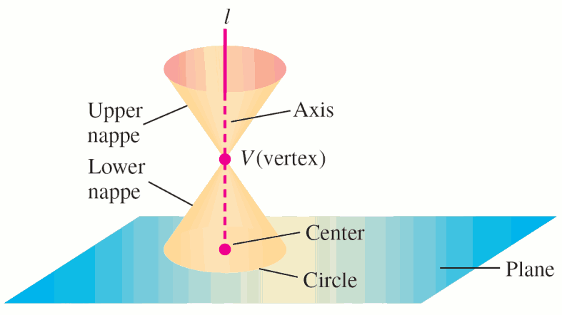
RIGHT CIRCULAR CONE
The vertex separates the surface into two parts called nappes of the cone.

Slide 5
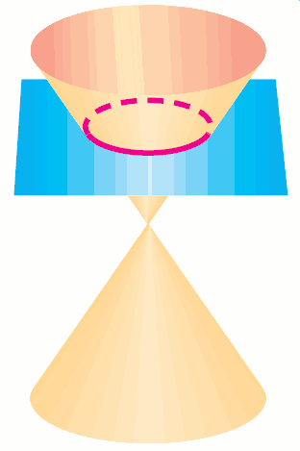
Definitions
If we slice the cone with a plane, the intersections of the slicing plane and the cone are conic sections. If the slicing plane is horizontal (parallel to the first plane), the intersection is a circle.

Slide 6
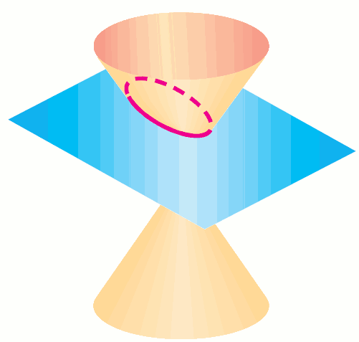
Definitions
If the slicing plane is inclined slightly from the horizontal, the intersection is an oval-shaped curve called an ellipse.

Slide 7
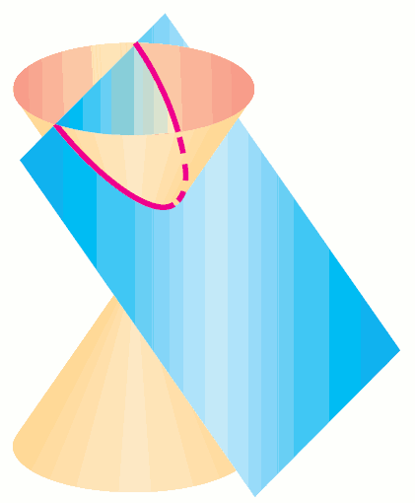
Definitions
If the angle of the slicing plane increases so that the slicing plane is parallel to one of the lines generating the cone, the intersection is called a parabola.

Slide 8
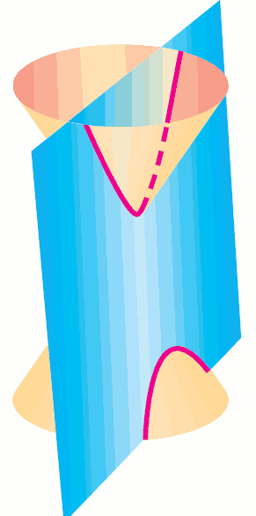
Definitions
If the angle of the slicing plane increases so that the slicing plane intersects both nappes of the cone, the resulting intersection is called a hyperbola.

Slide 9
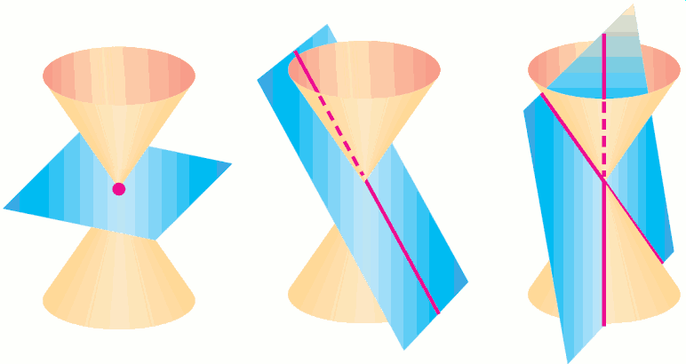
Definitions
Intersections of the slicing plane through the vertex result in points and lines called degenerate conic sections.

Slide 10
Definitions
The general conic [“section” is implied] is a nonlinear curve or pair of chiral curves. This shows the particular linear (or less) cases, namely a point (vertex), a line, and a pair of intersecting lines.

