Slide 1



Chapter 9
Analytic Geometry
© 2010 Pearson Education, Inc.
All rights reserved

Slide 2
The Parabola
SECTION 9.2
1
Define a parabola geometrically.
Find an equation of a parabola.
Translate a parabola.
Use the reflecting property of parabolas.
Understand that being given the formulas for the standard forms will hardly be a panacea for working with conics. You are obligated to remember many details for each type.
2
3
4

Slide 3
PARABOLA
Let l be a line and F a point in the plane not on the line l. The the set of all points P in the plane that are the same distance from F as they are from the line l is called a parabola.
Thus, a parabola is the set of all points P for which d(F, P) = d(P, l), where d(P, l) denotes the distance between P and l.

Slide 4
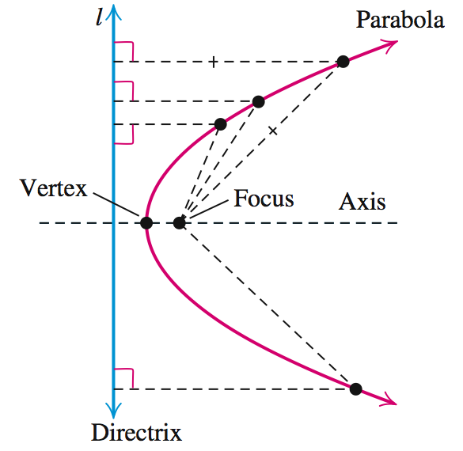
PARABOLA
Line l is the directrix.
Point F is the focus.
The line through the focus, perpendicular to
the directrix is the axis or axis of symmetry.
The point at which the axis intersects the parabola is the vertex.

Slide 5
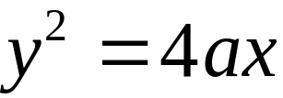
EQUATION OF A PARABOLA
The equation y2 = 4ax is called the standard equation of a parabola with vertex (0, 0) and focus (a, 0). Similarly, if the focus of a parabola is placed on the negative x-axis, we obtain the equation y2 = – 4ax as the standard equation of a parabola with vertex (0, 0) and focus (– a, 0).

Slide 6
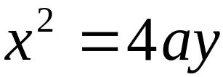
EQUATION OF A PARABOLA
By interchanging the roles of x and y, we find that the equation x2 = 4ay is the standard equation of a parabola with vertex (0, 0) and focus (0, a). Similarly, if the focus of a parabola is placed on the negative x-axis, we obtain the equation x2 = – 4ay as the standard equation of a parabola with vertex (0, 0) and focus (0, – a).

Slide 7
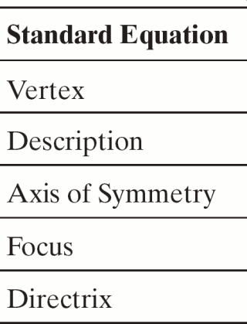
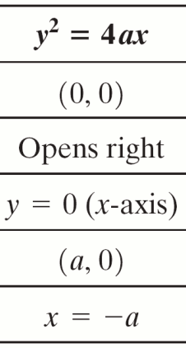
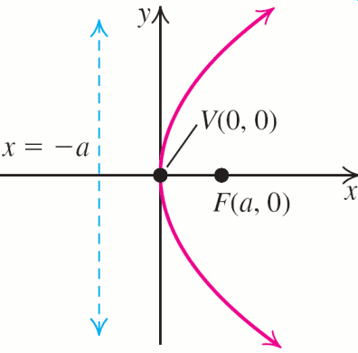
MAIN FACTS ABOUT A PARABOLA WITH a > 0

Slide 8
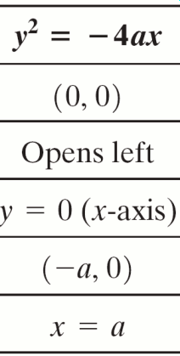
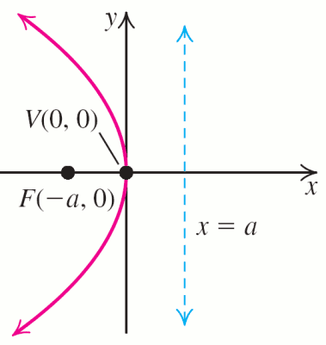
MAIN FACTS ABOUT A PARABOLA WITH a > 0

Slide 9
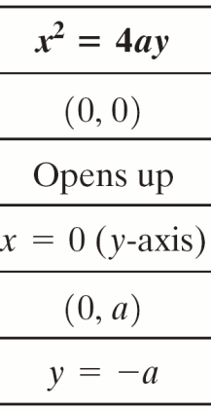
MAIN FACTS ABOUT A PARABOLA WITH a > 0

Slide 10
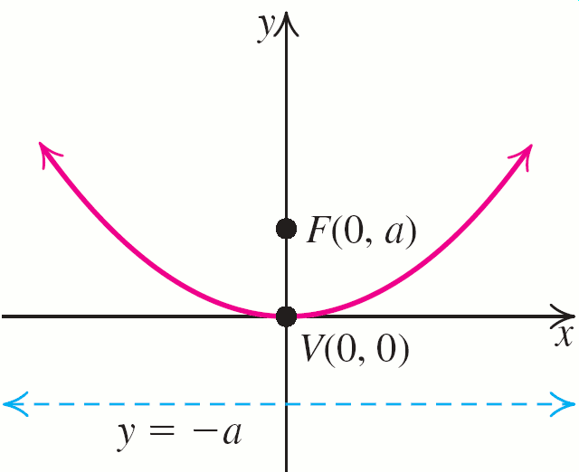
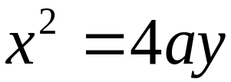
MAIN FACTS ABOUT A PARABOLA WITH a > 0

Slide 11
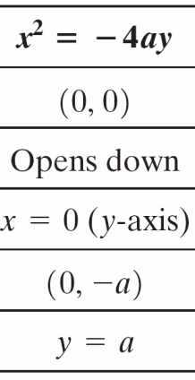
MAIN FACTS ABOUT A PARABOLA WITH a > 0

Slide 12
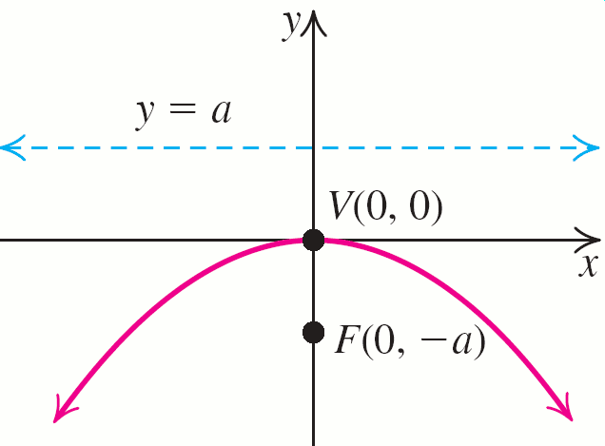
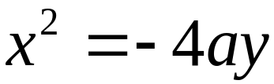
MAIN FACTS ABOUT A PARABOLA WITH a > 0

Slide 13
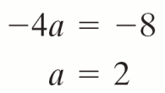
EXAMPLE 1
Graphing a Parabola
Graph each parabola and specify the vertex, focus, directrix, and axis.
a. x2 = −8y b. y2 = 5x
Solution
a. The equation x2 = −8y has the standard form x2 = −4ay; so

Slide 14
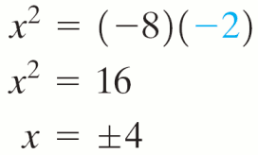
EXAMPLE 1
Graphing a Parabola
Solution continued
From the from of the equation (x^2 = - 4ay) we must see that . .
The parabola opens down. The vertex is the origin, and the focus is (0, −2). The directrix is the horizontal line y = 2; the axis of the parabola is the y-axis.
Since the focus is (0, −2) substitute y = −2 in the equation x2 = −8y of the parabola to obtain

Slide 15
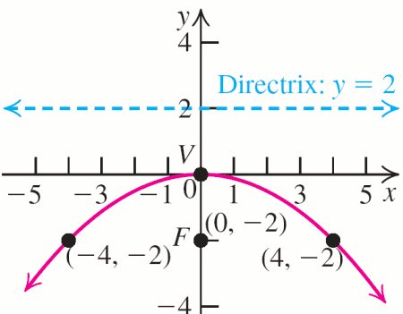
EXAMPLE 1
Graphing a Parabola
Solution continued
Thus, the points (4, −2) and (−4, −2) are two symmetric points on the parabola to the right and the left of the focus.

Slide 16
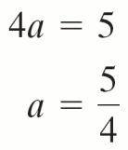
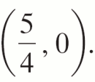

EXAMPLE 1
Graphing a Parabola
Solution continued
b. The equation y2 = 5x has the standard form y2 = 4ax.
The parabola opens to the right. The vertex is the origin, and the focus is The directrix is the vertical line the axis of the parabola is the x-axis.

Slide 17

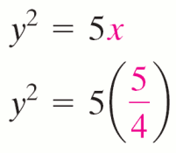
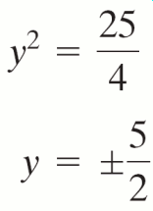
EXAMPLE 1
Graphing a Parabola
Solution continued
To find two symmetric points on the parabola that are above and below the focus, substitute
in the equation of the parabola.

Slide 18
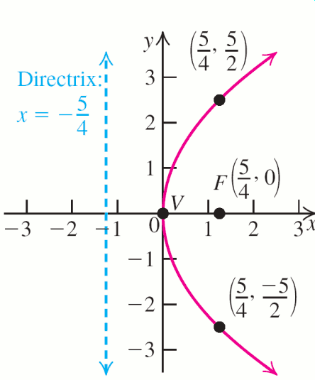
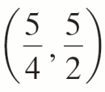
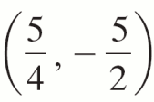
EXAMPLE 1
Graphing a Parabola
Solution continued
Plot the two additional points and
on the parabola.

Slide 19
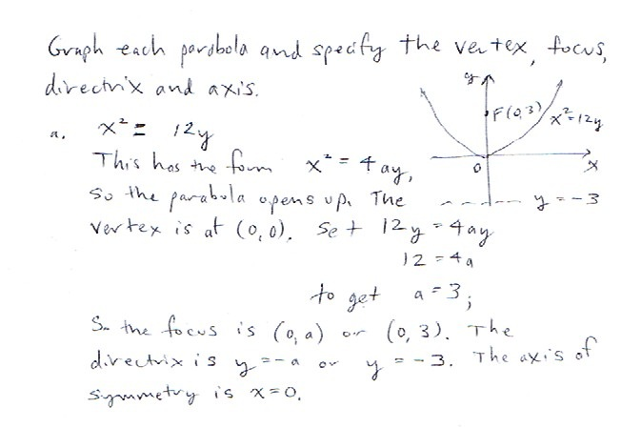
Practice Problem

Slide 20
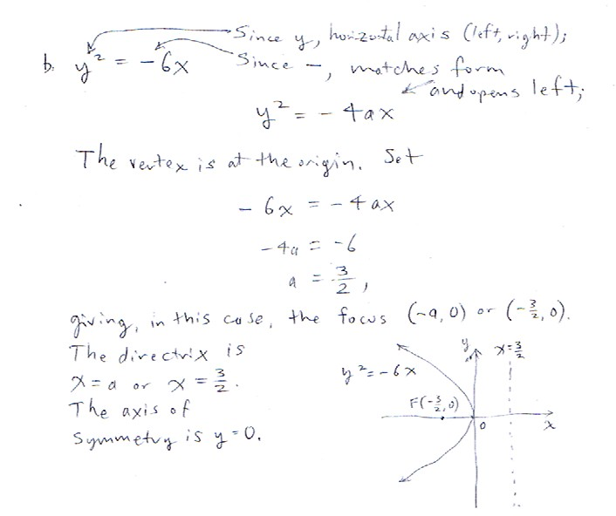
Practice Problem
This is what you’ll need to know.
←----------

Slide 21
LATUS RECTUM
The line segment passing through the focus of a parabola, perpendicular to the axis, and having endpoints on the parabola is called the latus rectum of the parabola.
The following figures show that the length of the latus rectum for the graphs of y2 = ±4ax and x2 = ±4ay for a > 0 is 4a.

Slide 22
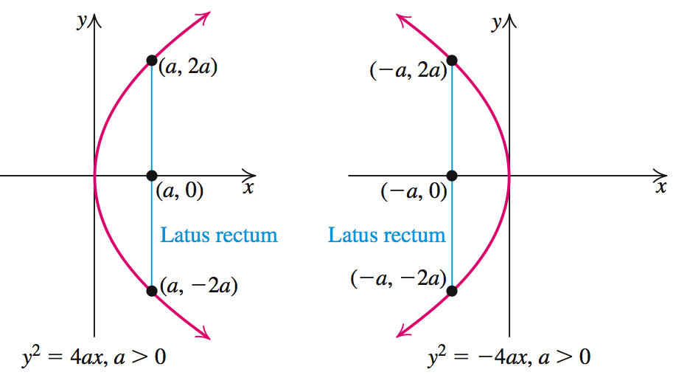
LATUS RECTUM

Slide 23
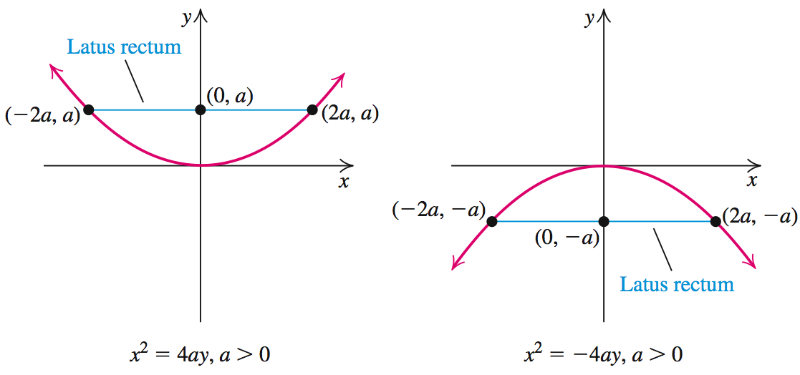
LATUS RECTUM

Slide 24
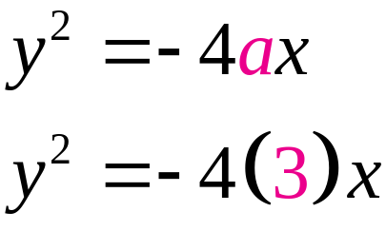
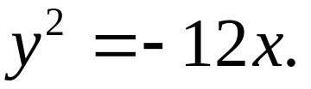
EXAMPLE 2
Finding the Equation of a Parabola
Find the standard equation of a parabola with vertex (0, 0) and satisfying the given description.
a. The focus is (–3, 0).
b. The axis of the parabola is the y-axis, and the graph passes through the point (–4, 2).
Solution
a. Vertex (0, 0) and focus (–3, 0) are both on the x-axis, so parabola opens left and the equation has the form y2 = – 4ax with a = 3.
The equation is

Slide 25
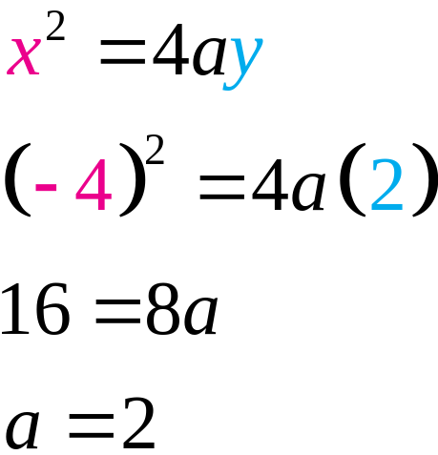
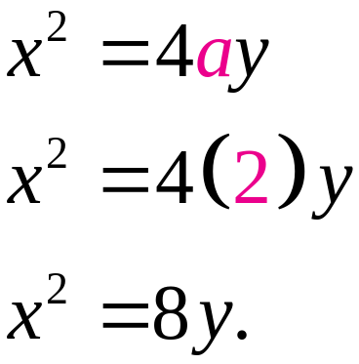
EXAMPLE 2
Finding the Equation of a Parabola
Solution continued
b. Vertex is (0, 0), axis is the y-axis, and the point (–4, 2) is above the x-axis, so parabola opens up and the equation has the form x2 = – 4ay and x = –4 and y = 2 can be substituted in to obtain
The equation is

Slide 26
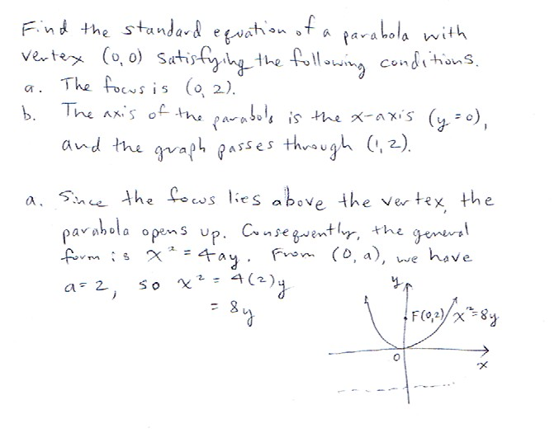
Practice Problem

Slide 27
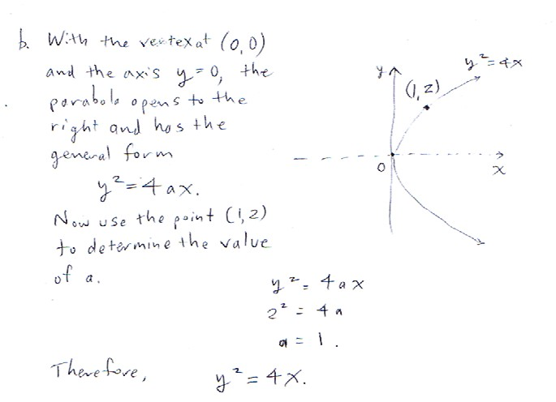
Practice Problem
The point (1, 2) must satisfy the equation, so we use it to first solve for the unknown value of a.

Slide 28
Main facts about a parabola with vertex (h, k) and a > 0
[a > 0 so that sign is + for 4a(x – h)]
Standard Equation | (y – k)² = 4a(x – h)
Equation of axis | y = k
Description | Opens right
Vertex | (h, k)
Focus | (h + a, k)
Directrix | x = h – a

Slide 29
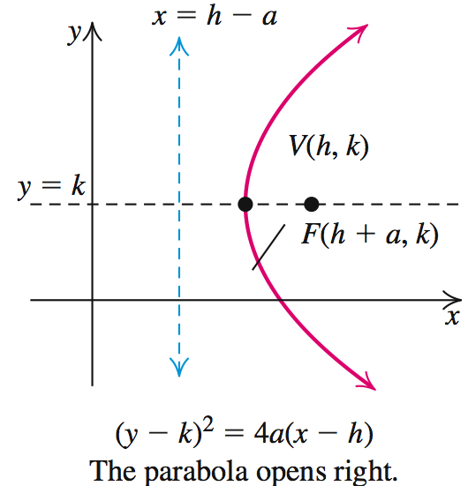
Main facts about a parabola with vertex (h, k) and a > 0

Slide 30
Main facts about a parabola with vertex (h, k) and a > 0
Standard Equation | (y – k)² = –4a(x – h)
Equation of axis | y = k
Description | Opens left
Vertex | (h, k)
Focus | (h – a, k)
Directrix | x = h + a

Slide 31
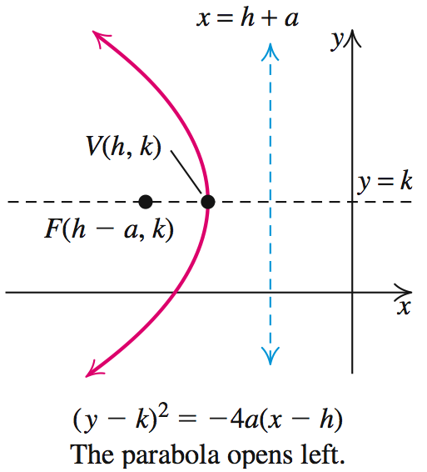
Main facts about a parabola with vertex (h, k) and a > 0

Slide 32
Main facts about a parabola with vertex (h, k) and a > 0
Standard Equation | (x – h)² = 4a(y – k)
Equation of axis | x = h
Description | Opens up
Vertex | (h, k)
Focus | (h, k + a)
Directrix | y = k – a

Slide 33
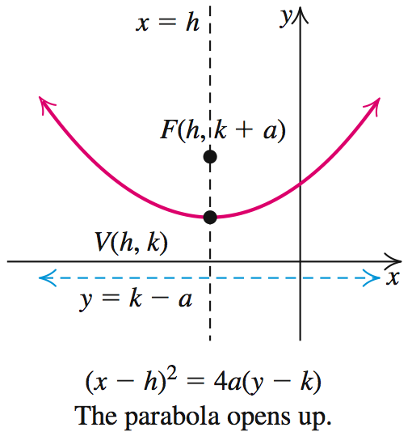
Main facts about a parabola with vertex (h, k) and a > 0

Slide 34
Main facts about a parabola with vertex (h, k) and a > 0
Standard Equation | (x – h)² = – 4a(y – k)
Equation of axis | x = h
Description | Opens down
Vertex | (h, k)
Focus | (h, k – a)
Directrix | y = k + a

Slide 35
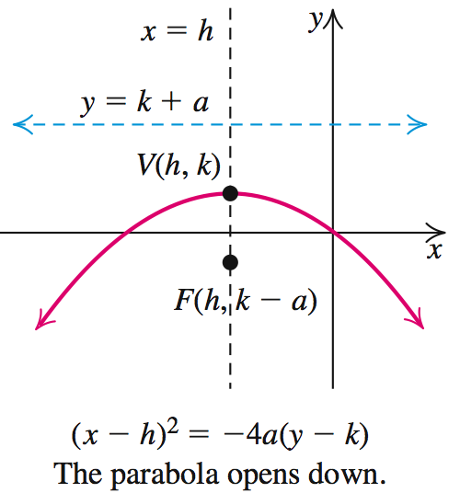
Main facts about a parabola with vertex (h, k) and a > 0

Slide 36
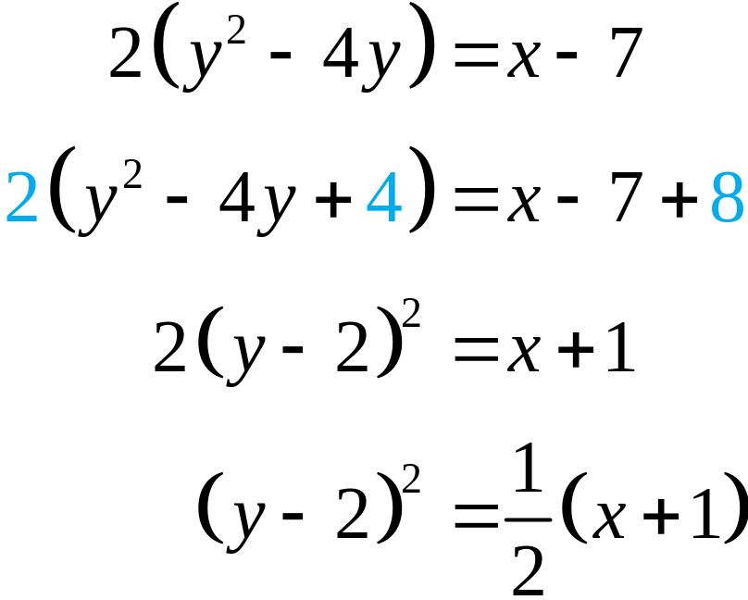
EXAMPLE 3
Graphing a Parabola
Find the vertex, focus, and the directrix of the parabola 2y2 – 8y – x + 7 = 0. Sketch the graph of the parabola.
Solution
Complete the square on y.

Slide 37
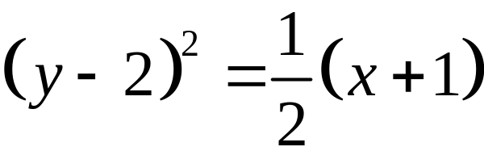
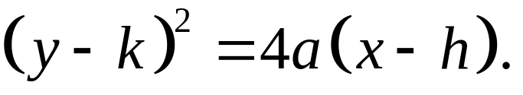
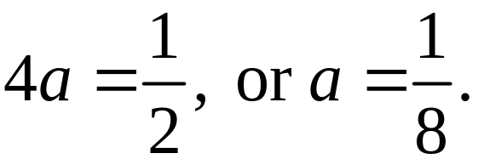
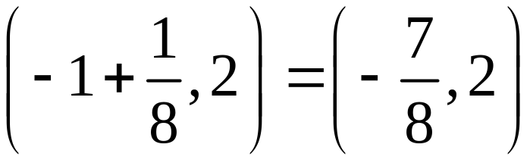
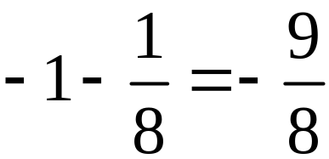
EXAMPLE 3
Graphing a Parabola
Solution continued
Compare
with the standard
form
We have h = –1, k = 2, and
Vertex: (h, k) = (–1, 2)
Focus: (h + a, k) =
Directrix: x = h – a =

Slide 38
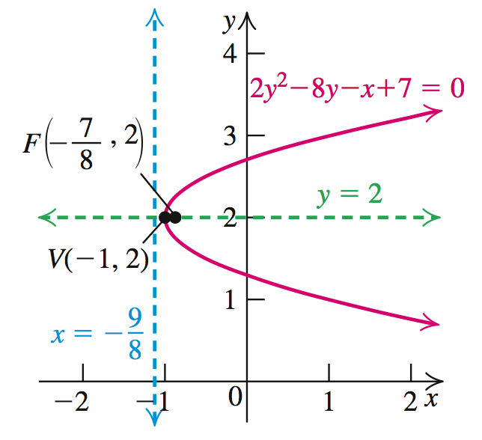
EXAMPLE 3
Graphing a Parabola
Solution continued

Slide 39
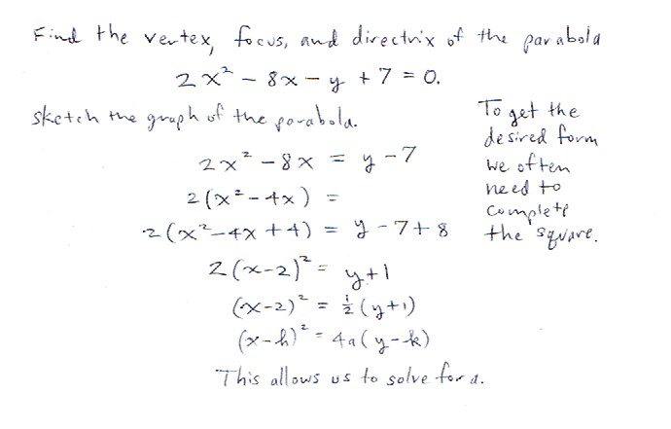
Practice Problem
Compare this to the standard form.
<
<

Slide 40
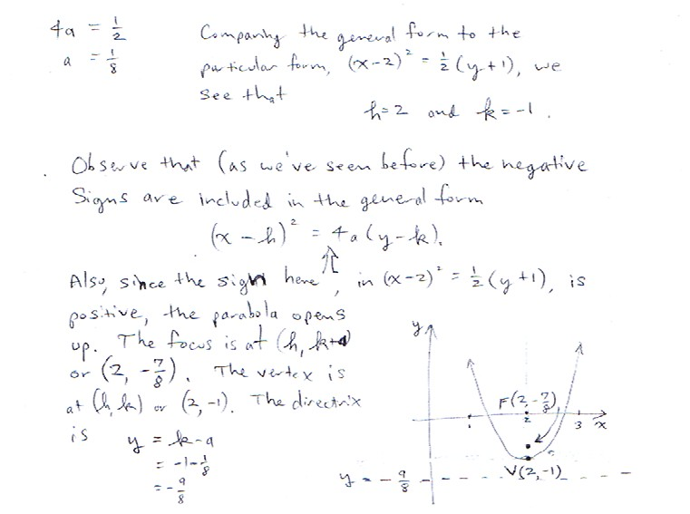
Practice Problem

Slide 41
REFLECTING PROPERTY OF PARABOLAS
A property of parabolas that is useful in applications is the reflecting property: If a reflecting surface has parabolic cross sections with a common focus, then all light rays entering the surface parallel to the axis will be reflected through the focus.
This property is used in reflecting telescopes and satellite antennas, because the light rays or radio waves bouncing off a parabolic surface are reflected to the focus, where they are collected and amplified. (See next slide.)

Slide 42
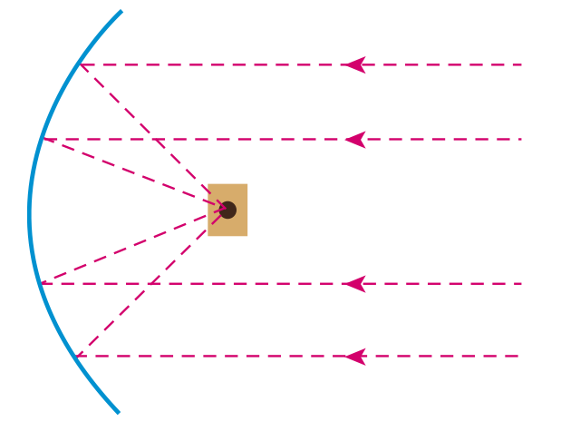
REFLECTING PROPERTY OF PARABOLAS

Slide 43
REFLECTING PROPERTY OF PARABOLAS
Conversely, if a light source is located at the focus of a parabolic reflector, the reflected rays will form a beam parallel to the axis. This principle is used in flashlights, searchlights, and other such devices. (See next slide.)

Slide 44
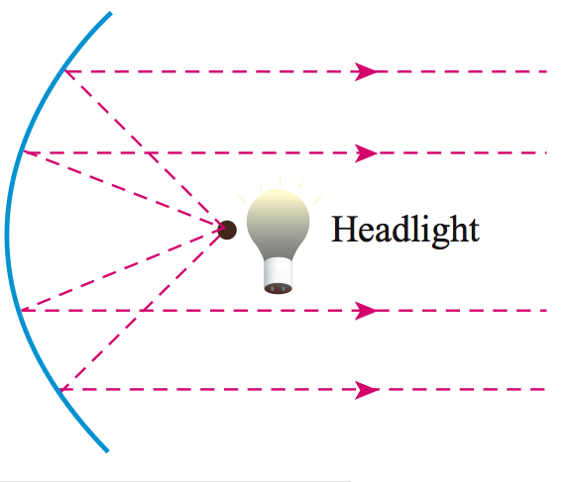
REFLECTING PROPERTY OF PARABOLAS

Slide 45
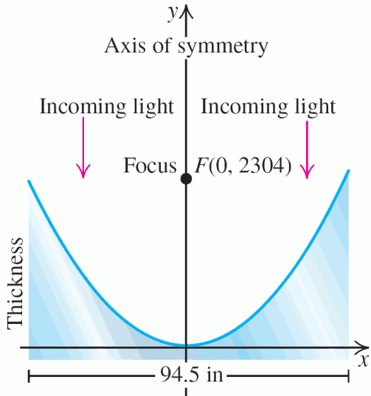
Calculating Some Properties of the Hubble Space Telescope
EXAMPLE 4
The parabolic mirror used in the Hubble Space Telescope has a diameter of 94.5 inches. Find the equation of the parabola if its focus is 2304 inches from the vertex. What is the thickness of the mirror at the edges?
(Not to scale)

Slide 46

Calculating Some Properties of the Hubble Space Telescope
EXAMPLE 4
Solution
Position the parabola so that its vertex is at the origin and its focus is on the positive y-axis. The equation of the parabola is of the form

Slide 47

Calculating Some Properties of the Hubble Space Telescope
EXAMPLE 4
Solution
To find the thickness y of the mirror at the edge, substitute x = 47.25 (half the diameter) in the equation x2 = 9216y and solve for y.
Thus, the thickness of the mirror at the edges is approximately 0.242248 inch.

Slide 48

Practice Problem
This is a rather typical problem. You must realize that you have been asked to provide the y-coordinate given the x-coordinate (1.5). Since the point is on the parabola, it satisfies the equation for this parabola (x^2=29.2y). So we solve for y.

