Slide 1



Chapter 9
Analytic Geometry
© 2010 Pearson Education, Inc.
All rights reserved

Slide 2
The Ellipse
SECTION 9.3
1
Define an ellipse.
Find the equation of an ellipse.
Translate ellipses.
Use ellipses in applications.
2
3
4

Slide 3
ELLIPSE
An ellipse is the set of all points in the plane, the sum of whose distances from two fixed points is a constant.
The fixed points are called the foci (the plural of focus) of the ellipse.

Slide 4
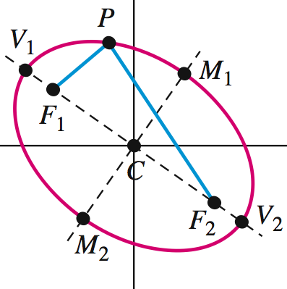
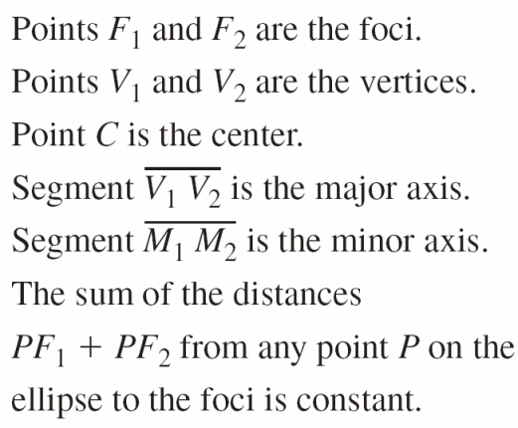
ELLIPSE

Slide 5
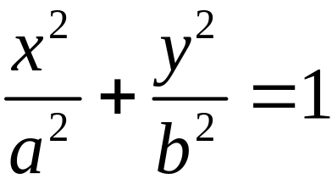
EQUATION OF AN ELLIPSE
is the standard form of the equation of an ellipse with center (0, 0) and foci (–c, 0) and (c, 0), where b2 = a2 – c2.

Slide 6
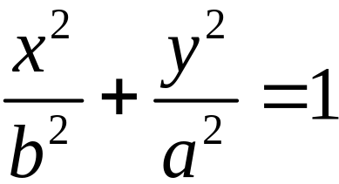
EQUATION OF AN ELLIPSE
Similarly, by reversing the roles of x and y, an equation of the ellipse with center
(0, 0) and foci (0, −c) and (0, c) and on the
y-axis is given by
.

Slide 7
HORIZONTAL AND VERTICAL ELLIPSES
If the major axis of an ellipse is along or parallel to the x-axis, the ellipse is called a horizontal ellipse, while an ellipse with major axis along or parallel to the y-axis is called a vertical ellipse.

Slide 8
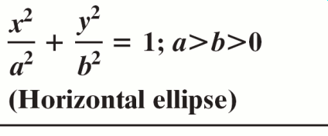

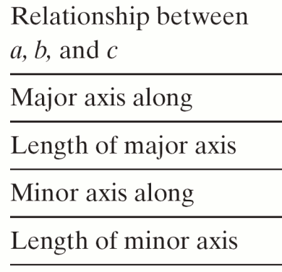
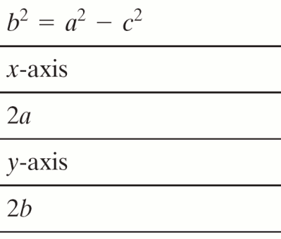
MAIN FACTS ABOUT AN ELLIPSE
WITH CENTER (0, 0)

Slide 9
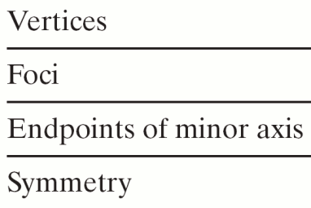
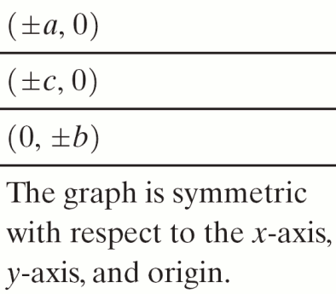
MAIN FACTS ABOUT AN ELLIPSE
WITH CENTER (0, 0)

Slide 10
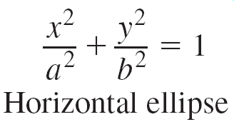
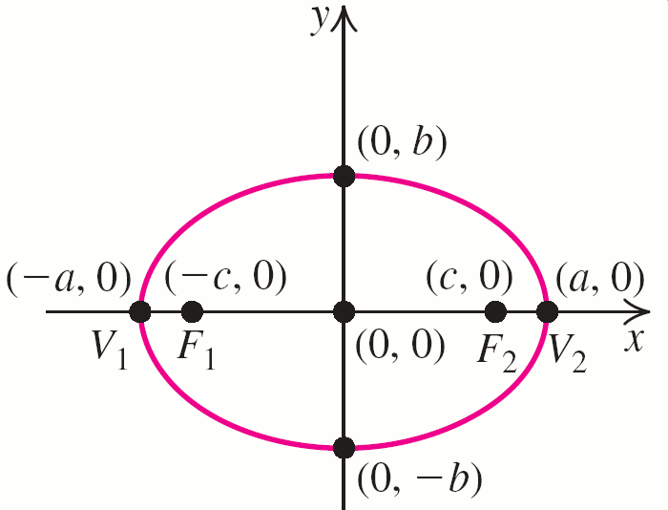
MAIN FACTS ABOUT AN ELLIPSE
WITH CENTER (0, 0)

Slide 11
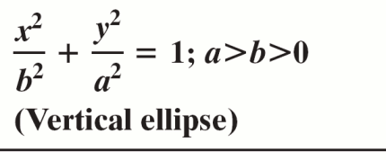
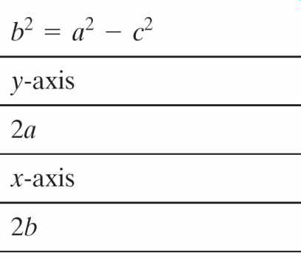
MAIN FACTS ABOUT AN ELLIPSE
WITH CENTER (0, 0)

Slide 12
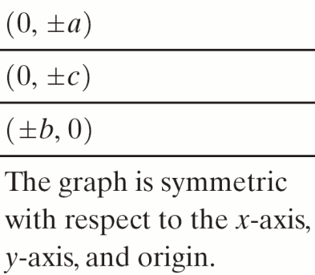
MAIN FACTS ABOUT AN ELLIPSE
WITH CENTER (0, 0)

Slide 13
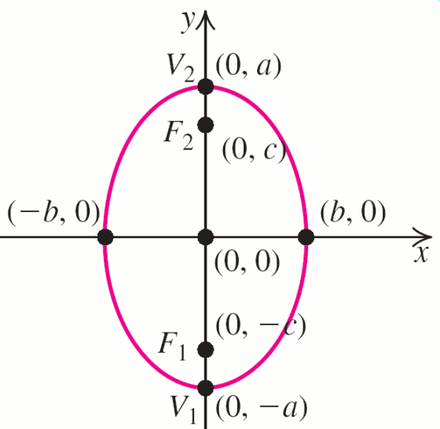
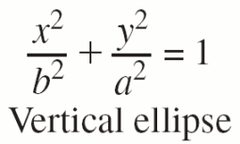
MAIN FACTS ABOUT AN ELLIPSE
WITH CENTER (0, 0)

Slide 14
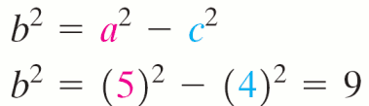
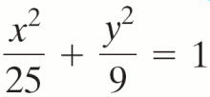
EXAMPLE 1
Finding the Equation of an Ellipse
Find the standard form of the equation of the ellipse that has vertex (5, 0) and foci (±4, 0).
Solution
Since the foci are (−4, 0) and (4, 0) the major axis is on the x-axis. We know c = 4 and a = 5; find b2.
Substituting into the standard equation, we get
.

Slide 15
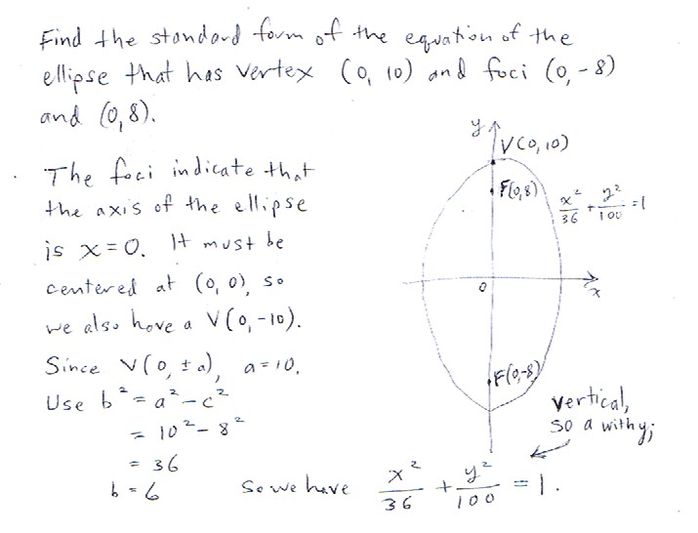
Practice Problem

Slide 16
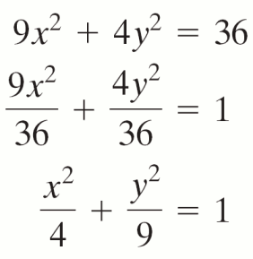
EXAMPLE 2
Graphing an Ellipse
Sketch a graph of the ellipse whose equation is 9x2 + 4y2 = 36. Find the foci of the ellipse.
Solution
First, write the equation in standard form:

Slide 17
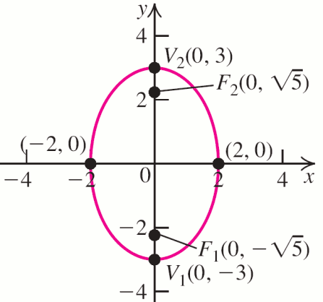

EXAMPLE 2
Graphing an Ellipse
Solution continued
Because the denominator in the y2-term is larger than the denominator in the x2-term, the ellipse is a vertical ellipse.
Here a2 = 9 and b2 = 4, so c2 = a2 – b2 = 5.
Vertices: (0, ±3)
Foci:
Length of major axis: 6
Length of minor axis: 4

Slide 18
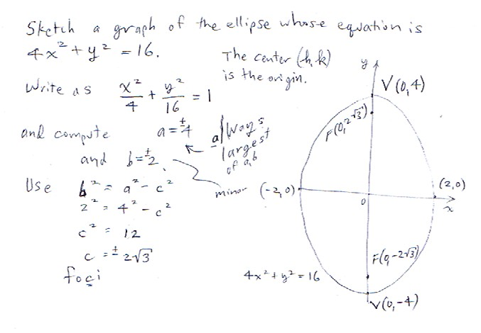
Practice Problem

Slide 19
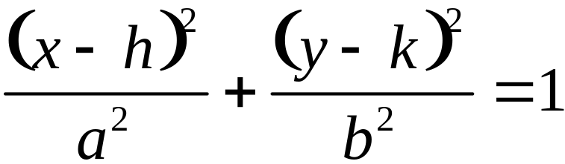
TRANSLATIONS OF ELLIPSES
Horizontal and vertical shifts can be used to obtain the graph of an ellipse whose equation is
The center of such an ellipse is (h, k), and its major axis is parallel to a coordinate axis.

Slide 20
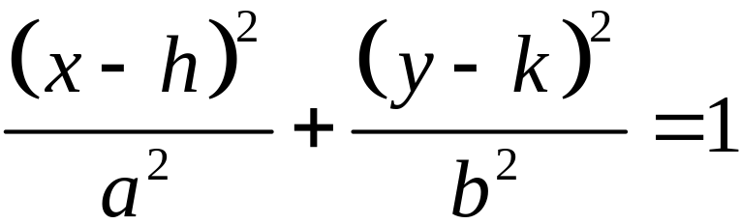
Main facts about horizontal ellipses with center (h, k)
Standard Equation
Center | (h, k)
Major axis along the line | y = k
Length of major axis | 2a
Minor axis along the line | x = h
Length of minor axis | 2b

Slide 21
Main facts about horizontal ellipses with center (h, k)
Vertices | (h + a, k), (h – a, k)
Endpoints of minor axis | (h, k – b), (h, k + b)
Foci | (h + c, k), (h – c, k)
Equation involving a, b, and c | c² = a² – b²
Symmetry | The graph is symmetric about the lines x = h and y = k.

Slide 22
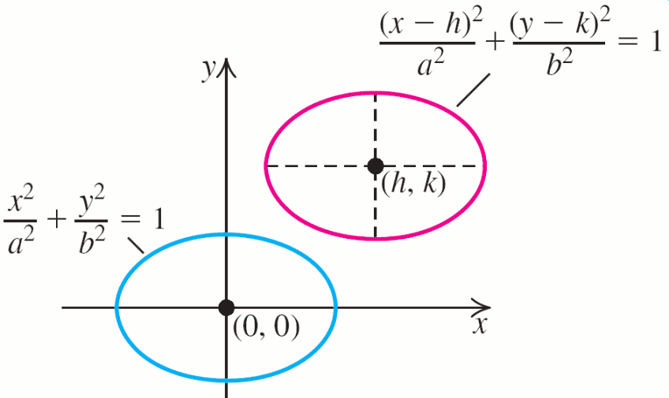
Graphs of horizontal ellipses

Slide 23
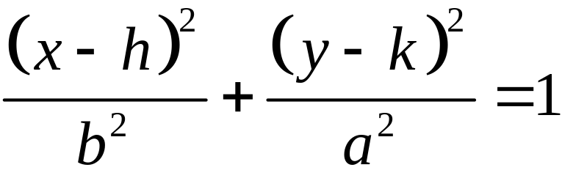
Main facts about vertical ellipses with center (h, k)
Standard Equation
Center | (h, k)
Major axis along the line | x = h
Length major axis | 2a
Minor axis along the line | y = k
Length minor axis | 2b

Slide 24
Main facts about vertical ellipses with center (h, k)
Vertices | (h, k + a), (h, k – a)
Endpoints of minor axis | (h – b, k), (h + b, k)
Foci | (h, k + c), (h, k – c)
Equation involving a, b, c | c² = a² – b²
Symmetry | The graph is symmetric about the lines x = h and y = k

Slide 25
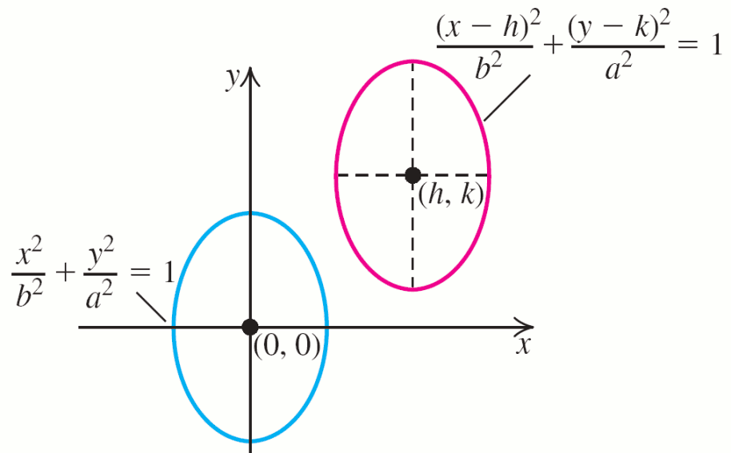
Graphs of vertical ellipses

Slide 26
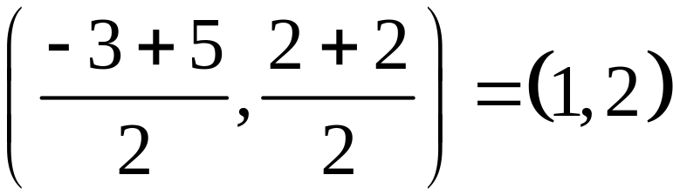
EXAMPLE 3
Finding the Equation of an Ellipse
Find an equation of the ellipse that has foci (–3, 2) and (5, 2), and has a major axis of length 10.
Solution
Foci lie on the line y = 2, so horizontal ellipse.
Center is midpoint of foci
Length major axis =10, vertices at a distance of a = 5 units from the center.
Foci at a distance of c = 4 units from the center.

Slide 27
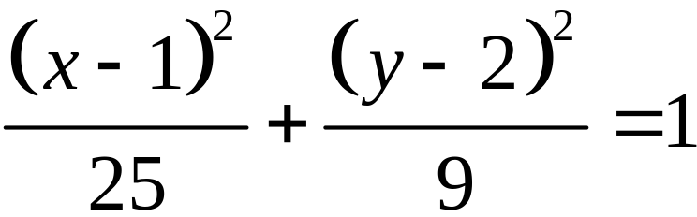
EXAMPLE 3
Finding the Equation of an Ellipse
Solution continued
Use b2 = a2 – c2 to obtain b2.
b2 = (5)2 – (4)2 = 25 – 16 = 9 to obtain b2.
Major axis is horizontal so standard form is
Replace: h = 1, k = 2, a2 = 25, b2 = 9
Center: (1, 2) a = 5, b = 3, c = 4

Slide 28
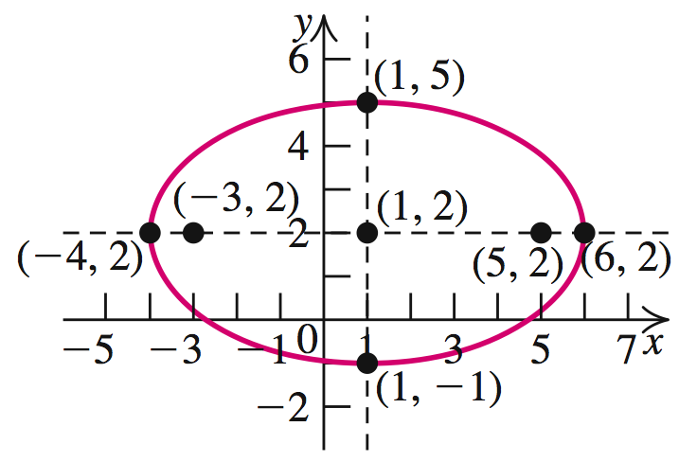
EXAMPLE 3
Finding the Equation of an Ellipse
Solution continued
Vertices: (h ± a, k) = (1 ± 5, 2) = (–4, 2) and (6, 2)
Endpoints minor axis: (h, k ± b) = (1, 2 ± 3)
= (1, –1) and (1, 5)

Slide 29
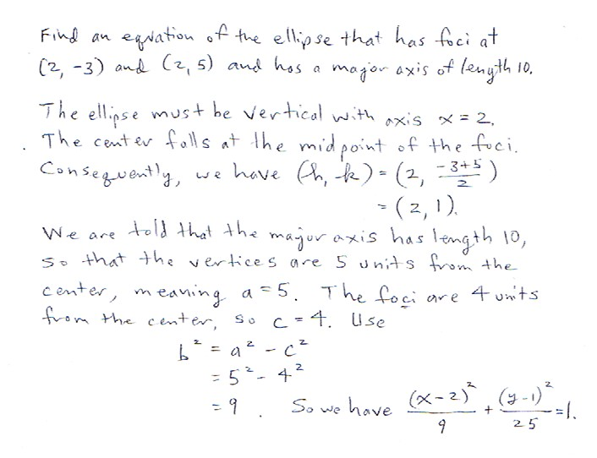
Practice Problem

Slide 30
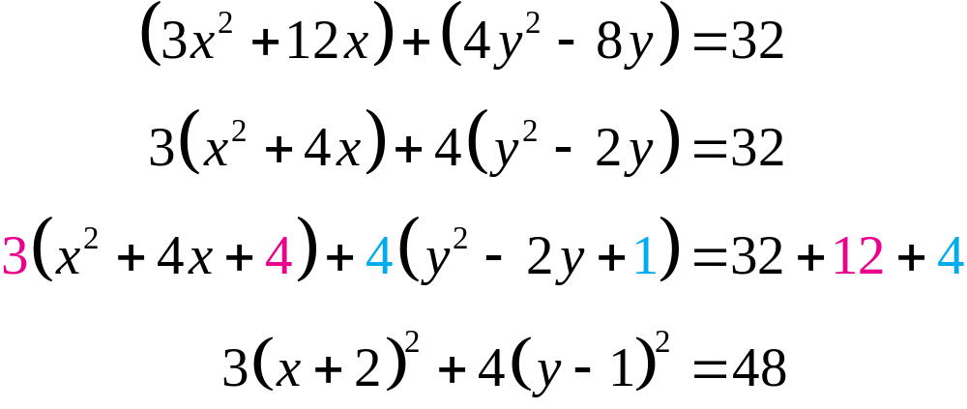
EXAMPLE 4
Converting to Standard Form
Find the center, vertices, and foci of the ellipse with equation 3x2 + 4y2 +12x – 8y – 32 = 0.
Solution
Complete squares on x and y.

Slide 31
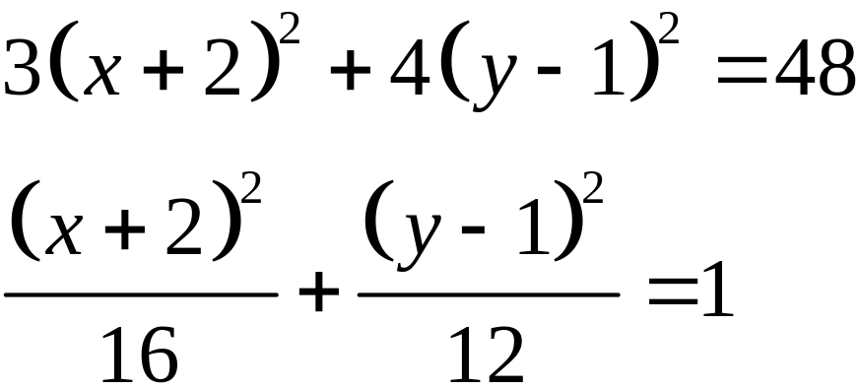
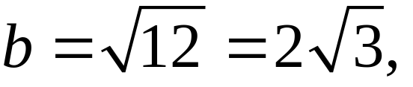
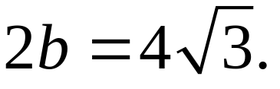
EXAMPLE 4
Converting to Standard Form
Solution continued
This is standard form. Center: (–2, 1), a2 = 16, b2 = 12, and c2 = a2 – b2 = 16 – 12 = 4. Thus, a = 4, and c = 2.
Length of major axis is 2a = 8.
Length of minor axis is

Slide 32
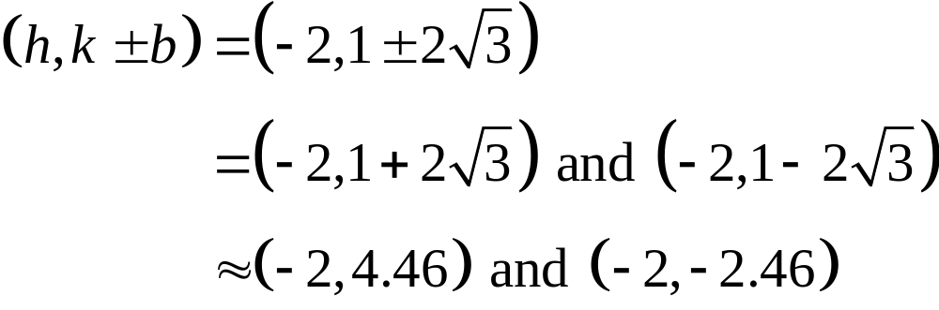
EXAMPLE 4
Converting to Standard Form
Solution continued
Center: (h, k) = (–2, 1)
Foci: (h ± c, k) = (–2 ± 2, 1) = (–4, 1) and (0, 1)
Vertices: (h ± a, k) = (–2 ± 4, 1)
= (–6, 1) and (2, 1)
Endpoints of minor axis:

Slide 33
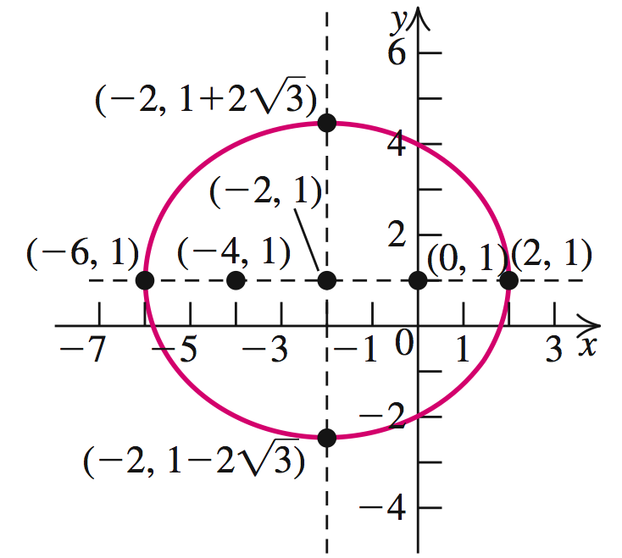
EXAMPLE 4
Converting to Standard Form
Solution continued

Slide 34
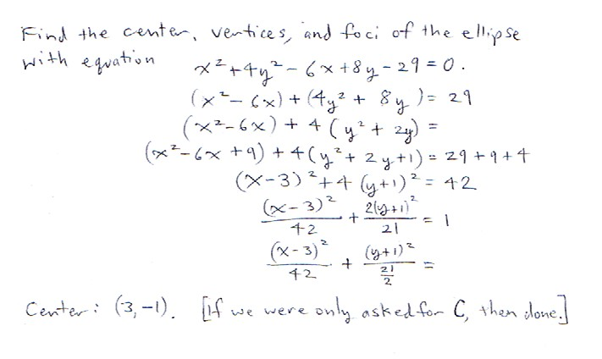
Practice Problem

Slide 35
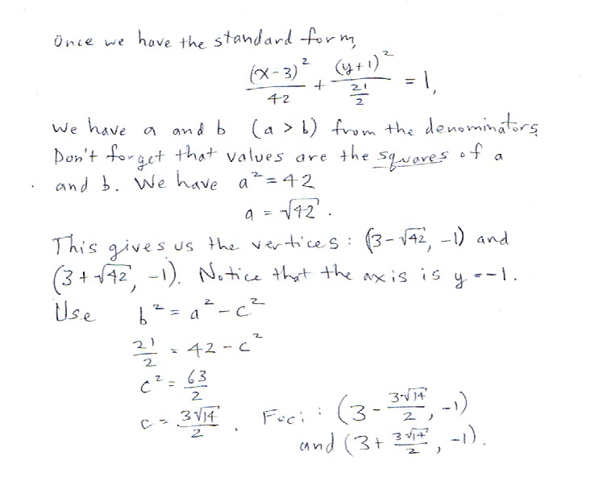
Practice Problem

Slide 36
APPLICATIONS OF ELLIPSES
1. The orbits of the planets are ellipses with the sun at one focus. [Kepler’s observation]
2. Newton reasoned that comets move in elliptical orbits about the sun. [also, Halley]
3. We can calculate the distance traveled by a planet in one orbit around the sun.
4. The reflecting property for an ellipse says that a ray of light originating at one focus will be reflected to the other focus.

Slide 37
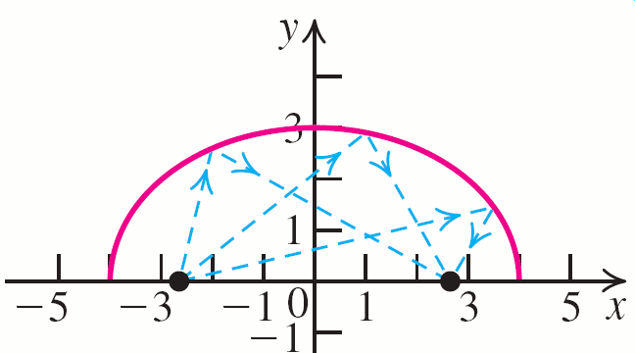
REFLECTING PROPERTY OF ELLIPSES

Slide 38
EXAMPLE 5
Lithotripsy
An elliptical water tank has a major axis of length 6 feet and a minor axis of length 4 feet.
The source of high-energy shock waves from a lithotripter is placed at one focus of the tank.
To smash the kidney stone of a patient, how far should the stone be positioned from the source?

Slide 39

EXAMPLE 5
Lithotripsy
Solution
Since the length of the major axis of the ellipse is 6 feet, we have 2a = 6; so a = 3.
Similarly, the minor axis of 4 feet gives 2b = 4 or b = 2. To find c, we use the equation c2 = a2 – b2. We have
c2 = 32 – 22 = 5. Therefore, .

Slide 40



EXAMPLE 5
Lithotripsy
Solution continued
If we position the center of ellipse at (0, 0) and the major axis along the x-axis, then the foci of the ellipse are and .
The distance between these foci is
≈ 4.472 feet. The kidney stone should be positioned 4.472 feet from the source of the shock waves.

Slide 41
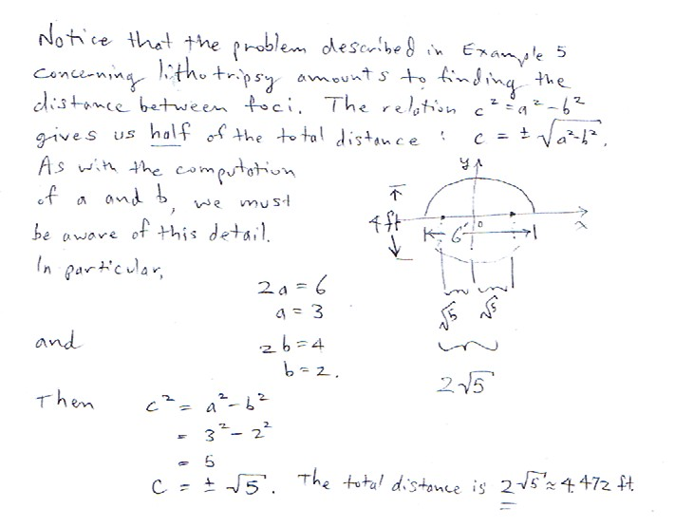
Practice Problem

Slide 42
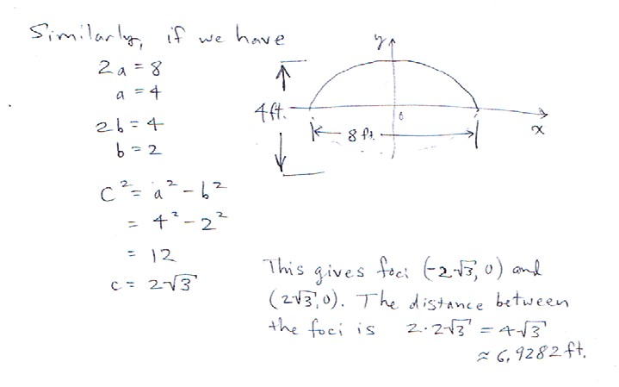
Practice Problem
It is important to have this relationship between a, b, and c. In the next section, we’ll see what happens when the relationship is c^2=a^2+b^2.

