Slide 1



Chapter 9
Analytic Geometry
© 2010 Pearson Education, Inc.
All rights reserved

Slide 2
The Hyperbola
SECTION 9.4
1
Define a hyperbola.
Find the asymptotes of a hyperbola.
Graph [sketch] a hyperbola.
Translate hyperbolas.
Use hyperbolas in applications.
2
3
4
5

Slide 3
HYPERBOLA
A hyperbola is the set of all points in the plane, the difference of whose distances from two fixed points is constant.
The fixed points are called the foci of the hyperbola.

Slide 4
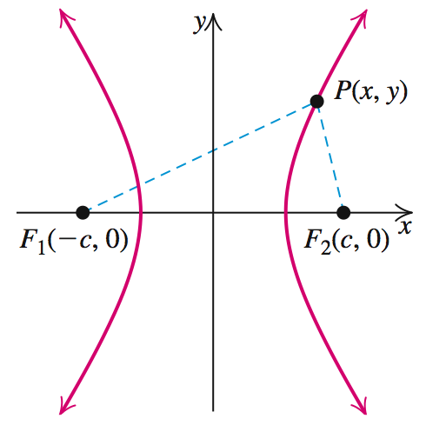
HYPERBOLA
Here is a hyperbola in standard position, with foci F₁(–c, 0) and F₂(c, 0) on the x-axis at equal distances from the origin. The two parts of the hyperbola are called branches.

Slide 5
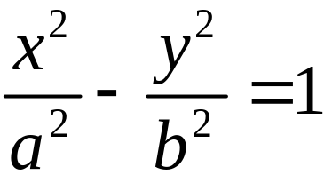
EQUATION OF A HYPERBOLA
is called the standard form of the equation of a hyperbola with center (0, 0).
The x-intercepts are −a and a. The points corresponding to these x-intercepts are the vertices of the hyperbola.

Slide 6
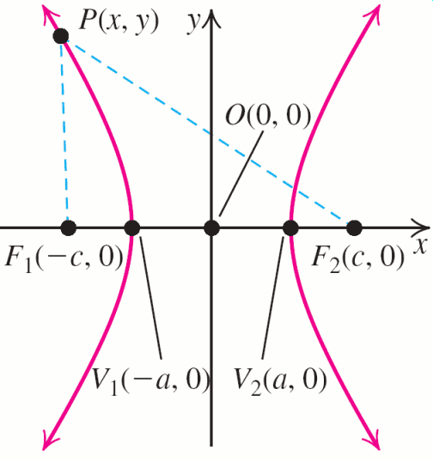
PARTS OF A HYPERBOLA
The line segment joining the two vertices is the transverse axis. The center is the midpoint of the transverse axis. The line segment joining (0, –b) and (0, b) is the conjugate axis.

Slide 7
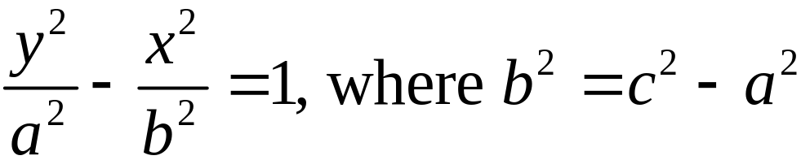
EQUATION OF A HYPERBOLA
Similarly, an equation of a hyperbola with center (0, 0) and foci (0, –c) and (0, c) on the y-axis is given by:
Recall that with ellipse c^2=a^2-b^2,
while here we have c^2=a^2+b^2.
Here the vertices are (0, − a) and (0, a). The transverse axis of length 2a of the graph of the equation lies on the y-axis, and its conjugate axis is the segment joining the points (−b, 0) and (0, b) of length 2b that lies on the x-axis. [conjugate~minor]

Slide 8
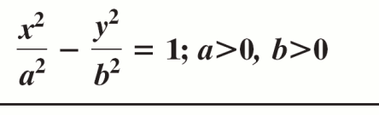

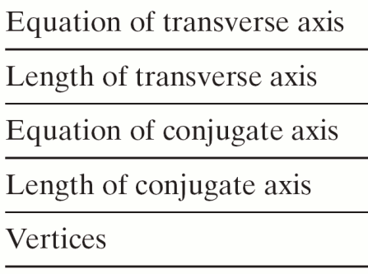
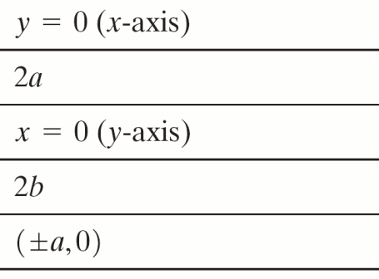
MAIN FACTS ABOUT HYPERBOLAS CENTERED AT (0, 0)

Slide 9
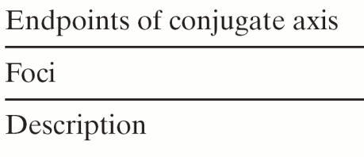
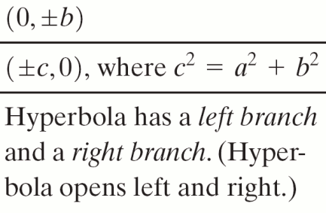
MAIN FACTS ABOUT HYPERBOLAS CENTERED AT (0, 0)

Slide 10
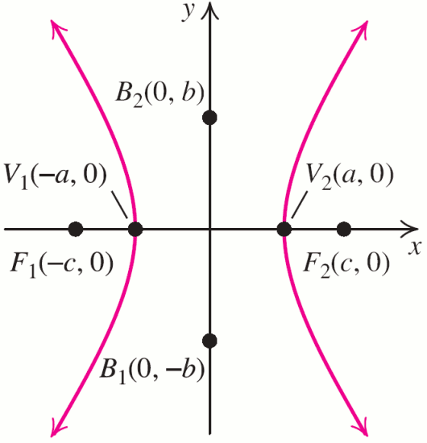
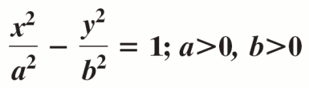
MAIN FACTS ABOUT HYPERBOLAS CENTERED AT (0, 0)

Slide 11
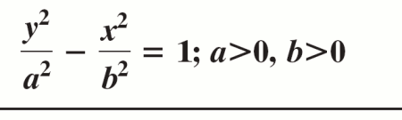
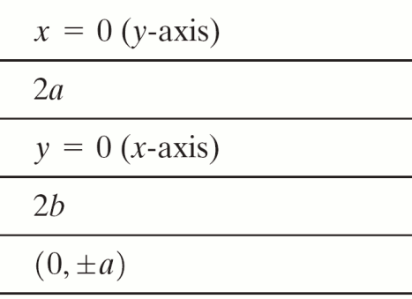
MAIN FACTS ABOUT HYPERBOLAS CENTERED AT (0, 0)

Slide 12
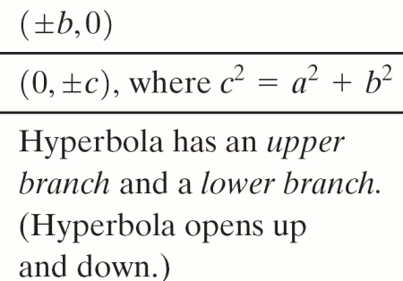
MAIN FACTS ABOUT HYPERBOLAS CENTERED AT (0, 0)

Slide 13
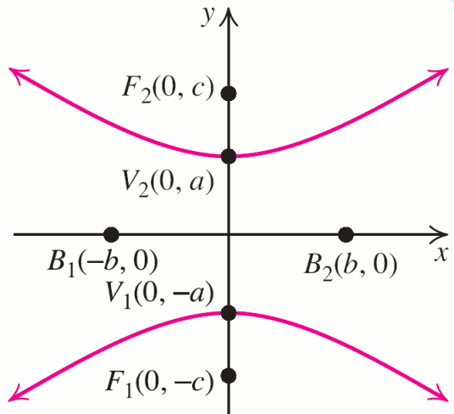
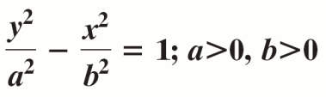
MAIN FACTS ABOUT HYPERBOLAS CENTERED AT (0, 0)

Slide 14
Conic abc’s
We can think of first a circle. Here, both foci are coincident at the center.
As we separate the foci, making them distinct and unequal, the circle takes on some ellipticity.
As the foci approach the vertices, the ellipticity becomes extreme and the result is a thin disk.
Finally, as the foci cross to the other side (away from the center) of the vertices, the result is that the ellipse has been exploded into a double-branched hyperbola.
This evidently describes the nature of the a, b, c relationships in ellipses and hyperbolas.

Slide 15
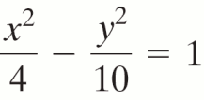
EXAMPLE 1
Determining the Orientation of a Hyperbola
Does the hyperbola have its transverse axis on the x-axis or y-axis?
Solution
The orientation (left–right branches or up–down branches) of a hyperbola is determined
by noting where the minus sign occurs in the standard equation.
In the equation in this example, the minus sign precedes the y2-term, so the transverse axis is on the x-axis.

Slide 16
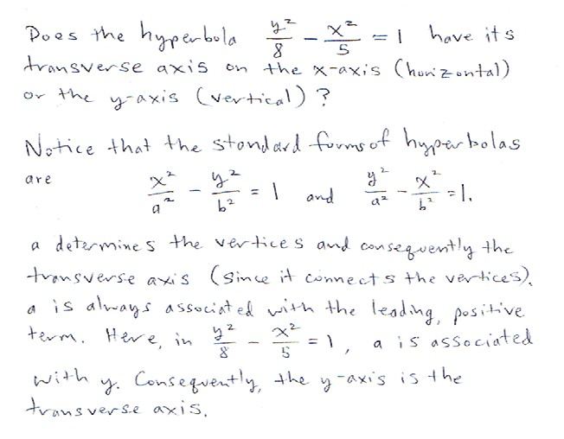
Practice Problem
The transverse axis is the line of symmetry of a single branch (and in this regard it is likened to the major axis of an ellipse, which also contains the vertices [and foci]).
Perhaps think “travels the vertices,” for transverse axis.

Slide 17
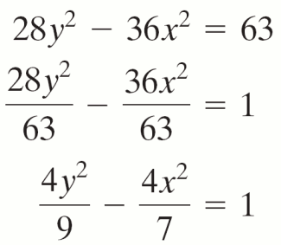
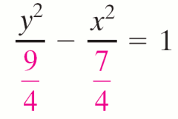
EXAMPLE 2
Finding the Vertices and Foci from the Equation of a Hyperbola
Find the vertices and foci for the hyperbola
28y2 – 36x2 = 63.
Solution
First, convert the equation to the standard form.

Slide 18
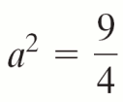

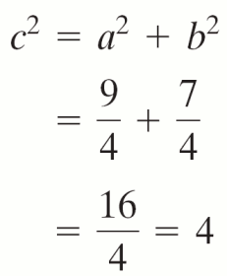
EXAMPLE 2
Finding the Vertices and Foci from the Equation of a Hyperbola
Solution continued
Since the coefficient of x2 is negative, the transverse axis lies on the y-axis.
and
and therefore

Slide 19

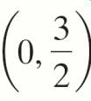
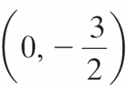
EXAMPLE 2
Finding the Vertices and Foci from the Equation of a Hyperbola
Solution continued
Since we require a > 0 and c > 0, and c = 2. The vertices of the hyperbola are and . The foci of the hyperbola are (0, −2) and (0, 2).

Slide 20
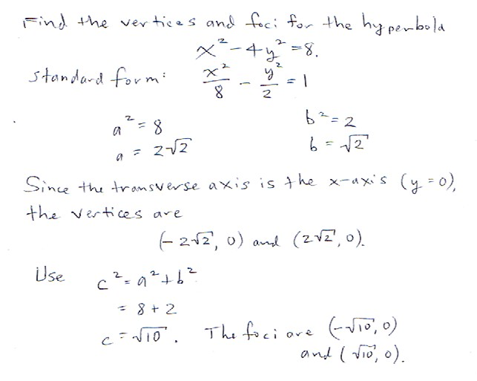
Practice Problem
Ironically, the hyperbola is actually “simpler” than the parabola, since there isn’t an open up direction to worry about.
As expected, the vertices and foci are included in the transverse axis.

Slide 21
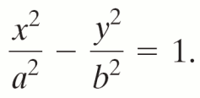
EXAMPLE 3
Finding the Equation of a Hyperbola
Find the standard form of the equation of a hyperbola with vertices (±4, 0) and foci (±5, 0).
Solution
Since the foci of the hyperbola are on the x-axis, the transverse axis lies on the x-axis.
The center of the hyperbola is midway between the foci, at (0, 0). The standard form of such a hyperbola is

Slide 22
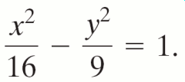
EXAMPLE 3
Finding the Equation of a Hyperbola
Solution continued
The distance a between the center (0, 0) to either vertex, (−4, 0) or (4, 0) is 4; so a = 4 and a2 = 16.
The distance c between the center to either focus, (5, 0) or (−5, 0) is 5; so c = 5 and c2 = 25.
Use b2 = c2 – a2: b2 = 25 − 16 = 9.
Substitute a2 = 16 and b2 = 9 into the standard
form to get

Slide 23
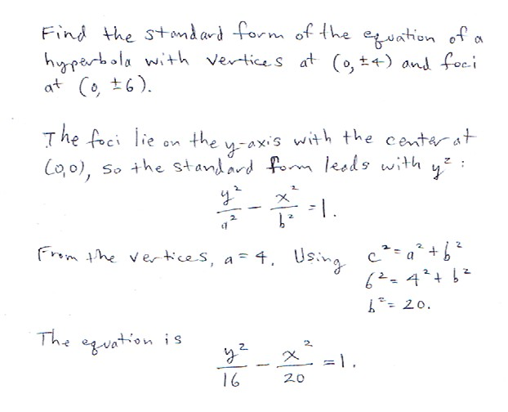
Practice Problem

Slide 24
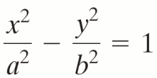

THE ASYMPTOTES OF A HYPERBOLA WITH CENTER (0, 0)
1. The graph of the hyperbola has
transverse axis along the x-axis and has the following two asymptotes:

Slide 25
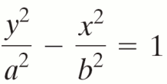

THE ASYMPTOTES OF A HYPERBOLA WITH CENTER (0, 0)
2. The graph of the hyperbola has
transverse axis along the y-axis and has the following two asymptotes:

Slide 26
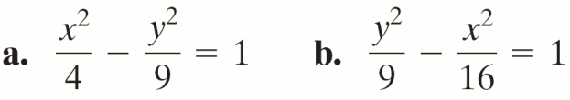
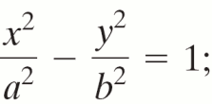
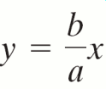


EXAMPLE 4
Finding the Equation of a Hyperbola
Determine the asymptotes of each hyperbola.
Solution
a. The hyperbola is of the form so a = 2 and b = 3.
Substituting these values into and
we get the asymptotes

Slide 27
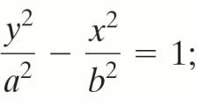



EXAMPLE 4
Finding the Equation of a Hyperbola
Solution continued
b. The hyperbola has the form so a = 3 and b = 4.
Substituting these values into and
we get the asymptotes

Slide 28
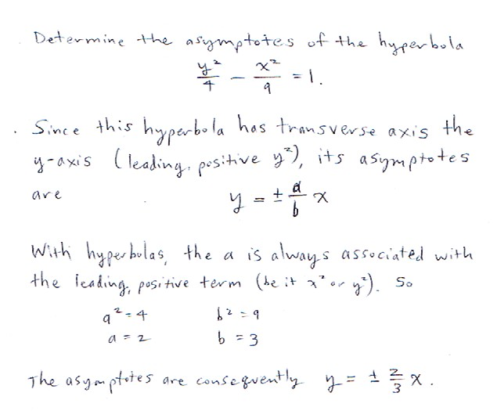
Practice Problem

Slide 29
Practice Problem

Slide 30
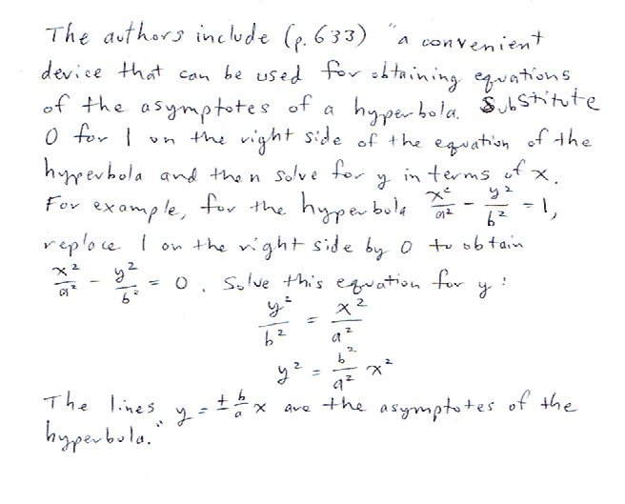
Note

Slide 31
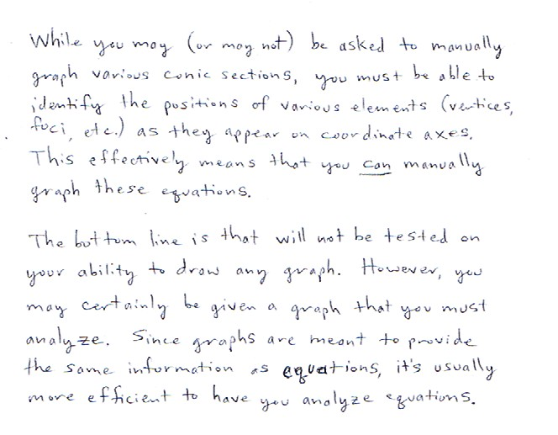
Practice Problem

Slide 32
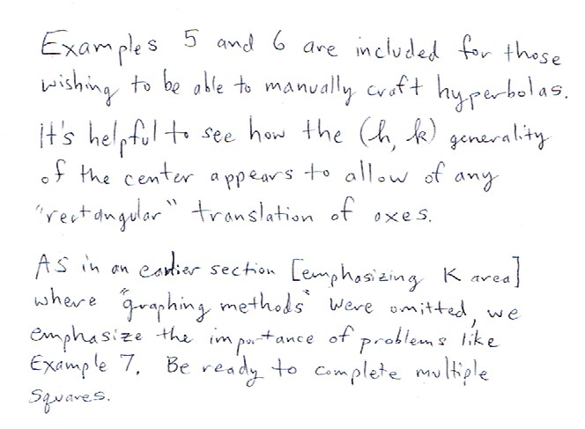
Practice Problem

Slide 33
PROCEDURE FOR GRAPHING A HYPERBOLA CENTERED AT (0, 0)
Step 1 Write the equation in standard form.
Determine transverse axis and the orientation of the hyperbola.
Step 2 Locate vertices and the endpoints of
the conjugate axis.
Step 3 Lightly sketch the fundamental rectangle by drawing dashed lines parallel to the coordinate axes through the points in Step 2.

Slide 34
PROCEDURE FOR GRAPHING A HYPERBOLA CENTERED AT (0, 0)
Step 4 Sketch the asymptotes. Extend the
diagonals of the fundamental rectangle.These are the asymptotes.
Step 5 Sketch the graph. Draw both branches
of the hyperbola through the vertices, approaching the asymptotes. The foci are located on the transverse axis, c units from the center, where c2 = a2 + b2.

Slide 35
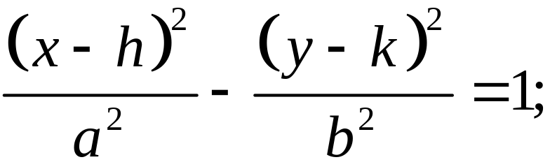
MAIN PROPERTIES OF HYPERBOLAS CENTERED AT (h, k)
Standard Equation | a > 0, b > 0
Equation of transverse axis | y = k
Length of transverse axis | 2a
Equation of conjugate axis | x = h
Length of conjugate axis | 2b
Center | (h, k)

Slide 36
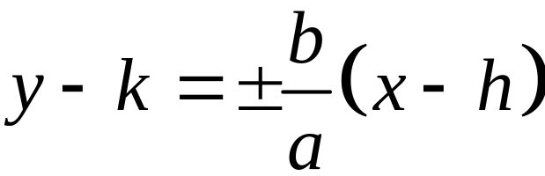
MAIN PROPERTIES OF HYPERBOLAS CENTERED AT (h, k)
Vertices | (h − a, k), (h + a, k)
Endpoints of conjugate axis | (h, k − b), (h, k + b)
Foci | (h − c, k), (h + c, k)
Equation involving a, b, and c | c² = a² + b²
Asymptotes

Slide 37
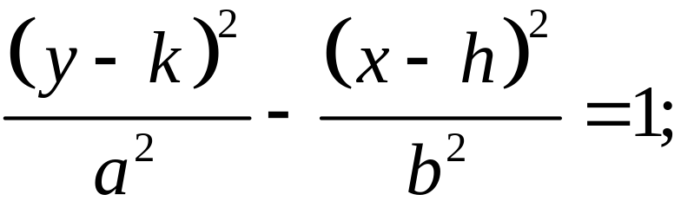
MAIN PROPERTIES OF HYPERBOLAS CENTERED AT (h, k)
Standard Equation | a > 0, b > 0
Equation of transverse axis | x = h
Length of transverse axis | 2a
Equation of conjugate axis | y = k
Length of conjugate axis | 2b
Center | (h, k)

Slide 38
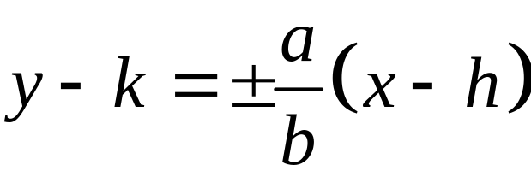
MAIN PROPERTIES OF HYPERBOLAS CENTERED AT (h, k)
Vertices | (h, k – a), (h, k + a)
Endpoints of conjugate axis | (h – b, k), (h + b, k)
Foci | (h, k – c), (h, k + c)
Equation involving a, b, and c | c² = a² + b²
Asymptotes

Slide 39
PROCEDURE FOR SKETCHING THE GRAPH OF A HYPERBOLA CETNERED AT (h, k)
Step 1 Plot the center (h, k), and draw horizontal and vertical dashed lines through the center.
Step 2 Locate the vertices and the endpoints of the conjugate axis. Lightly sketch the fundamental rectangle, with sides parallel to the coordinate axes, through these points.

Slide 40
PROCEDURE FOR SKETCHING THE GRAPH OF A HYPERBOLA CETNERED AT (h, k)
Step 3 Sketch dashed lines through opposite vertices of the fundamental rectangle. These are the asymptotes.
Step 4 Draw both branches of the hyperbola, through the vertices and approaching the asymptotes.
Step 5 The foci are located on the transverse axis, c units from the center, where c2 = a2 + b2.

Slide 41
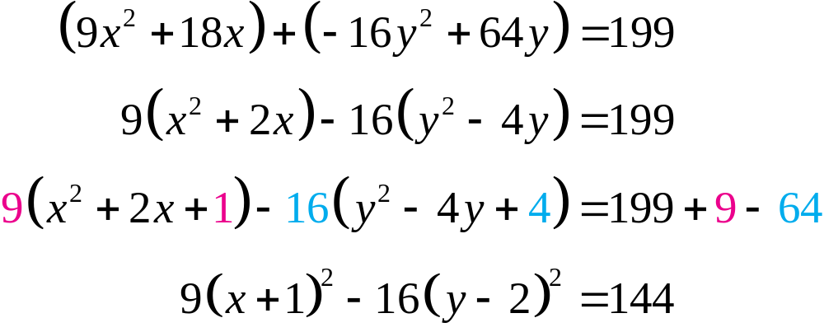
EXAMPLE 7
Graphing a Hyperbola
Show that 9x2 – 16y2 + 18x + 64y –199 = 0 is an equation of a hyperbola, and then graph the hyperbola.
Solution
Complete the squares on x and y.

Slide 42
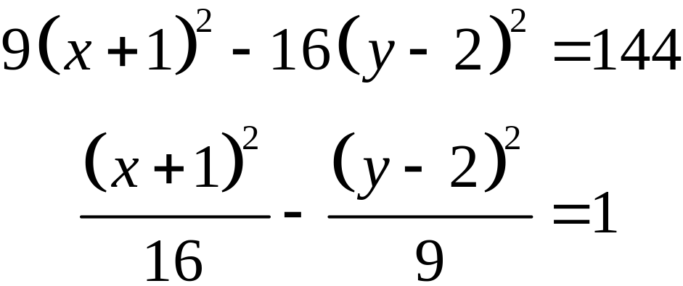
EXAMPLE 7
Graphing a Hyperbola
Solution continued
Steps 1-2 Locate the vertices.
Center (–1, 2); a2 = 16, a = 4; b2 = 9, b = 3
(h – a, k) = (–1– 4, 2) = (–5, 2)
(h + a, k) = (–1+ 4, 2) = (3, 2)
Draw the fundamental rectangle.
Vertices: (3, –1), (3, 5), (–5, 5), (–5, –1)

Slide 43
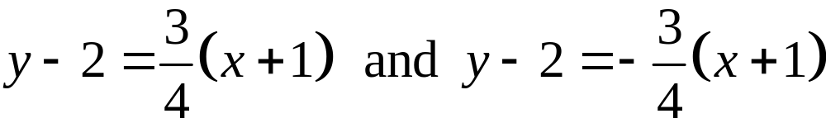
EXAMPLE 7
Graphing a Hyperbola
Solution continued
Step 3 Sketch the asymptotes. Extend the diagonals of the rectangle obtained in Step 2 to sketch the asymptotes:
Step 4 Sketch the graph. Draw two branches opening left and right, starting from the vertices (–5, 2) and (3, 2) and approaching the asymptotes.

Slide 44
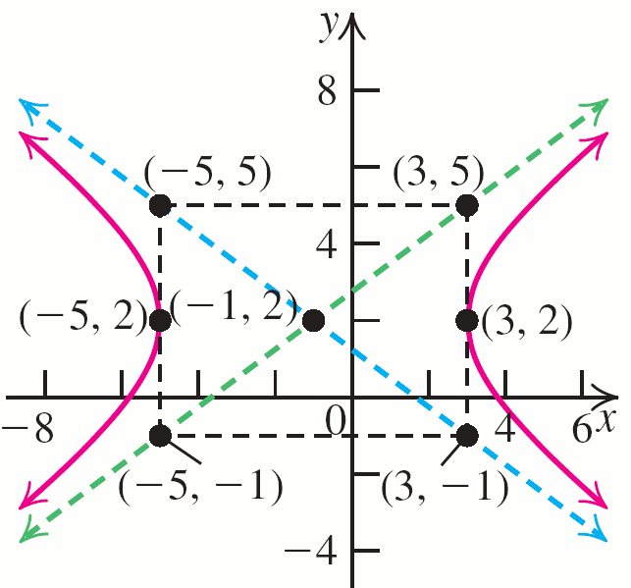
EXAMPLE 7
Graphing a Hyperbola
Solution continued

Slide 45
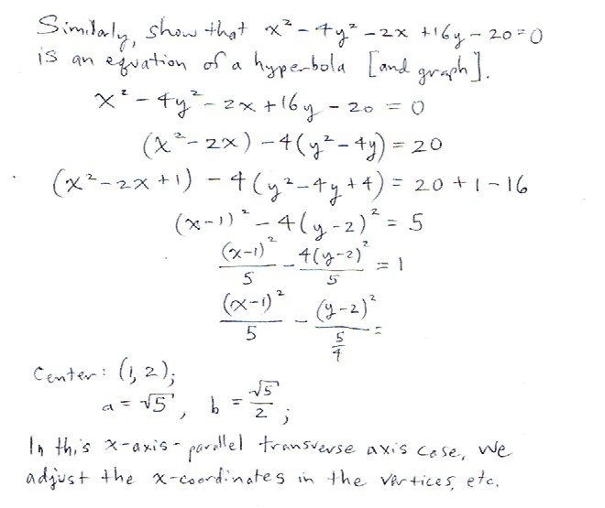
Practice Problem

Slide 46
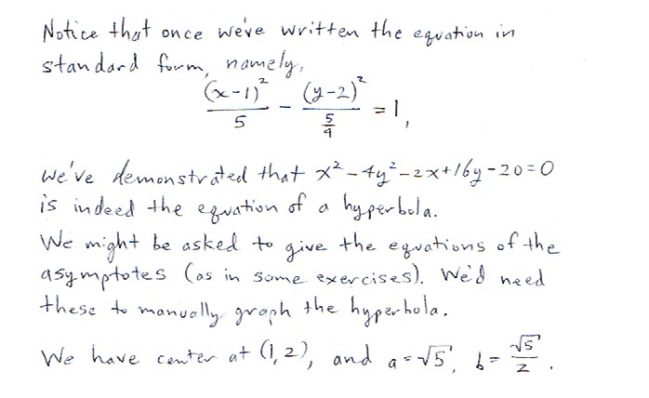
Practice Problem

Slide 47
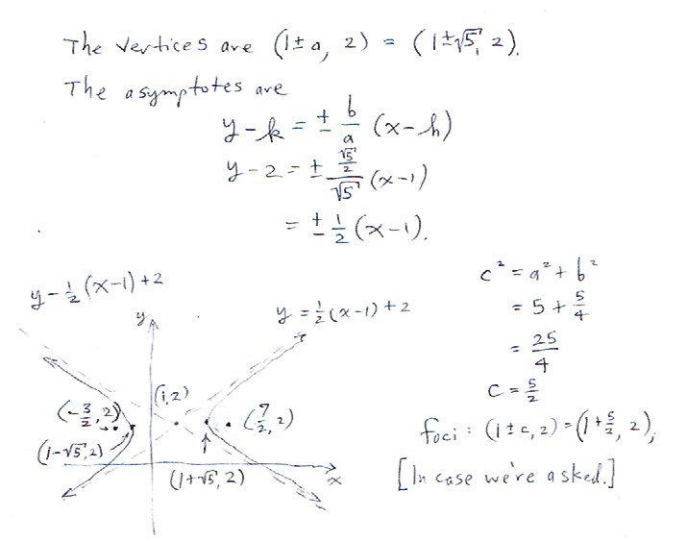
Practice Problem

Slide 48
APPLICATIONS OF HYPERBOLAS
1. Comets that do not move in elliptical orbits around the sun almost always move in hyperbolic orbits.
2. Boyle’s Law states that if a perfect gas is kept at a constant temperature, then its pressure P and volume V are related by the equation PV = c, where c is constant. The graph of this equation is a hyperbola.

Slide 49
APPLICATIONS OF HYPERBOLAS
3. The hyperbola has the reflecting property that a ray of light from a source at one focus of a hyperbolic mirror (a mirror with hyperbolic cross sections) is reflected along the line through the other focus.
4. The definition of a hyperbola forms the basis of several important navigational systems, such as LORAN (Long Range Navigation).

Slide 50
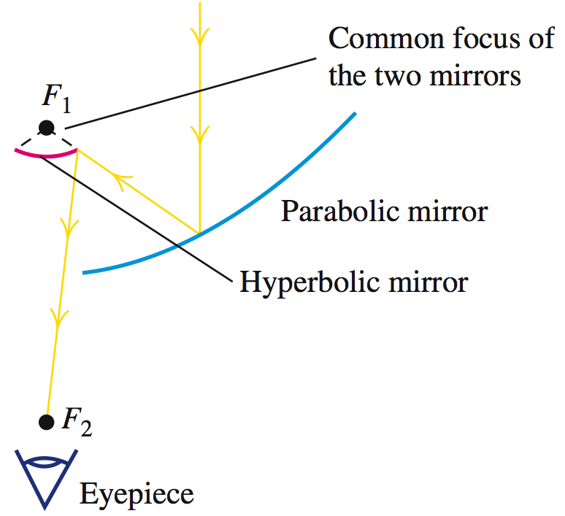
The reflecting properties of the parabola and hyperbola are combined into
one design for a reflecting telescope. The parallel rays from a star are finally focused at the eyepiece at F₂.

Slide 51

Practice Problem

Slide 52

Practice Problem

