Slide 1



Chapter 10
Further Topics
in Algebra
© 2010 Pearson Education, Inc.
All rights reserved

Slide 2
Sequences and Series
SECTION 10.1
1
Use sequence notation and find specific and general terms in a sequence.
Use factorial notation.
Use summation notation to write partial sums of a series.
2
3

Slide 3
DEFINITION OF A SEQUENCE
An infinite sequence is a function whose domain is the set of positive integers. The function values, written as
a₁, a₂, a₃, a₄, … , a_{n}, …,
are called the terms of the sequence. The nth term, a_{n}, is called the general term of the sequence.

Slide 4
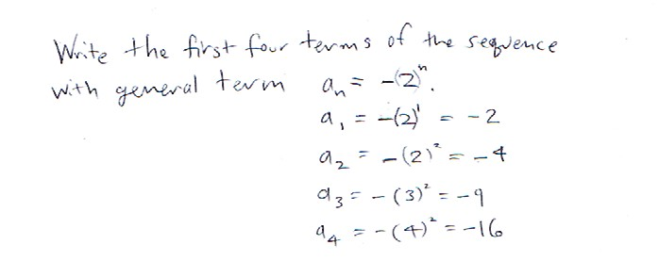
Practice Problem

Slide 5
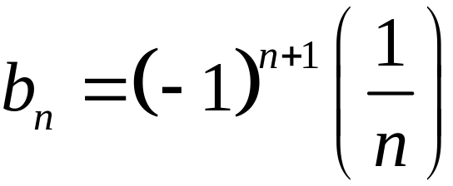
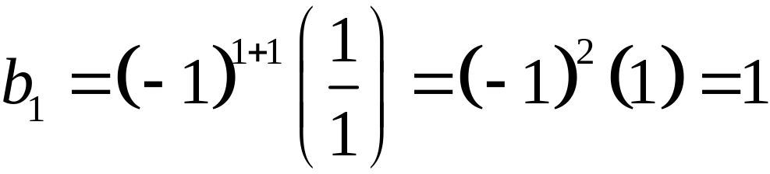
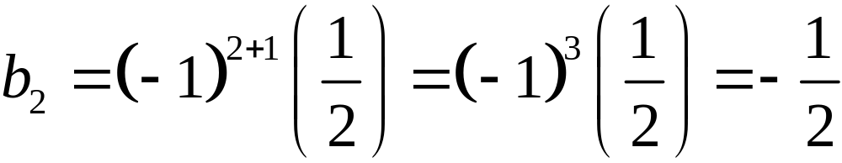
Writing the First Several Terms of a Sequence
EXAMPLE 2
Write the first six terms of the sequence defined by:
Solution
Replace n with each integer from 1 to 6.

Slide 6
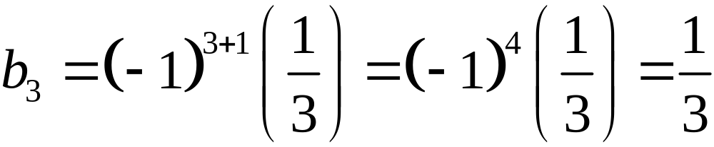
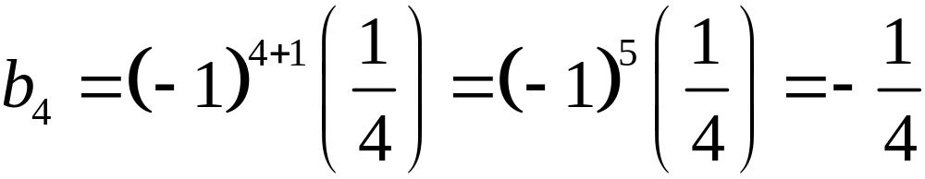
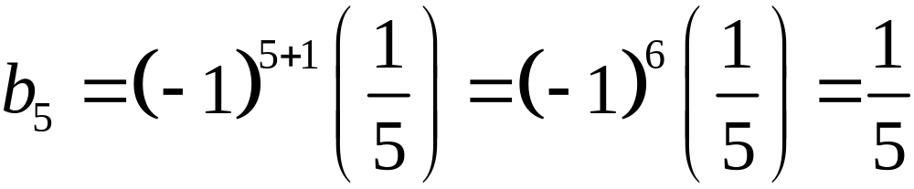
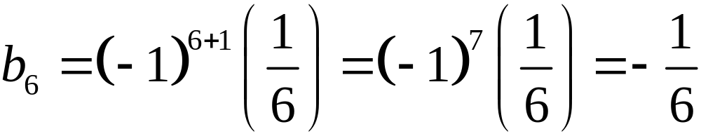
Writing the First Several Terms of a Sequence
EXAMPLE 2
Solution continued

Slide 7
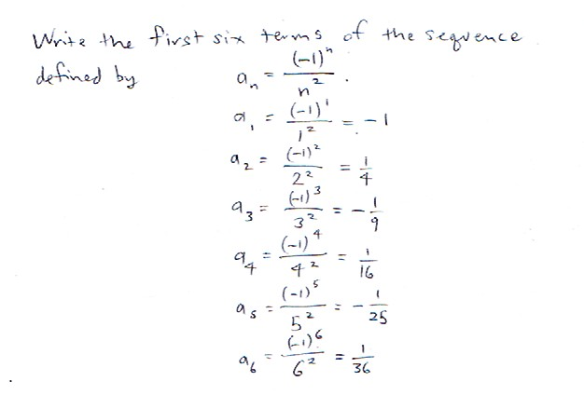
Practice Problem

Slide 8
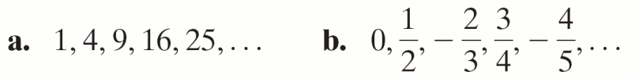
Finding a General Term of a Sequence from a Pattern
EXAMPLE 3
Write the general term a_{n} for a sequence whose first five terms are given.
Solution
Write the position number of the term above each term of the sequence and look for a pattern that connects the term to the position number of the term.

Slide 9

Finding a General Term of a Sequence from a Pattern
EXAMPLE 3
Solution
a.
Apparent pattern: Here 1 = 12, 4 = 22, 9 = 32, 16 = 42, and 25 =52. Each term is the square of the position number of that term. This suggests a_{n} = n2.

Slide 10
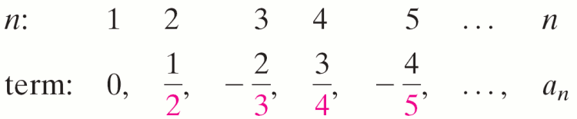
Finding a General Term of a Sequence from a Pattern
EXAMPLE 3
Solution continued
b.
Apparent pattern: When the terms alternate in sign and n = 1, we use factors such as (−1)n if we want to begin with the factor −1 or we use factors such as (−1)n+1 if we want to begin with the factor 1.

Slide 11
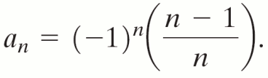
Finding a General Term of a Sequence from a Pattern
EXAMPLE 3
Solution continued
b. continued
Notice that each term can be written as a quotient with denominator equal to the position number and numerator equal to one less than the position number, suggesting the general
term

Slide 12
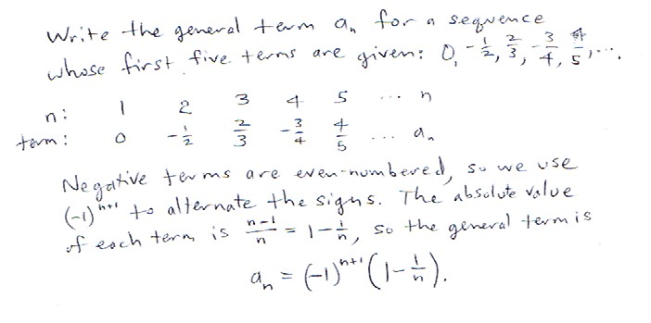
Practice Problem

Slide 13
RECURSIVE FORMULAS
A recursive formula requires that one or more of the first few terms of the sequence be specified and all other terms be defined in relation to previously defined terms.
The Fibonacci sequence is a famous sequence that is defined recursively and shows up often in nature. In this sequence, we specify the first two terms as a₀ = 1 and a₁ = 1; each subsequent term is the sum of the two terms immediately preceding it.

Slide 14
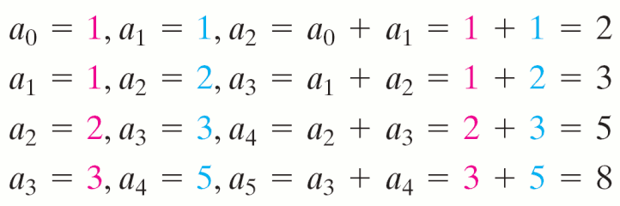
THE FIBONACCI SEQUENCE
So we have
This sequence can also be defined in subscript notation:

Slide 15
Finding Terms of a Recursively Defined Sequence
EXAMPLE 4
Write the first five terms of the recursively defined sequence
a₁ = 4, a_{n+1} = 2a_{n} – 9
Solution
We are given the first term of the sequence: a₁ = 4.
a₂ = 2a₁ – 9 = 2(4) – 9 = –1
a₃ = 2a₂ – 9 = 2(–1) – 9 = –11
a₄ = 2a₃ – 9 = 2(–11) – 9 = –31
a₅ = 2a₄ – 9 = 2(–31) – 9 = –71
So the first five terms of the sequence are:
4, –1, −11, −31, −71

Slide 16
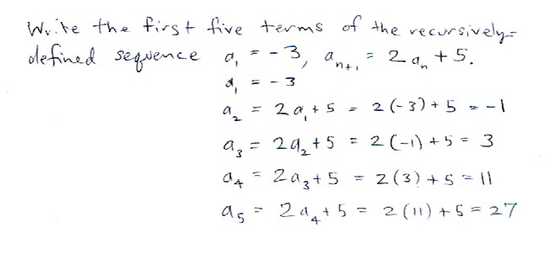
Practice Problem

Slide 17
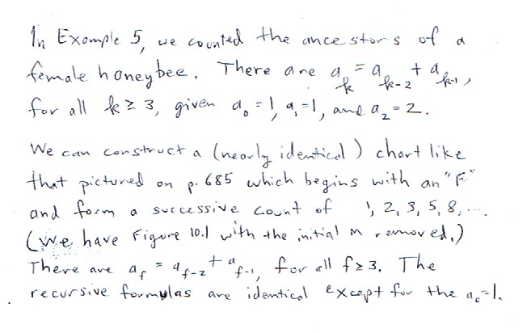
Practice Problem

Slide 18
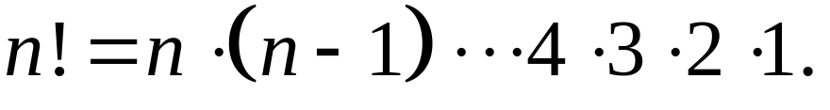

DEFINITION OF FACTORIAL
For any positive integer n, n factorial (written n!) is defined as
As a special case, zero factorial (written 0!) is defined as

Slide 19
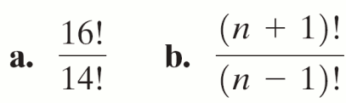
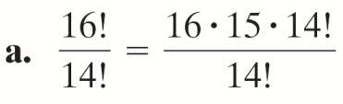
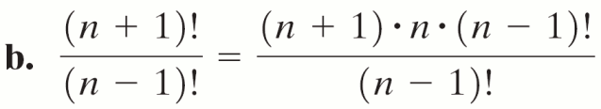
EXAMPLE 6
Simplifying a Factorial Expression
Simplify.
Solution
= 16 · 15 = 240
= (n + 1)n

Slide 20
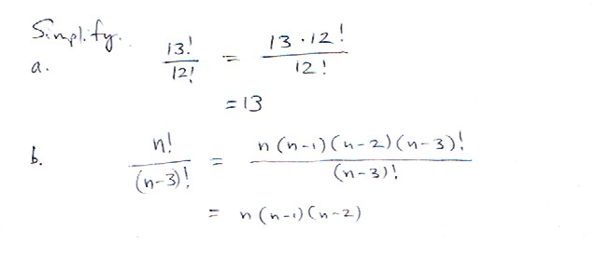
Practice Problem

Slide 21
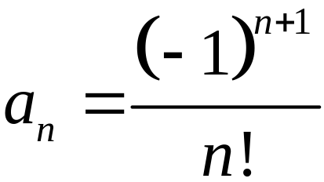
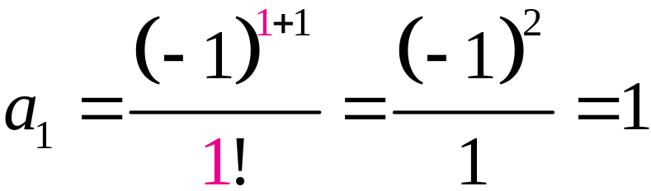
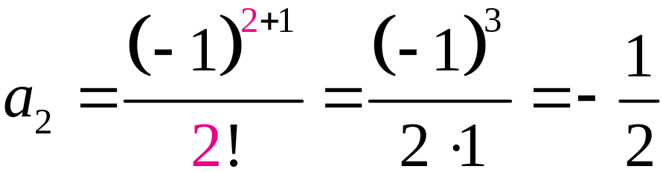
Writing Terms of a Sequence Involving Factorials
EXAMPLE 7
Write the first five terms of the sequence whose general term is:
Solution
Replace n with each integer from 1 through 5.

Slide 22
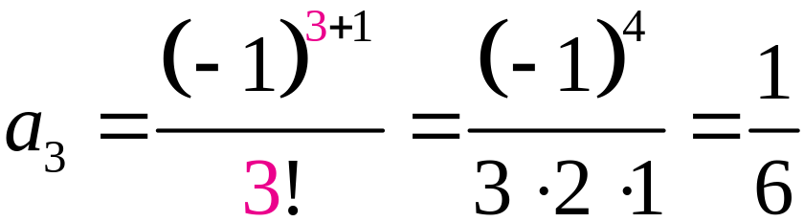
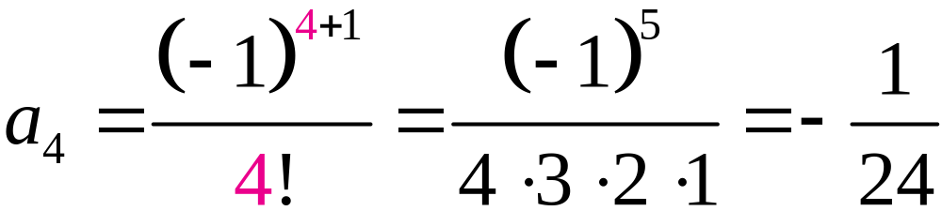
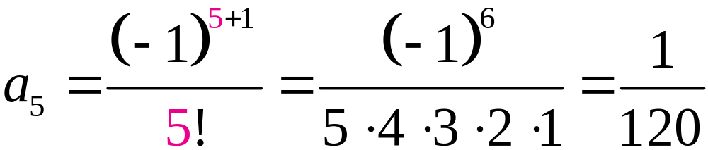
Writing Terms of a Sequence Involving Factorials
EXAMPLE 7
Solution continued

Slide 23
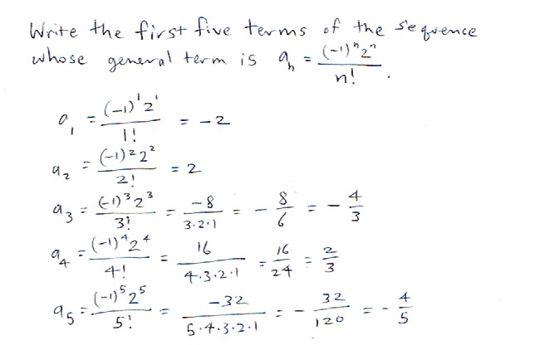
Practice Problem

Slide 24
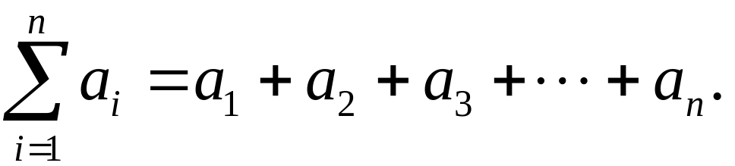
SUMMATION NOTATION
The sum of the first n terms of a sequence a₁, a₂, a₃, …, a_{n}, … is denoted by
The letter i in the summation notation is called the index of summation, n is called the upper limit, and 1 is called the lower limit, of the summation.

Slide 25
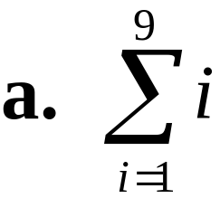
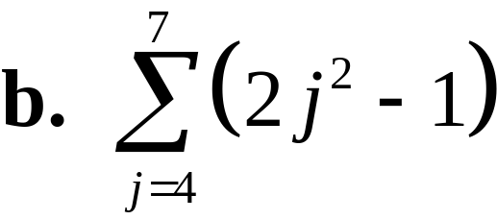
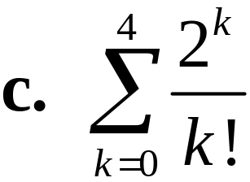
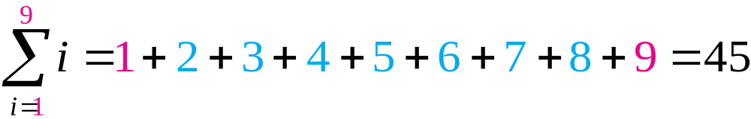
Evaluating Sums Given in Summation Notation
EXAMPLE 8
Find each sum.
Solution
a. Replace i with integers 1 through 9, inclusive, and then add.

Slide 26
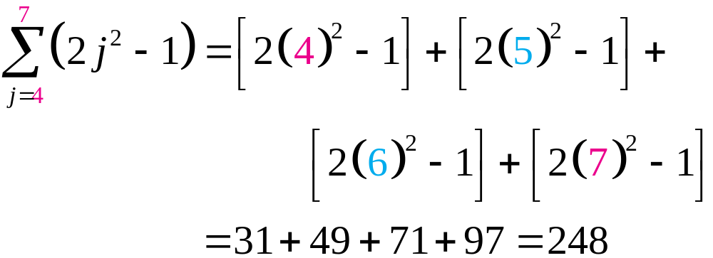
Evaluating Sums Given in Summation Notation
EXAMPLE 8
Solution continued
b. Replace j with integers 4 through 7, inclusive, and then add.

Slide 27
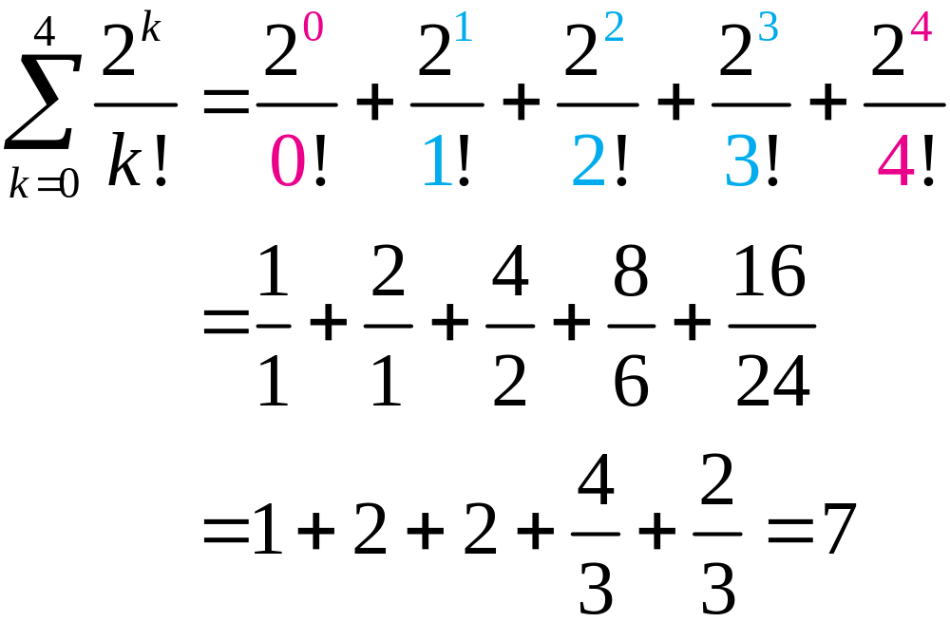
Evaluating Sums Given in Summation Notation
EXAMPLE 8
Solution continued
c. Replace k with integers 0 through 4, inclusive, and then add.

Slide 28
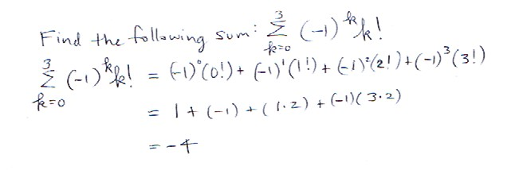
Practice Problem

Slide 29
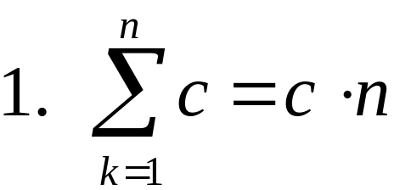
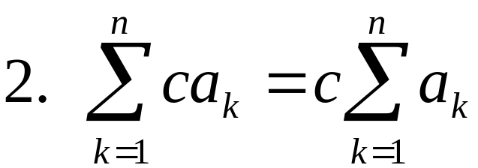
SUMMATION PROPERTIES
Let a_{k} and b_{k}, represent the general terms of two sequences, and let c represent any real number. Then

Slide 30
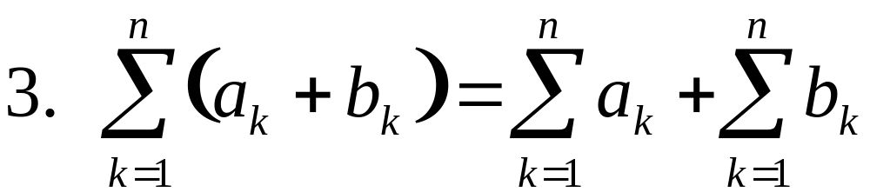
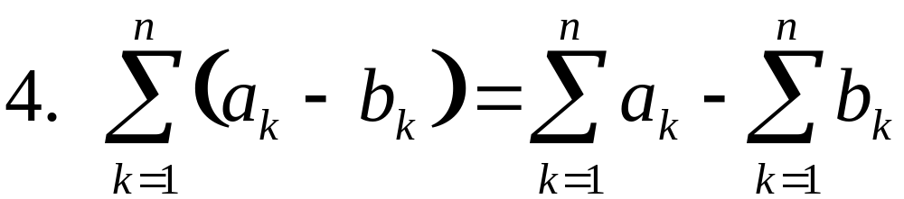
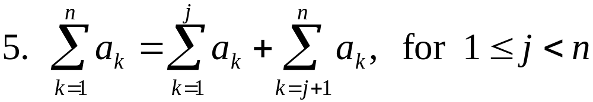
SUMMATION PROPERTIES

Slide 31
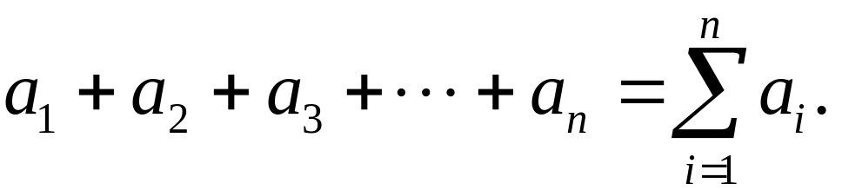
DEFINITION OF A SERIES
Let a₁, a₂, a₃, … , a_{k}, … be an infinite sequence. Then
1. The sum of the first n terms of the sequence is called the nth partial sum of the sequence and is denoted by
This sum is a finite series.

Slide 32
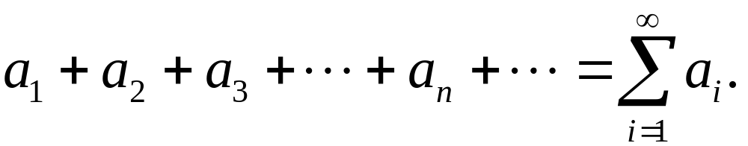
DEFINITION OF A SERIES
2. The sum of all terms of the infinite sequence is called an infinite series and is denoted by

Slide 33
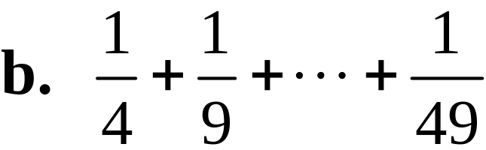

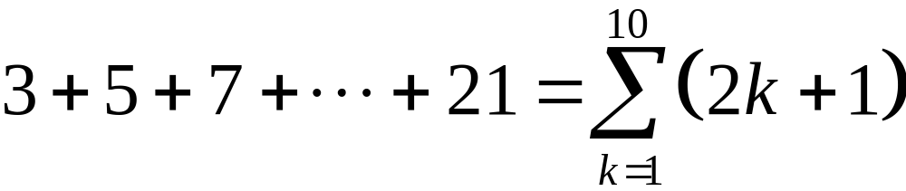
EXAMPLE 9
Writing a Partial Sum in Summation Notation
Write each sum in summation notation.
Solution
a. This is the sum of consecutive odd integers from 3 to 21. Each can be expressed as 2k + 1, starting with k = 1 and ending with k = 10.

Slide 34
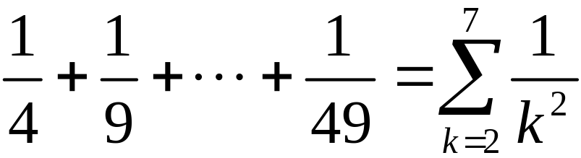
EXAMPLE 9
Writing a Partial Sum in Summation Notation
Solution continued
b. This finite series is the sum of fractions, each of which has numerator 1 and denominator k2, starting with k = 2 and ending with k = 7.

Slide 35
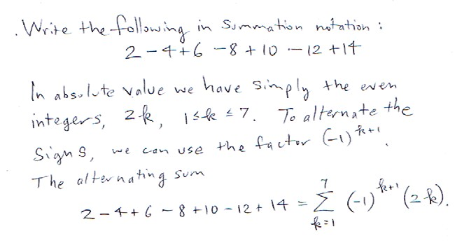
Practice Problem

