Slide 1



Chapter 10
Further Topics
in Algebra
© 2010 Pearson Education, Inc.
All rights reserved

Slide 2
Arithmetic Sequences; Partial Sums
SECTION 10.2
1
Identify an arithmetic sequence and find its common difference.
Find the sum of the first n terms of an arithmetic sequence.
2

Slide 3
DEFINITION OF AN ARITHMETIC SEQUENCE
The sequence a₁, a₂, a₃, a₄, … , a_{n}, …
is an arithmetic sequence, or an arithmetic progression if there is a number d such that each term in the sequence except the first is obtained from the preceding term by adding d to it. The number d is called the common difference of the arithmetic sequence. We have
d = a_{n + 1} – a_{n}, n ≥ 1.

Slide 4
RECURSIVE DEFINITION OF AN ARITHMETIC SEQUENCE
An arithmetic sequence
a₁, a₂, a₃, a₄, … , a_{n}, …
can be defined recursively. The recursive formula
a_{n + 1} = a_{n} + d for n ≥ 1
defines an arithmetic sequence with first term a₁ and common difference d.

Slide 5
nTH TERM OF AN ARITHMETIC SEQUENCE
If a sequence a₁, a₂, a₃, … is an arithmetic sequence, then its nth term, a_{n}, is given by
a_{n} = a₁ + (n – 1)d,
where a₁ is the first term and d is the common difference.

Slide 6
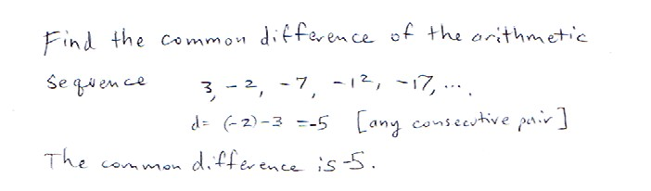
Practice Problem

Slide 7
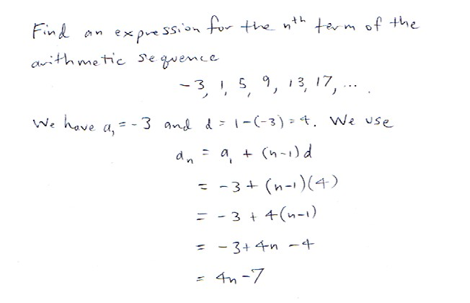
Practice Problem

Slide 8
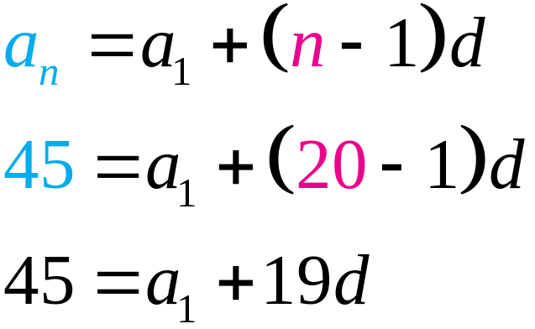
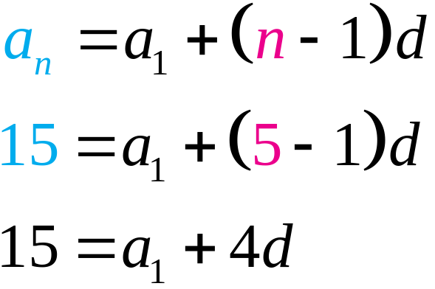
Finding the Common Difference of an Arithmetic Sequence
EXAMPLE 3
Find the common difference d and the nth term a_{n} of an arithmetic sequence whose 5th term is 15 and whose 20th term is 45.
Solution

Slide 9
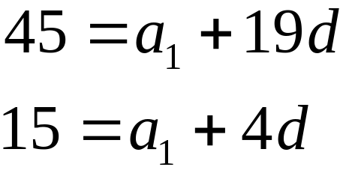
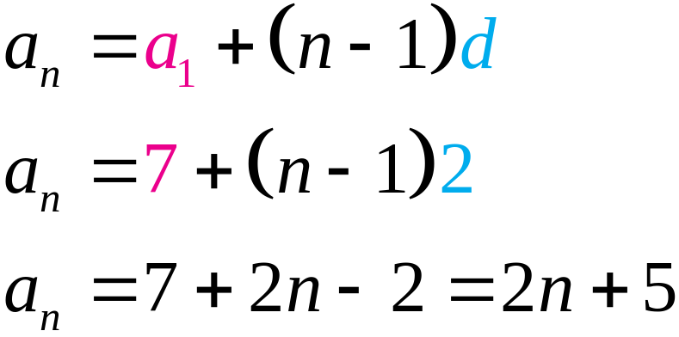
Finding the Common Difference of an Arithmetic Sequence
EXAMPLE 3
Solution continued
Solving the system of equations
gives a₁ = 7 and d = 2.
The nth term is given by a_{n} = 2n + 5, n ≥ 1.

Slide 10
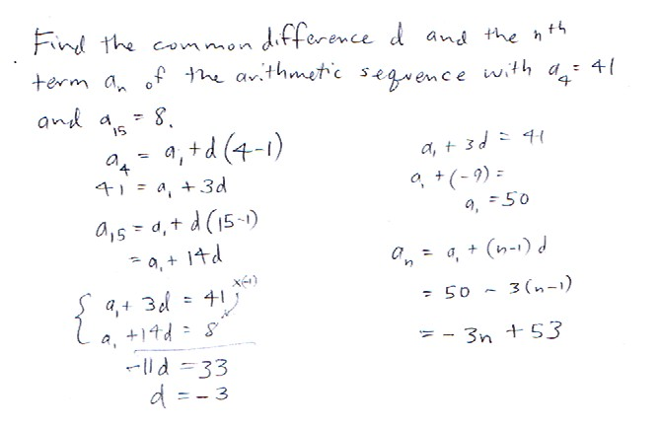
Practice Problem

Slide 11
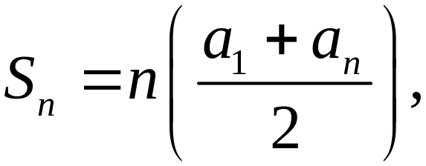
SUM OF n TERMS OF AN ARITHMETIC SEQUENCE
Let a₁, a₂, a₃, … a_{n} be the first n terms of an arithmetic sequence with common difference d. The sum S_{n} of these n terms is given by
where a_{n} = a₁ + (n – 1)d.

Slide 12
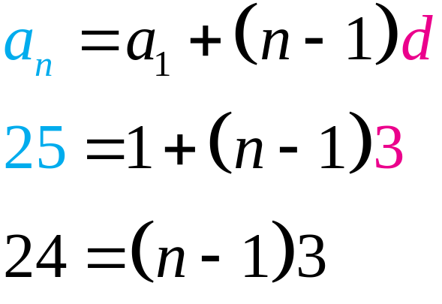
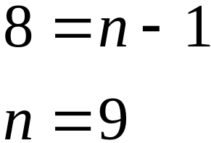
Finding the Sum of Terms of a Finite Arithmetic Sequence
EXAMPLE 4
Find the sum of the arithmetic sequence of numbers:
1 + 4 + 7 + … + 25
Solution
Arithmetic sequence with a₁ = 1 and d = 3. First find the number of terms.

Slide 13
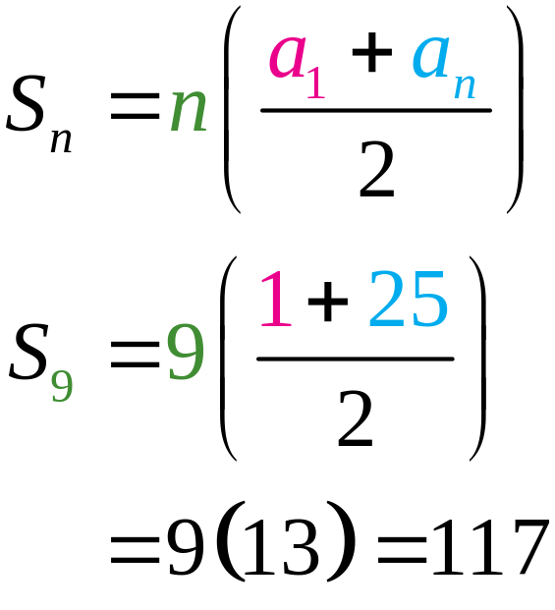
Finding the Sum of Terms of a Finite Arithmetic Sequence
EXAMPLE 4
Solution continued
Thus 1 + 4 + 7 + … + 25 = 117.

Slide 14
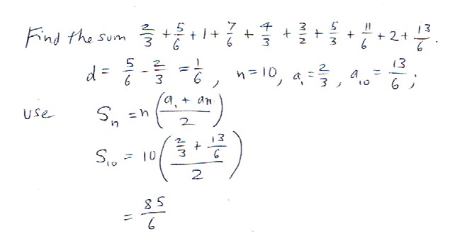
Practice Problem

Slide 15
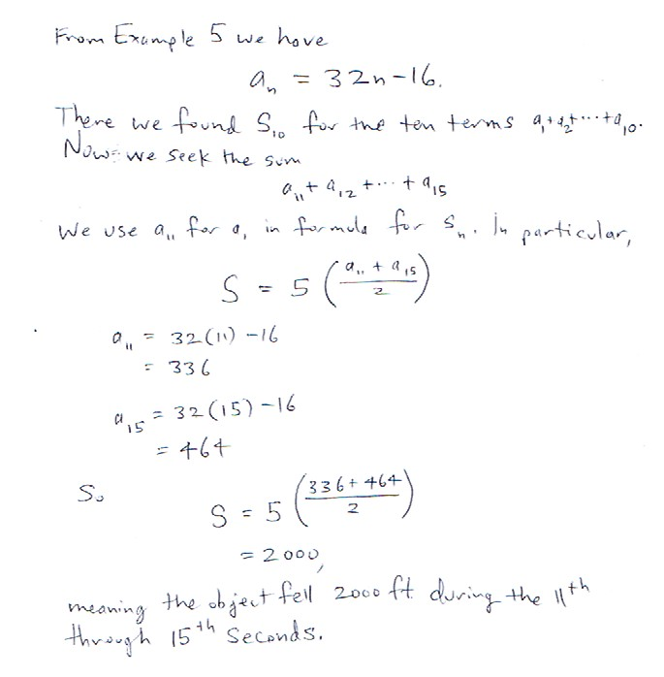
Practice Problem

