Slide 1



Chapter 10
Further Topics
in Algebra
© 2010 Pearson Education, Inc.
All rights reserved

Slide 2
Geometric Sequences and Series
SECTION 10.3
1
Identify a geometric sequence and find its common ratio.
Find the sum of a finite geometric sequence.
Solve annuity problems.
Find the sum of an infinite geometric sequence.
2
3
4

Slide 3
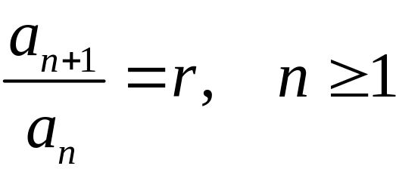
DEFINITION OF A GEOMETRIC SEQUENCE
The sequence a₁, a₂, a₃, a₄, … , a_{n}, …
is a geometric sequence, or a geometric progression, if there is a number r such that each term except the first in the sequence is obtained by multiplying the previous term by r. The number r is called the common ratio of the geometric sequence.

Slide 4
RECURSIVE DEFINITION OF A GEOMETRIC SEQUENCE
A geometric sequence
a₁, a₂, a₃, a₄, … , a_{n}, …
can be defined recursively. The recursive formula
a_{n + 1} = ra_{n}, n ≥ 1
defines a geometric sequence with first term a₁ and common ratio r.

Slide 5
THE GENERAL TERM OF A GEOMETRIC SEQUENCE
Every geometric sequence can be written in the form
a₁, a₁r, a₁r2, a₁r3, … , a₁rn−1, …
where r is the common ratio. Since a₁ = a₁(1) = a₁r0, the nth term of the geometric sequence is
a_{n} = a₁rn–1, for n ≥ 1.

Slide 6
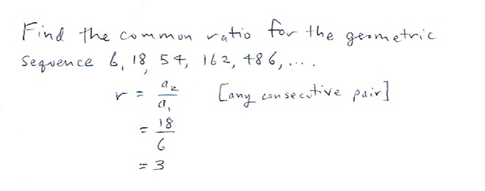
Practice Problem

Slide 7
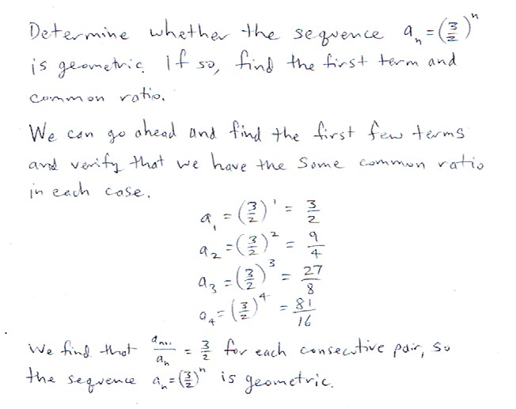
Practice Problem

Slide 8
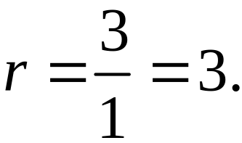
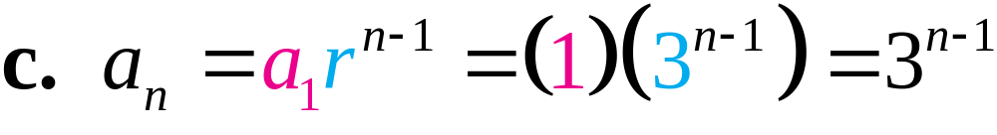
EXAMPLE 3
Finding Terms in a Geometric Sequence
For the geometric sequence 1, 3, 9, 27, …, find each of the following:
a. a₁ b. r c. a_{n}
Solution
a. The first term of the sequence is given a₁ = 1.
b. Find the ratio of any two consecutive terms:

Slide 9
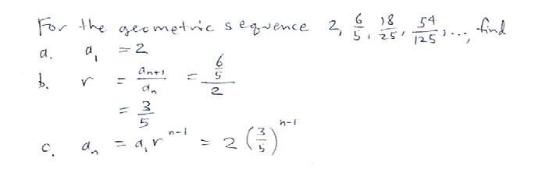
Practice Problem

Slide 10
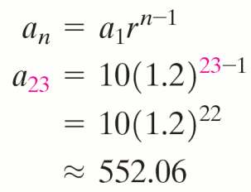
Finding a Particular Term in a Geometric Sequence
EXAMPLE 4
Find the 23rd term of a geometric sequence whose first term is 10 and whose common
ratio is 1.2.
Solution

Slide 11
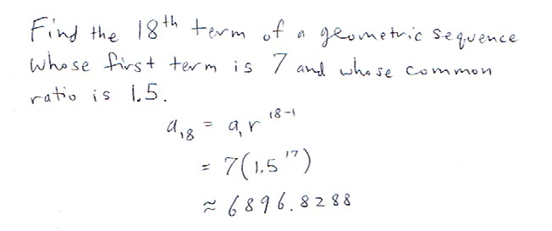
Practice Problem

Slide 12
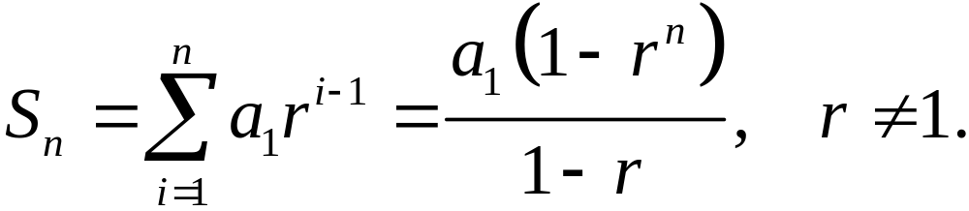
SUM OF THE TERMS OF A FINITE GEOMETRIC SEQUENCE
Let a₁, a₂, a₃, … a_{n} be the first n terms of a geometric sequence with first term a₁ and common ration r. The sum S_{n} of these terms is

Slide 13
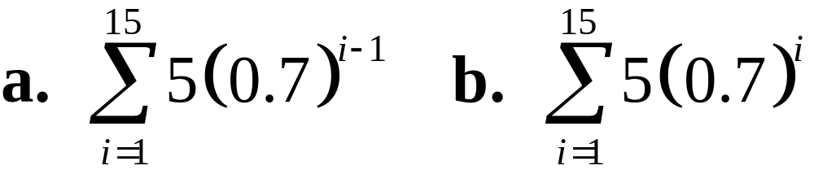
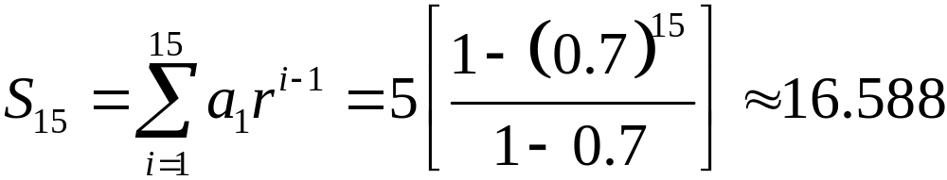
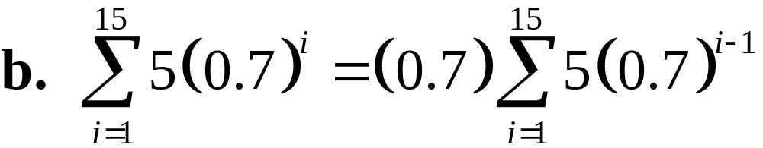
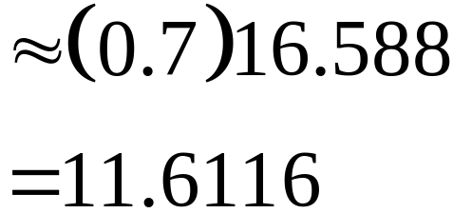
Finding the Sum of Terms of a Finite Geometric Sequence
EXAMPLE 5
Find each sum.
Solution
a. a₁ = 5, r = 0.7, n = 15

Slide 14
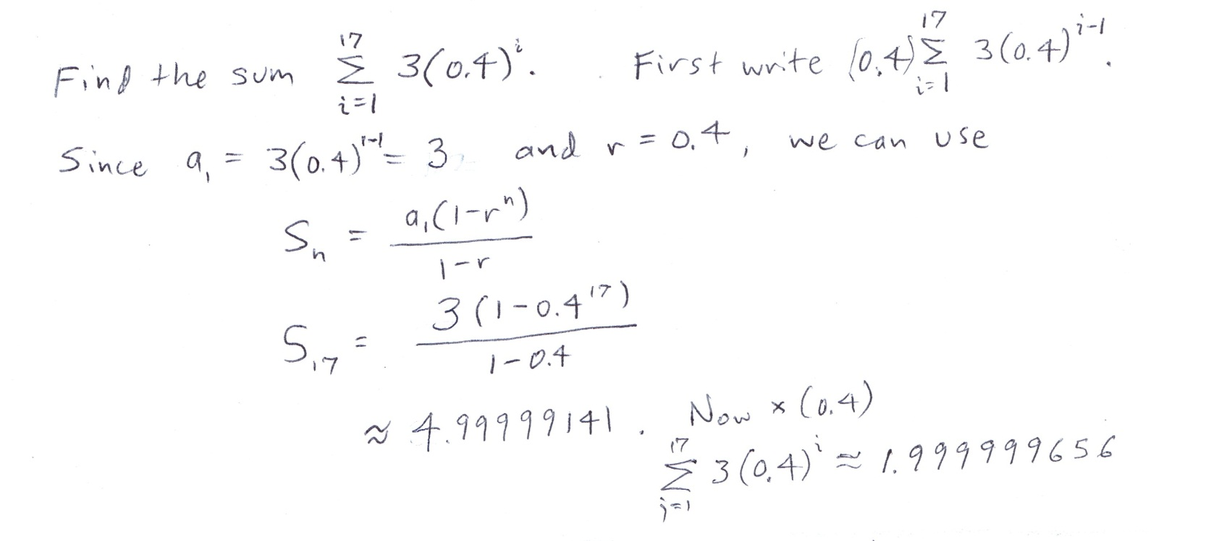
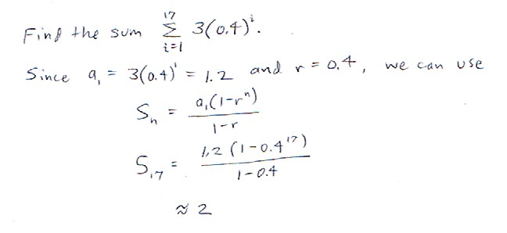
Practice Problem

Slide 15
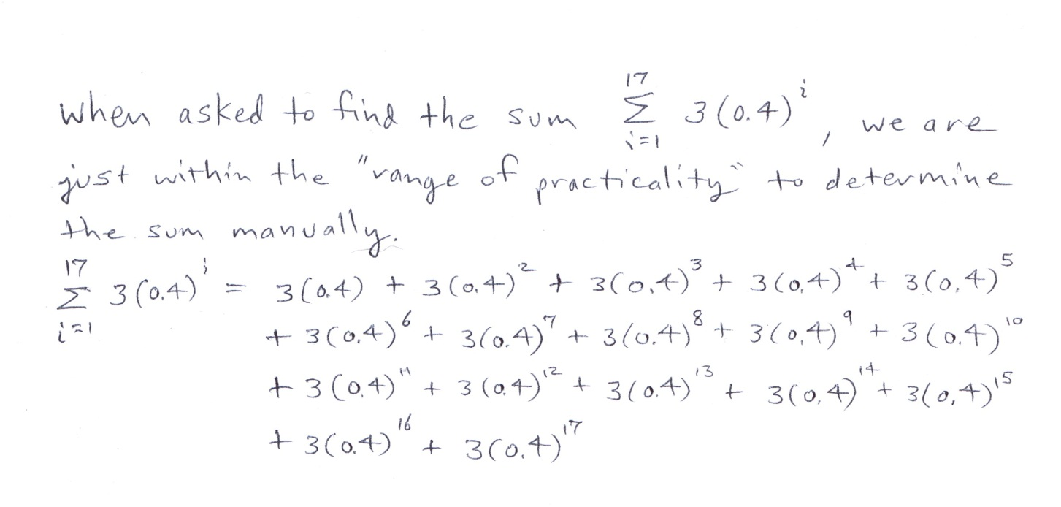

Slide 16
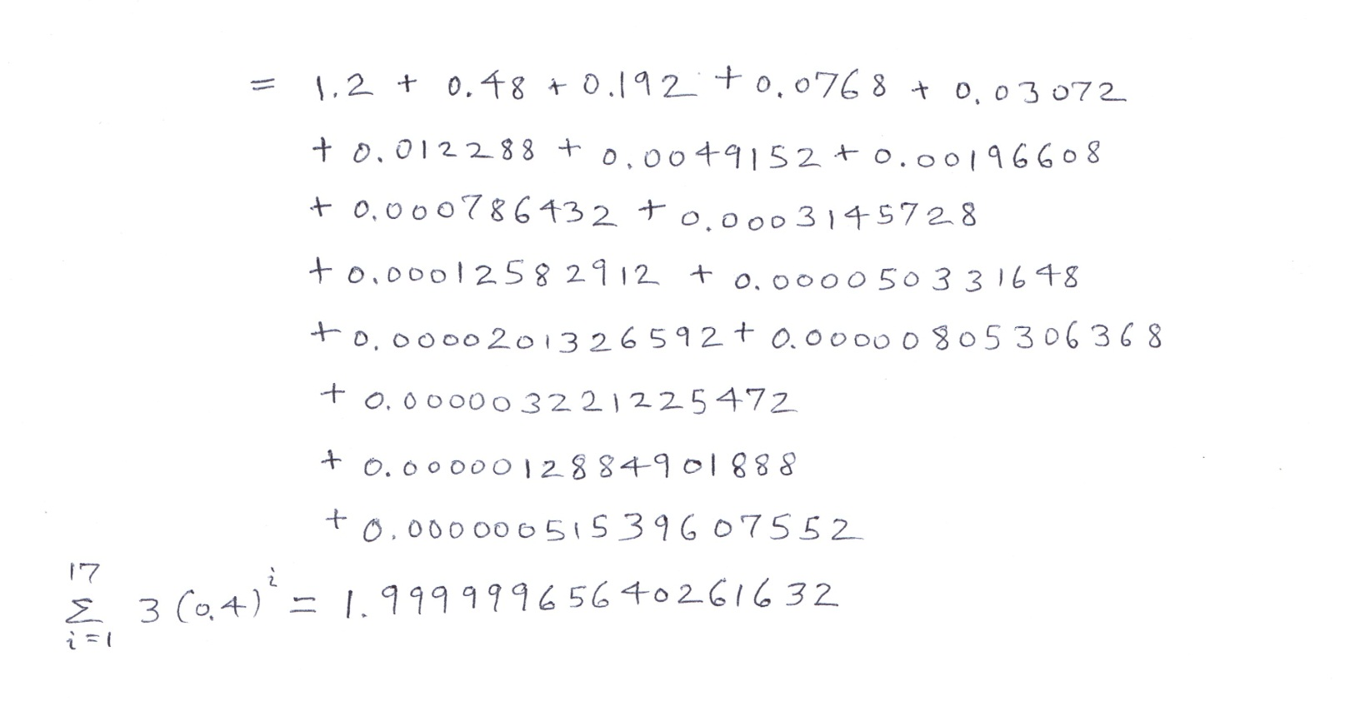

Slide 17
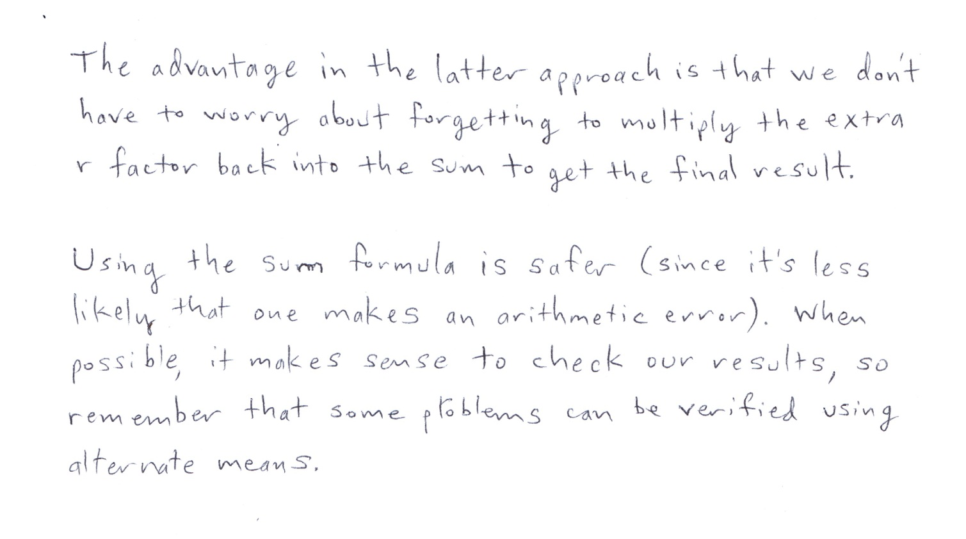

Slide 18
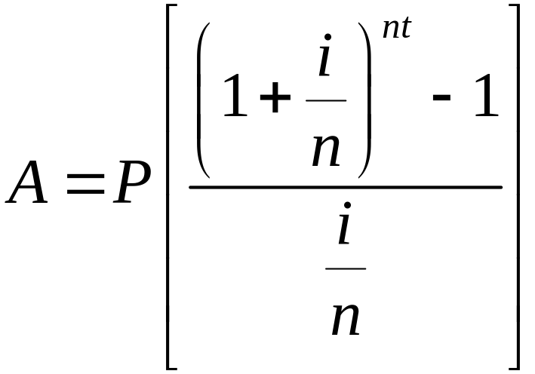
VALUE OF AN ANNUITY
Let P represent the payment in dollars made at the end of each of n compounding periods per year, and let i be the annual interest rate. Then the value of A of the annuity after t years is:

Slide 19
EXAMPLE 6
Finding the Value of an Annuity
An individual retirement account (IRA) is a common way to save money to provide funds after retirement. Suppose you make payments of $1200 into an IRA at the end of each year at an annual interest rate of 4.5% per year, compounded annually. What is the value of this annuity after 35 years?

Slide 20
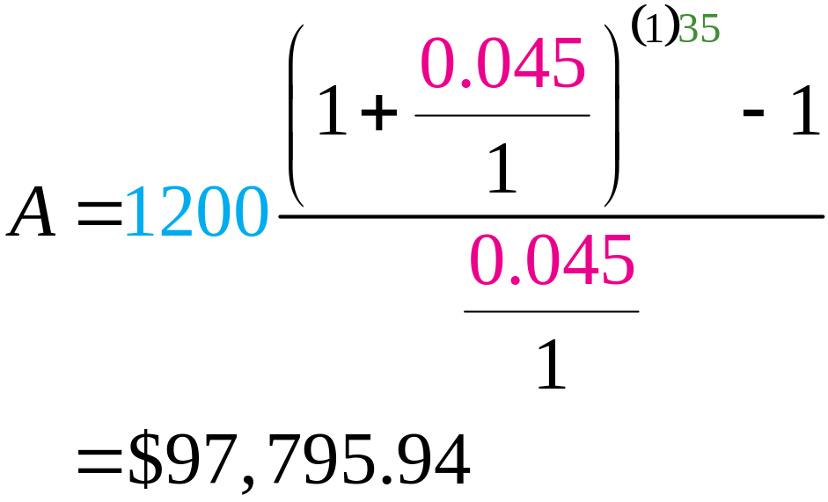
EXAMPLE 6
Finding the Value of an Annuity
Solution
P = $1200, i = 0.045 and t = 35 years
The value of the IRA after 35 years is $97,795.94.

Slide 21
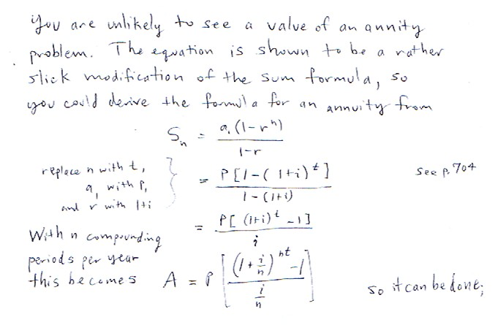
Practice Problem

Slide 22
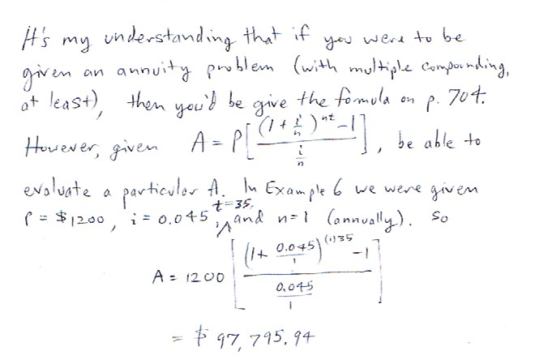
Practice Problem

Slide 23
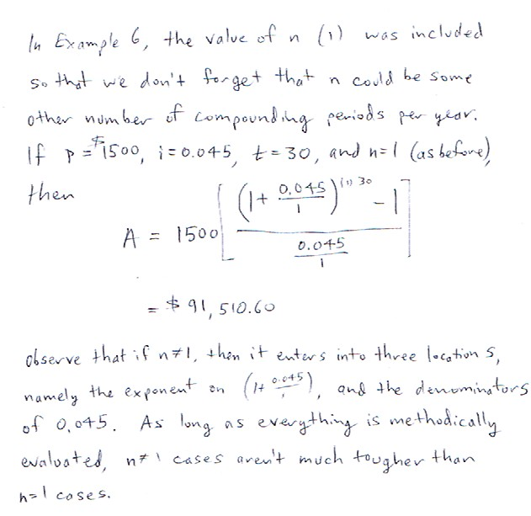
Practice Problem

Slide 24
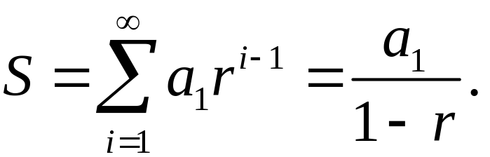
SUM OF THE TERMS OF AN INFINITE GEOMETRIC SEQUENCE
If |r| < 1, the infinite sum
a₁ + a₁r + a₁r2 + a₁r3 + … + a₁rn–1 + …
is given by

Slide 25
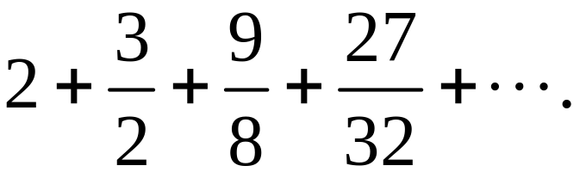
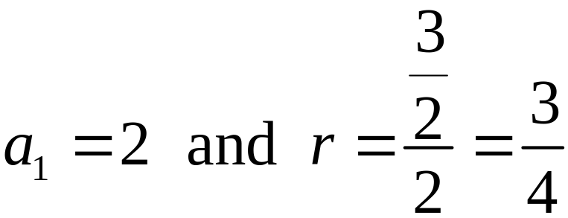
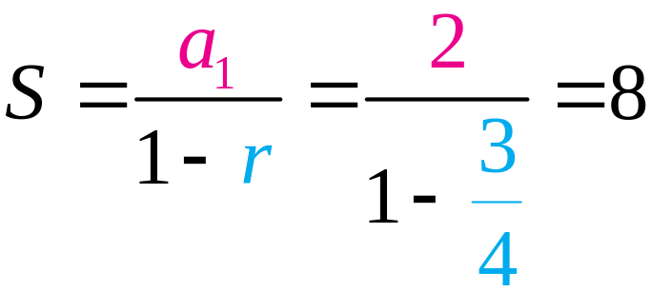
Finding the Sum of an Infinite Geometric Series
EXAMPLE 7
Find the sum
Solution
Since |r| < 1, use the formula:

Slide 26
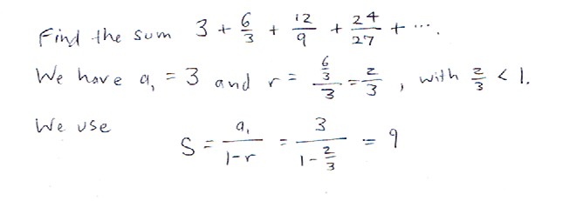
Practice Problem

Slide 27
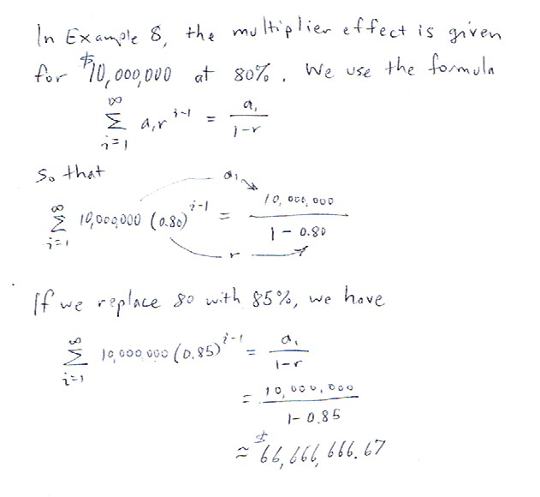
Practice Problem

